Slide 1
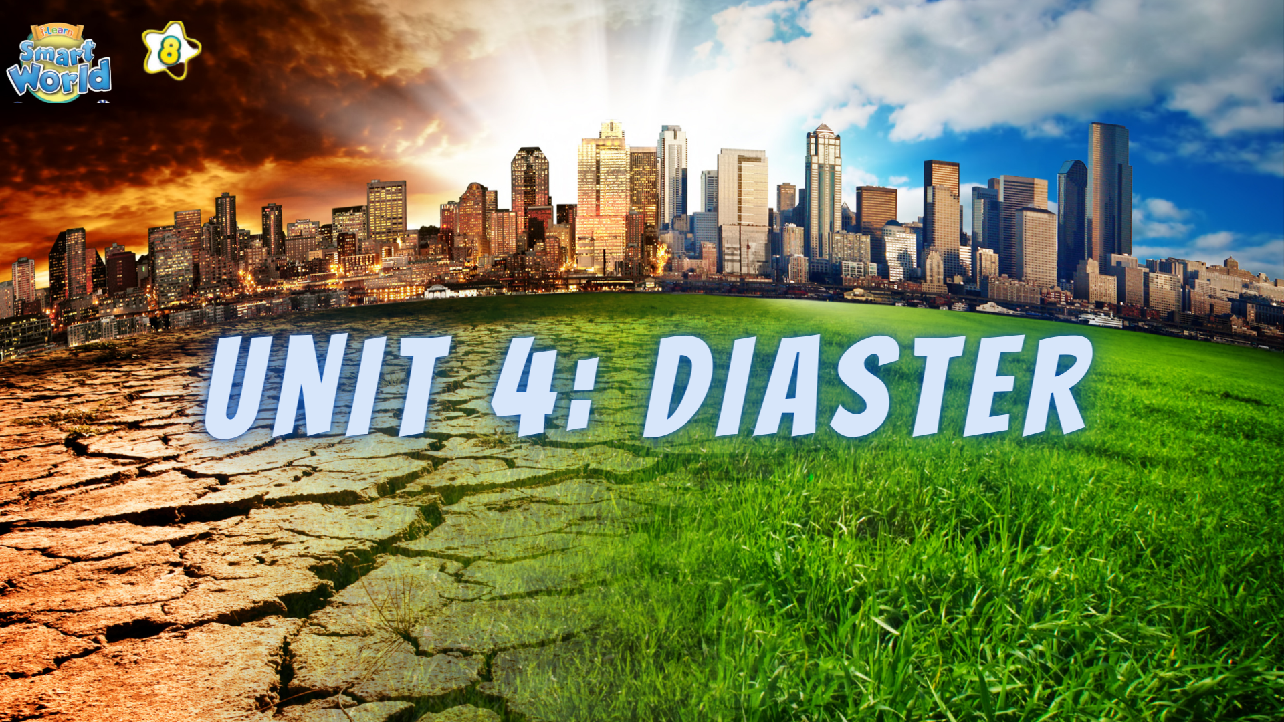

Slide 2

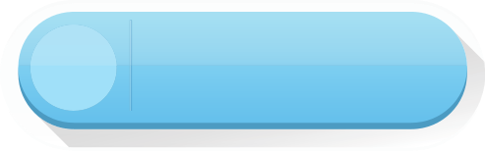

LESSON 9
REVIEW 1

Slide 3

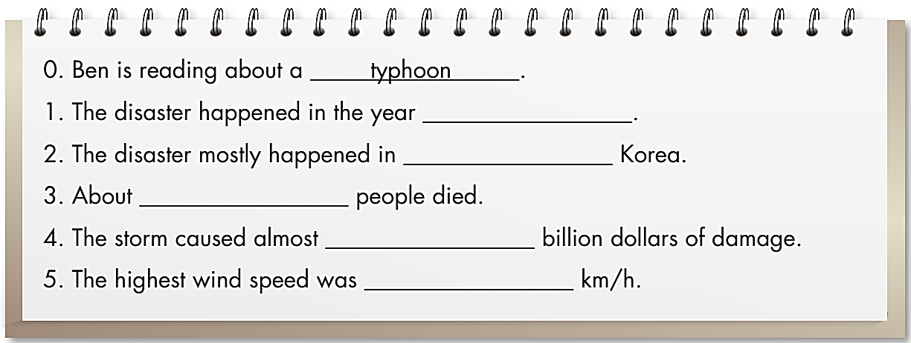
2003
North and South
120
5
280

Slide 4
Listen to the transcript again and practice with your partner.
Sue: Hi, Ben. That’s an interesting picture.
What are you reading?
Ben: Hi, Sue. I’m reading about a typhoon.
It’s called Typhoon Maemi. This is what it
looks like from space.
Sue: Wow. When was the typhoon?
Ben: It was in 2003.
Sue: Oh, OK. Where was it?
Ben: It mostly happened in North and South
Korea, but it affected other countries, too.
Sue: Was it a very strong storm?
Ben: Yes, it was very strong. It caused
a lot of damage, and many people died.
Sue: Oh, no. How many people died?
Ben: One hundred and twenty people.
Sue: How much damage did the typhoon cause?
Ben: It caused almost five billion dollars of
damage.
Sue: Wow! That’s a lot of money! How strong
was the wind?
Ben: The highest wind speed was two hundred
and eighty kilometers per hour.

Slide 5
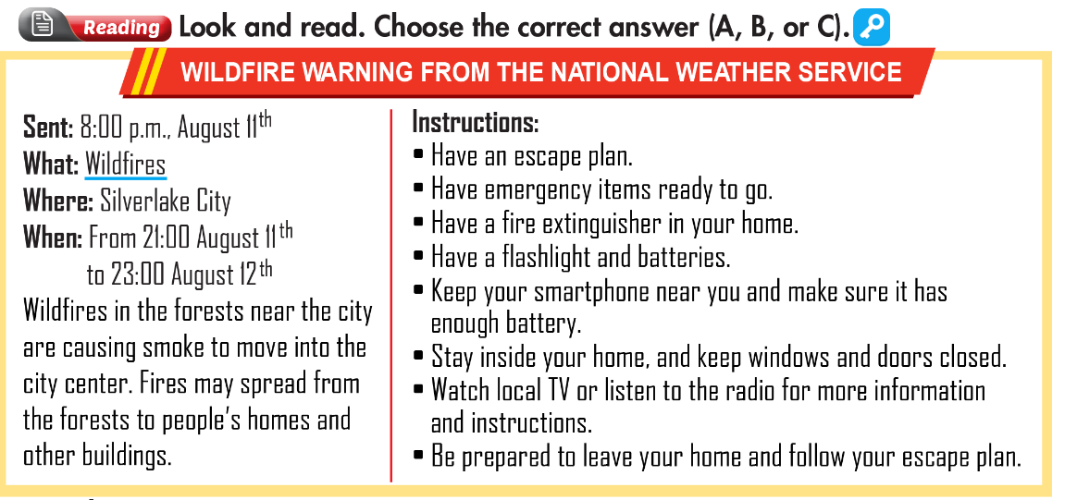

Slide 6
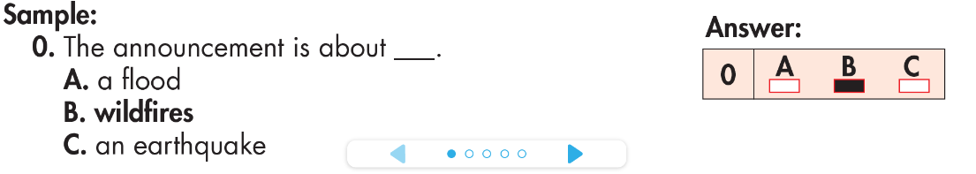

Slide 7
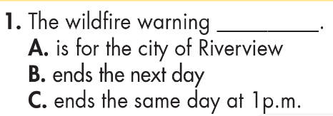

Slide 8
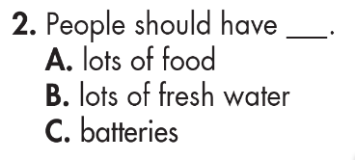

Slide 9
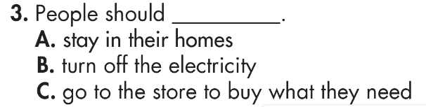

Slide 10
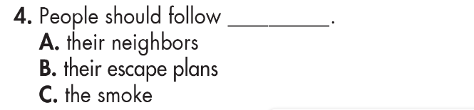

Slide 11
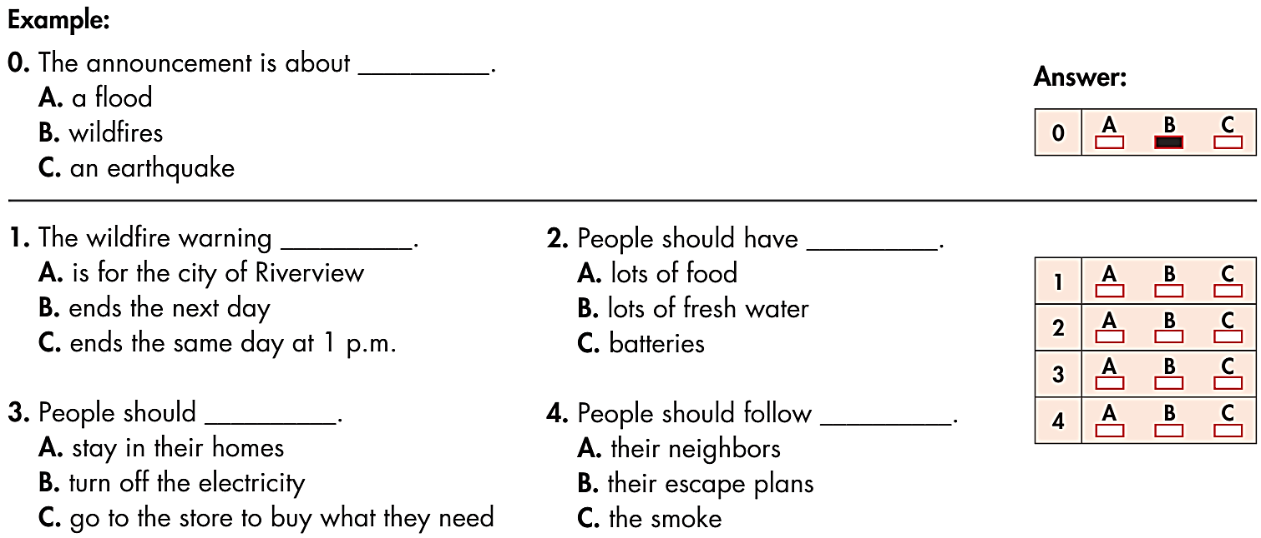

Slide 12

HOMEWORK
Review the target language learnt in the unit
Practice test taking skills

Slide 13


