Slide 1



Bài giảng điện tử
Unit 3: Wild life
Lesson 1: Vocabulary
ANIMALS

Slide 2
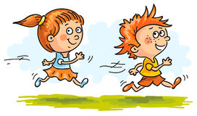
WHO IS FASTER?

Slide 3
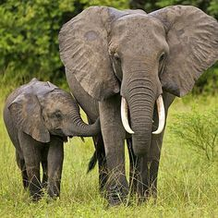

What do you think it is?

Slide 4
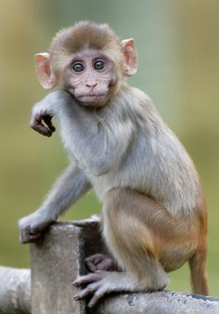
What do you think it is?

Slide 5
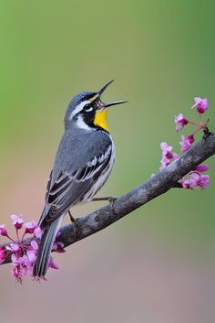
What do you think it is?

Slide 6
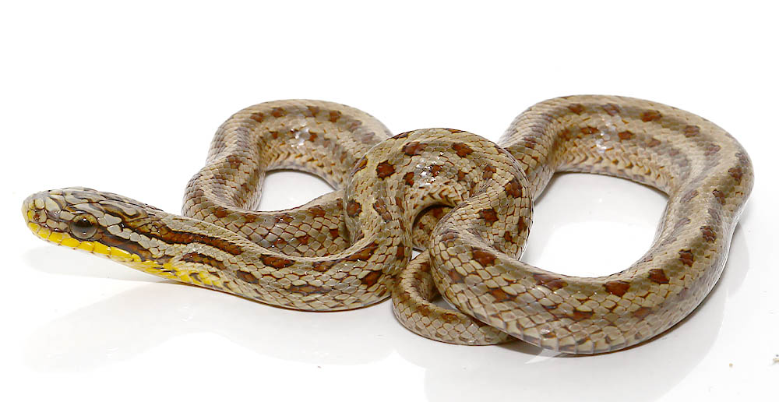
What do you think it is?

Slide 7
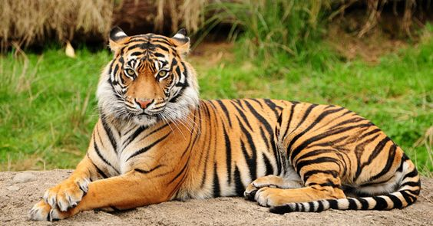
What do you think it is?

Slide 8
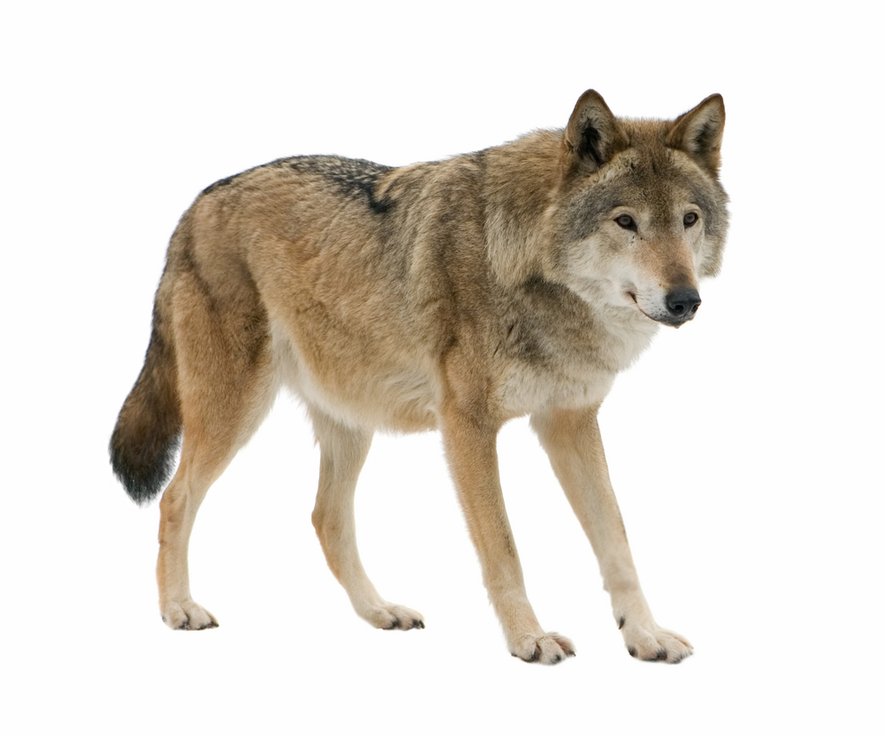
What do you think it is?

Slide 9
Where do these animals live?
Are they dangerous?

Slide 10

UNIT 3: wildlife
Lesson 1: VOCABULARY - ANIMALS

Slide 11
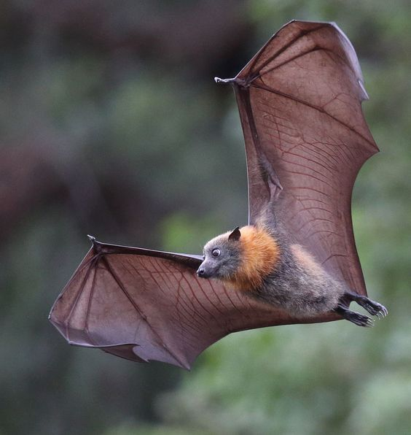
New words
1. bat (n) /bæt/ (n)

Slide 12
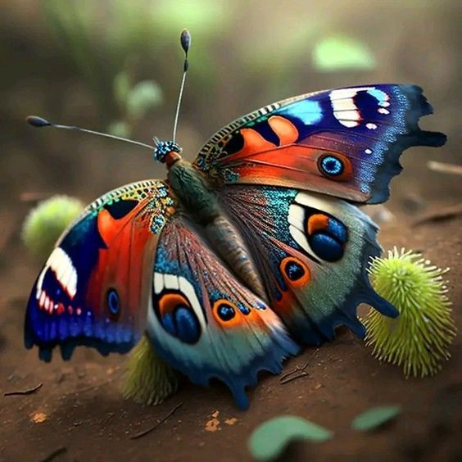
New words
2. butterfly /ˈbʌtəflaɪ/ (n)

Slide 13
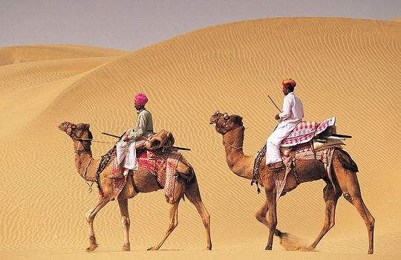
New words
3. camel /ˈkæməl/ (n)

Slide 14
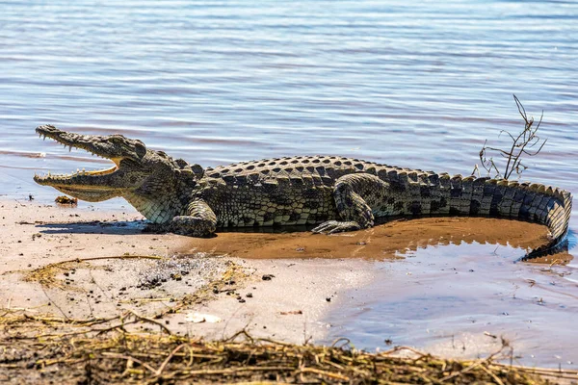
New words
4.crocodile /ˈkrɒkədaɪl/ (n)

Slide 15
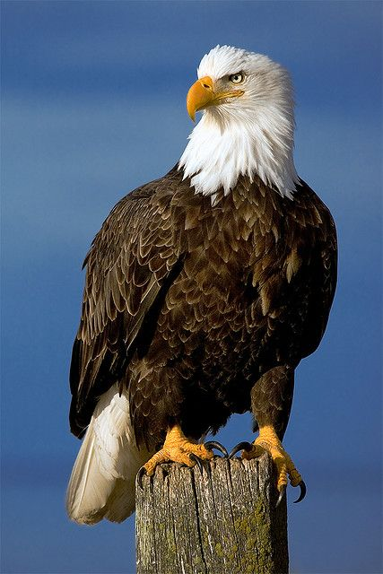
New words
5. eagle
/ˈiːɡəl/ (n)

Slide 16
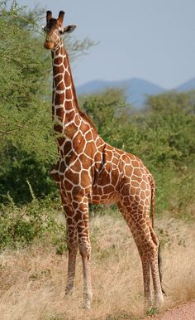
New words
6. giraffe
/dʒəˈrɑːf/ (n)

Slide 17
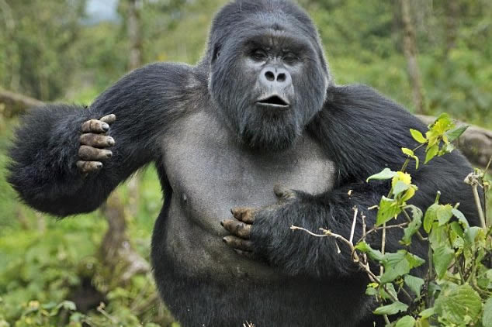
New words
7. gorilla /ɡəˈrɪlə/ (n)

Slide 18
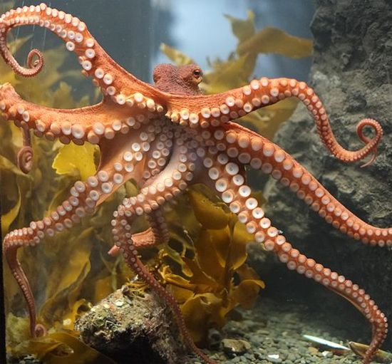
New words
8. octopus /ˈɒktəpəs/ (n)

Slide 19
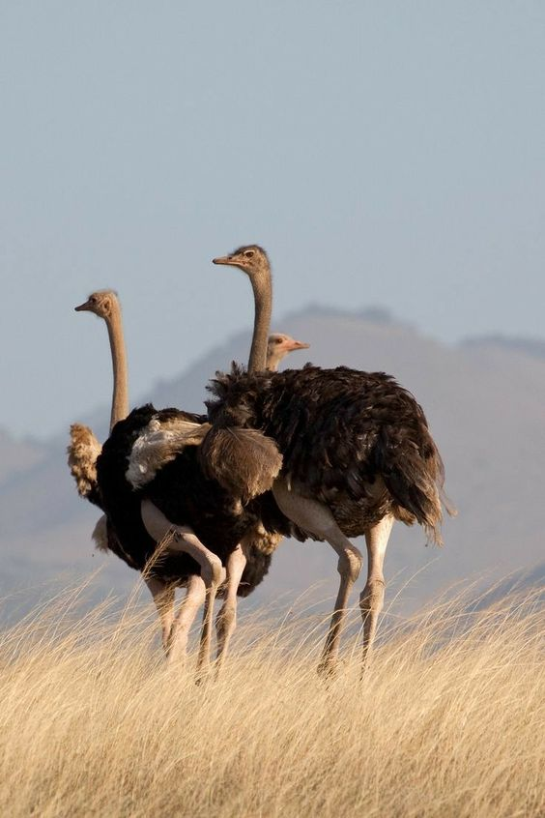
New words
9. ostrich
/ˈɒstrɪtʃ/ (n)

Slide 20
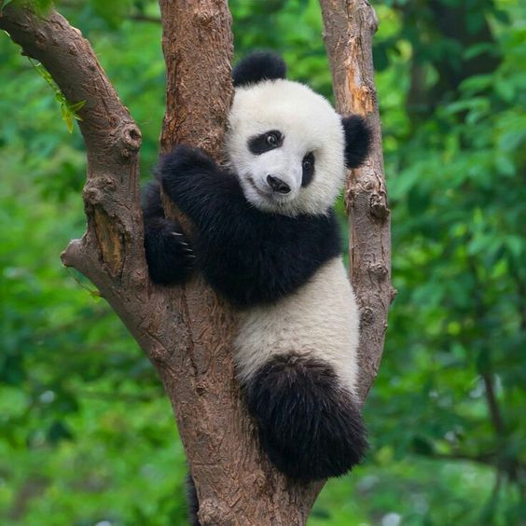
New words
10. panda /ˈpændə/ (n)

Slide 21
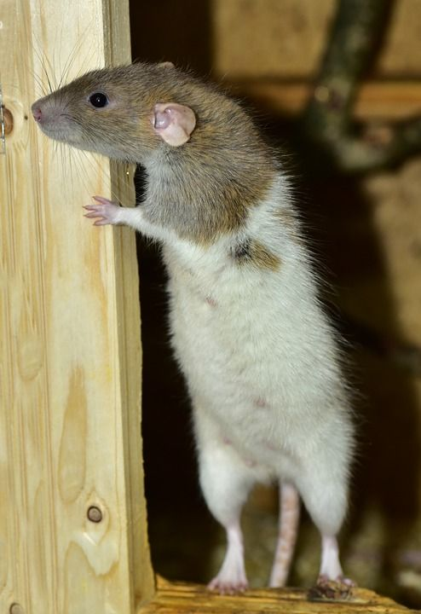
New words
11. rat /ræt/ (n)

Slide 22
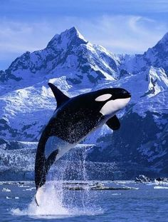
New words
12. whale
/ˈweɪl/ (n)

Slide 23
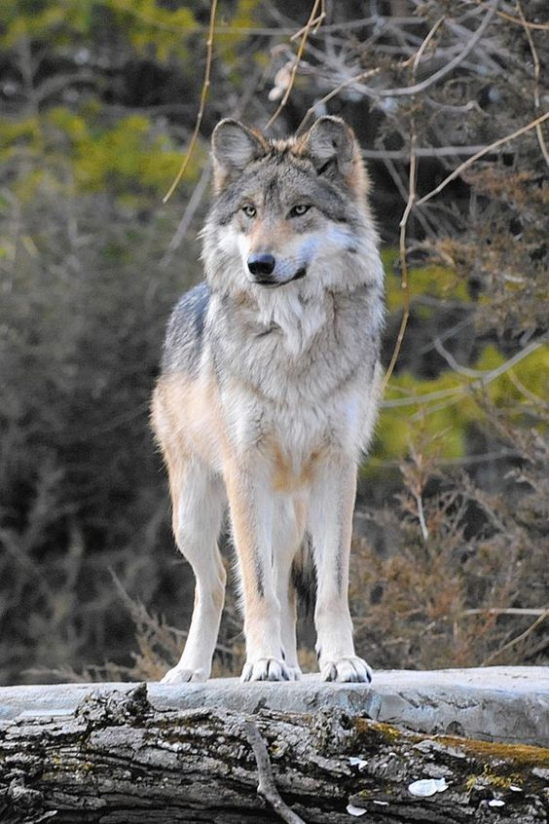
New words
13. wolf
/wʊlf/ (n)
→ wolves
/wʊlvz/ (pl.n)

Slide 24
New words
14. creature
/ˈkriːtʃər/ (n)
: a living thing, real or imaginary, that can move around
Octopuses and other sea c_ _ _t_ _ _s
Respect for all living………………… (9 letters –pl.n)
(creatures)
creatures

Slide 25
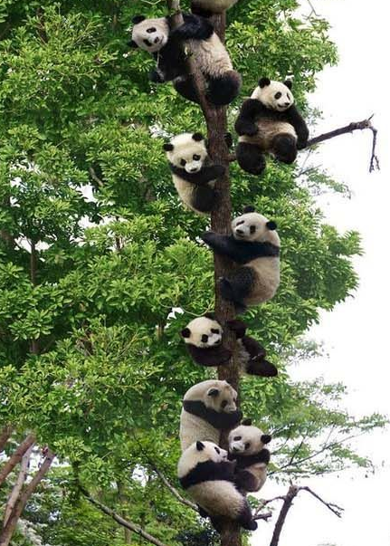
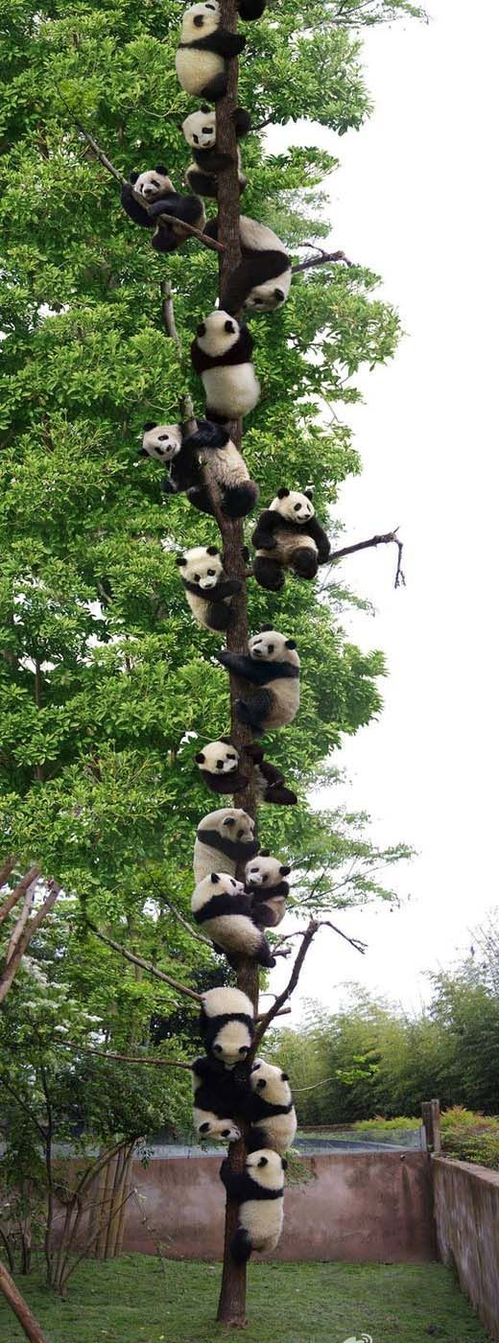


New words
15. close-up
/ˈkləʊs ʌp/ (n)
: a photograph, or picture in a film, taken very close to somebody/something so that it shows a lot of detail

Slide 26
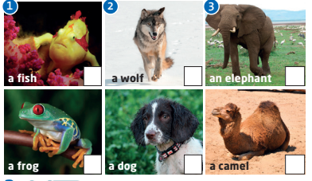
Which animal is correct for each conversation?

Slide 27
Which animal is correct for each conversation?
√
√
√

Slide 28
Listen again and complete the Key Phrases.
Key phrases
Identifying things
1) What do you think _______ ? 2) ____________ no idea. 3) It looks like _________ . 4) It sounds like _________ . 5) Maybe it’s _____________ ?
it is
I’ve got
a frog
a dog
an elephant

Slide 29
Look at the questions and sentences. Listen and repeat.
1) What do you think it is? 2) It looks like a camel. 3) It sounds like a cat. 4) Is it a dog? 5) Maybe it's a giraffe.

Slide 30

Creature close-ups Game

Slide 31
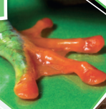
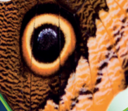
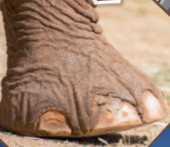
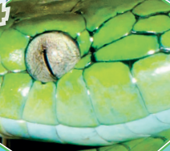
1)
3)
frog
butterfly
4)
2)
elephant
snake

Slide 32
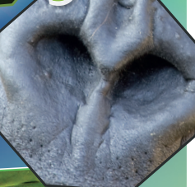
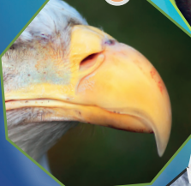
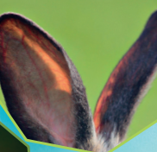
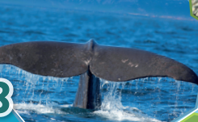
5)
6)
gorilla
eagle
7)
8)
rabbit
whale

Slide 33
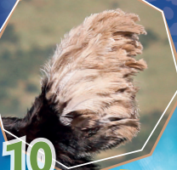
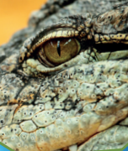
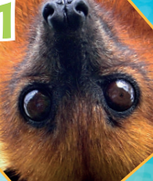
10)
9)
ostrich
crocodile
11)
bat

Slide 34
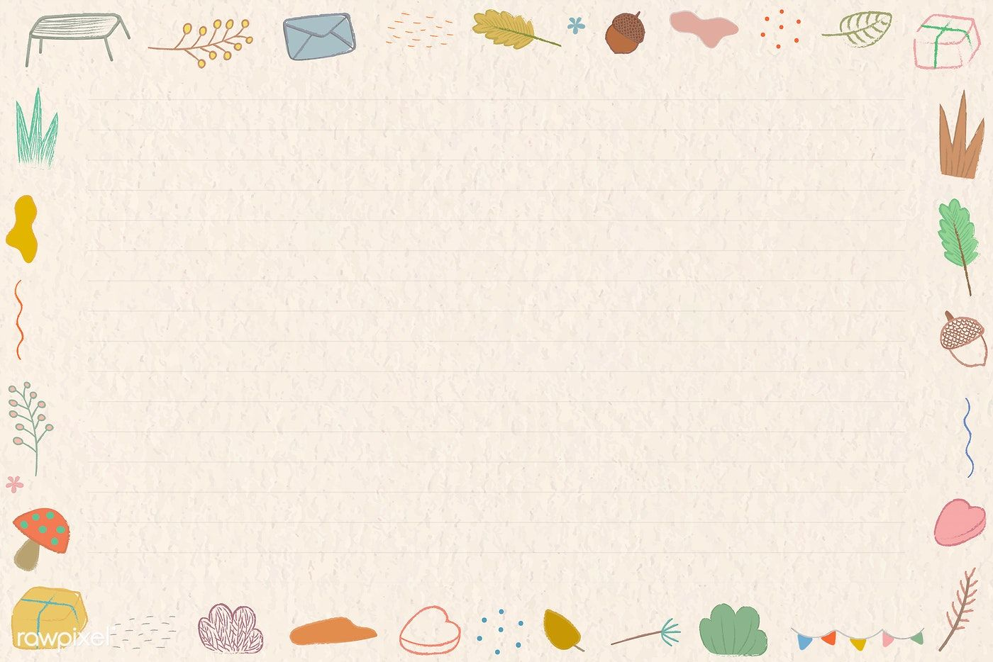
Guessing game

Slide 35
Look at the questions. What do you think the animal is?
Does it live in water/on land?
Has it got wings / legs / a tail?
How many legs has it got?
Does it eat other animal?
What color is it?
Is it dangerous? Is it a pet?
Does it lay egg?...

Slide 36
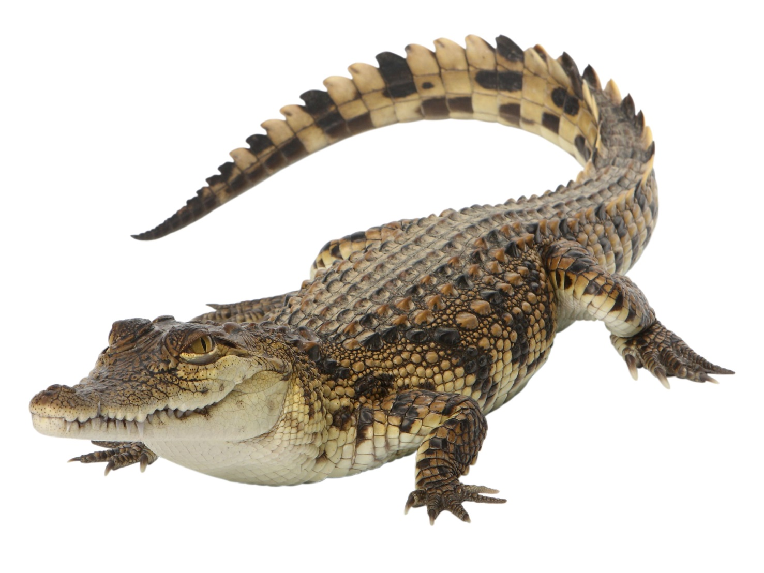
Crocodile

Slide 37
whale

Slide 38
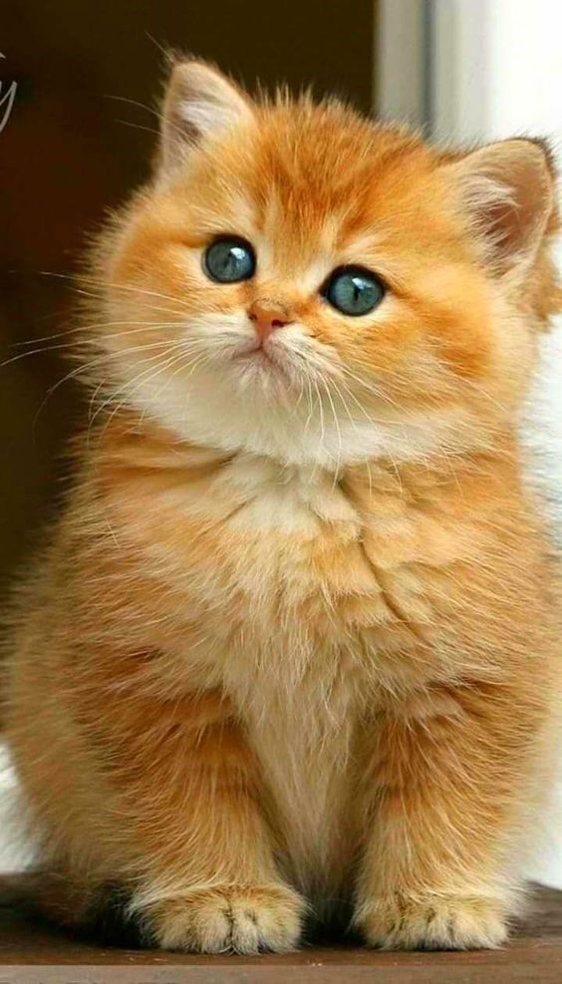
Cat

Slide 39
eagle

Slide 40
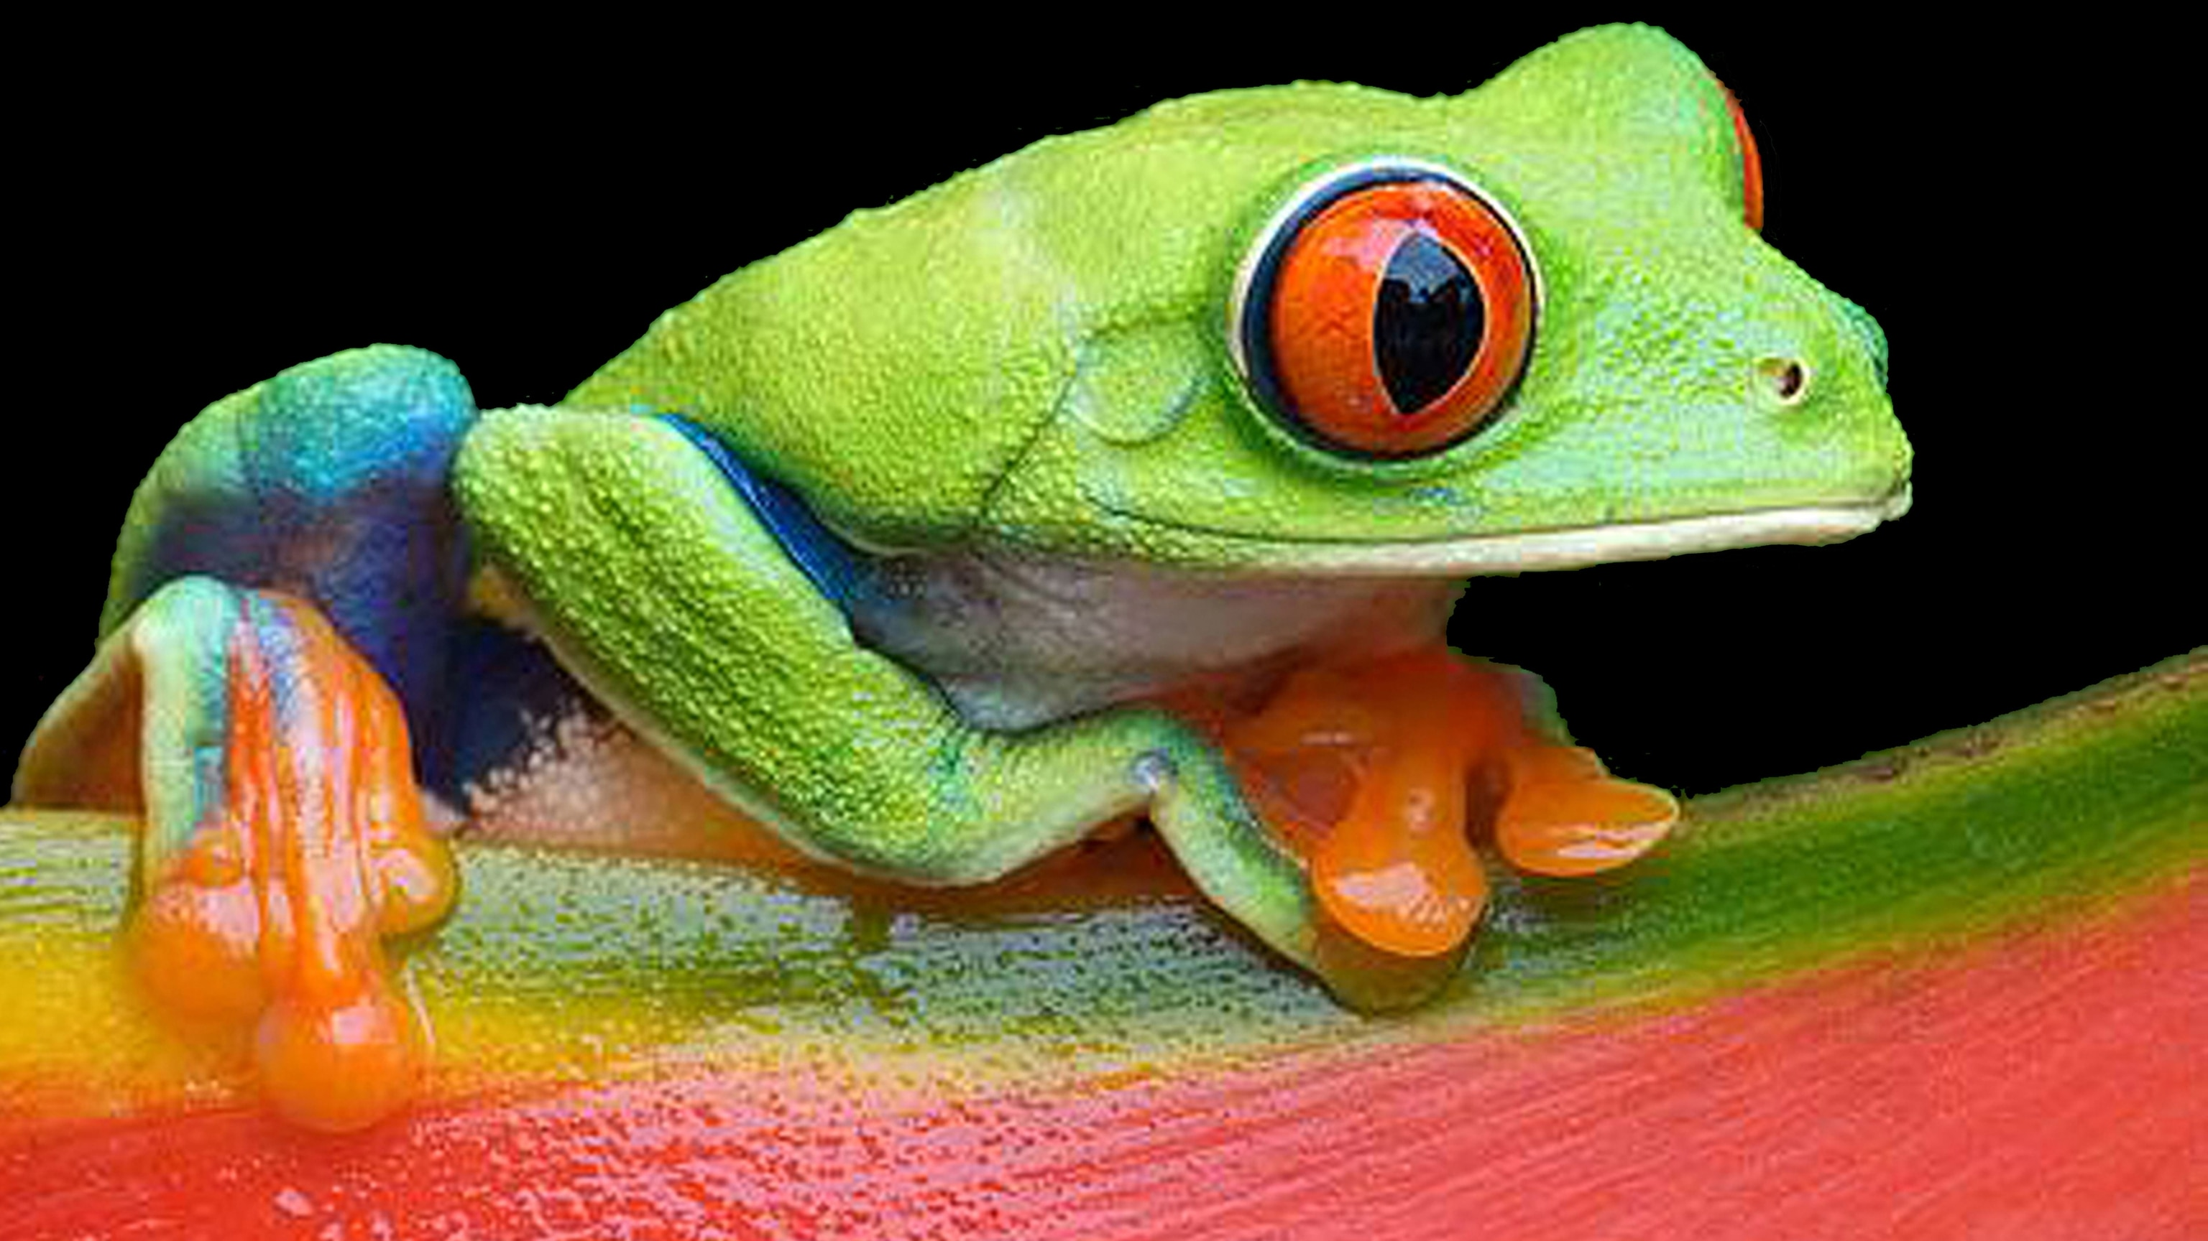
frog

Slide 41

speaking
TALK ABOUT YOUR PET OR AN AMIMAL THAT YOU LOVE
What animal is it? How old is it?
How does it look like?
What do you usually do with it? Where? When?
Why do you love it?

Slide 42
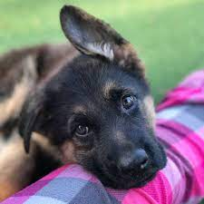

speaking
My pet dog’s name is Bruno. He is from the breed of German Shepherds. He is 2 years old, fluffy and black and brown in colour.He gets delighted to see me when I come back from school. He protects our house from intruders, especially at night. He spends most of his time with me and my Dad. He is very gentle with us but gets extremely aggressive when he spots a stranger. He goes with my father for morning walks and with me for evening walks. We provide him with healthy food, rice and meat. He loves playing, jumping and running. He is very active all the time. When I am upset, he cheers me up by licking me and showering lots of love. I love him so much.

Slide 43
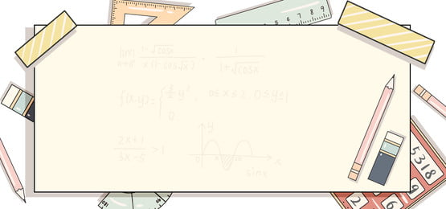
Homework
Learn by heart all the new words and Key phrases.
Do exercise 5 (page 39)
Prepare Unit 3 - Lesson 2: Reading
The ugliest animals? (page 40)
New words: the words in blue

