Slide 1


Slide 2
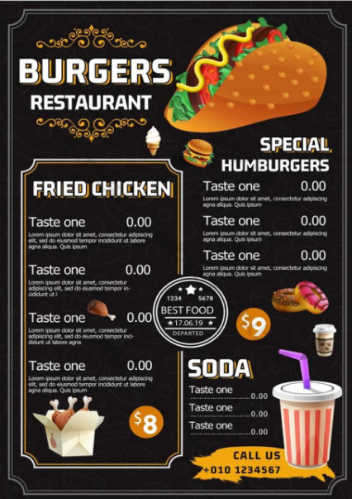
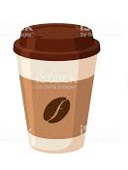

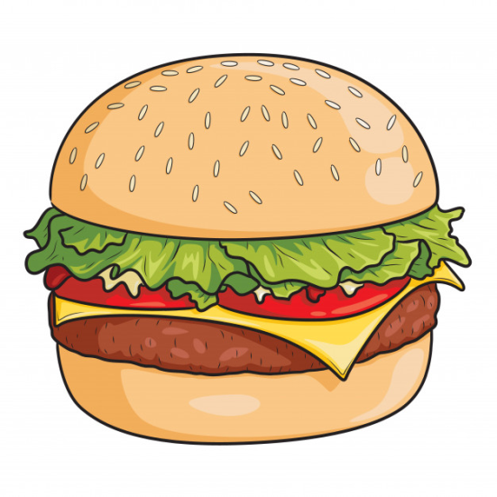

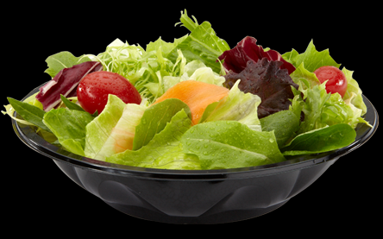

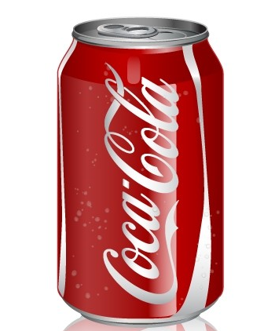
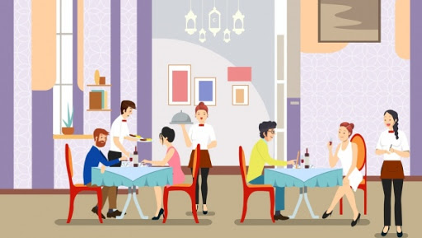
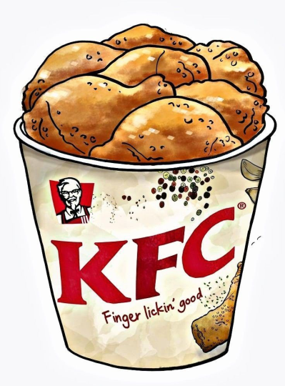
GUESSING GAME!
COFFEE
FRENCH FRIES
Menu
MINERAL WATER
BURGER
SALAD
FRIED CHICKEN
COCA COLA
ORANGE JUICE
RESTAURANT

Slide 3

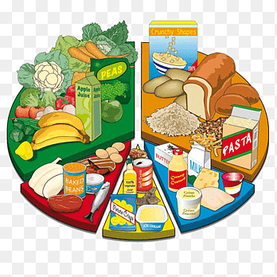
UNIT 5: FOOD AND HEALTH
LESSON 6: SPEAKING

Slide 4
THINK
WHAT IS YOUR FAVOURITE RESTAURANT OR CAFÉ?
WHAT KIND OF FOOD DO YOU USUALLY EAT THERE?
IS THE FOOD NICE?
HOW MUCH DO YOU USUALLY PAY?

Slide 5
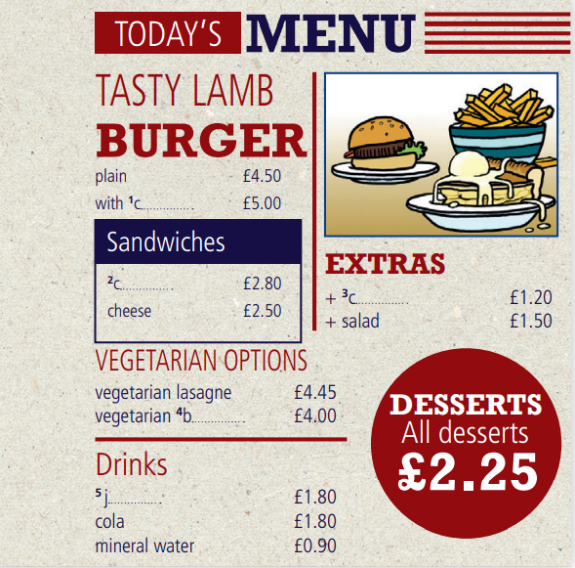
EXERCISE 1: Complete the menu with the words in the box. Which things on the menu do you like or dislike?
burger juice chicken chips cheese
1. cheese
2. chicken
3. chips
4. burger
5. juice

Slide 6

EXERCISE 2: Listen and say the prices.
£4.50 four pounds fifty
£1.00 one pound
£1.20 one pound twenty
£4.95 four pounds ninety-five
£0.80 eighty pence

Slide 7
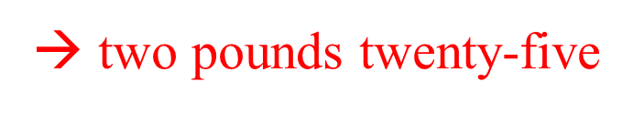

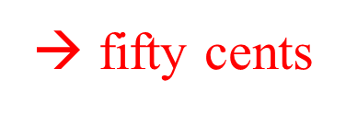
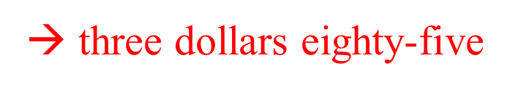
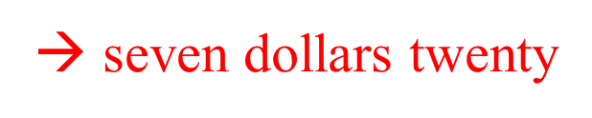
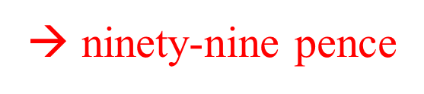
EXERCISE 3: Read and say the prices. Listen and check.
1 £2.25
2 €1.00
3 €0.50
4 $3.85
5 $7.20
6 £0.99
GLOSSARY
$ = dollar(s) and cents € = euro(s) and cents
£ = pound(s) and pence

Slide 8
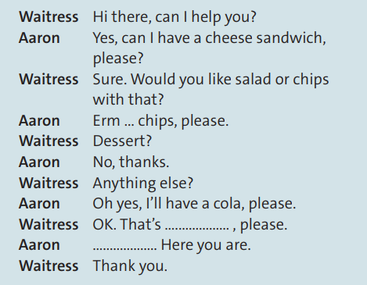
EXERCISE 4: Read the dialogue, look at the menu and calculate the total price. Then watch or listen and check. Is Aaron’s meal very healthy?
→ £2.50 + £1.20 + £1.80 = £5.50
Is Aaron’s meal very healthy?
→ His meal isn't very healthy.

Slide 9
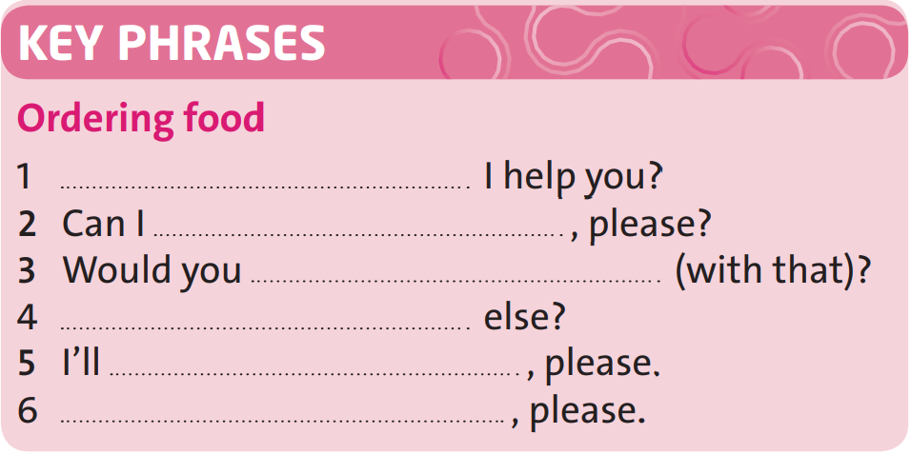
EXERCISE 5: Look at the dialogue and complete these Key Phrases. Then practise the dialogue with a partner. Use different items from the menu in exercise 1.
Can
have a cheese sandwich
like salad or chips
Anything
have a cola
That's £5.50

Slide 10

EXERCISE 6: Work in pairs. Prepare and practise two dialogues using the Key Phrases and the situations below. Use the menu in exercise 1.
Situation A: You’re very hungry and you love desserts! You’ve got £10.
Situation B: You’re a vegetarian and you don’t like cola. You’ve got £6.

Slide 11
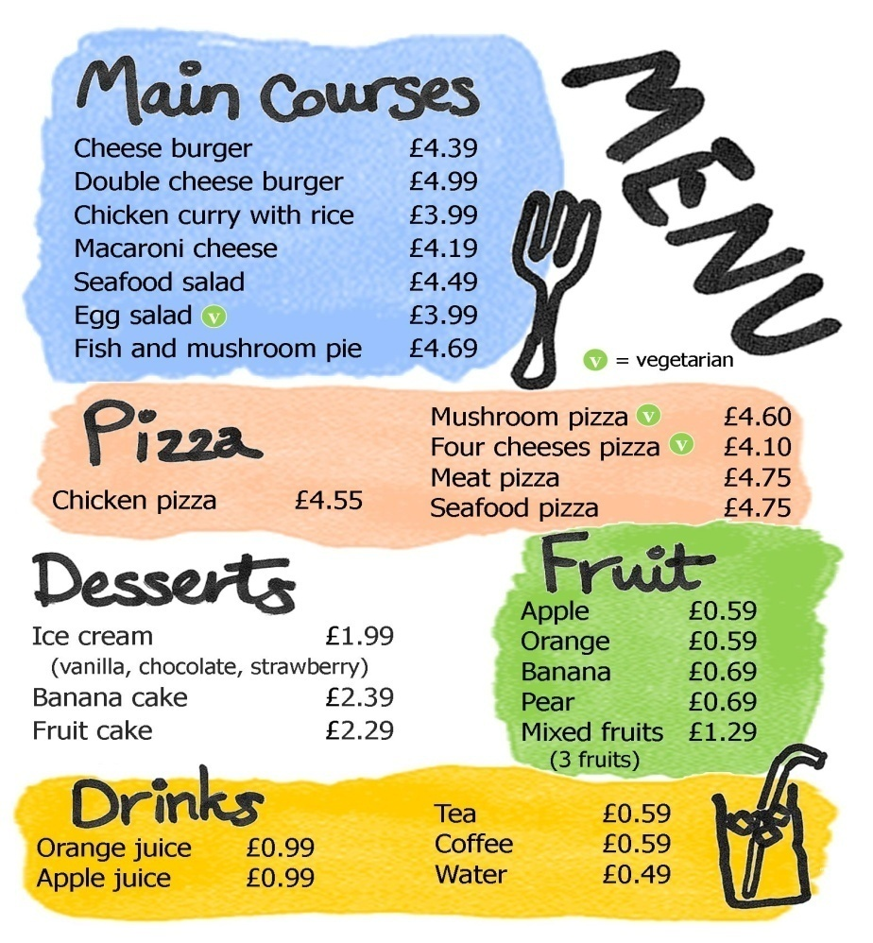
PRACTISE
Write the own menu

Slide 12


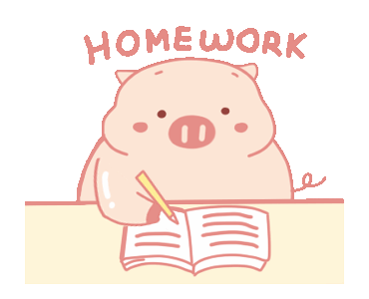
- Learn by heart all structures.
- Write the own menu

Slide 13



