Slide 1


Slide 2


LETTER DICTATION

Slide 3
LETTER DICTATION
RULE:- Divide into 4 groups
Receive strings of words from teacher
Work in groups to figure out what the questions are
Raise hand to answer
FOR EXAMPLE:
Whatareyoudoingtoday? → What are you doing today?
Whatdoyouliketowatch? → What do you like to watch?

Slide 4
Doyoublogaboutyourlife?
WhatdoyouwatchonTV?
Howoftendoeshemakethevideos?
Howaboutwatchingafilm?
Howmanylanguagesdoesyourmotherspeak?
→ Do you blog about your life?
→ What do you watch on TV?
→ How often does he make the videos?
→ How about watching a film?
→ How many languages does your mother speak?

Slide 5


UNIT 1:
LESSON 6: SPEAKING
THINKING OF THINGS TO DO
I can make and respond to suggestions.

Slide 6
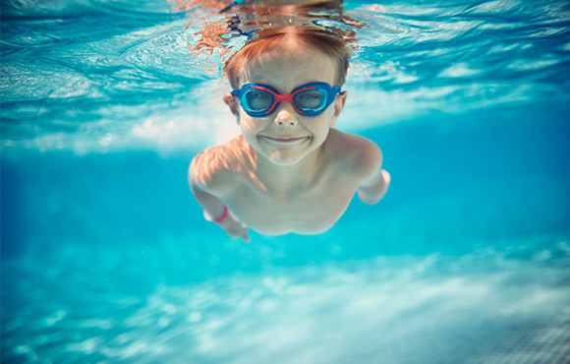

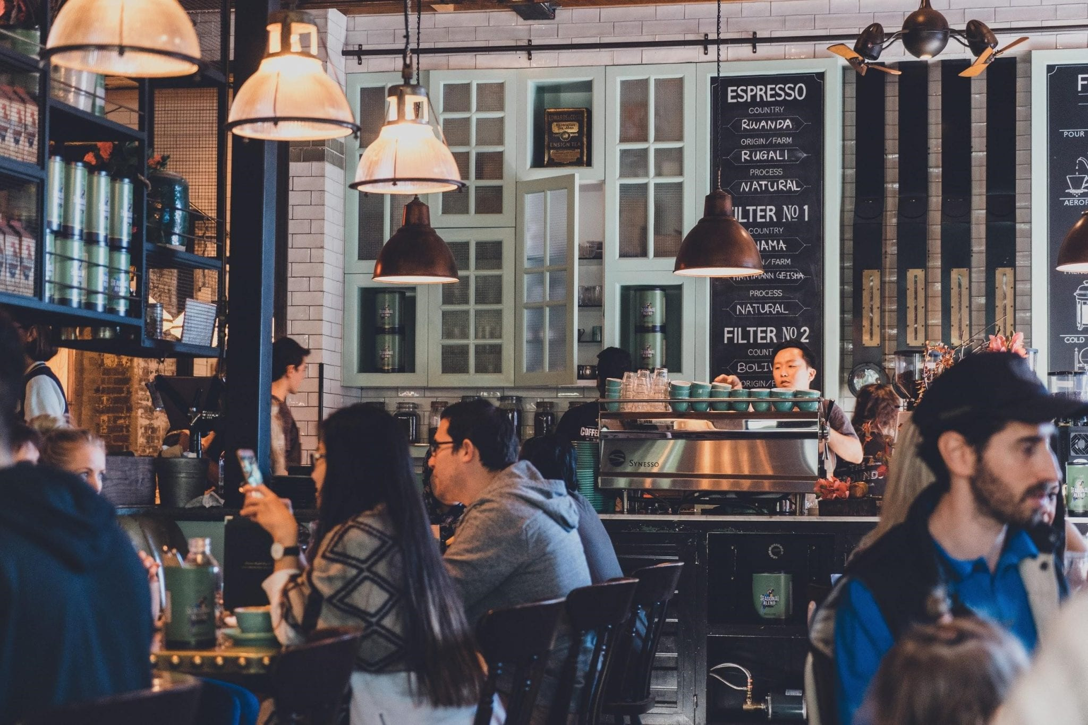
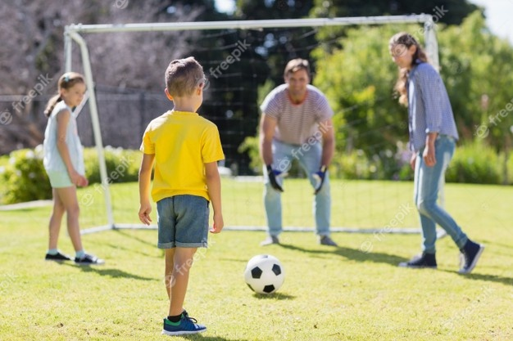
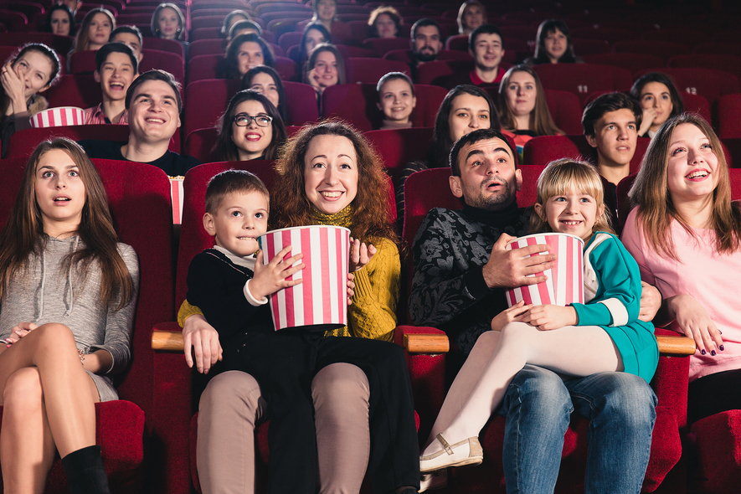
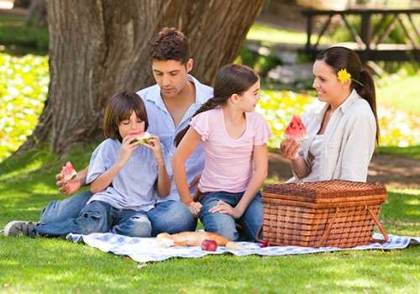
⇨What can you do in your town at the weekend?⇦

Slide 7


✓Activity 1: Complete the dialogue with the key phrases. Then watch or listen and check. What do Lisa and Jamie decide to do?
KEY PHRASES
1. Shall we do something?
2. That sounds like a good idea.
3. Let’s finish our homework now.
4. How about going into town?
5. Why don’t we go for a bike ride?
6. I don’t feel like cycling.
Jamie What are you doing today?
Lisa Nothing much. 1..................................................
Jamie I don’t want to stay at home all day. It’s boring.
Lisa Well, what do you want to do?
Jamie I don’t know. I just want to go out.
Lisa 2……………………………………………………………. We can take a sandwich.
Jamie It’s really cold. 3……………………………………………… when it’s cold.
Lisa Mmm. Well, I don’t want to play computer games all day.
Jamie 4……………………………………………………….... There’s a new café on the High Street. They say it’s very good.
Lisa 5 ……………………………………………………..…….. We can go to the shopping centre, too.
Jamie I don’t know about the shopping centre, but the café sounds good.
6 ………………………………………………..………….. and then get the bus into town.
Lisa OK.
Shall we do something?
Why don’t we go for a bike ride?
I don’t feel like cycling
How about going into town?
That sounds like a good idea.
Let’s finish our homework now.

Slide 8
✓Activity 1: Listen again and answer: “What do Lisa and Jamie decide to do?”
Jamie What are you doing today?
Lisa Nothing much. Shall we do something?
Jamie I don’t want to stay at home all day. It’s boring.
Lisa Well, what do you want to do?
Jamie I don’t know. I just want to go out.
Lisa Why don’t we go for a bike ride?. We can take a sandwich.
Jamie It’s really cold. I don’t feel like cycling. when it’s cold.
Lisa Mmm. Well, I don’t want to play computer games all day.
Jamie How about going into town? There’s a new café on the High Street. They say it’s very good.
Lisa That sounds like a good idea. We can go to the shopping centre, too.
Jamie I don’t know about the shopping centre, but the café sounds good. Let’s finish our homework now. and then get the bus into town.
Lisa OK.
What do Lisa and Jamie decide to do?
→ Lisa and Jamie decide to get the bus into town / go to a café in town.

Slide 9
✓Activity 2: Look at the Key Phrases. Which key phrases are for making suggestions and which are for responding to suggestions? Write S (suggestion) or R (response)
KEY PHRASES
1. Shall we do something?
2. That sounds like a good idea.
3. Let’s finish our homework now.
4. How about going into town?
5. Why don’t we go for a bike ride?
6. I don’t feel like cycling.
S
R
S
S
S
R

Slide 10


Slide 11
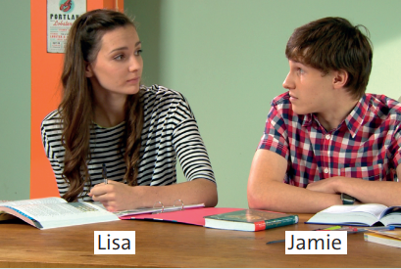
✓Activity 3: Practice the dialogue with a partner.

Slide 12
✓Activity 4: Choose the correct phrases in mini-dialogues. Listen and check. Then practice in pairs.
1. A Let’s / Why do something different.
B OK. What do you want / feel to do?
2. A Why don’t we / We’ll go to the cinema?
There’s a good film on this week.
B That ’s like / sounds like a good idea.
3. A How about going / go for a walk?
B No thanks. I don’t really like / feel like going for a walk.
4. A What shall we doing / do ?
B Nothing. I’m happy here on the sofa.

Slide 13


Slide 14
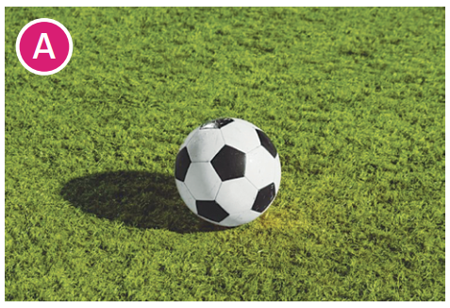
✓Activity 5: Use it! Prepare and practice a new dialogue. Use the key phrases and at least two ideas from pictures A-D.
Example:
A Shall we play football?
B I don’t feel like playing
football. It’s hot.

Slide 15
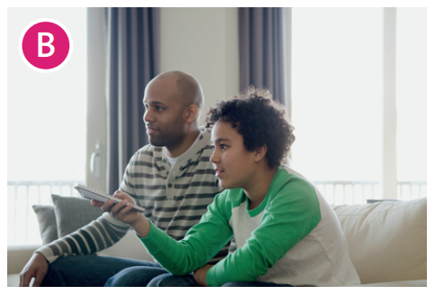
✓Activity 5: Use it! Prepare and practice a new dialogue. Use the key phrases and at least two ideas from pictures A-D.
Example: A How about watching a film?
B That sounds like a good idea! Which film do you want to watch?

Slide 16
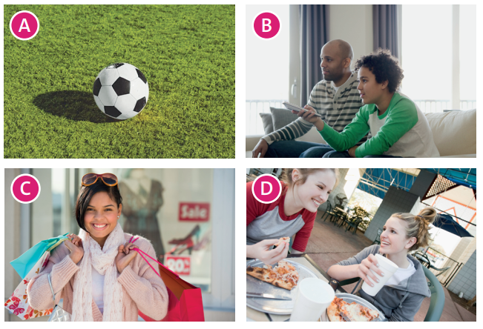
✓Activity 5: Use it! Prepare and practice a new dialogue. Use the key phrases and at least two ideas from pictures A-D.

Slide 17
HOMEWORK
- Learn by heart all key phrases.
- Workbook: Exercises page 11.

Slide 18


