Slide 1
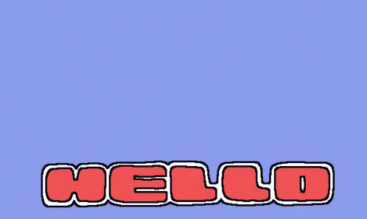

Slide 2
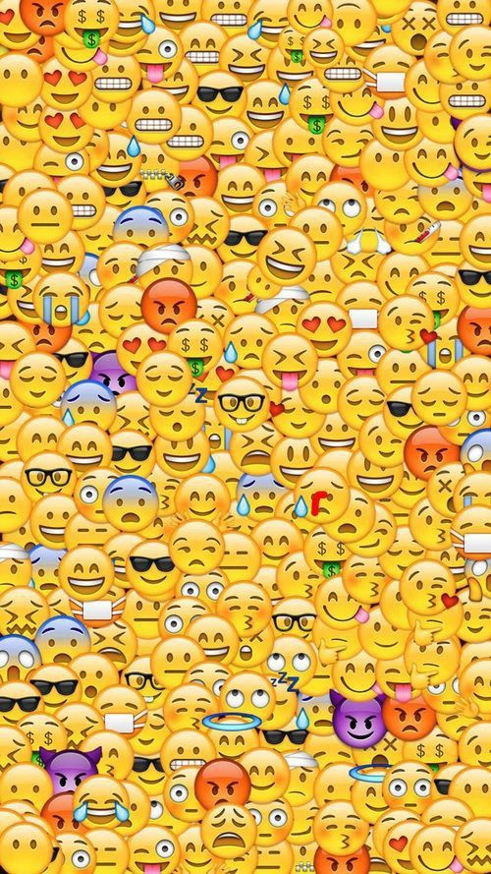
What do these emojis mean?

Slide 3





happy
sad
sick
hungry
scared

Slide 4
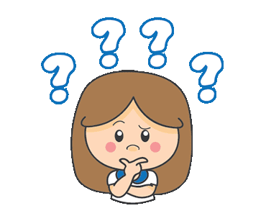
"Why do people use emoticons?”

Slide 5

UNIT 2
COMMUNICATION
LESSON 2: READING
IDENTIFY THE MAIN TOPICS IN AN ARTICLE.
I can identify the main topics in an article.

Slide 6
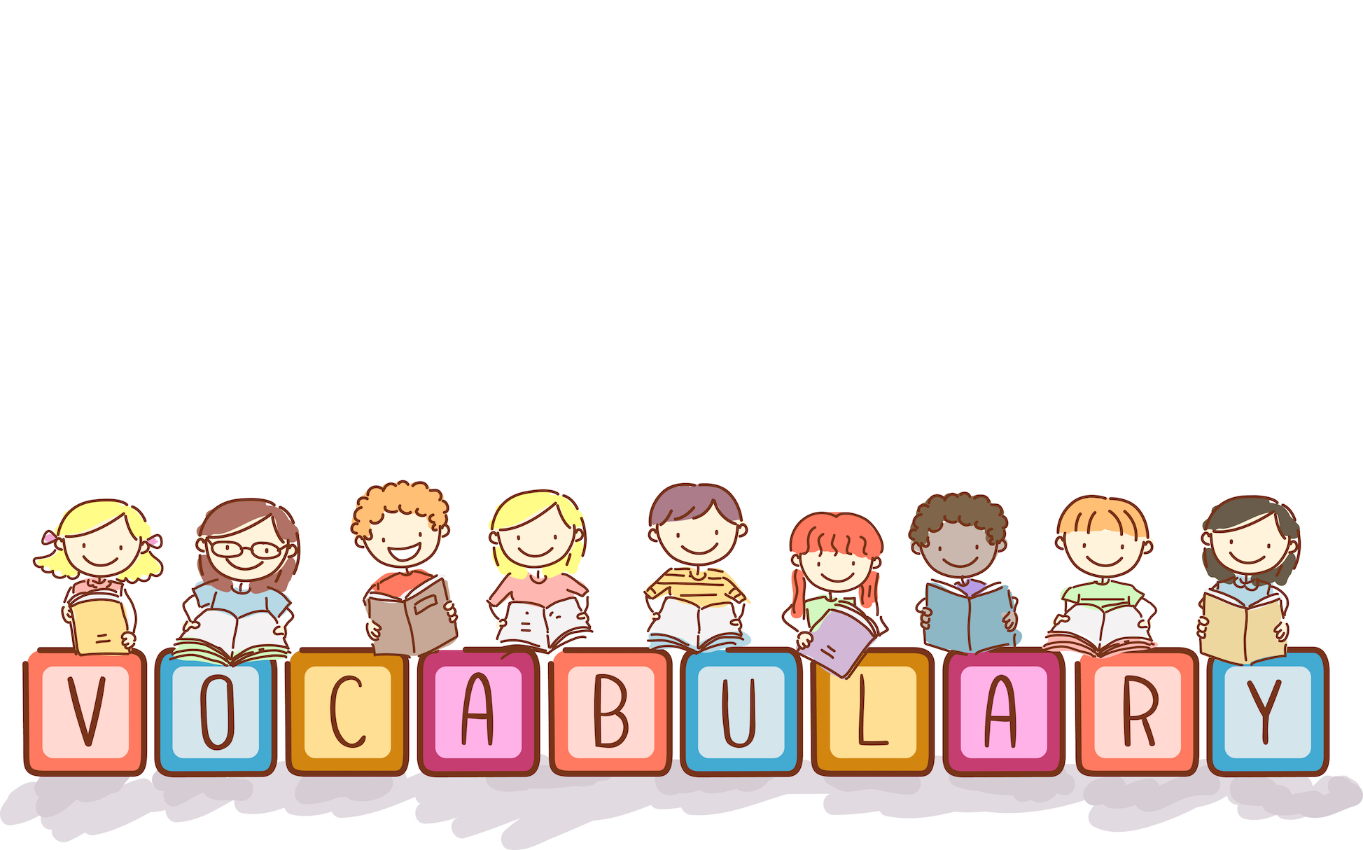

Slide 7


I. NEW WORDS:
1. communicate (v)
/kəˈmjuːnɪkeɪt/
giao tiếp, liên lạc
to share information with others by speaking, writing, moving your body, or using other signals
→ communication (n)
2. creative (adj)
/kriˈeɪ.tɪv/
sáng tạo
3. international (adj)
/ˌɪntəˈnæʃənəl/
thuộc về quốc tế
relating to or including more than one country
4. funny (adj)
/ˈfʌn.i/
hài hước, vui nhộn
5. useful (adj)
/ˈjuːs.fəl/
hữu ích, có ích
effective; helping you to do or achieve something

Slide 8


Slide 9
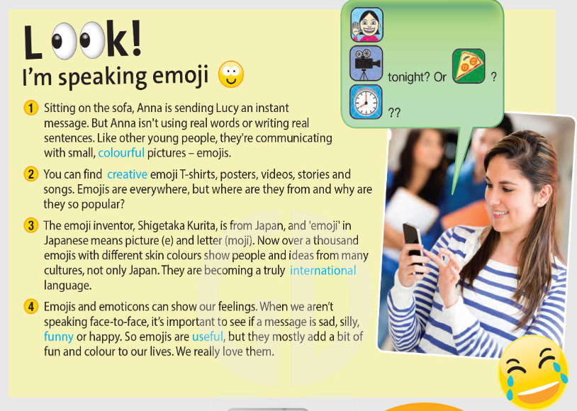


Slide 10
✓ Activity 1: Read the article. Which of topics A–E are in the text? Put the topics in order.
A Emojis to communicate
B Fashion in Japan
C Emojis in everyday life
D Emojis and emotions
E Where emojis are from
1
2
4
3

Slide 11
FURTHER PRACTICE !!!

Slide 12
✓ Activity 2: Read and listen to the article. Write True or False.
1 Lucy is reading a message made of emoticons
2 There are emojis on clothes.
3 Emojis show only Japanese culture
4 The people and faces in the new emojis use a lot more colours.
5 Emojis don’t help with communication.
False
→ She is reading a message made of emojis.
True
False
→ They show ideas from many cultures.
True
False
→ They can show people’s feelings.

Slide 13
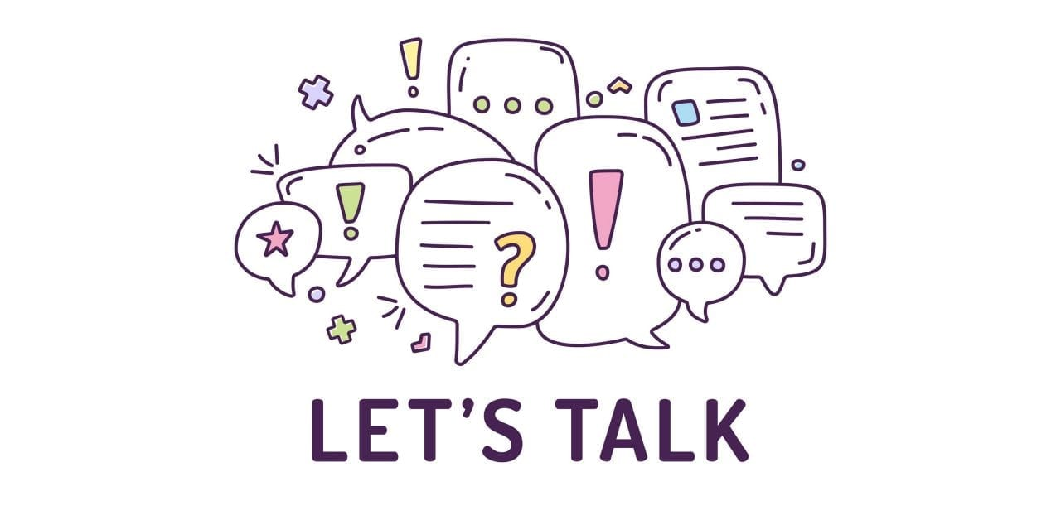

Slide 14
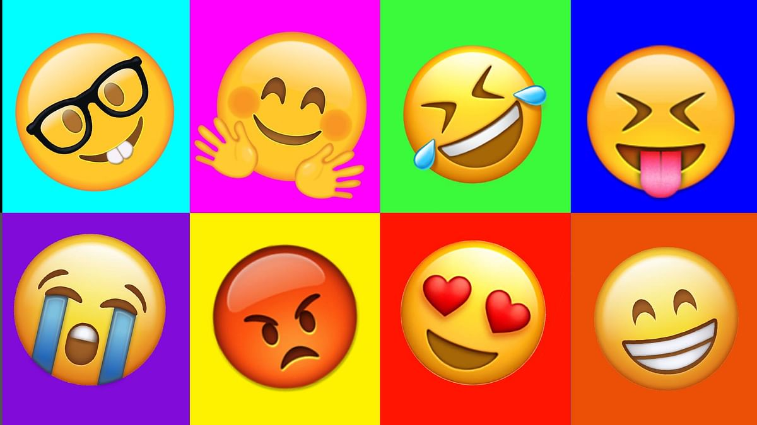
✓ Activity 4: Use it! Work in pairs. Do you like emojis? Why / Why not?

Slide 15
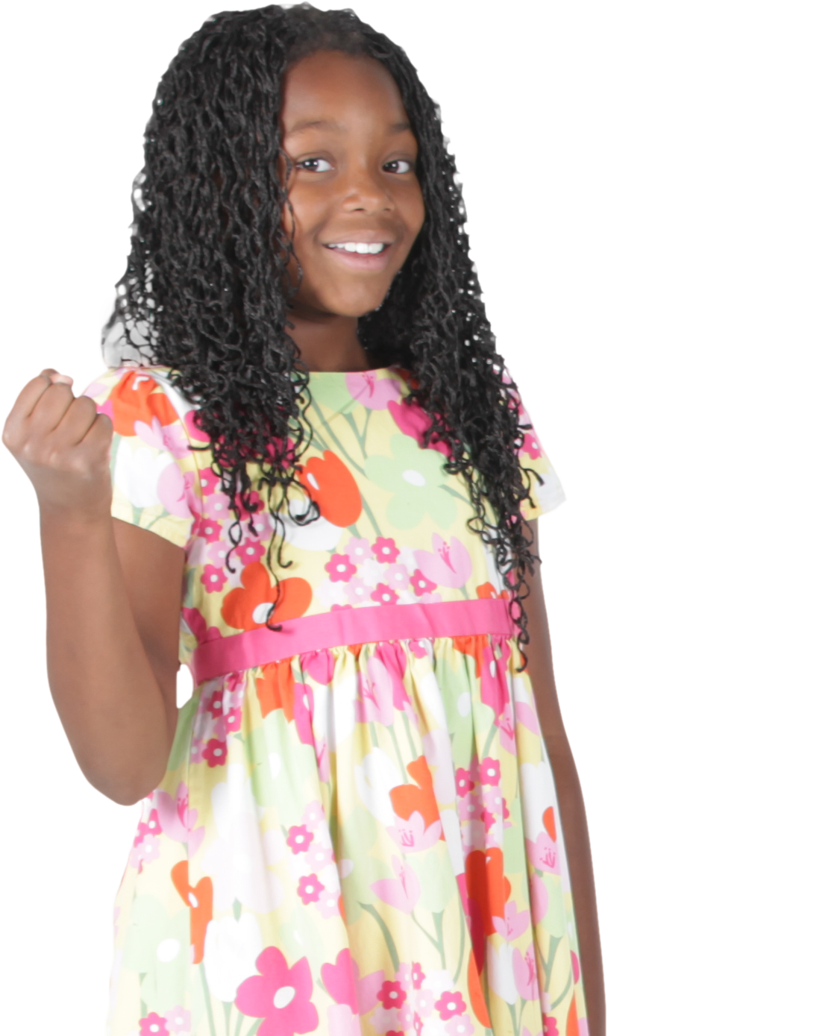
✓ Activity 4: Use it! Work in pairs. Do you like emojis? Why / Why not?
I love using emojis, especially when I text my friends. Using emojis can save most of my time instead of typing long words. It is also boring to use normal words.

Slide 16

- Learn by heart all the new words.
- Workbook: Exercises page 20
- Prepare Lesson 3 – Language focus - Present continuous: affirmative and negative

Slide 17


