Slide 1


Slide 2


LETTER DICTATION

Slide 3
LETTER DICTATION
RULE:- Divide into 4 groups
Receive strings of words from teacher
Work in groups to figure out what the questions are
Raise hand to answer
FOR EXAMPLE:
Whatareyoudoingtoday? → What are you doing today?
Whatdoyouliketowatch? → What do you like to watch?

Slide 4
Doyoublogaboutyourlife?
WhatdoyouwatchonTV?
Howoftendoeshemakethevideos?
Howaboutwatchingafilm?
Howmanylanguagesdoesyourmotherspeak?
→ Do you blog about your life?
→ What do you watch on TV?
→ How often does he make the videos?
→ How about watching a film?
→ How many languages does your mother speak?

Slide 5

UNIT 2
COMMUNICATION
LESSON 6: SPEAKING
MAKE PLANS OVER THE PHONE
I can make plans with friends.

Slide 6

When you want to tell friends something important, do you phone or text?

Slide 7

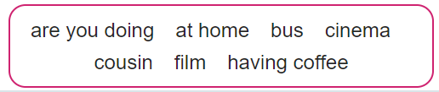
✓ Activity 1: Complete the dialogue with the phrases in the box. Then watch or listen and check. What does Mike want to do? Why can’t Anna meet Mike now?
Anna Hello?
Mike Hi, Anna. It’s Mike.
Anna Hi there. How are things?
Mike Good. Are you ¹______________________?
Anna Yes. Why?
Mike Well, I’m ²_______________________with Sally in town. We’re thinking of going to
the ³_____________________. Are you interested?
Anna I’d like to come, but I can’t right now.
Mike What ⁴____________________________?
Anna I’m waiting to Skype my ⁵__________________in Canada. What time’s
the ⁶_______________?
Mike It’s at four o’clock.
Anna Oh, that’s OK. I can make it at four. That’s lots of time to Skype and then get
the ⁷__________________into town.
Mike Cool! Text me when you’re on the bus.
Anna OK. See you later.
at home
having coffee
cinema
are you doing
cousin
film
bus

Slide 8

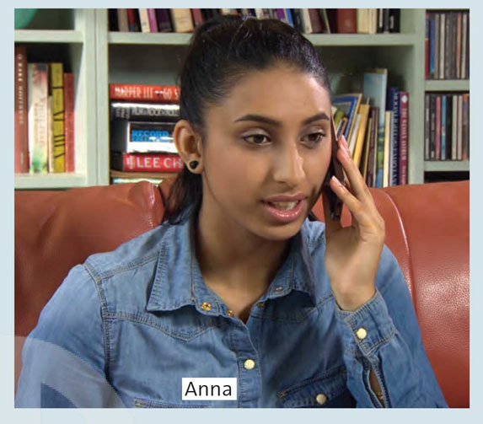
✓ Activity 1: Complete the dialogue with the phrases in the box. Then watch or listen and check. What does Mike want to do? Why can’t Anna meet Mike now?
Mike wants to go to the cinema.
Anna is waiting to Skype her cousin in Canada.

Slide 9
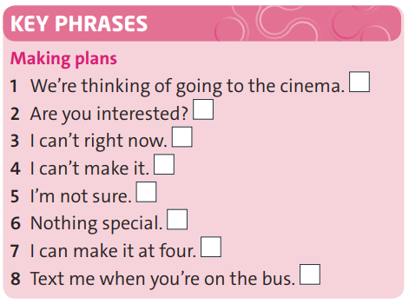
✓ Activity 2: Read the Key Phrases. Cover the dialogue and try to remember who says the phrases, Anna or Mike. Which key phrases are not used?
Mike
Mike
Anna
Anna
Mike

Slide 10


Slide 11
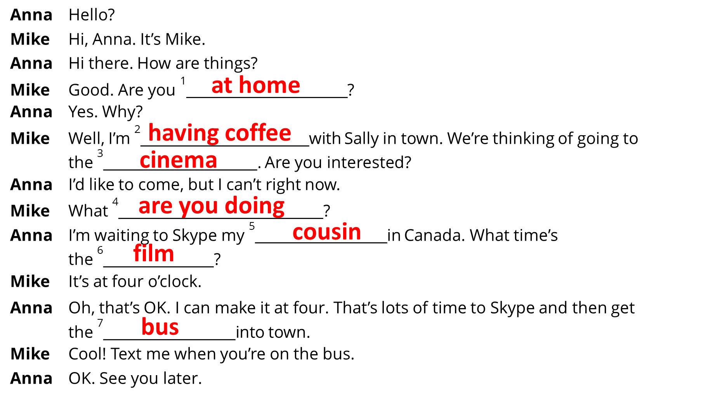
✓ Activity 3: Work in pairs. Practise the dialogue.

Slide 12
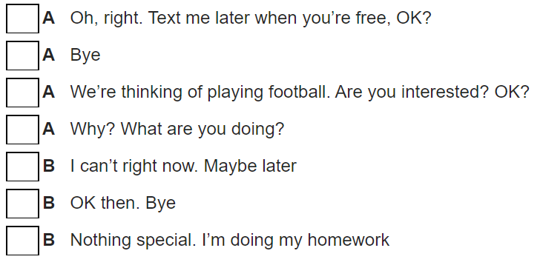
✓ Activity 4: : Put the dialogue in the correct order. Listen and check. Then practise it with your partner
5
7
1
3
2
6
4

Slide 13
FURTHER PRACTICE !!!

Slide 14
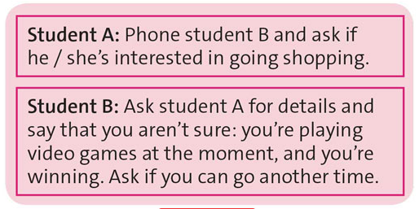
✓ Activity 5: Use it! Read the situation. Practise a new dialogue using the key phrases and the dialogue in exercise 1 to help you.

Slide 15

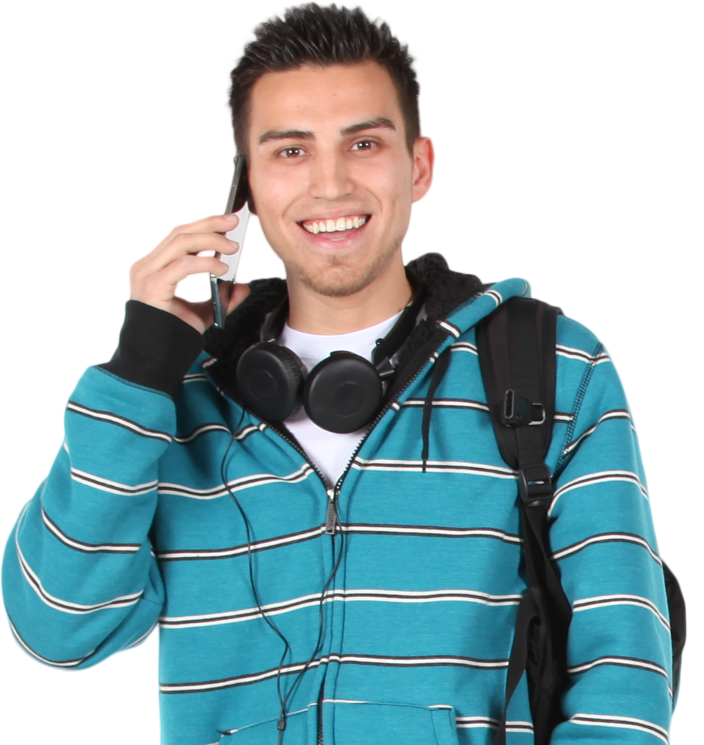
Hello Mike. I’m thinking of going shopping this afternoon. Are you interested?
Sorry, I think I can’t come right now. How about tomorrow?
Why? What are you doing?
I’m playing video games, and I’m winning. It’s an online game so I can’t pause it.
Don’t worry. I’m free in the evening, too. Call me when you finish playing.
OK, see you later.

Slide 16

- Learn by heart all key phrases.
- Workbook: Exercises page 23.

Slide 17


