Slide 1



Unit 3
The Past
Reading

Slide 2


Page 36
www.phuongnam.edu.vn

Slide 3
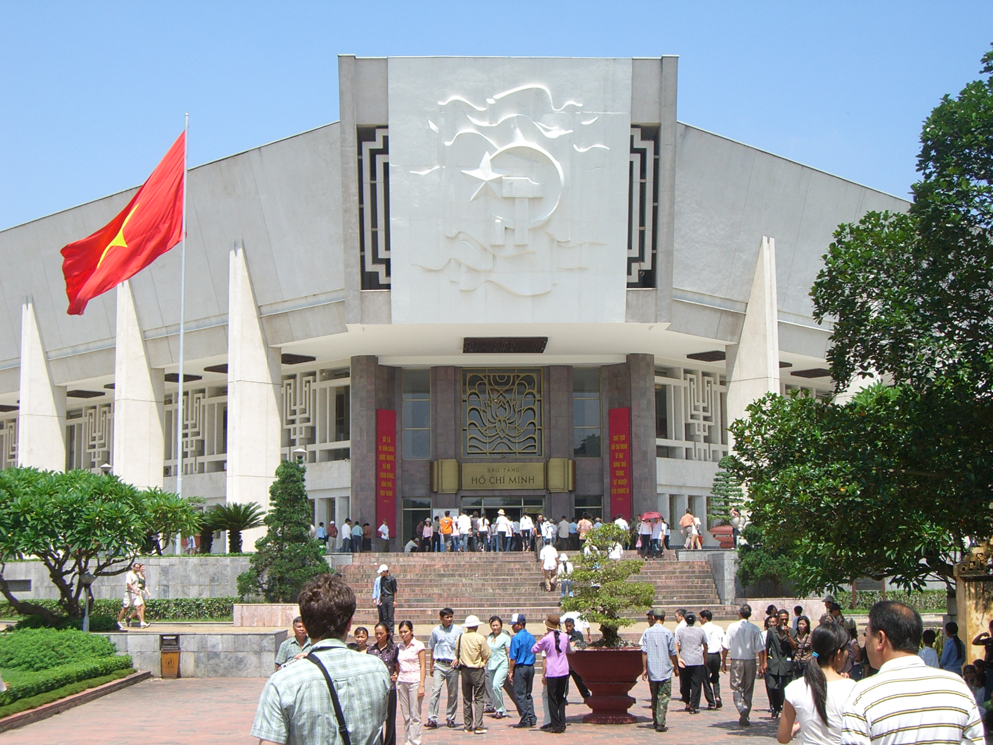
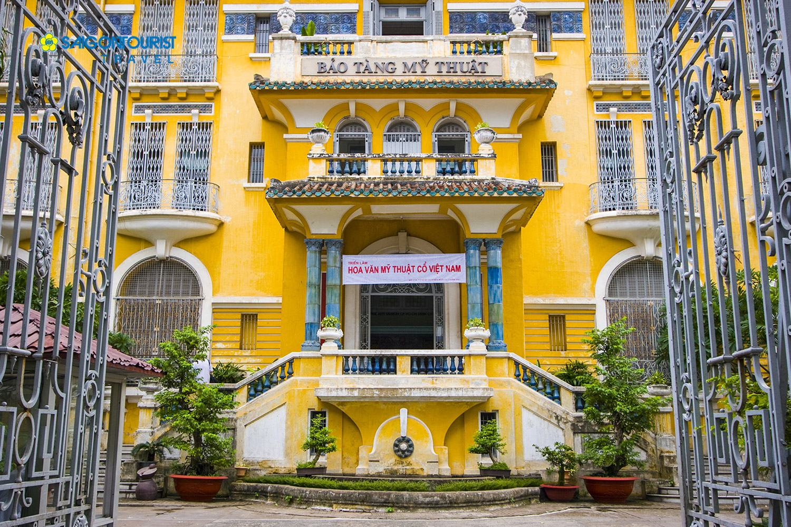
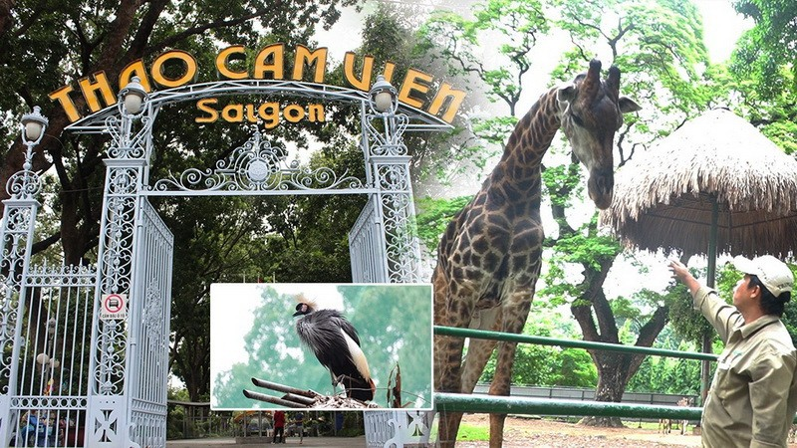
Think of an exciting place for a school trip.
Recommendations
Art Museum
History Museum
Zoo
www.phuongnam.edu.vn

Slide 4
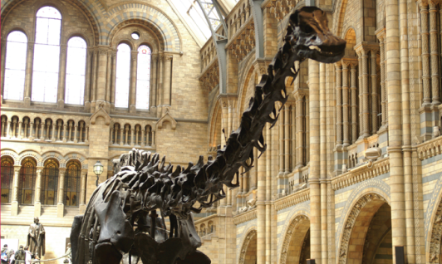
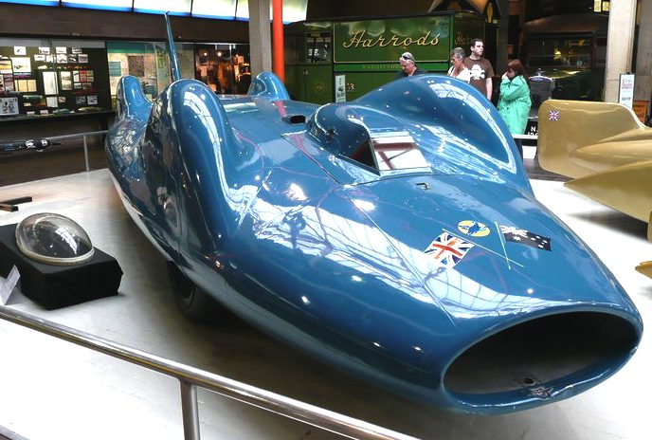
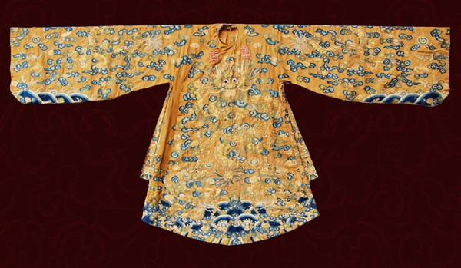
Look at the photos. Answer the questions.
Then read the reports and check your answers.
www.phuongnam.edu.vn

Slide 5
Look at the photos. Answer the questions.
1. What are the objects in the photos?
Clothes
Dinosaur bones
Cars
2. How old do you think the Bluebird is?
Perhaps from 1900s
3. Can you think of words to describe the objects in the photos?
Big, long, blue, old, fast
Big, long teeth, millions of years
Old, expensive, fancy, royal
www.phuongnam.edu.vn

Slide 6
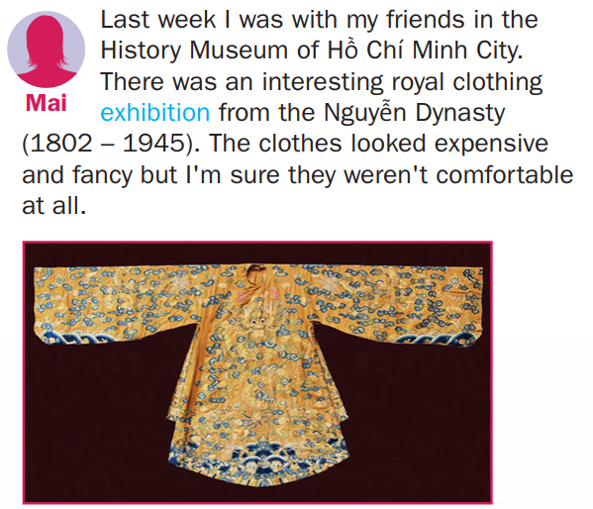
1. Read the reports and check your answers.
1. What are the objects in the photos?
Clothes
2. How old do you think the Bluebird is?
3. Can you think of words to describe the objects in the photos?
Old, expensive, fancy, royal, uncomfortable
www.phuongnam.edu.vn

Slide 7
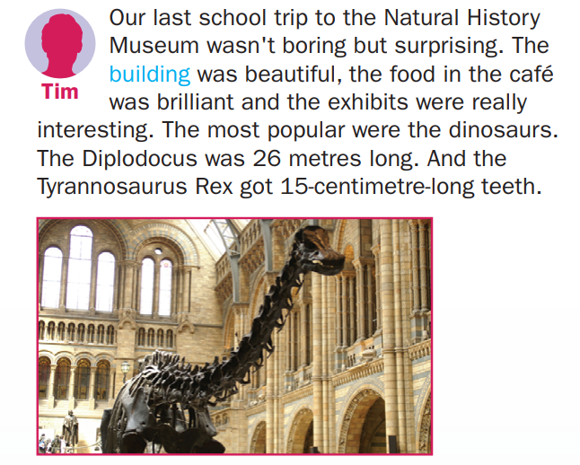
1. Read the reports and check your answers.
1. What are the objects in the photos?
Dinosaur bones
2. How old do you think the Bluebird is?
3. Can you think of words to describe the objects in the photos?
Big, long teeth, ancient, popular
www.phuongnam.edu.vn

Slide 8
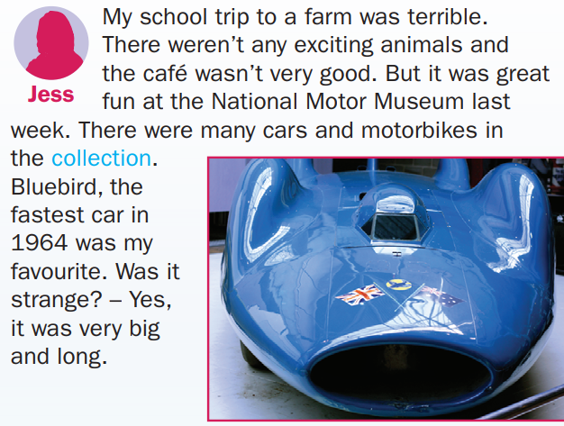
1. Read the reports and check your answers.
1. What are the objects in the photos?
Cars
2. How old do you think the Bluebird is?
From 1964
3. Can you think of words to describe the objects in the photos?
Big, long, blue, old, fast, strange
www.phuongnam.edu.vn

Slide 9

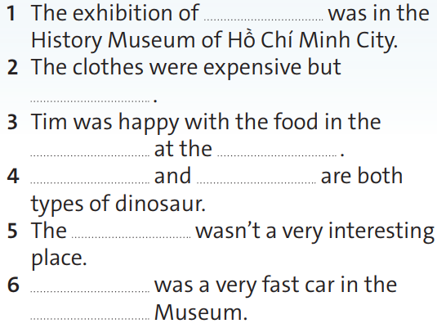

2. Read and listen to the reports.
Complete the sentences with the information from the text.
royal clothing
uncomfortable
café
Natural History Museum
Diplodocus
Tyrannosaurus Rex
farm
Bluebird
National Motor
www.phuongnam.edu.vn

Slide 10
Extra exercise- TRUE/ FALSE
1. Mai thinks the clothes were comfortable to wear.
False
→ She thinks they were uncomfortable.
2. Tim said the Tyrannosaurus Rex was 15 cm long.
False
→ Its teeth were 15 cm long.
www.phuongnam.edu.vn

Slide 11
Extra exercise- TRUE/ FALSE
3. Jess’ trip to the farm wasn’t very nice.
True
4. Bluebird was quite a small car.
False
→It was very big.
www.phuongnam.edu.vn

Slide 12

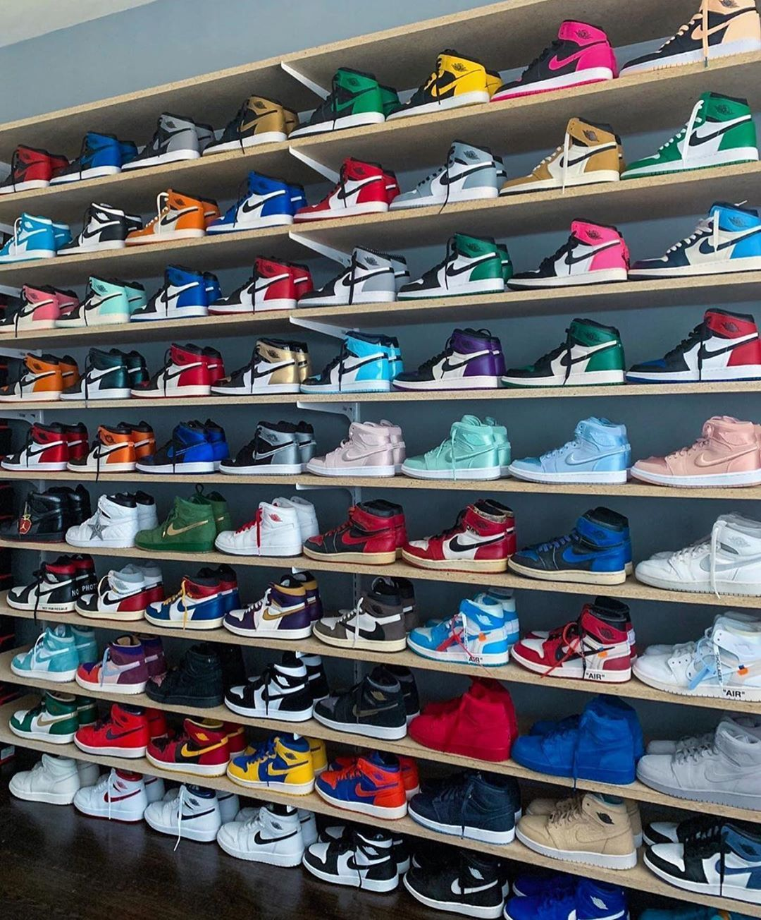

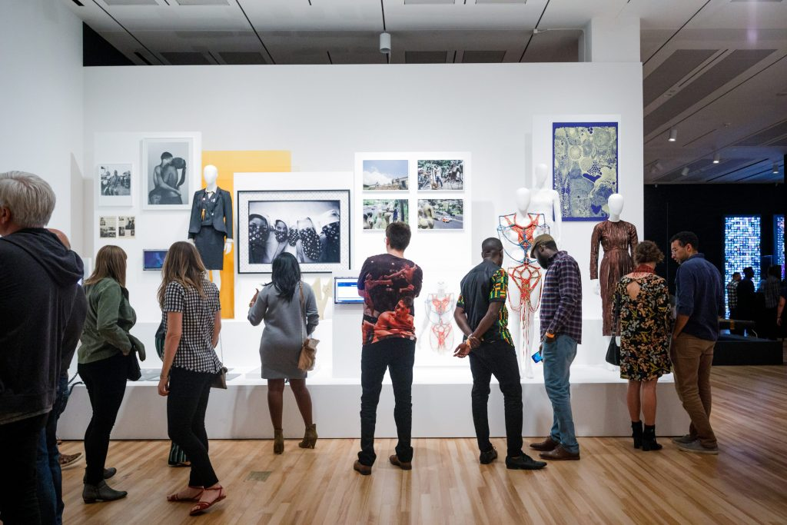
1. Exhibition /ˌeksɪˈbɪʃn/ (noun): a collection of things, for example works of art, that are shown to the public
2. Building /ˈbɪldɪŋ/ (noun): a structure such as a house or school that has a roof and walls
3. Collection /kəˈlekʃn/ (noun) a group of objects, often of the same sort, that have been collected
www.phuongnam.edu.vn

Slide 13

www.phuongnam.edu.vn

Slide 14
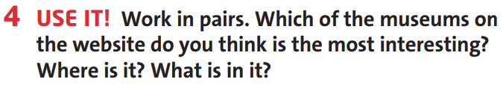
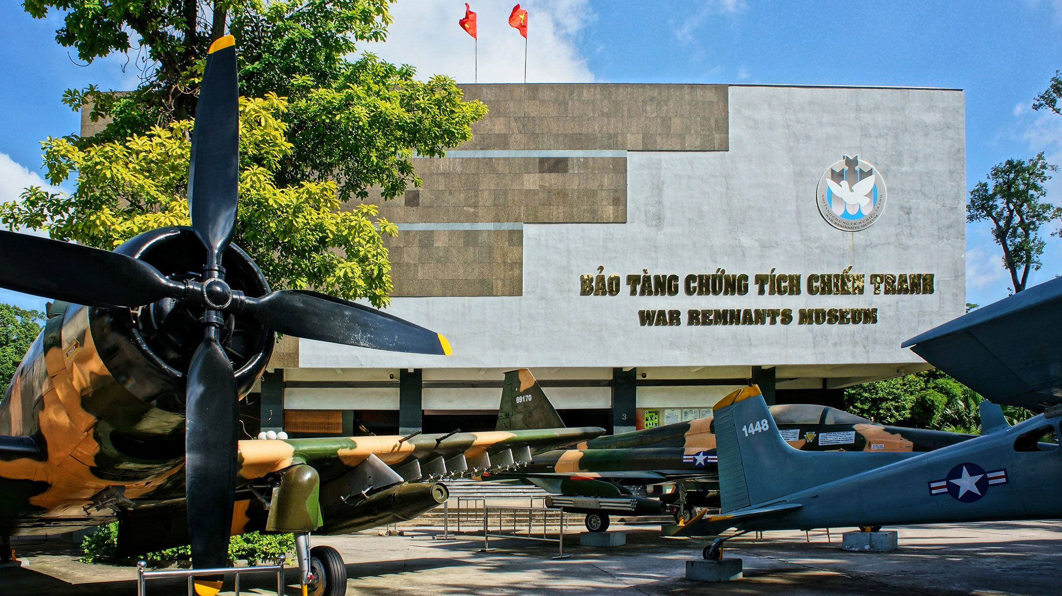
Suggested answer:
The war remnants museum
Address: 28 Vo Van Tan, District 3, Ho Chi Minh City, Vietnam.
It contains exhibits relating to the First Indochina War and the Vietnam War.
www.phuongnam.edu.vn

Slide 15

Homework
 Write about events from history in your country
 Learn by heart all the new words
 Prepare for next lesson – Language Focus: was, were – there was, there were
www.phuongnam.edu.vn

Slide 16

www.phuongnam.edu.vn

Slide 17



Thank you!
CTCP ĐẦU TƯ VÀ PHÁT TRIỂN GIÁO DỤC PHƯƠNG NAM

