Slide 1


Slide 2


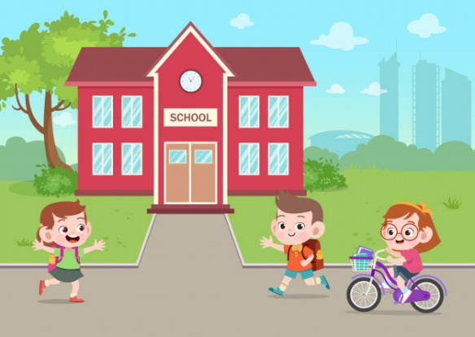
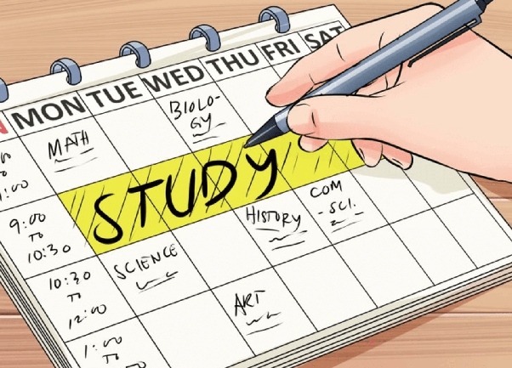
GUESSING
01
What time do you get up?
How do you go to school?
02
03
How many subjects do you study a day?"

Slide 3

UNIT 4: LEARNING WORLD
LESSON 1: VOCABULARY – SCHOOL SUBJECTS

Slide 4
EXERCISE 1: Look at pictures 1–9. Then complete the questions with the words in the box. Listen and check your answers.
Art English geography Spanish history PE¹ science ICT² maths
¹ Physical Education ² Information and Communication Technology

Slide 5


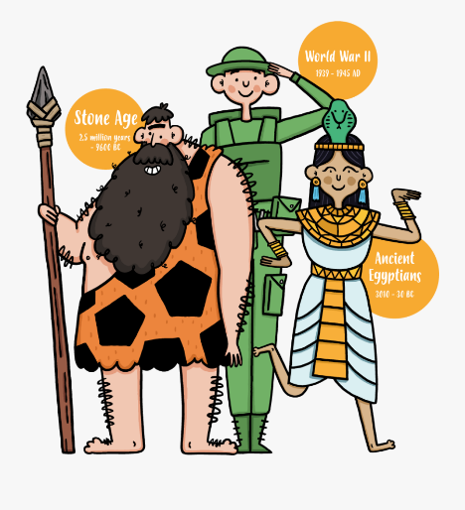
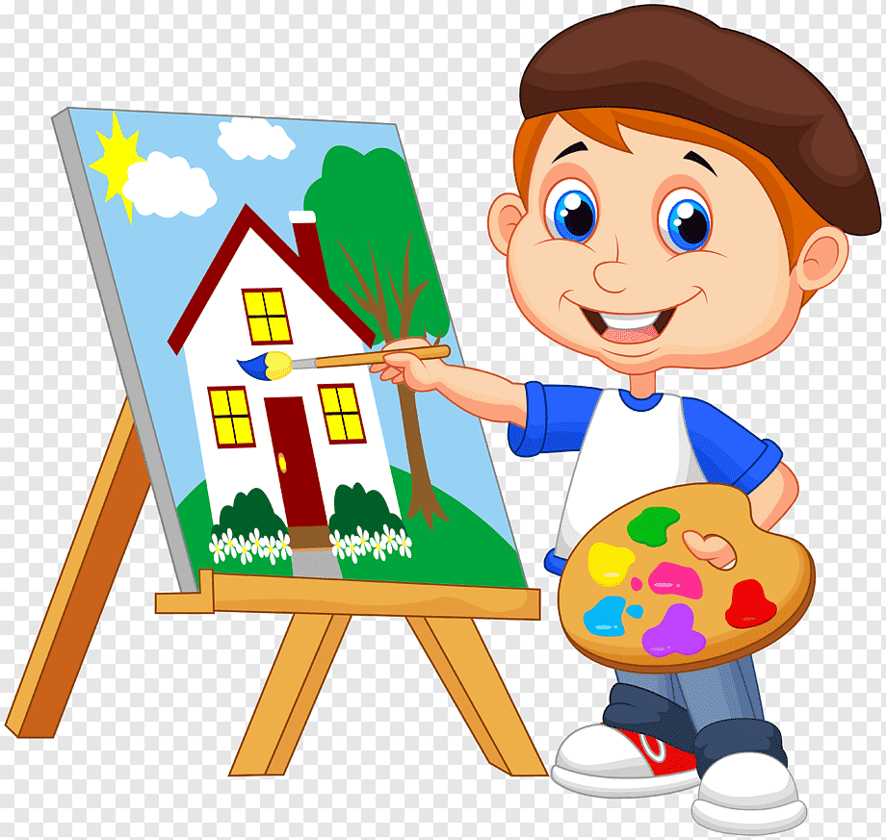

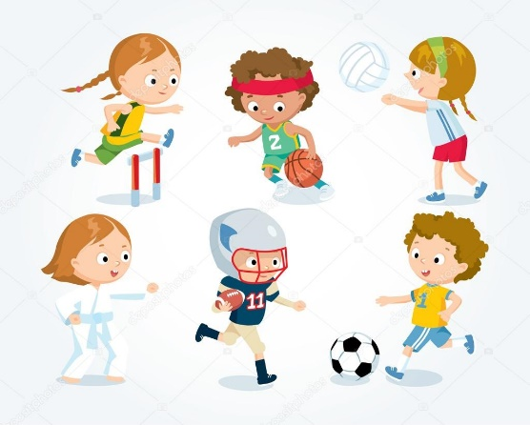


EXERCISE 1: Look at pictures 1–9. Then complete the questions with the words in the box. Listen and check your answers.
- New words:
English (n) /ˈɪŋ.ɡlɪʃ/
geography (n) /dʒiˈɒɡ.rə.fi/
history (n) /ˈhɪs.tər.i/
art (n) /ɑːt/
ICT (n) = Information and Communication Technology
/ˌɪn.fəˈmeɪ.ʃən/ /ænd/ /kəˌmjuː.nɪˈkeɪ.ʃən/ /tekˈnɒl.ə.dʒi/
PE (n) = Physical Education
/ˌfɪz.ɪ.kəl ed.jʊˈkeɪ.ʃən/
maths (n) /mæθs/
science (n) /ˈsaɪ.əns/

Slide 6

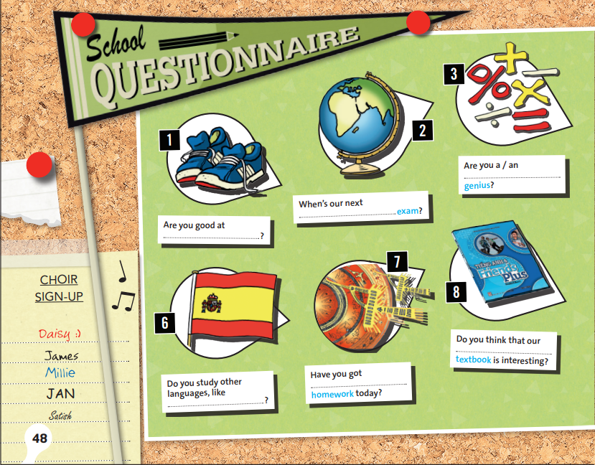
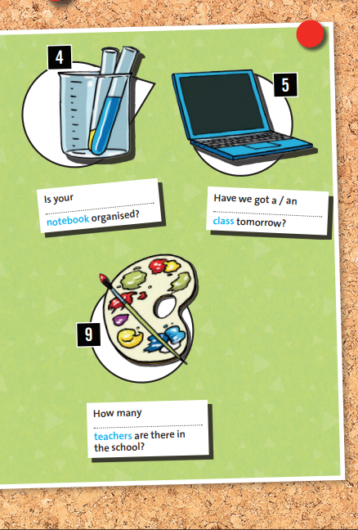
EXERCISE 1: Look at pictures 1–9. Then complete the questions with the words in the box. Listen and check your answers.
maths
science
ICT
geography
PE
English
art
history
Spanish

Slide 7
EXERCISE 2: Work in pairs. Ask and answer the questions in the School questionnaire.
maths
science
ICT
geography
PE
English
art
history
Spanish

Slide 8



Choose three school subjects from page 48 and draw their own pictures to illustrate them.
Try to guess the subjects they have been given.
Close their books and swap pictures with a partner.

Slide 9
EXERCISE 3: Watch or listen and answer the questions.
1. Why does Georgia like Wednesday?
→ Georgia likes Wednesday because she has her two favorite subjects: maths and geography.
2. What language does Ben prefer?
→ Ben prefers Spanish.

Slide 10
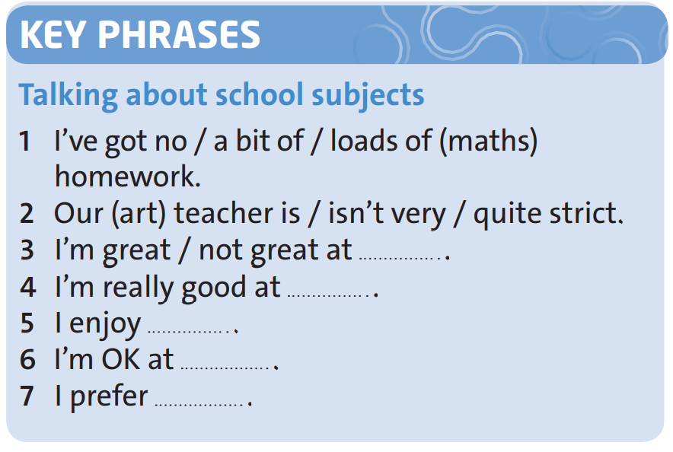
EXERCISE 4: Watch or listen again and complete the Key Phrases.
science
history
French
French
Spanish

Slide 11

EXERCISE 5: Work in pairs
Do you enjoy English?
What are you good at?
Do you prefer maths or French?
Is your maths teacher strict?

Slide 12


Write three sentences using the key phrases.
Work with a new partner.

Slide 13


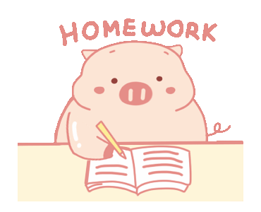
- Learn by heart all the new words.
- Prepare for next lesson - Reading

