Slide 1


Unit 5: ACHIEVE
Lesson 4:
VOCABULARY & LISTENING

Slide 2






Unit 5:
Vocabulary and Listening
JOBS AND SKILLS
I can understand people talking about skills
page 62
Teacher:

Slide 3

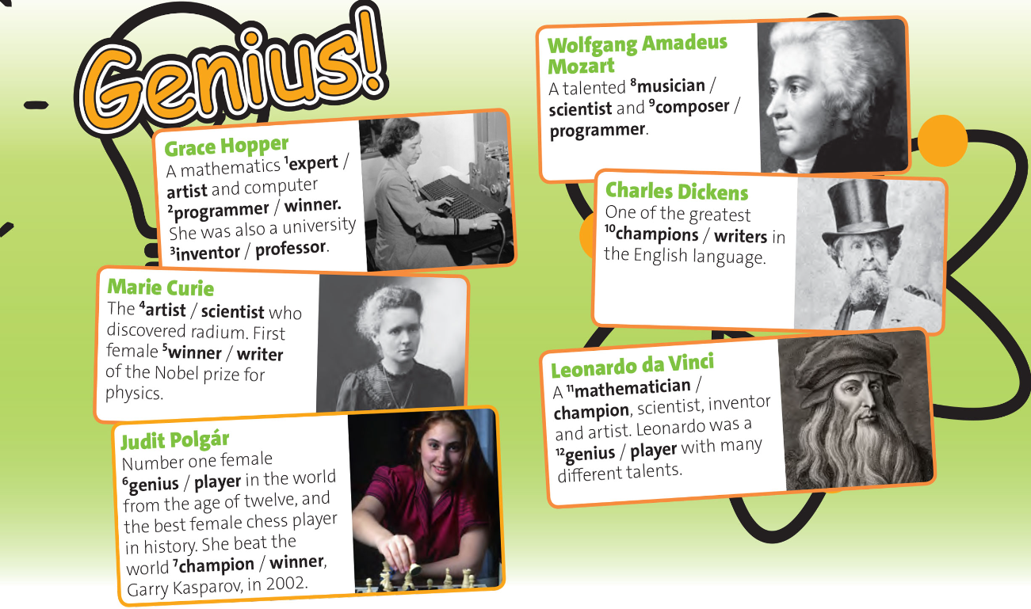
Activity 1: Choose the correct bold words in the texts. Listen and check

Slide 4

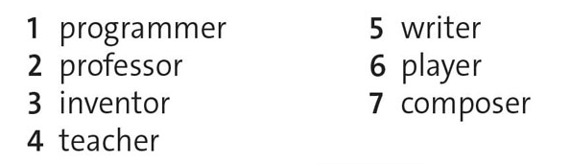
Activity 2: PRONUNCIATION /ə/ in jobs Listen to the jobs. Then listen again and repeat.

Slide 5
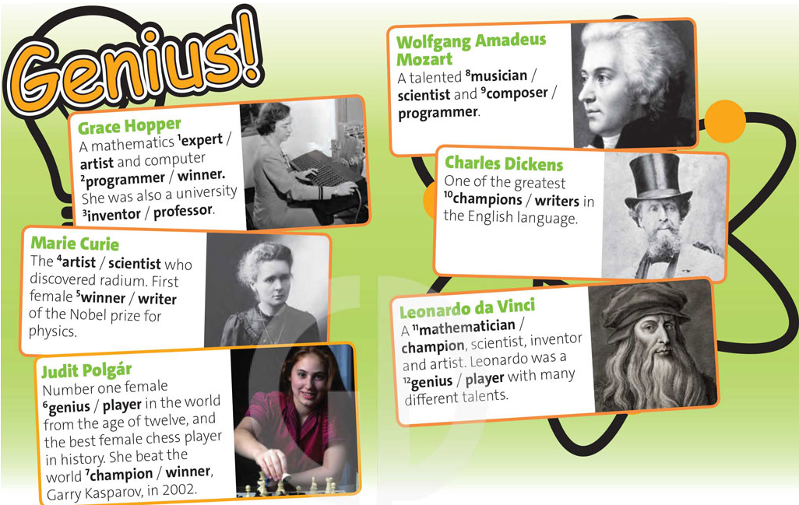

Activity 3: Listen to more jobs and skills. Find the words you hear in the text in exercise 1.
Listen again and repeat the words.

Slide 6

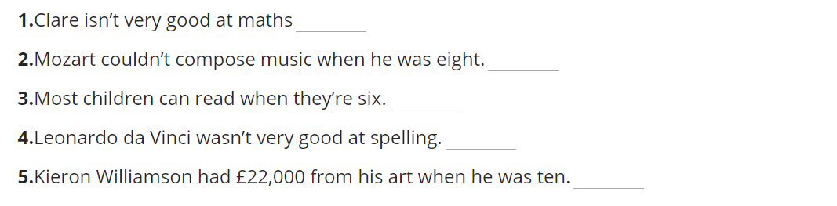
Activity 4: Listen to part of the programmer and write True or False.
true
false
He wrote a piece of music when he was eight.
true
true
false
He had £1.5 million from his art when he was ten

Slide 7
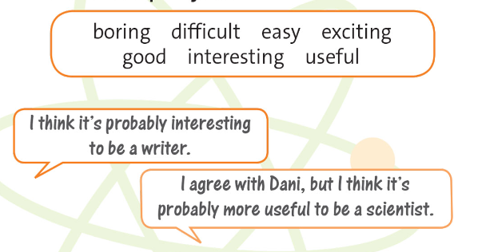

Activity 5: USE IT! Work in pairs. Use comparative and superlative form of the adjective in the box to compare jobs.

Slide 8



Activity 5: USE IT! Work in pairs. Use comparative and superlative form of the adjective in the box to compare jobs.
I think it is interesting to be a body builder. You can build up your muscles and have a nice body.
I think it’s extremely difficult and boring to become a body builder because you need to be disciplined.

