Slide 1


Unit 5: ACHIEVE
Lesson 2: READING

Slide 2

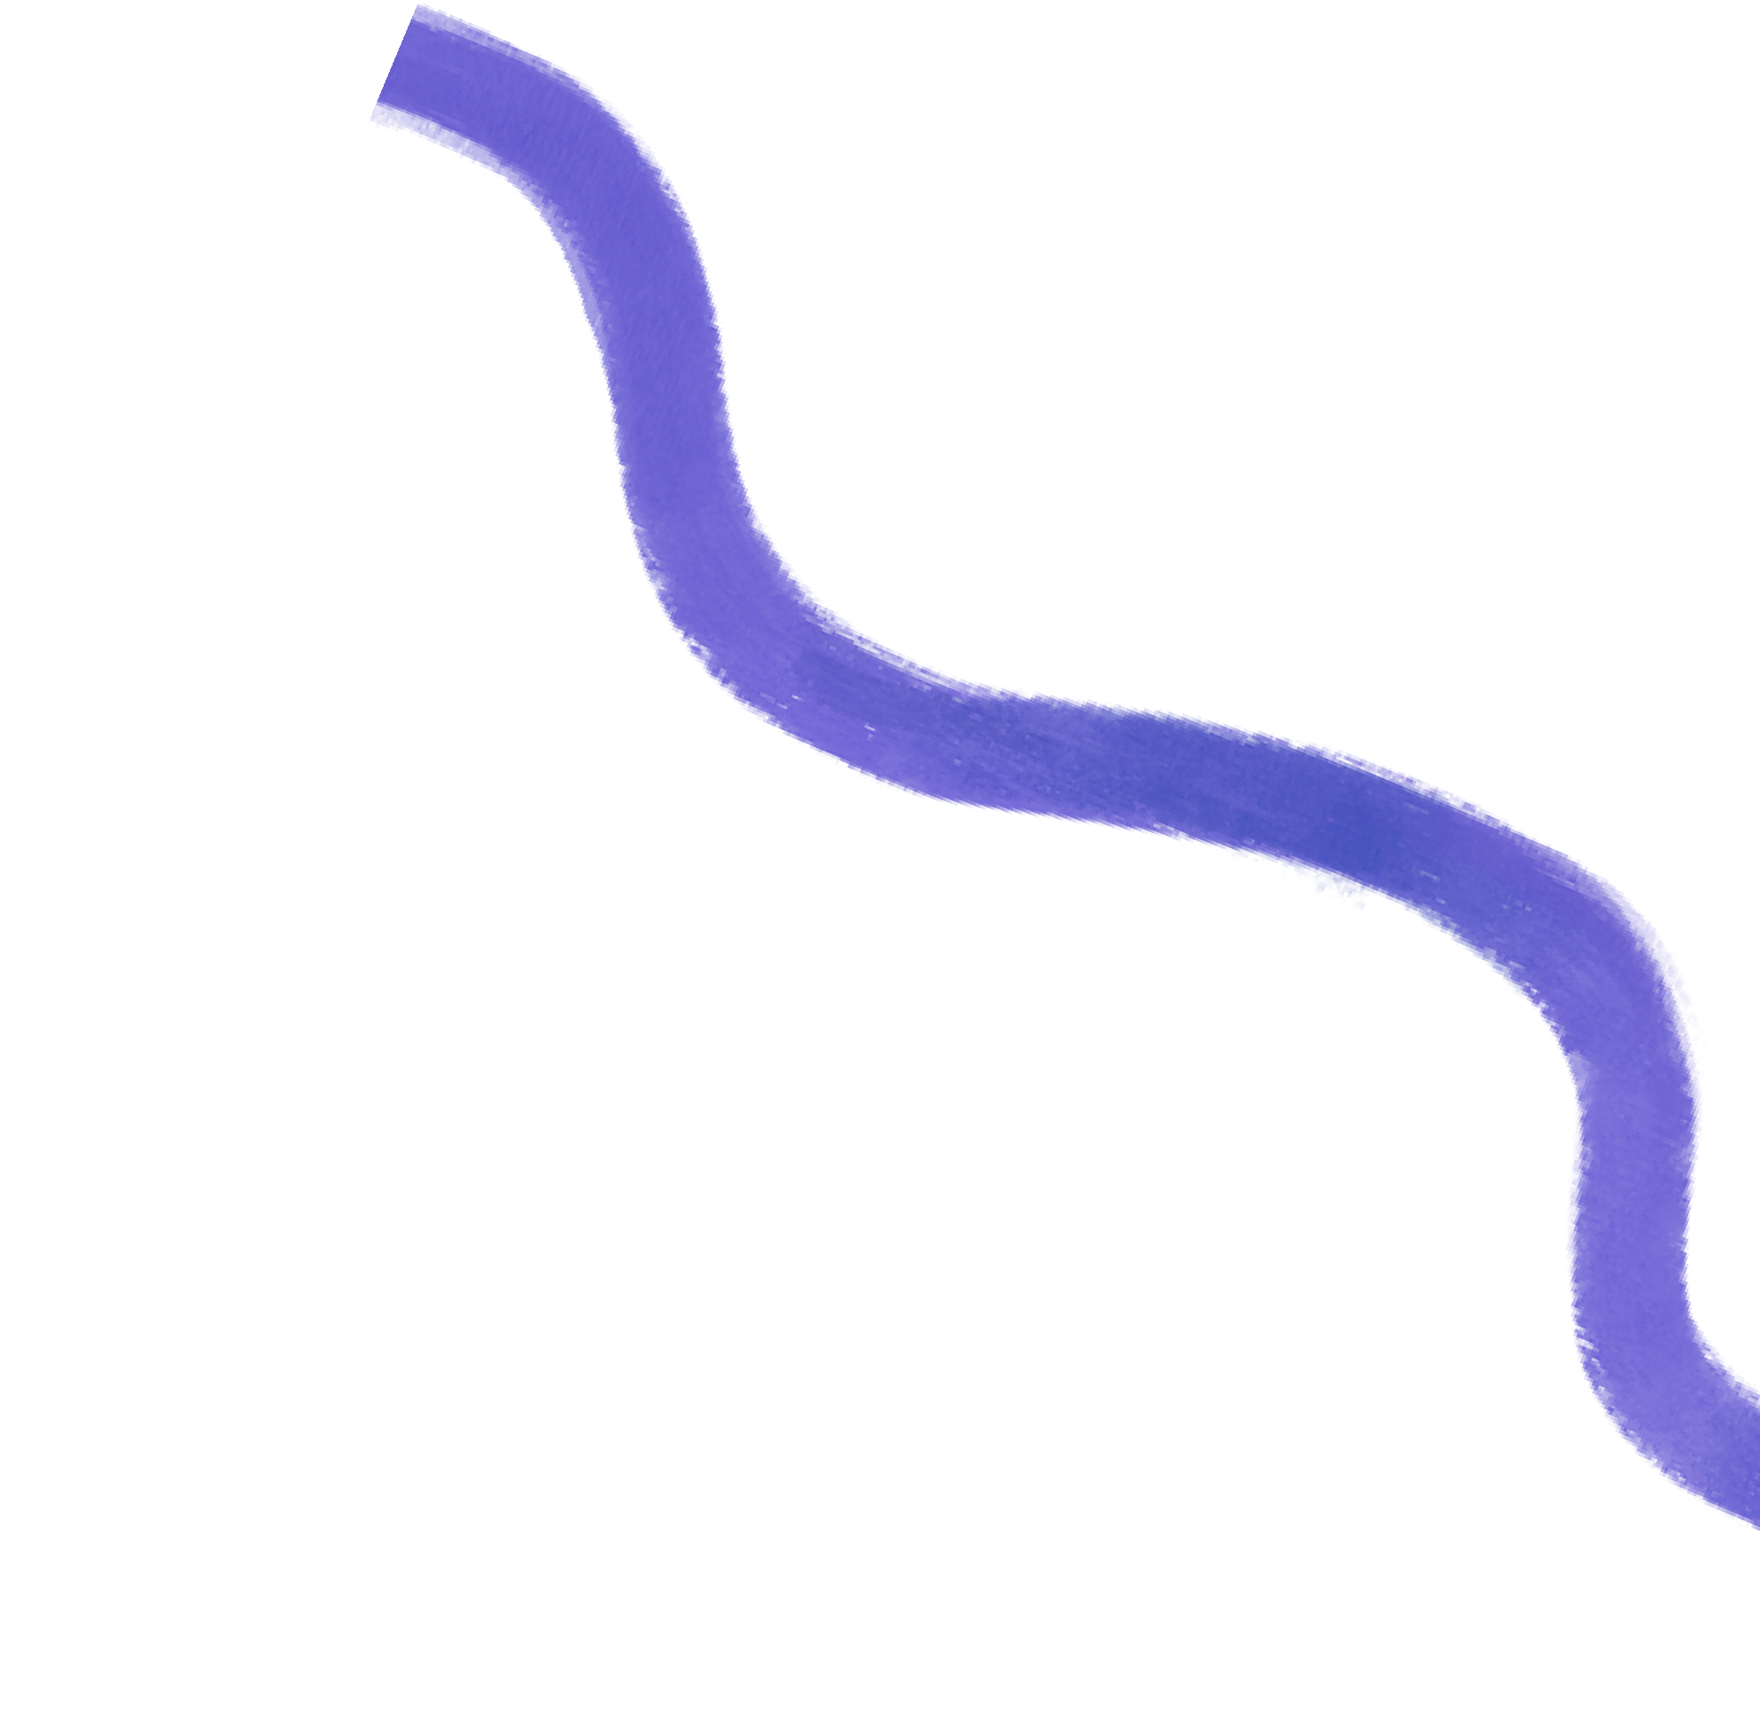




Unit 5:Achieve Reading
MEALS FOR MEDAL
I can guess word in a text I don’t know by looking at the context
page 60
Teacher:

Slide 3
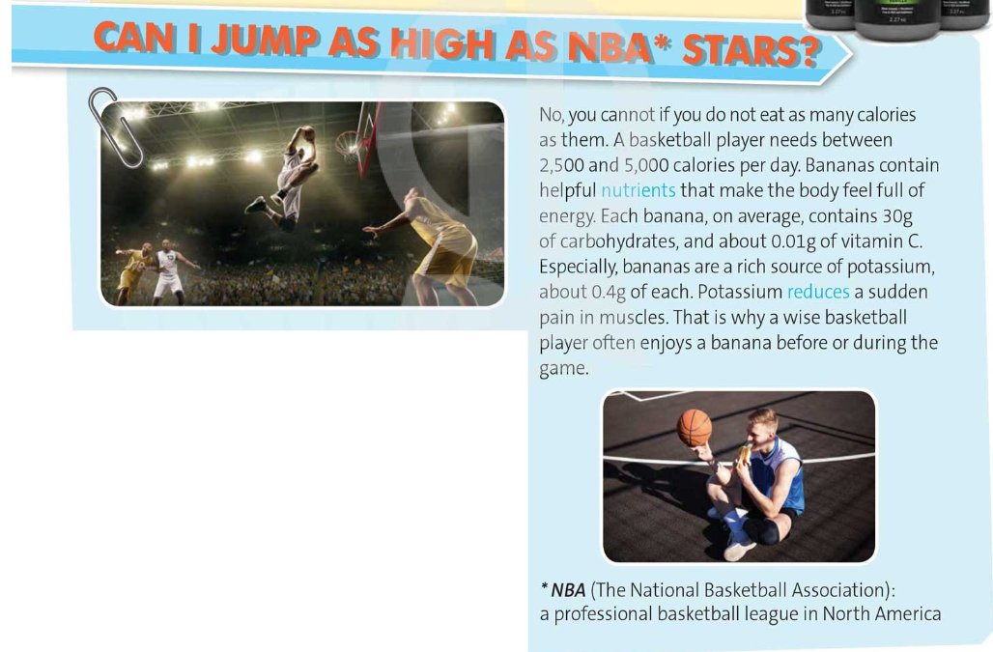
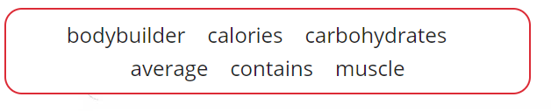
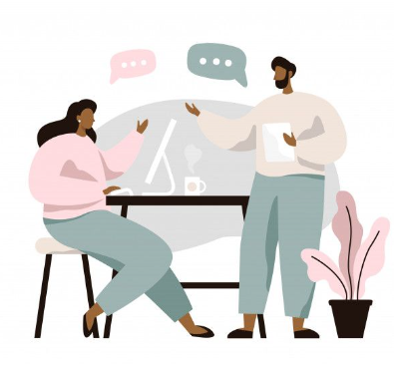
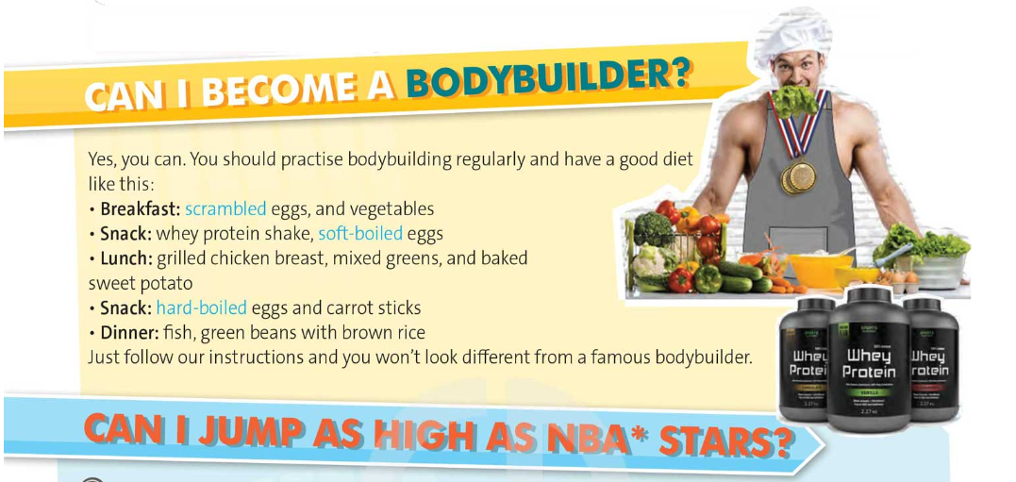
Activity 1:
Read the text quickly. The following words may be new to you.
What do you think they mean? Compare your ideas with a partner's.

Slide 4


Activity 2:
Read and listen to the text and answer the questions.
What should you do to become a bodybuilder?
2. What can you eat most when you practise bodybuilding?
To become a bodybuilder, you should practise bodybuilding regularly and have good diet.
You can eat eggs most when you practise bodybuilding.

Slide 5



Activity 2:
Read and listen to the text and answer the questions.
3. How many calories does a basketball player need a day?
4. Why are bananas good for basketball players?
5. What do you think about the title of the text – Meals for medals?
A basketball player needs between 2,500 and 5,000 calories a day.
Because bananas contain helpful nutrients that make the body feel full of energy.
The tittle shows the importance of a good diet. Your meals can help you achieve medals.

Slide 6

Bodybuilder /ˈbɒdibɪldə(r)/ : someone who regularly does special exercises to make their muscles bigger
Calories/ˈkæləriz/ : a unit of energy, often used as a measurement of the amount of energy that food provides
Carbohydrates/ˌkɑːbəʊˈhaɪdreɪt/ : one of several substances, such as sugar or starch, that provide the body with energy, or foods containing these substances such as bread, potatoes, pasta, and rice
Average/ˈævərɪdʒ/ : the result you get by adding two or more amounts together and dividing the total by the number of amounts
Contain/kənˈteɪn/ : to have something inside or include something as a part
Muscle/ˈmʌsl/: one of many tissues in the body that can tighten and relax to produce movement
Activity 3:
VOCABULARY PLUS! Use a dictionary to check the meaning of the words in blue in the text.

Slide 7
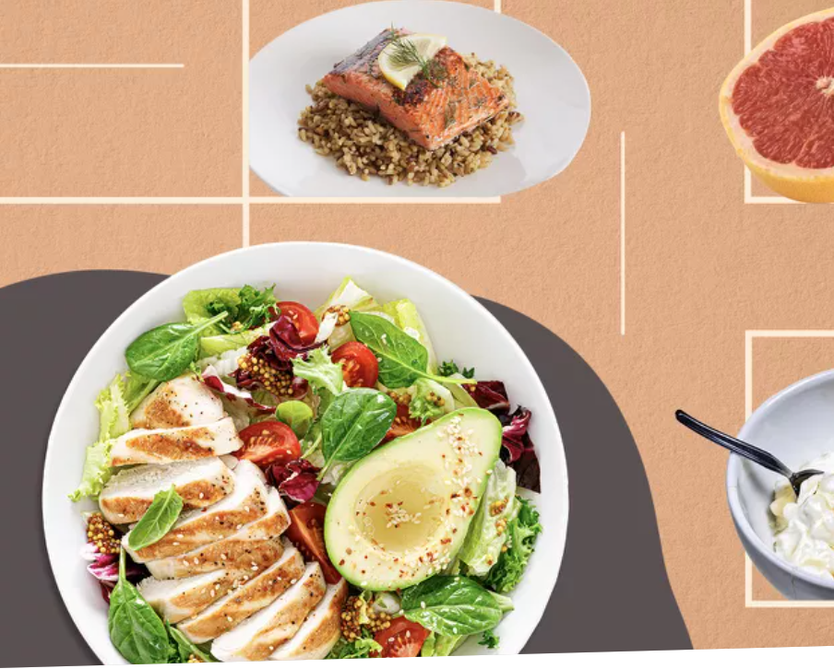

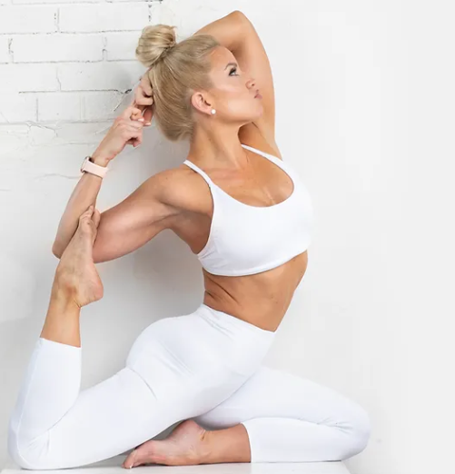
Activity 7: USE IT!
Work in pairs. Do you think a good diet can bring you medals?

Slide 8
Activity 7: USE IT!
Work in pairs. Do you think a good diet can bring you medals?
I definitely think that a good diet can bring you medals. With a good diet, you can build up your strength, improve your agility and boost your performance.

