Slide 1

Welcome
To our class
Let's learn and have fun!

Slide 2

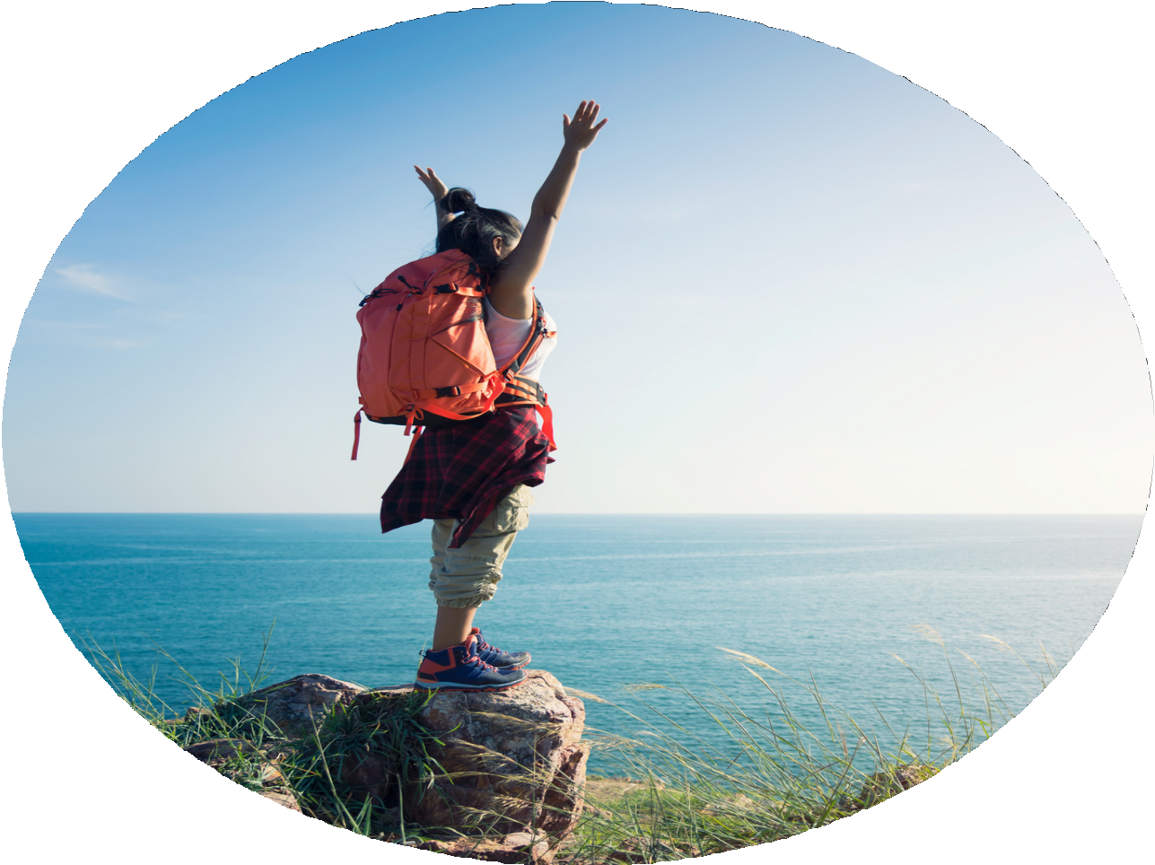
Unit 3: Adventure
Vocabulary Natural Feature

Slide 3

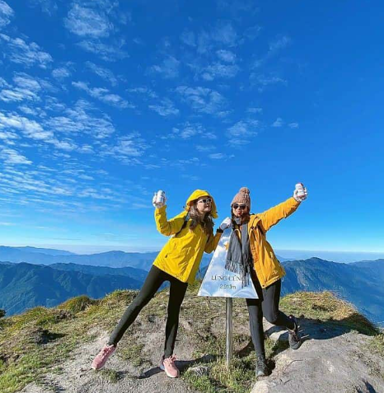
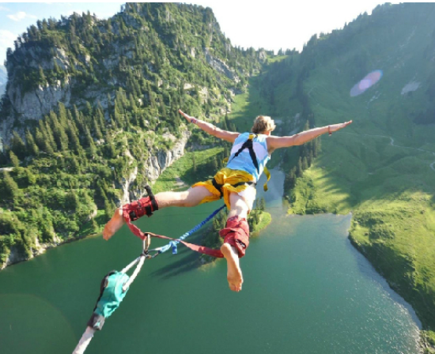
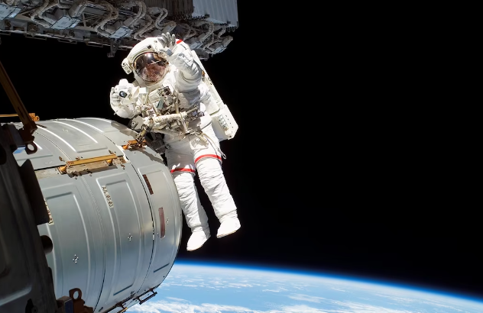
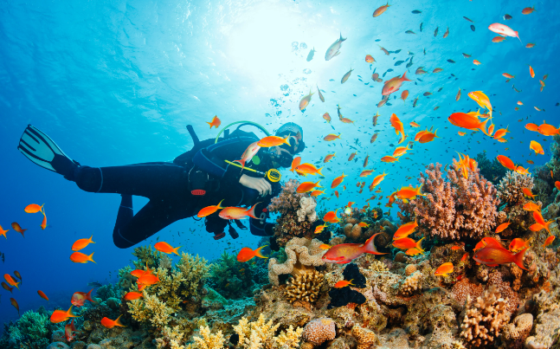

Have you ever thought of experenice these activities?
Which have you done?

Slide 4
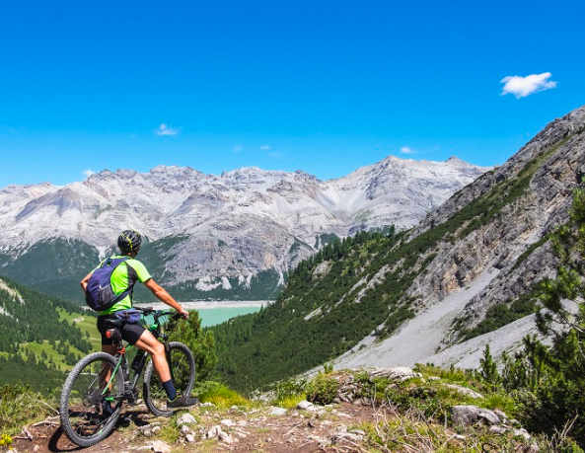
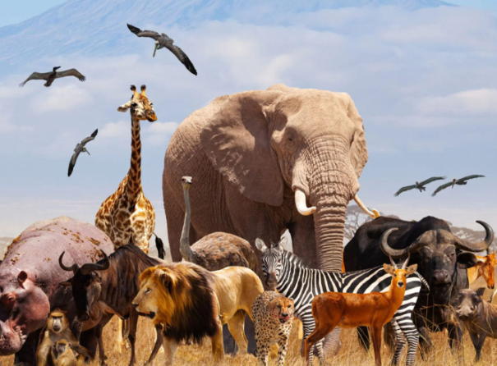
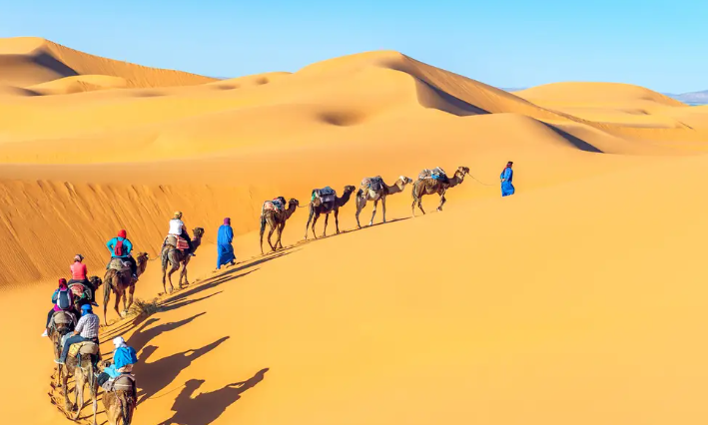
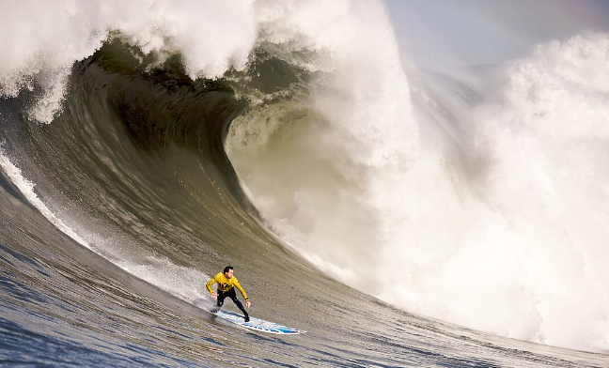
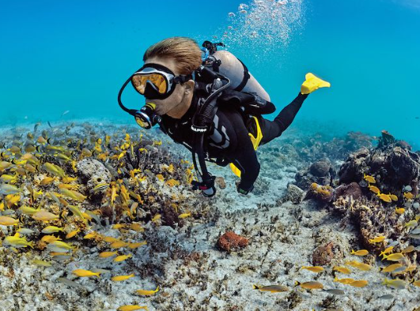
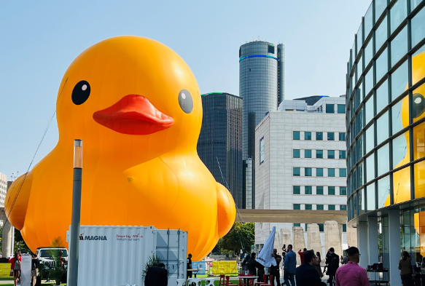
Vocabulary
New Words
Definition
Illustration
Adventure
an unusual, exciting, and possibly dangerous activity, such as a trip or experience, or the excitement produced by such an activity
Scuba-diving
the sport of swimming underwater with special breathing equipment
Enormous
extremely large
Wildlife
animals and plants that grow independently of people, usually in natural conditions
Desert
an area, often covered with sand or rocks, where there is very little rain and not many plants
Surfing
to ride on a wave as it comes towards land, while standing or lying on a special board

Slide 5
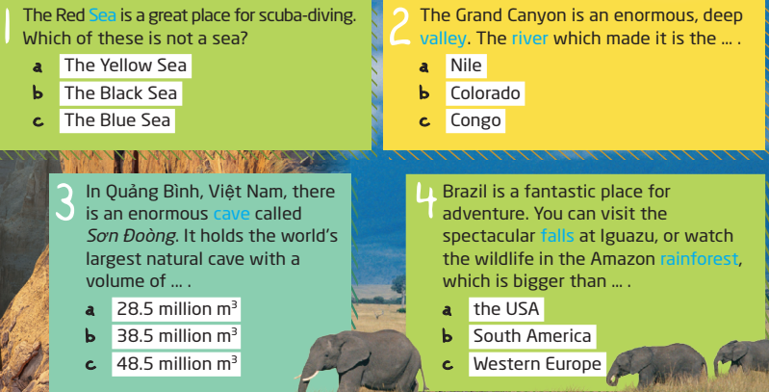
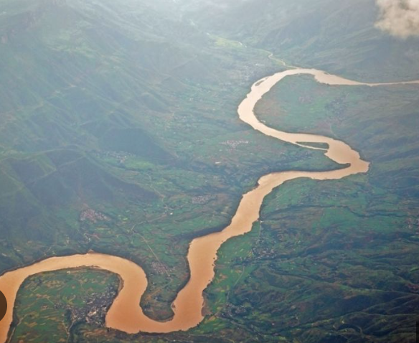
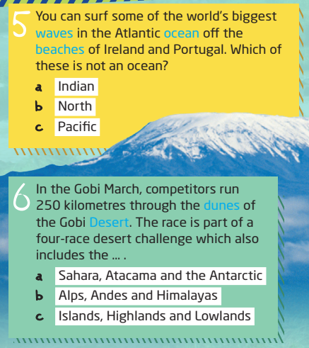
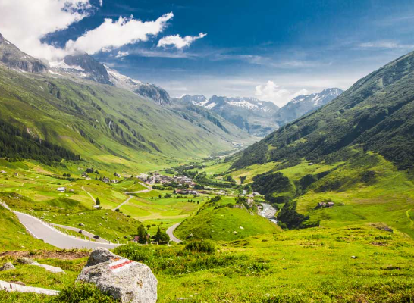
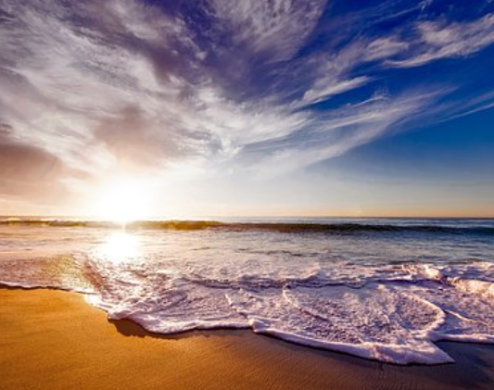
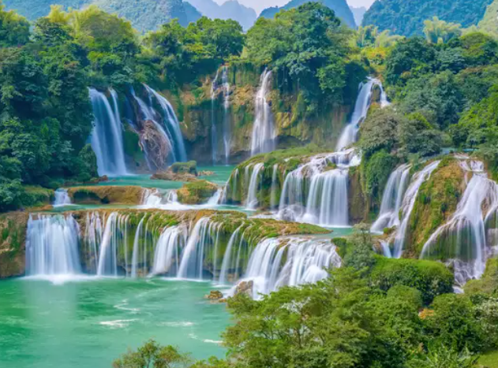
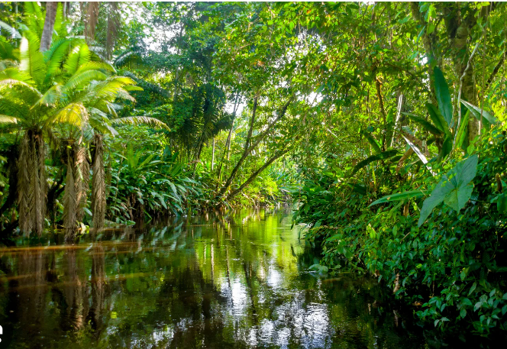
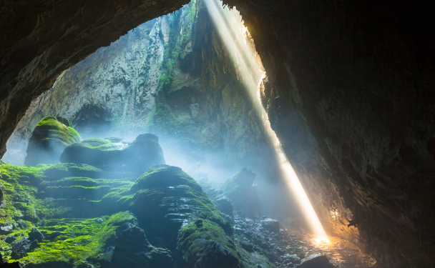
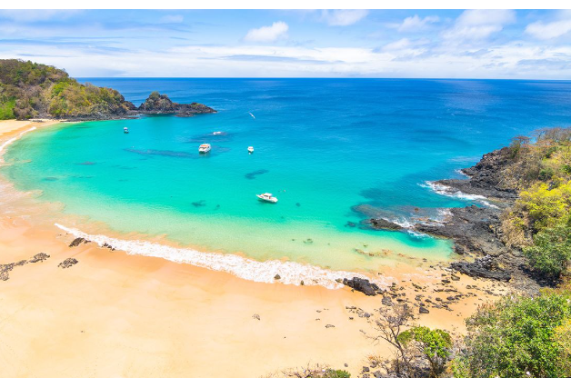
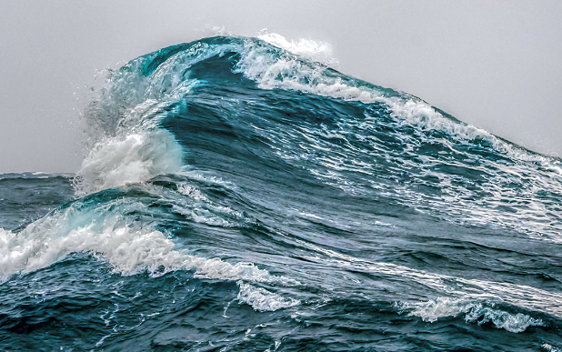
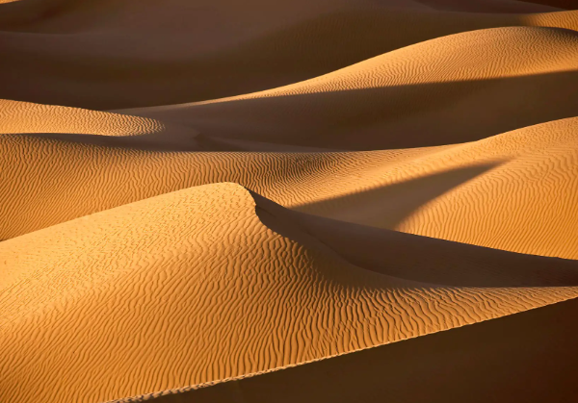
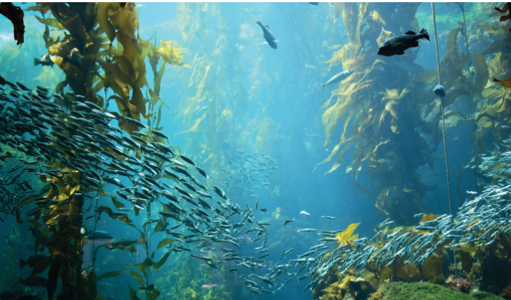
Activity 1:
Complete the table with the words in blue in the quiz.
Then compare your answers with a partner's
Land
Water
Valley
Sea
Cave
River
Rainforest
Falls
Beaches
Waves
Dunes
Ocean
Desert

Slide 6
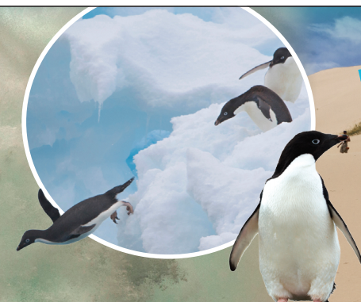
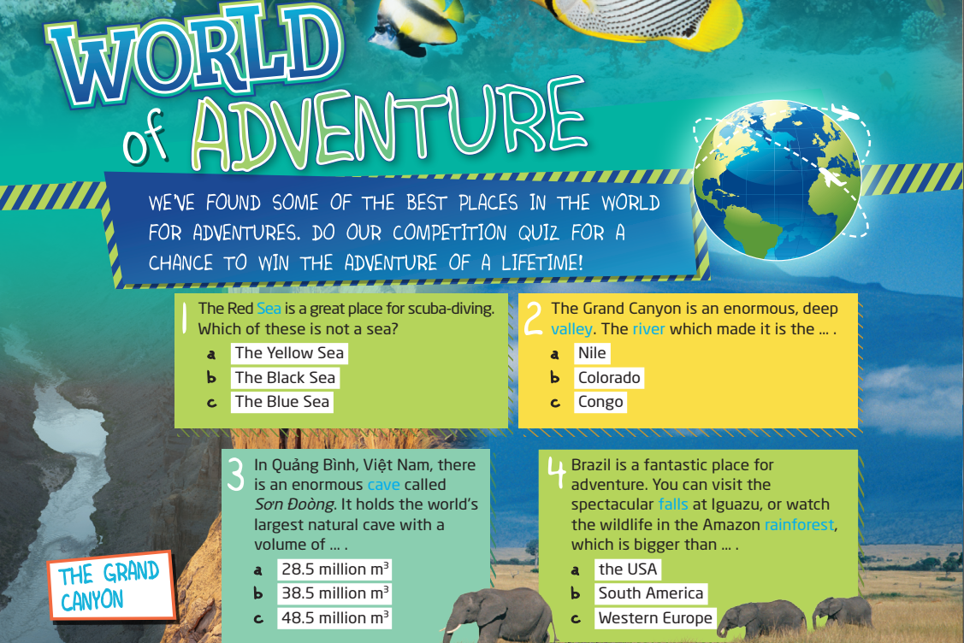
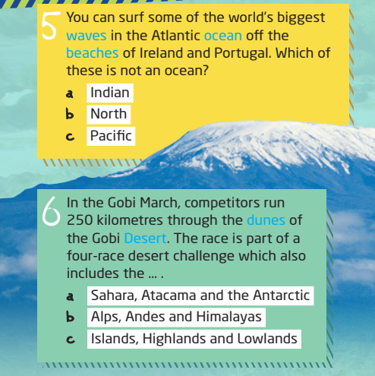
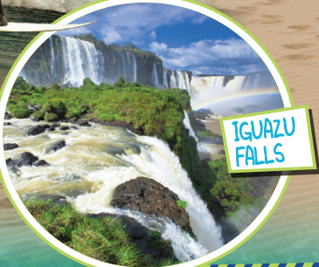
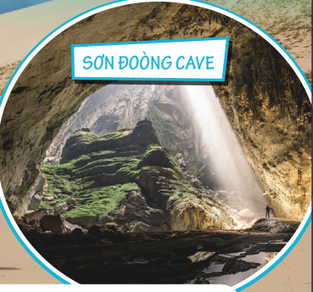
Activity 2: Do the quiz with a partner. Then listen and check your answers.

Slide 7


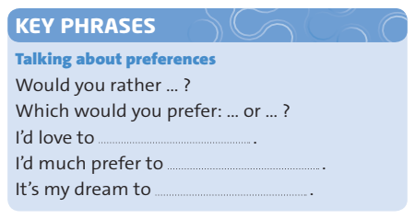

Activity 3:
Watch or listen to Max, Alicia and Elizabeth talking about places and activities.
What place would each person like to visit?
Speaker 1 (Max): The sea / beach Speaker 2 (Alicia): The Sahara Desert Speaker 3 (Elizabeth): A forest

Slide 8

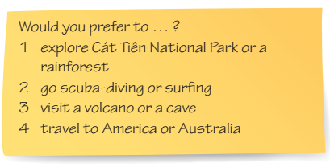
Activity 4: USE IT! Work in pairs. Ask and answer questions 1–4 using the key phrases.

Slide 9

HOME WORK
Learn by heart the vocabulary
Do the exercise in your student book

Slide 10


Thank you, class!

