Slide 2

Welcome to my English class
Notes:
Wellcome to my class.

Slide 3

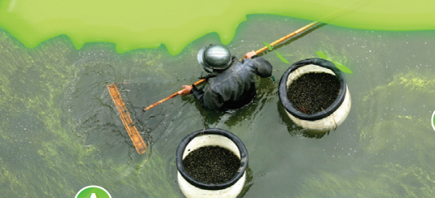
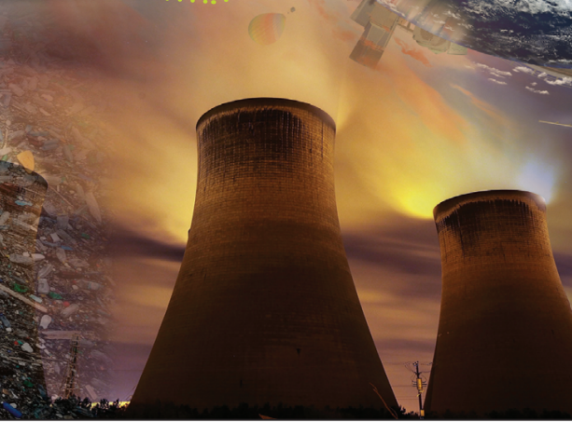
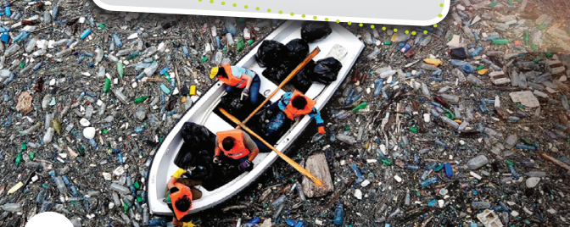
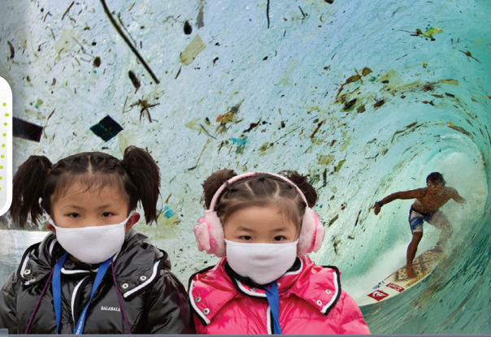
What types of pollution do the photos show? Can you think of three more problems in the world today?
Notes:
air pollution
Water pollution
soil pollution
Noise pollution

Slide 4
Unit 4: MATERIAL WORLD
Lesson 1:
VOCABULARY – The environment and consumerism
Notes:
thế giới vật chất
/kənˈsjuːmərɪzəm/ : chủ nghĩa tiêu thụ

Slide 5
New Words

Slide 6
to give something to somebody.
Provide (v) /prəˈvaɪd/:
→ Provision (n) /prəˈvɪʒn/
Notes:
Cug cấp
prəˈvɪʒn

Slide 7
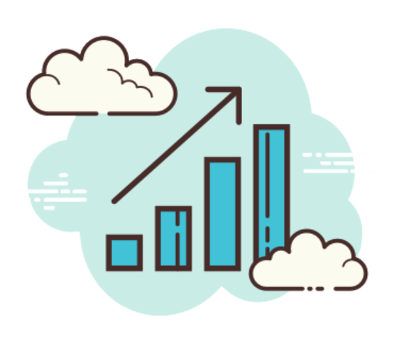
to gradually grow or become bigger, more advanced, stronger.
Develop (v) /dɪˈveləp/:
→ Development (n)
Notes:
Phat triển

Slide 8
Produce (v) /prəˈdjuːs/:
→ Product (n)
to make things to be sold, especially in large quantities.
Notes:
San xuat

Slide 9

Pollute (v) /pəˈluːt/:
→ Pollution (n) /pəˈluːʃn/
→ Pollutant (n) /pəˈluːtənt/
to make water, the air, or land dirty and not safe for people, animals, and plants.
Notes:
Gây ô nhiễm

Slide 10

Protect (v) /prəˈtekt/:
→ Protection (n)
to make sure that somebody/something is not harmed, injured, damaged

Slide 11
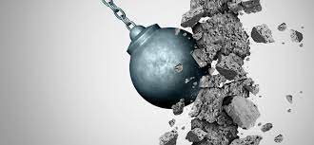
Destroy (v) /dɪˈstrɔɪ/:
Destruction (n) /dɪˈstrʌkʃn/
Destructive (adj) /dɪˈstrʌktɪv/
to damage something so badly that it no longer exists, works, etc.
Notes:
Tàn phá

Slide 12

to have enough money to be able to buy or do something.
Afford (v) /əˈfɔːd/:
→ can/ can’t afford to Vo
Notes:
Đủ khả năng chi trả

Slide 13
New Words
Provide (v)
→ Provide STH To SO
→ Provision (n)
Develop (v)
→ Development (n)
Produce (v)
Product (n)
Pollute (v)
→ (adj)
→ Pollution(n)
→ Pollutant (n)
Protect
→ Protection
Destroy (v)
→ Destruction (n)
→ Destructive (adj)
To afford

Slide 14


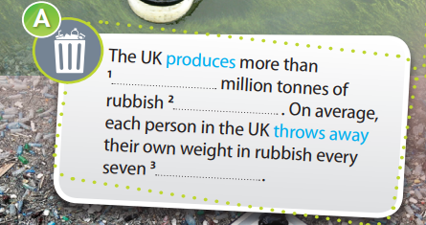
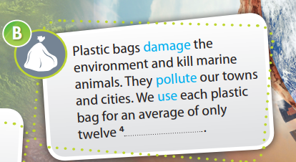
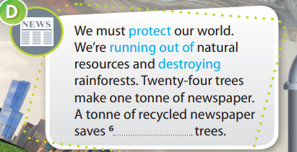
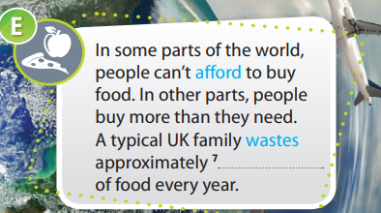
Notes:
Eco-intellect fact file: báo cáo về sự hiểu biết về hệ sinh thái

Slide 15
Words | Meaning
1. Provide | to give something to somebody.
2. Develop | to think of a new idea, product, etc. and make it successful.
3. Produce | to make something or bring something into existence.
4. Throw away | to get rid of something that you no longer want.
5. Damage | to have a bad effect on something/somebody.
6. Pollute | to make water, the air, or land dirty and not safe for people, animals, and plants.
7. Use | to do something with a machine, a method, etc. for a particular purpose.
8. Save | to keep somebody/something safe from death, harm, etc.
9. Recycle | to treat things that have already been used so that they can be used again.
10. Afford | to have enough money to buy something.
11. Waste | to not make good or full use of somebody/something.
12. Protect | to make sure that somebody/something is not harmed, damaged, etc.
13. Run out of | to use up or finish a supply of something.
14. Destroy | to damage something so badly that it no longer exists, works.
Notes:
Để meaning

Slide 16
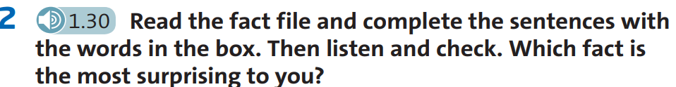


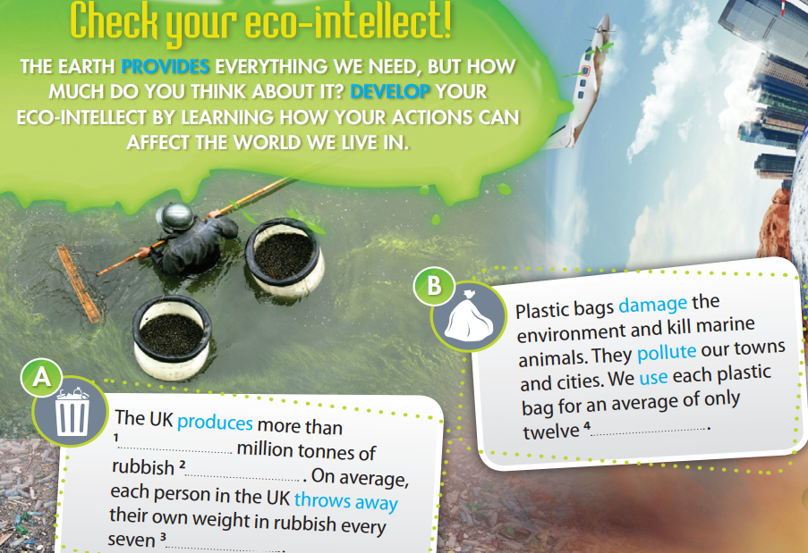
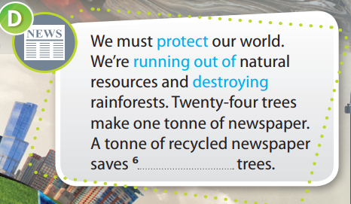
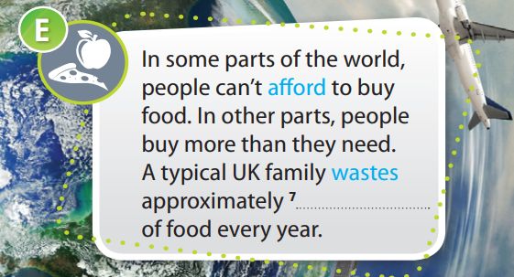
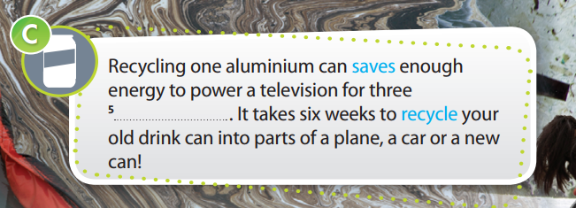
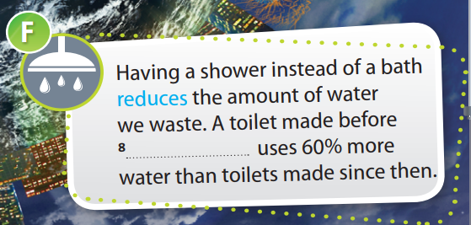
seventeen
minutes
100
every year
weeks
£700
hours
1993
Notes:
Chèn file nghehours

Slide 17

Watch or listen to four people talking about the environment. Which person is not concerned about the future of our planet? Why? Do you agree?
Yana | Mitchell | Paul | Will
people should buy less.
we should do something about pollution and climate change.
healthy food is too expensive.
isn’t worried about the environment because the Earth’s been around for a long time and the weather’s always changing.
‘That’s just the way things are.’

Slide 18
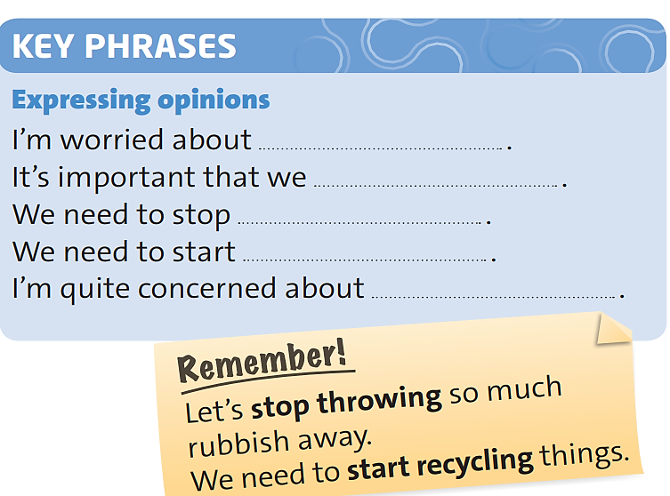

Slide 19

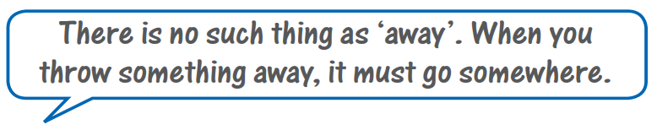
Work in groups. Read the quote and talk about whether you agree with it or not using the key phrases.
Notes:
Xem lại

Slide 20
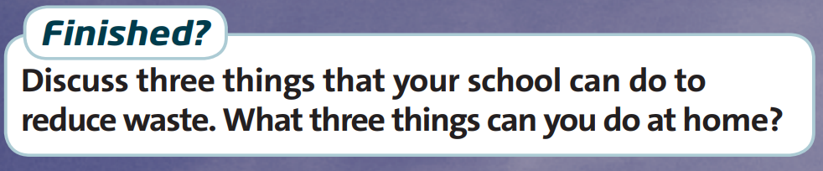
At school | At home
Donating books
Use a reusable bottle/cup
Use Less Paper
Buy Products with Minimal Packaging
Donate Old School Supplies
Use Reusable Bags Instead of Plastic Bags
Compost Cafeteria Leftovers/
Set up a compost
Stop Buying Plastic Bottles
Notes:
your school to encourage students to sort their materials. Keep bins for plastic, paper, and aluminum in your school so that students have a place to recycle these materials after they are finished with them.
This will allow you to reuse the dirt for gardening or landscaping purposes
ou can change this situation in your school by going for recycled paper and generally reducing the use of paper by students/ staff.

Slide 21
Homework
 Learn by heart all the new words.
 Prepare for the next lesson –Reading.

Slide 22
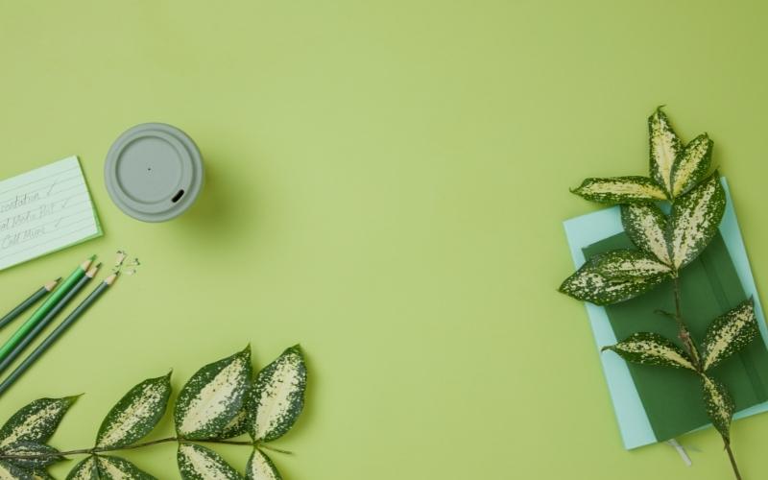

Thank You

