Slide 1


Slide 2


Unit 4: MATERIAL WORLD
Lesson 3:
LANGUAGE FOCUS – Quantifiers

Slide 3
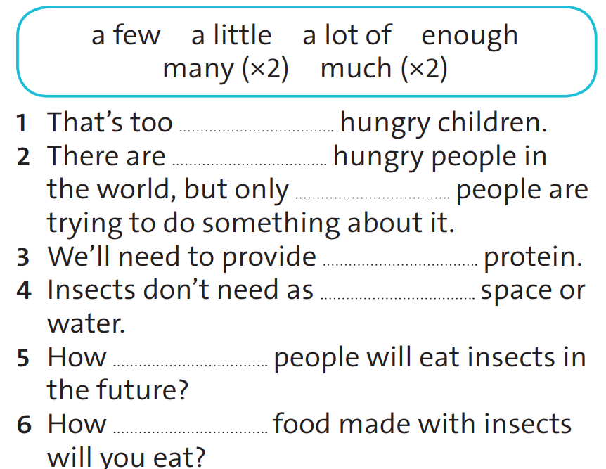
Exercise 1. Complete the sentences with the quantifiers in the box. There is one extra quantifier.
many
a lot of
a few
enough
much
many
much
Notes:
re

Slide 4
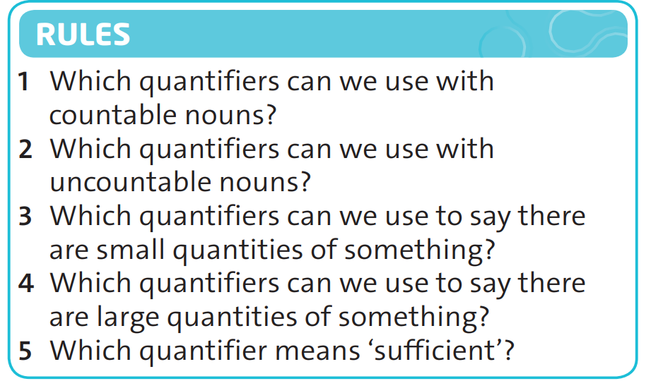
Exercise 2. Answer the questions in the rules with the words in exercise 1.
many, a few, a lot of, enough
enough, much, a little, a lot of
a few, a little
a lot of, much, many
enough

Slide 5
 | Many | Much | A lot of | A few | A little | Enough
Countable nouns | x |  | x | x |  | x
Uncountable nouns |  | x | x |  | x | x
Small quantities |  |  |  | x | x
Large quantities | x | x | x
Sufficient |  |  |  |  |  | x

Slide 6
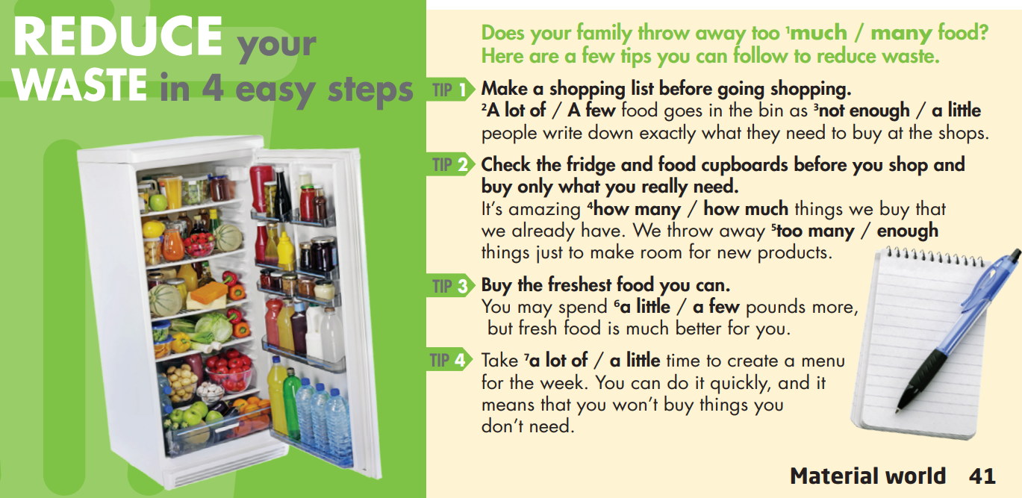
Exercise 3. Read the tips for reducing waste. Then choose the correct options.

Slide 7
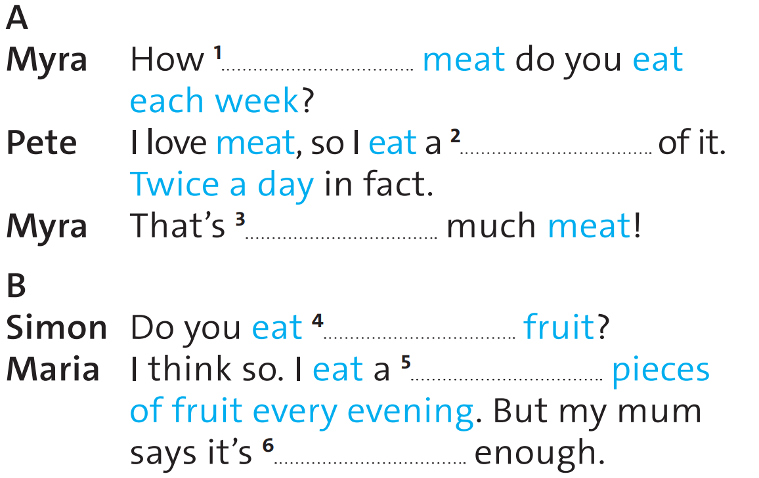
Exercise 4. Complete the dialogues.
much
lot
too
enough
few
not

Slide 8

Exercise 5. Use IT! Use the dialogues in exercise 4, replace the words in blue with the words in the box and a time phrase.
Myra: How much meat do you eat each week?
Pete: I love meat, so I eat a lot of it. Twice a day in fact.
Myra: That’s too much meat!
Myra: How much milk do you drink each week?
Pete: I love milk, so I drink a lot of it. Six times a day in fact.
Myra: That’s too much milk!

Slide 9

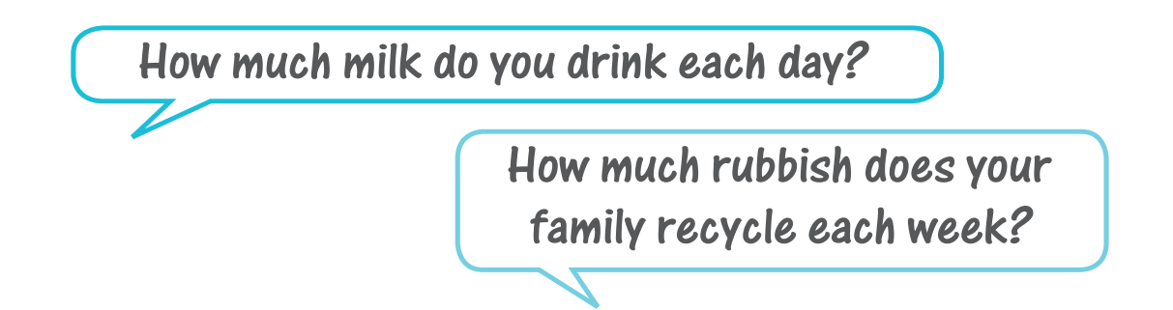
Write some rules for your class about how everyone can help reduce waste. Use quantifiers wherever possible.

Slide 10
Homework
 Learn by heart all structures.
 Prepare for the next lesson.

Slide 11


Thank You!

