Slide 1


Slide 2

Unit 4: MATERIAL WORLD
Lesson 7:
WRITING
A product review

Slide 3

Where can you read product reviews? Do you read or write them? Why / Why not?
- What products do you read reviews of?
- What information do they contain?
- How can they help you decide whether to buy something or not?
- Are reviews sometimes wrong?

Slide 4
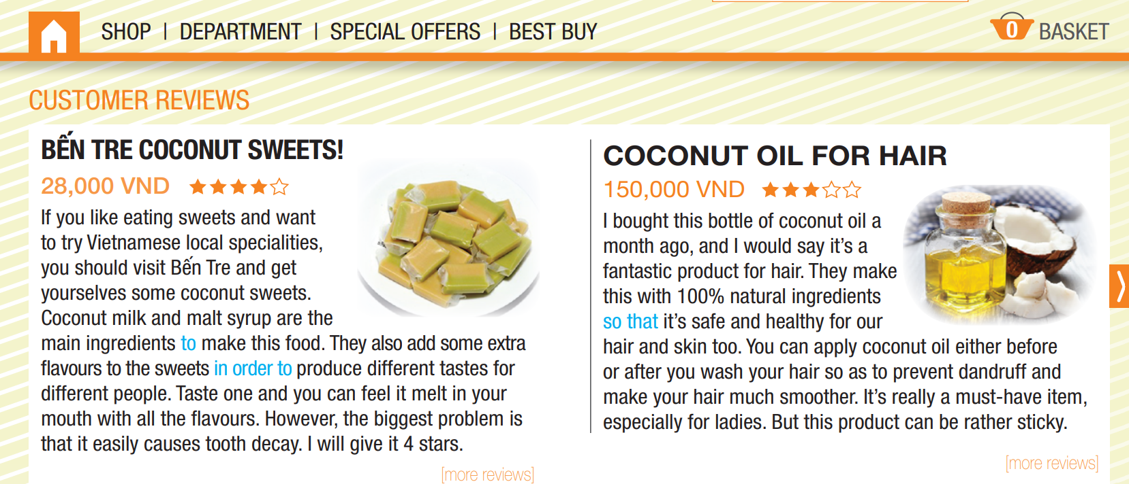
Exercise 1. Read the product reviews. What things are good about each product? What things are bad about each product?

Slide 5
Exercise 1. Read the product reviews. What things are good about each product? What things are bad about each product?
Good:
+ Coconut sweets have different tastes and flavours for different people.
+ Coconut oil made from natural ingredients is safe for hair and skin. It prevents dandruff and makes hair much smoother.
Bad:
+ Coconut sweets cause tooth decay.
+ Coconut oil is rather sticky.

Slide 6
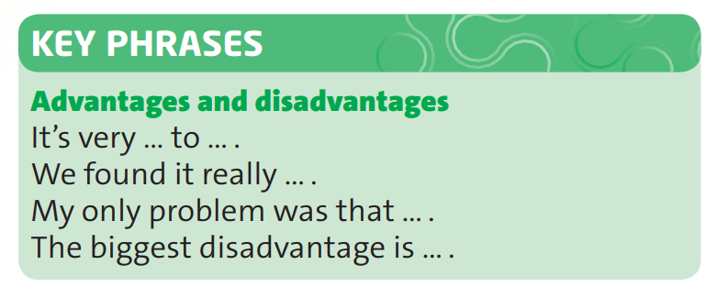
Exercise 2. Work in pairs. Think of something you have bought recently and use the key phrases to talk about its advantages and disadvantages.
Notes:
Cho thêm ví dụ

Slide 7
Language point: Clauses of purpose

Slide 8
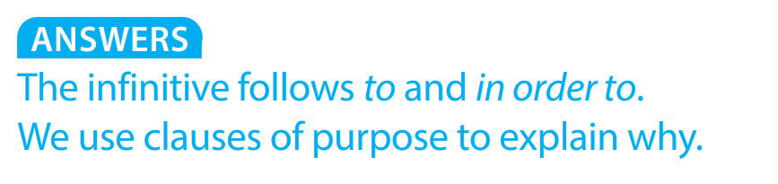
Exercise 3. Find the words in blue in the two reviews. What form of the verb follows to and in order to? When do we use clauses of purpose?
Notes:
1.34

Slide 9
Exercise 4. Complete the sentences with clauses of purpose and your own ideas.
1. I went to town …………………………………………………………...
2. She studied hard……………………………………………………………
so that I didn’t get lost.
in order to pass the exam.

Slide 10

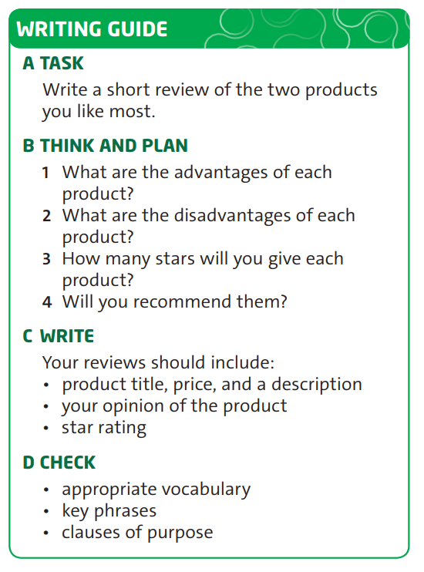
Exercise 5. Follow the steps in the Writing Guide.

Slide 11
Homework
 Learn by heart all the grammar points.
 Prepare for the next lesson: Unit 5: Years ahead – Vocabulary: Uses of get

Slide 12

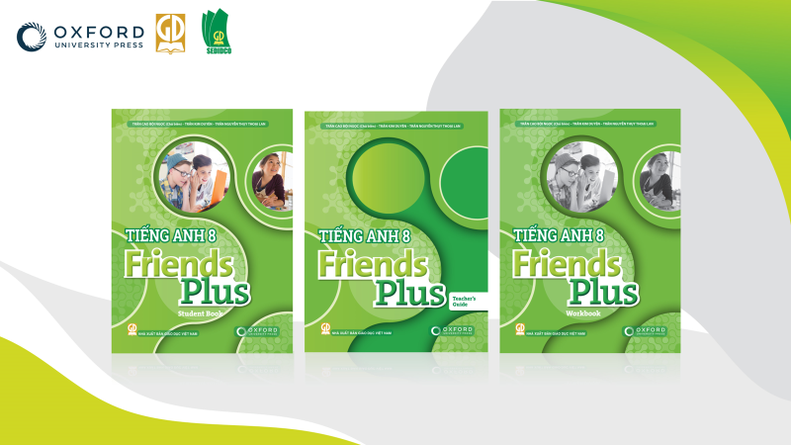
Thank You!

