Slide 1


Slide 2
Unit 5:
YEARS AHEAD
Language Focus

Slide 3

• WILL AND BE GOING TO
• FUTURE CONTINUOUS
I can talk about what I will be doing in the future.

Slide 4

Noughts and crosses

Slide 5


Settle down
Tie oneself down
Retire young
Enjoy oneself
Waste time
Look after yourself
Get involved with a charity
Take some time out
Take up a sport
Make the sentences with the words:
Ex: When will you settle down?

Slide 6
What are you going to do after this class?
I’m going to have lunch.
Yes, I will.
Will you get married one day?

Slide 7
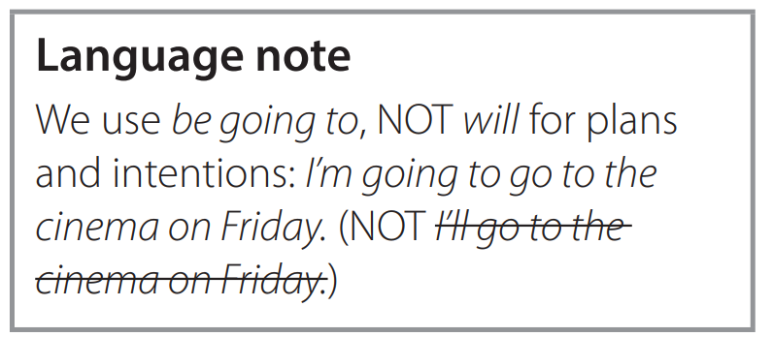
Exercise 1. Complete the sentences from the online forum on page 54. Which sentence refers to a general prediction and which refers to a definite plan or intention?
a I’m ______________ start up my own business.
b_________________ retire young.
going to
I’ll
Sentence b refers to a general prediction.
Sentence a refers to a definite plan or intention.

Slide 8
Exercise 1. Complete the sentences from the online forum on page 54. Which sentence refers to a general prediction and which refers to a definite plan or intention?
a I’m ______________ start up my own business.
b_________________ retire young.
going to
Sentence a refers to a definite plan or intention.
I’ll
Sentence b refers to a general prediction.

Slide 9
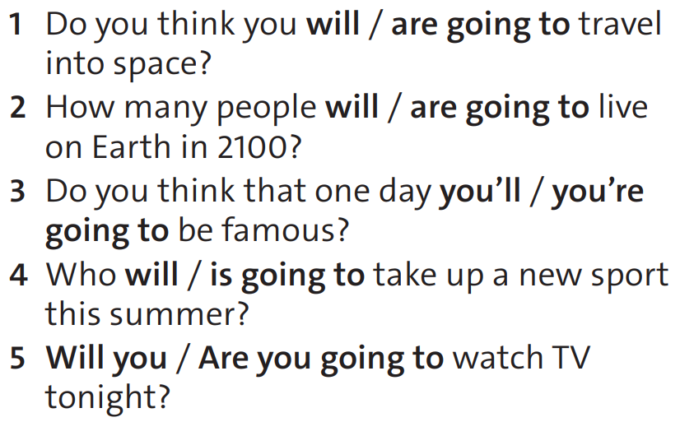
Exercise 2. Choose the correct options. Then ask and answer the questions with a partner.

Slide 10
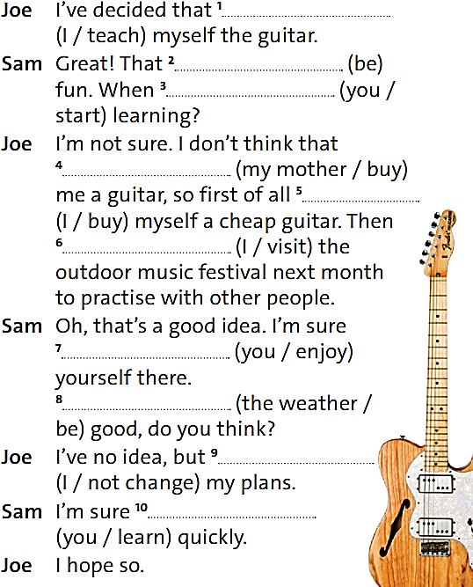
Exercise 3. Complete the dialogue with the correct form of will and be going to and the verbs in brackets.

Slide 11
Exercise 3. Complete the dialogue with the correct form of will and be going to and the verbs in brackets.
I’m going to teach
will be / ’ll be
will you/ are you going to start
my mother will buy
I’m going to buy
I’m going to visit

Slide 12
Exercise 3. Complete the dialogue with the correct form of will and be going to and the verbs in brackets.
you’ll enjoy
Will the weather be
I’m not going to change
you’ll learn

Slide 13
Rewrite the following sentences:
1. She intends to visit her grandmother this weekend.
going to visit her grandmother this weekend.
→She is……………………………………………………….
2. They intend to build a new bridge in this area.
going to build a new bridge in this area.
→They are ……………………………………………………….

Slide 14
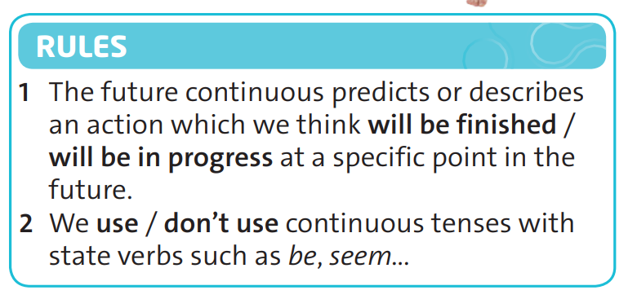
Exercise 4. Study the sentence from the online forum on page 54. Then choose the correct options in the rules.
In two years, I hope that I’ll be doing my black belt and I’ll be happy.
NOT I’ll be being happy.

Slide 15
Exercise 5. Order the words to make sentences. There is one extra word in each sentence.
1 watching TV / you / be / will / been / this time tomorrow / ?
2 the match / won’t / don’t / we / be / watching / on Sunday
3 will / staying / you / are / in a hotel / be / this time next week / ?
4 studying here / I / be / won’t / to / when I’m older
5 humans / living / live / be / will / in the future / on Mars / ?

Slide 16
Exercise 5. Order the words to make sentences. There is one extra word in each sentence.
1 watching TV / you / be / will / been / this time tomorrow / ?
2 the match / won’t / don’t / we / be / watching / on Sunday
3 will / staying / you / are / in a hotel / be / this time next week / ?
Will you be watching TV this time tomorrow? (been)
We won’t be watching the match on Sunday. (don’t)
Will you be staying in a hotel this time next week? (are)

Slide 17
Exercise 5. Order the words to make sentences. There is one extra word in each sentence.
4 studying here / I / be / won’t / to / when I’m older
5 humans / living / live / be / will / in the future / on Mars / ?
I won’t be studying here when I’m older. (to)
Will humans be living on Mars in the future? (live)

Slide 18

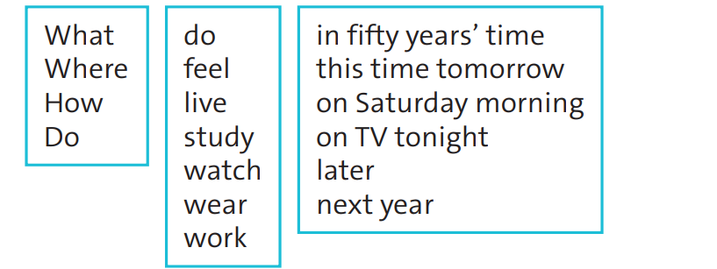

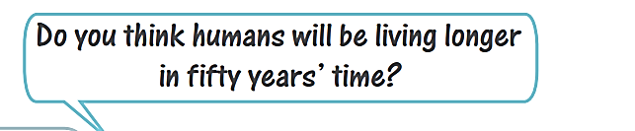
Exercise 6. Work in pairs using the future continuous and words from the boxes. Ask and answer the questions about your future.

Slide 19
Exercise 6. Work in pairs using the future continuous and words from the boxes. Ask and answer the questions about your future.
Where will you be living in fifty years’ time?
I think I will be living in another city in fifty years’ time.

Slide 20


Finished?
Write what you’ll be doing in ten years’ time.
I will be studying in a university ten years later. I might be living in the dormitory. I’m sure that I won’t be studying Medicine because I don’t like Chemistry. I love helping people, so I think I will be joining a charity group.

Slide 21
Homework
 Learn by heart all the grammar points.
Prepare for the next lesson:
Unit 5 (cont.): Speaking – Making arrangements (Key phrases to talk about plans, new words)

