Slide 1
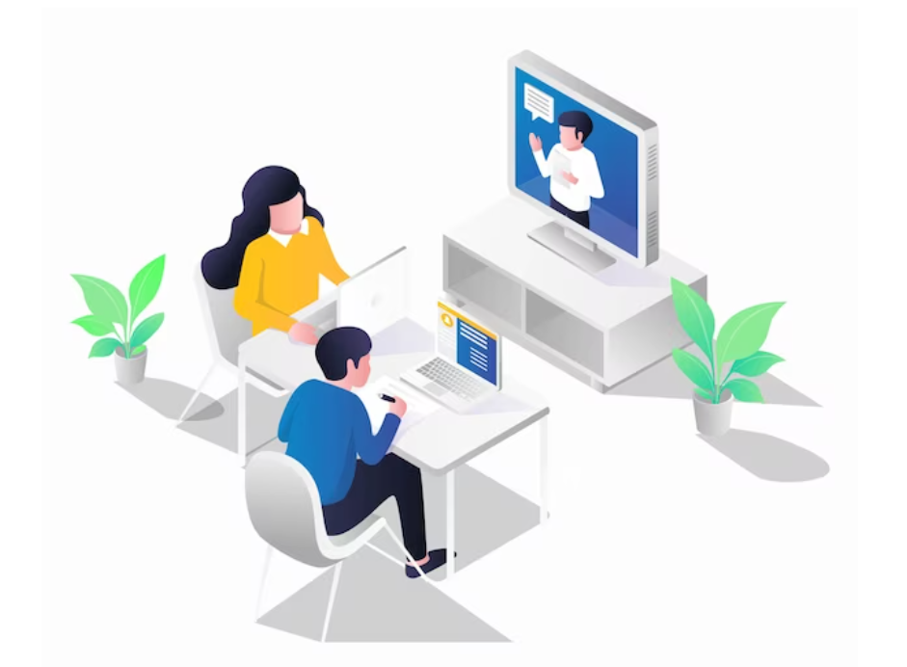
Welcome
let's get started

Slide 2

Unit 2
Sensation
Speaking Planning Free Time
I can discuss ideas about how to spend free time
Teacher: Ms. Quin

Slide 3

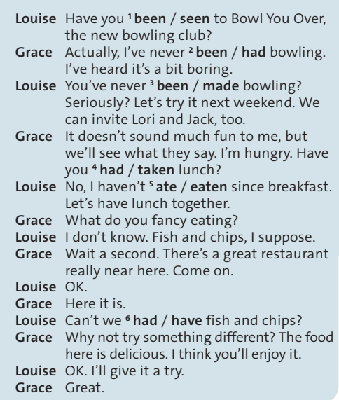
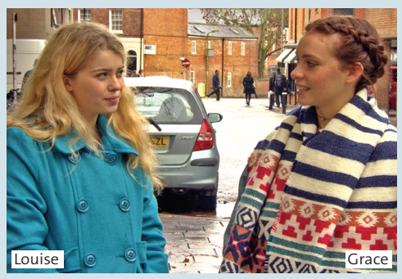
Activity 1:
Choose the correct words in the dialogue. Let’s watch a scary film after school.
Then watch or listen and check
What does Louise want to do next weekend?
Louise wants to go bowling
Where does Grace suggest going for lunch?
Grace suggests a great restaurant near here.
Notes:
Eating a delicious meal, listening to music, watching a movie, or performing everyday activities such as walking or engaging in conversation with friends – all these activities rely on the mechanisms of our senses. Our senses allow us to connect to the world around us, perceive our environment, and interact with other people.

Slide 4
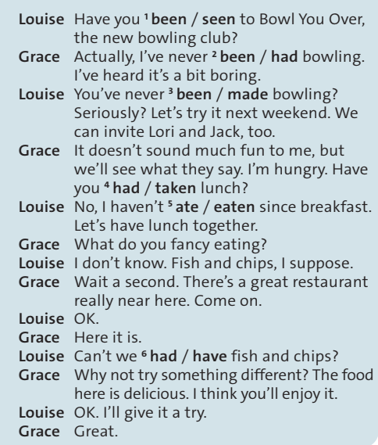
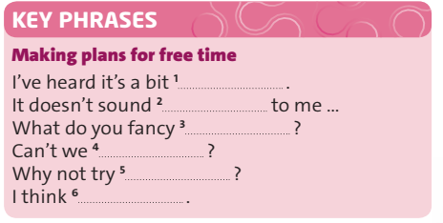
Activity 2:
Cover the dialogue and complete the Key Phrases. Watch or listen again and check.
boring
much fun
eating
have fish and chips
something different
you’ll enjoy it
Notes:
Eating a delicious meal, listening to music, watching a movie, or performing everyday activities such as walking or engaging in conversation with friends – all these activities rely on the mechanisms of our senses. Our senses allow us to connect to the world around us, perceive our environment, and interact with other people.

Slide 5


Activity 3:
Practise the dialogue with your partner.
Louise: Have you been to Bowl You Over, the new bowling club?
Grace: Actually, I’ve never been bowling. I’ve heard it’s a bit boring.
Louise: You’ve never been bowling? Seriously?
Let’s try it next weekend. We can invite Lori and Jack, too.
Grace: It doesn’t sound much fun to me, but we’ll see what they say. I’m hungry.
Have you had lunch?
Louise: No, I haven’t eaten since breakfast.
Let’s have lunch together.
Grace: What do you fancy eating?
Louise: I don’t know. Fish and chips, I suppose.
Grace: Wait a second. There’s a great restaurant really near here. Come on.
Louise: OK.
Grace: Here it is.
Louise: Can’t we 6 have fish and chips?
Grace: Why not try something different? The food here is delicious.
I think you’ll enjoy it.
Louise: OK. I’ll give it a try.
Grace: Great.
Notes:
Have you ever touched a weird or fascinating animal? What was it like? 2 3 Have you ever felt totally exhausted? Why? 3 1 Name the two most delicious and the two most disgusting things that you’ve ever eaten.

Slide 6

Activity 4:
PRONUNCIATION:
Stress for emphasis. Listen and repeat the sentences. Which sentence has more stressed words? Why?
Have you been to Bowl You Over?
You’ve never been bowling? Seriously?
The second question has more stressed words
because Louise is surprised, and we use stress to express surprise.

Slide 7
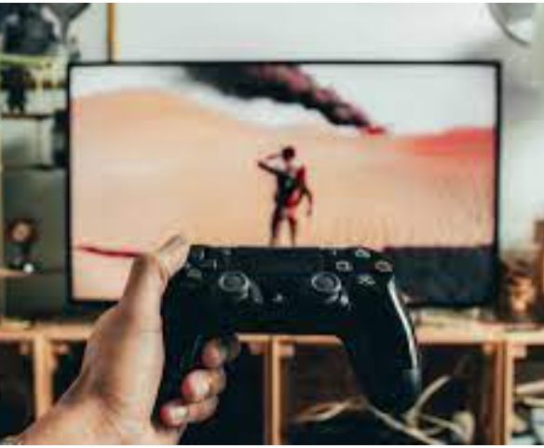


Activity 5:
Work in pairs. Read situations 1–3.
Take turns to suggest doing something after school. Use the key phrases.
watch a scary film
go for a bicycle ride
play a video game

Slide 8
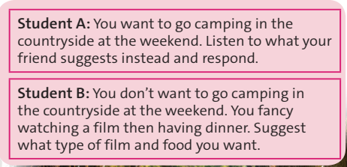


Activity 6:
USe IT! Work in pairs. Read the situation. Then prepare and practise a new dialogue.
Use the key phrases and the dialogue in exercise 1 to help you.

Slide 9

HOMEWORK
Learn the new words
Do the exercises in your workbook

Slide 10

See you
next lesson

