Slide 1

Welcome all participants

Slide 2
CROSSWORDS
1
S | W | I | M | M | I | N | G
2
P | I | C | N | I | C
3
S | H | R | I | N | E
4
H | E | R | O
KEY WORD
W | I | S | H

Slide 3

swimming
He often goes ___________ on weekends.

Slide 4
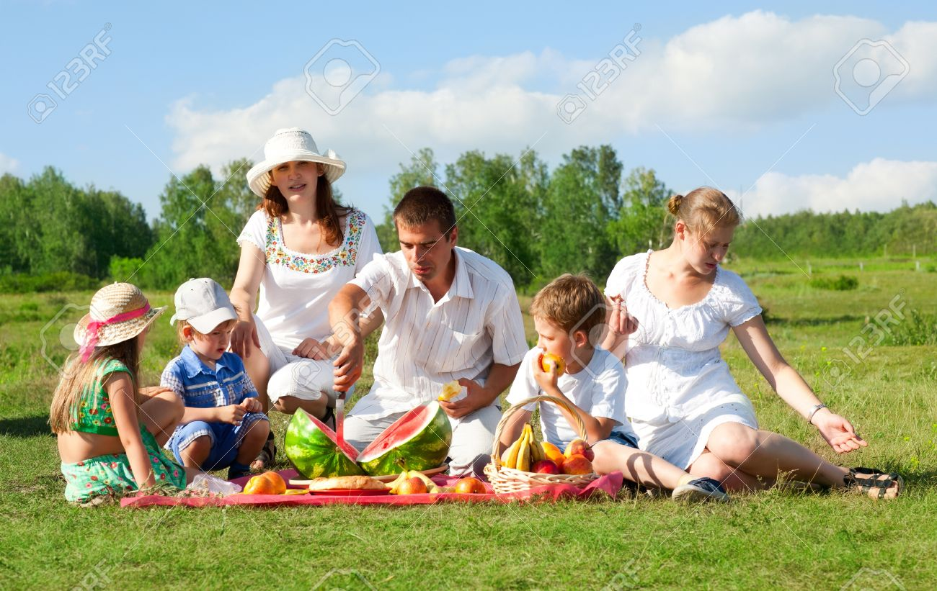
They are having a ____________ .
picnic

Slide 5
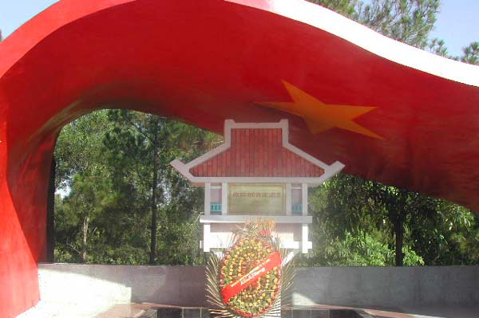
shrine

Slide 6
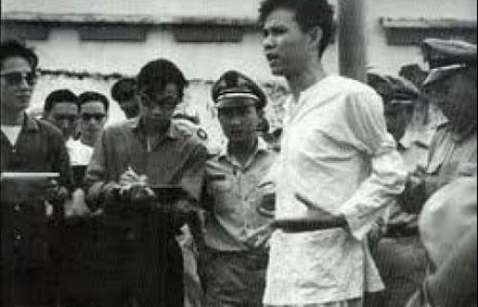
Nguyen Van Troi
hero

Slide 7

Unit 3:
A TRIP TO THE COUNTRYSIDE
LANGUAGE FOCUS

Slide 8
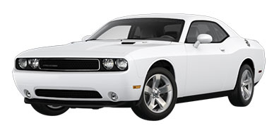

Slide 9
The Past Simple with “wish”
→ Talking about present wishes
Ex: I wish I had a car.
S₁ + wish + S₂ + Past Simple
be →were
be + not → weren’t
V → V₂/V_{ed}
V + not → didn’t + V(bf)
can → could

Slide 10


Slide 11

2. Modals “could/ would” with “wish”
→ Talking about future wishes
Ex: He wishes he could ride a bike some day.
Ex: She wishes she would be a doctor when she grows up.
S₁ + wish + S₂+ could/ would + V(base form)

Slide 12
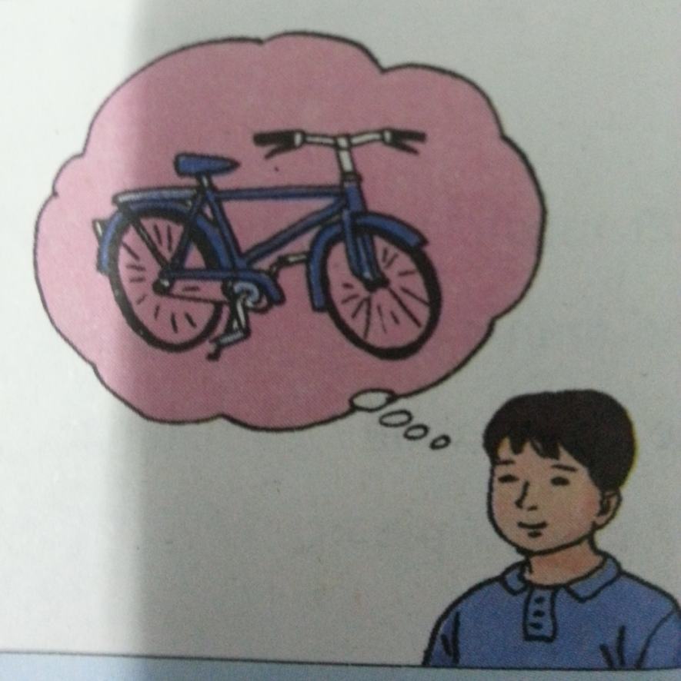
What do these people wish? Write the sentences.
a. Ba/ can have/ new bicycle
→ Ba wishes he could have a new bicycle.

Slide 13
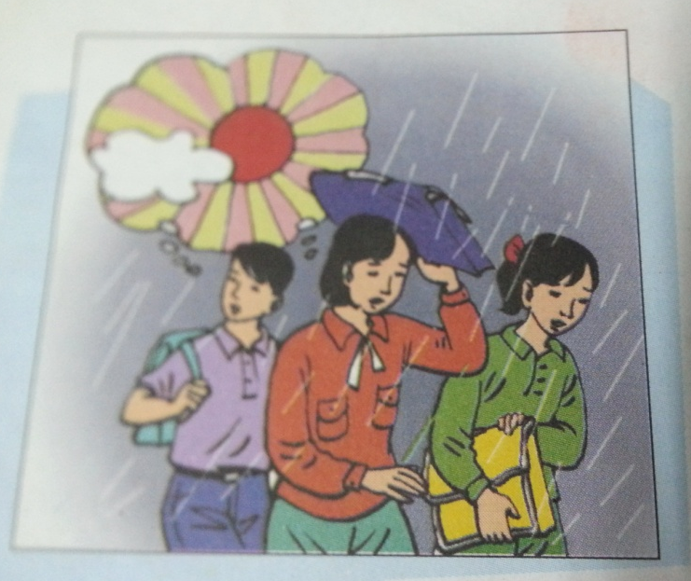
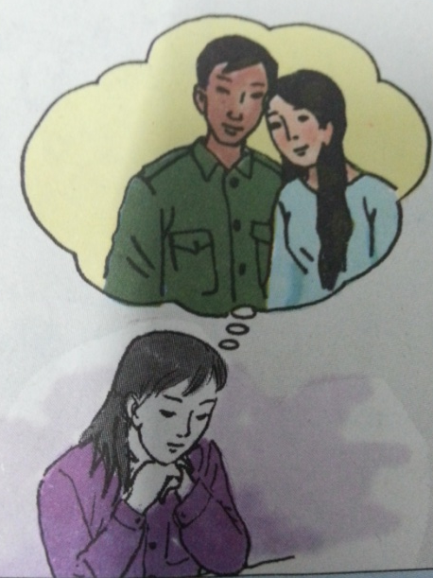
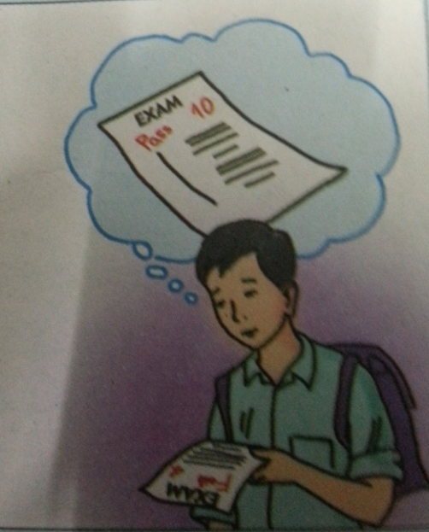
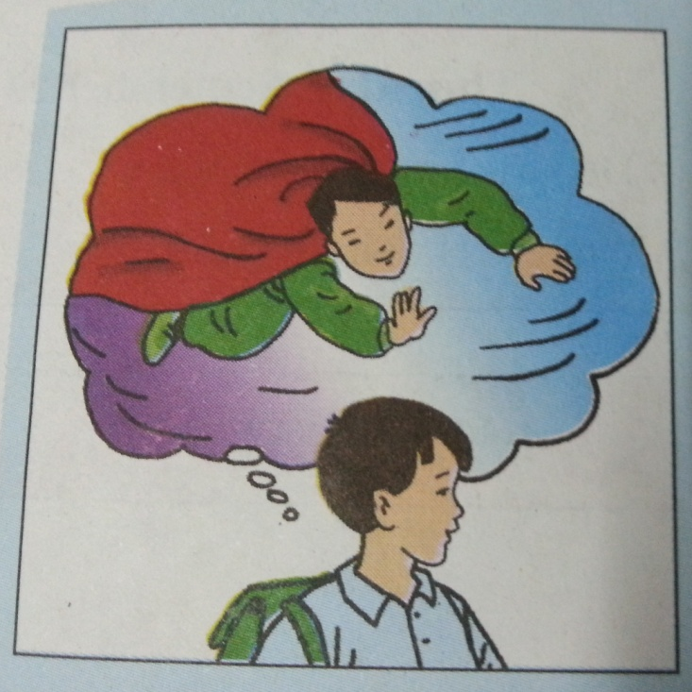
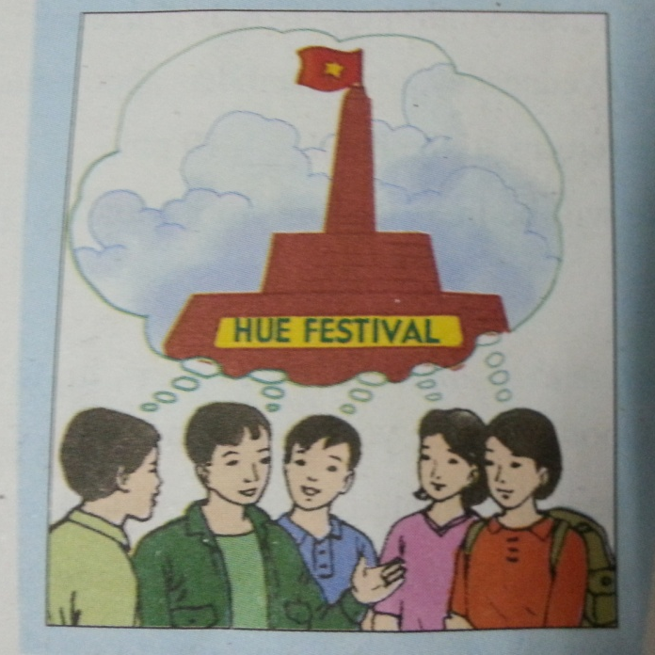
b/
c/
d/
e/
f/

Slide 14
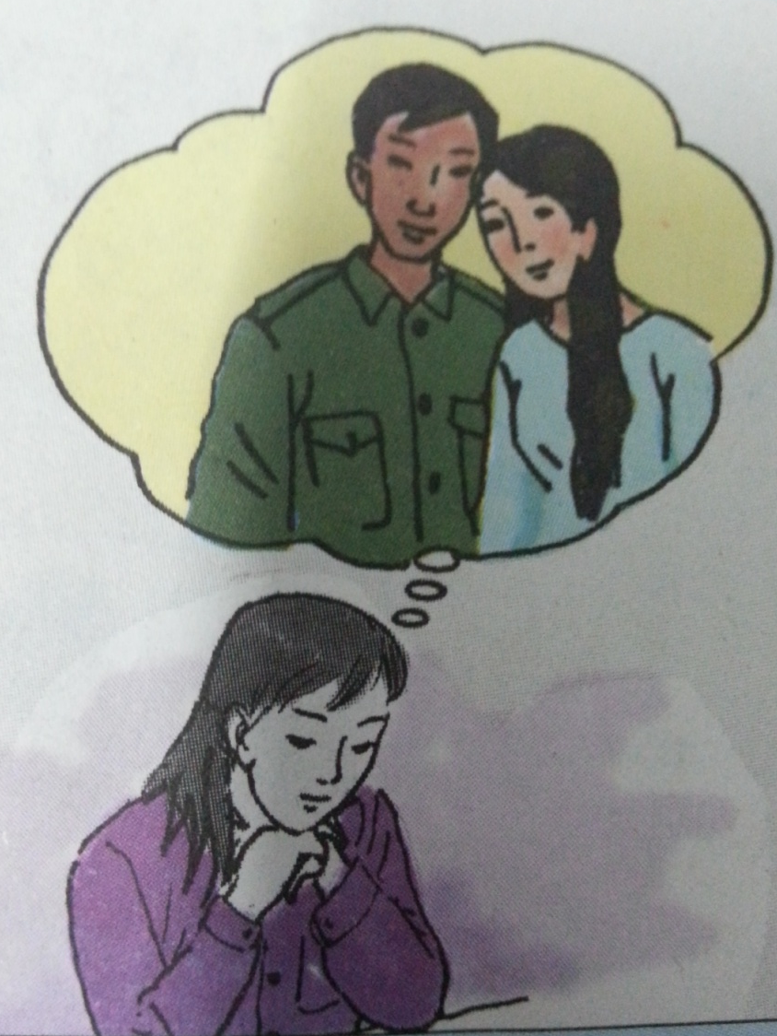
b. Hoa / can visit/ parents
→Hoa wishes she could visit her parents.

Slide 15
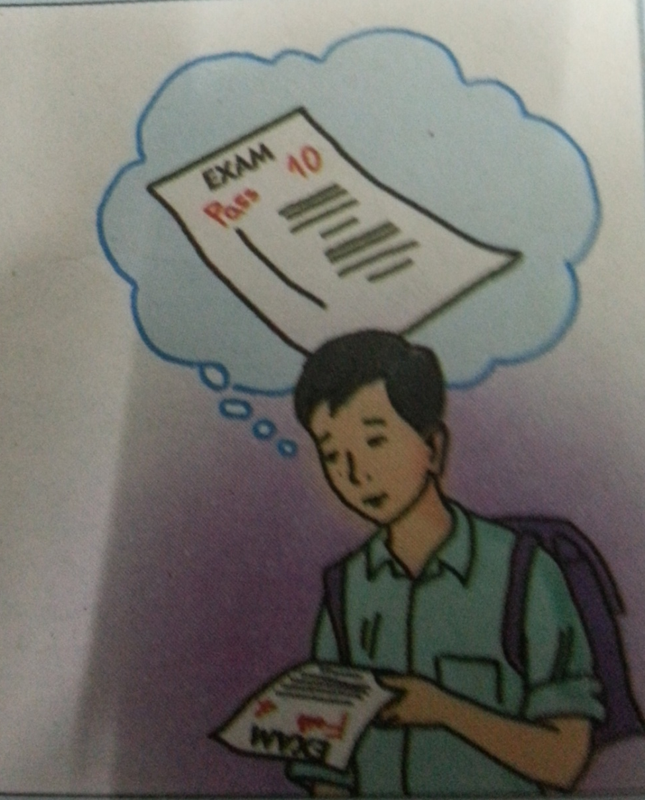
c. I / pass/ exam
→I wish I passed the exam.

Slide 16

d. We/ it/ not rain
→We wish it didn’t rain.

Slide 17

e. He/ can fly
→He wishes he could fly.

Slide 18

f. They/ stay/ Hue
→They wish they stayed in Hue.

Slide 19
Rewrite the following sentences.
It’s a pity. I don’t know her address.
→ I wish _________________________
2. What a pity! Susan isn’t here.
→ I wish _________________________
3. I’m sorry I can’t play the piano.
→ I wish _________________________
4. We’re sorry the weather will be bad tomorrow.
→ We wish _________________________
I knew her address.
Susan was/ were here.
I could play the piano.
the weather would be fine tomorrow.

Slide 20

What do you wish?
I wish…..
Work in pairs.

Slide 21
Brainstorming

Slide 22
Prepositions of time
STOP!
1
2
3
4
5
6
7
8
9
10
11
12
13
14
15
16
17
18
19
20
21
22
23
24
25
26
27
28
29
30
31
32
33
34
35
36
37
38
39
40
41
42
43
44
45
46
47
48
49
50
51
52
53
54
55
56
57
58
59
60

Slide 23
3. PREPOSITIONS OF TIME
in
+ year/ month/ season/ century/the morning/afternoon/evening...
Ex: in 2000 ; in May; in the summer; in the 21st century; in the morning
on
+ day/ date/ weekends…
Ex: on Sunday; on May 7; on May 7, 2000; on weekends; on Christmas Day

Slide 24
at
+ time /night/ noon/weekends…
Ex: at 10:30, at night, at noon, at weekends, at Christmas
Notes:
- before/ after 10:30
- between 7:30 and 10:30
- from 7:30 to/ up to 10:30
- till/ until 10:30
- for 2 hours
- since 2 o’clock

Slide 25
Work with a partner.
Look at Mr. Thanh’ s itinerary for his business trip to Singapore.
Itinerary for Le Huy Thanh
Monday, September 20 Depart: Ha Noi/ 2 pm Arrive: Singapore/ 6.30 pm | Wednesday, September 22 MEETING Raya Palace / 2.15 -7 pm DINNER Little India Restaurant / 7.30 -10 pm
Tuesday, September 21 MEETING Raffles Center/ 11 am – 1 pm LUNCH Lion City Restaurant/ 1.30 – 2 pm | Thursday, September 23 Depart: Singapore / 9 am Arrive: Ha Noi / 11.30 am

Slide 26
at till on after up to between
Complete the sentences. Use the prepositions in the box.
at
a/ Mr. Thanh leaves Ha Noi ______ 2 pm.
on
b/ He arrives in Singapore _____ Monday evening.
c/ On Tuesday morning, there is a meeting ______________ 11 am and 1pm.
between
d/ On Wednesday, Mr. Thanh has appointments ________ 10 pm.
till
after
e/ He returns to the hotel _________ 10 pm.
up to
f/ He will be in Singapore from Monday ______ Thursday.

Slide 27
Complete the sentences with on, at, in, for
on
a/ Goodbye! See you _________ Monday.
b/ The bus collected us _______ 5 o’clock early _______ the morning.
c/ We usually go to our home village at least once ______the summer.
d/ We walked ______ half an hour to reach the waterfall.
e/ They planned to have the trip _____ June.
f/ She loves to watch the stars _____ night.
at
in
in
for
in
at

Slide 28
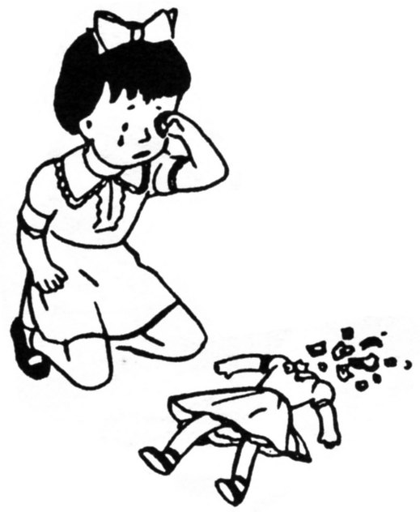

Slide 29
4. Adverb Clauses of Result:
Ex: Her doll is broken, so she is crying.
Adverb Clause of Result

Slide 30
Match the half- sentences. Then write the full sentences.
Hoa worked hard, …
It was hot, …
Nga is sick today, …
Na woke up late, …
The new camera didn’t work,…
so I turned on the air conditioner.
so she didn’t have time for breakfast.
so Mrs. Robinson took it back to the shop.
so she won’t go to school.
so she passed her exam.
1-e Hoa worked hard, so she passed her exam.

Slide 31
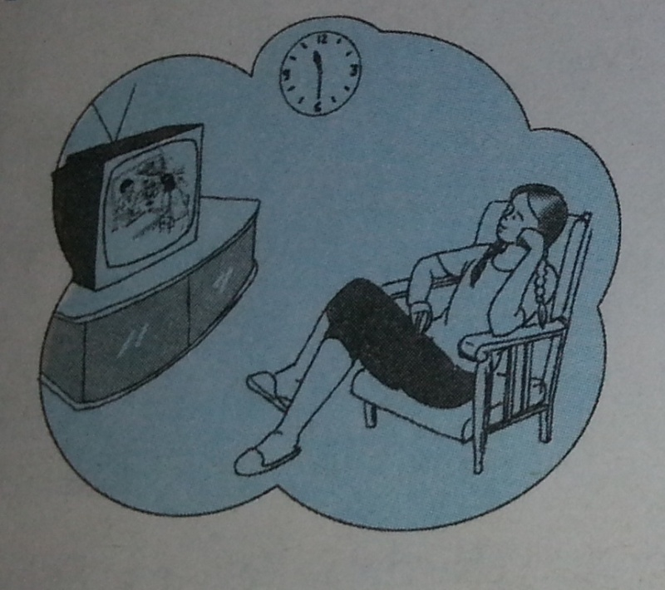
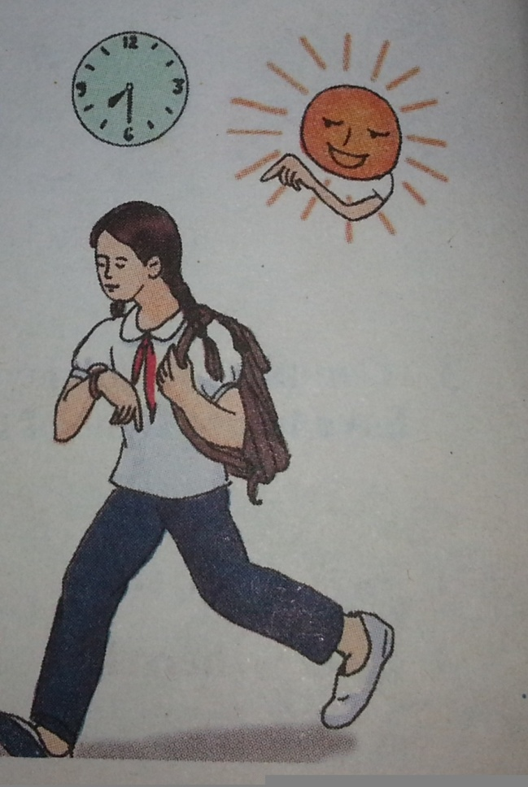
Hoa
Hoa watched TV late last night, so she went to school late this morning.

Slide 32
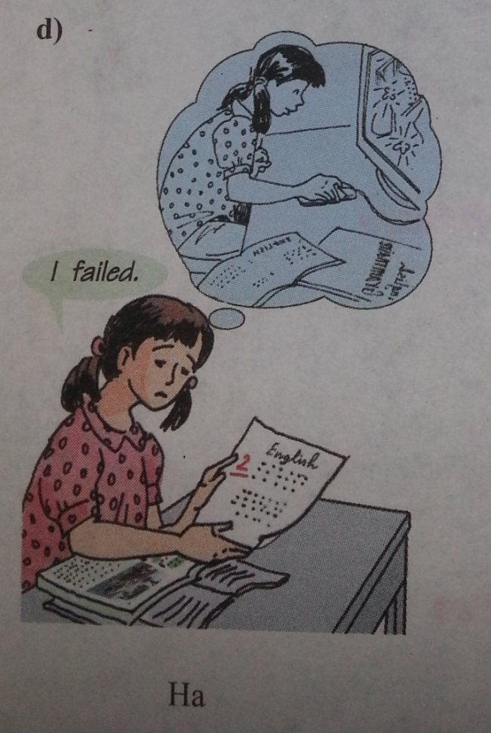
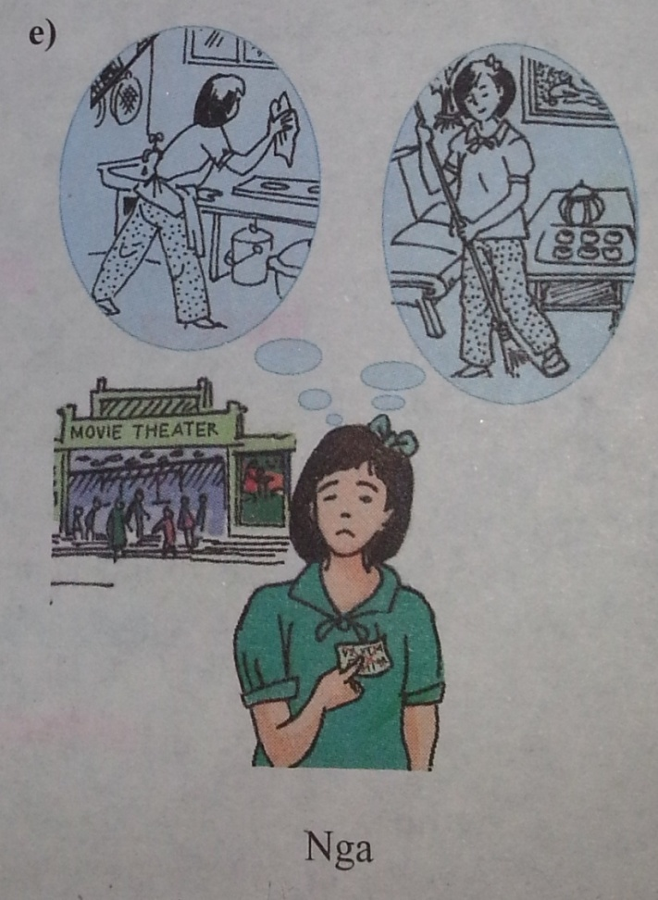
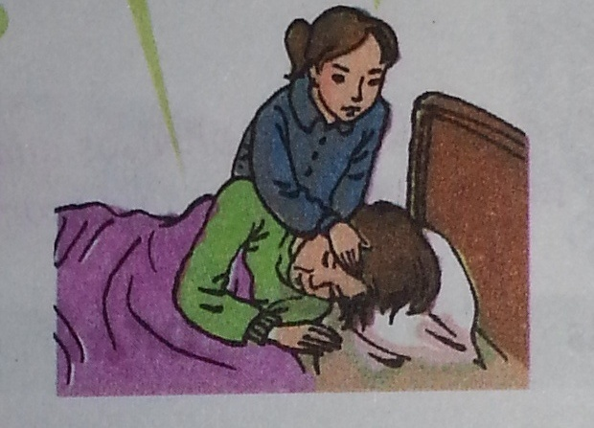
Ha
Nga
Mrs. Lien

Slide 33

Ha
Ha played the computer games too much, so she failed the English exam.

Slide 34

Nga
Nga had to do her chores, so she didn’t go to the movies.

Slide 35
Mrs. Lien
Mrs. Lien is sick, so she has to stay in bed.

Slide 36

Who is the winner?

Slide 37
Let’s write.
Group A: write the first clause (main clause).
Group B: write the second clause (adverb clause of result)

Slide 38
Homework
Review Vocabulary and Remember of unit 3.
Prepare Unit 4- Learning a foreign language (Getting started- Listen and read).
new words
reported speech

Slide 39
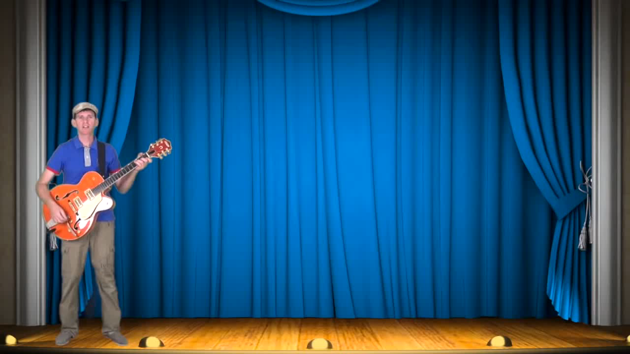

Slide 40

Thanks for joining us.

