Slide 1
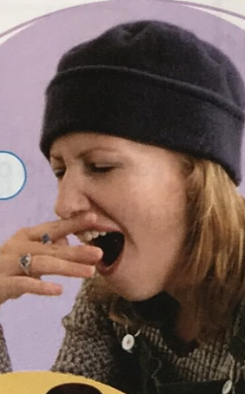
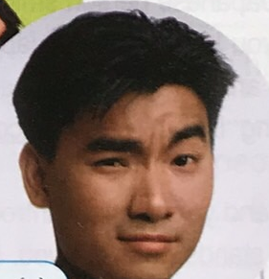
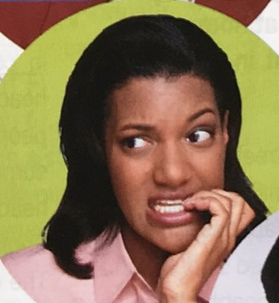
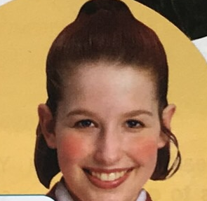
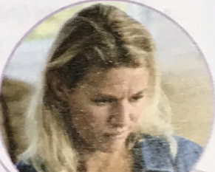
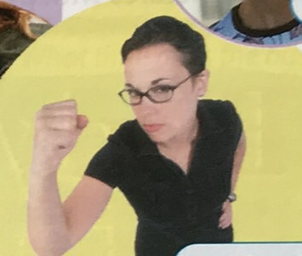
G
E
S
T
U
R
E
S

Slide 2

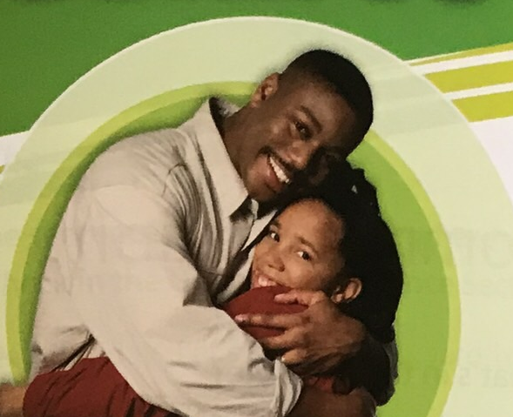
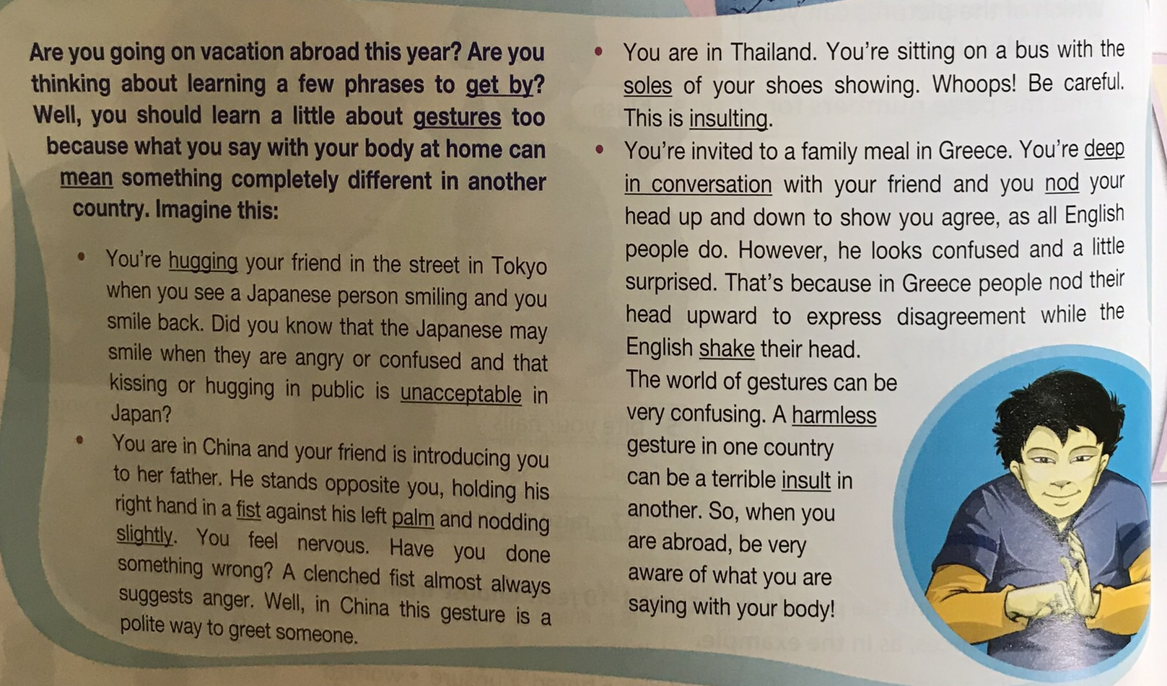
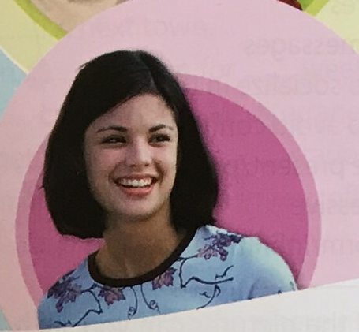

Do gestures suggest the same feelings throughout the world? Listen and read to find out.
Label the pictures with phrases from the text .

Slide 3

says “no”
we use gestures.
To greet someone in China, ______________________________
_________________________________
While travelling abroad, we should be careful how ______________
If the Greek nods his head, he ____________________________
insulted
you hold your right hands in a fist against
your left palm and nod slightly.
If the Thai sees the soles of your shoes showing, he will be ________
The Japanese person can be insulted if _____________________

Slide 4
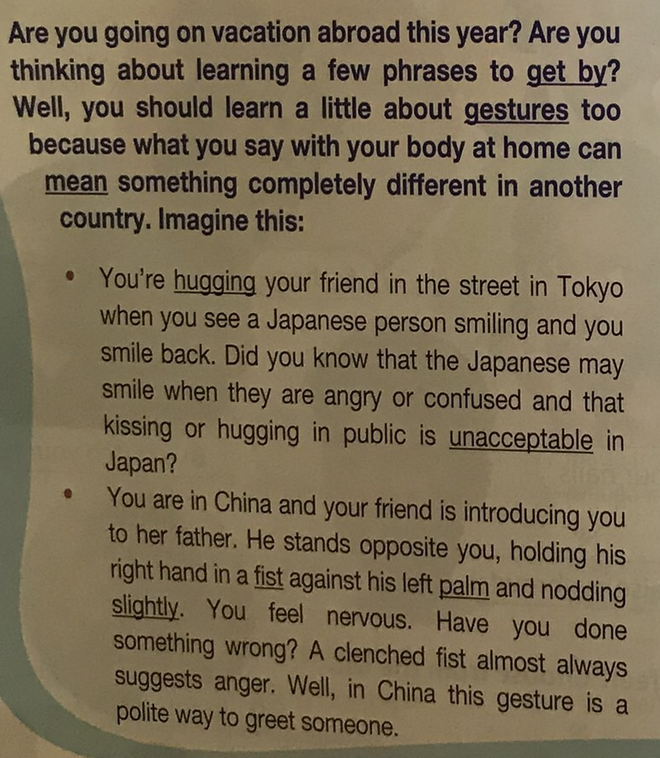
Explain the underlined words/ phrases. Then make sentences using them.
= manage to communicate with a few words/ phrases
= movements intended to communicate
= refer to
= putting your arms around someone to show affection
= not approved of
= closed hand with fingers and thumb together
= flat inner surface of hand
= to a small degree

Slide 5

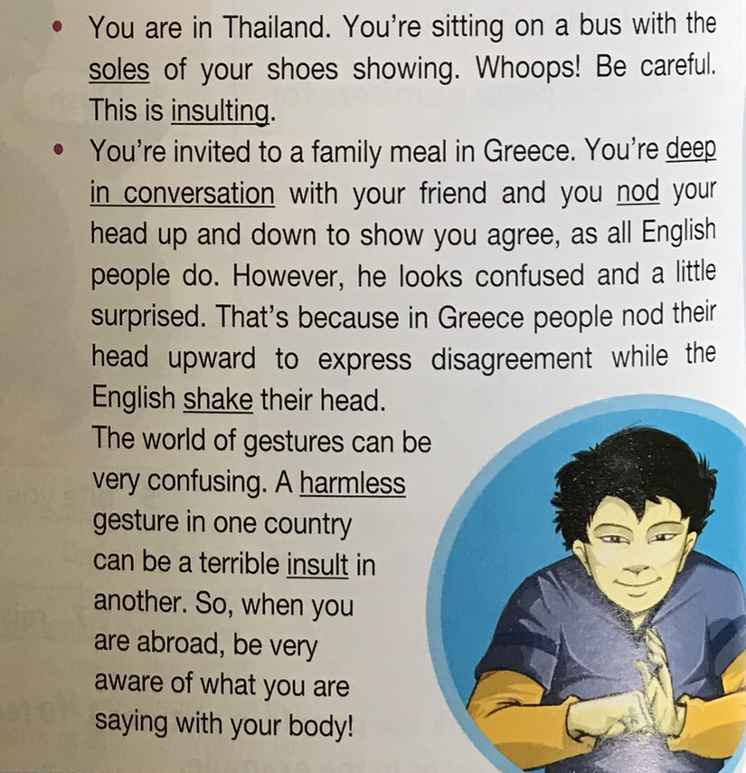
bottom of feet or shoes =
saying something offensive =
completely focused on talking to someone =
move head up and down in agreement =
move head from side to side in disagreement =
not causing damage/ offence =
offensive action/ comment =

Slide 6
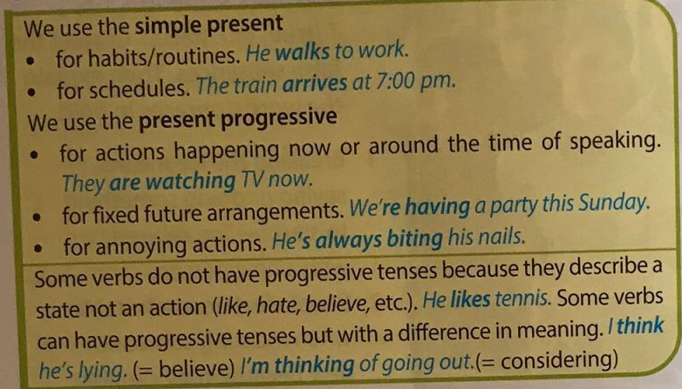
Simple present – Present progressive

Slide 7
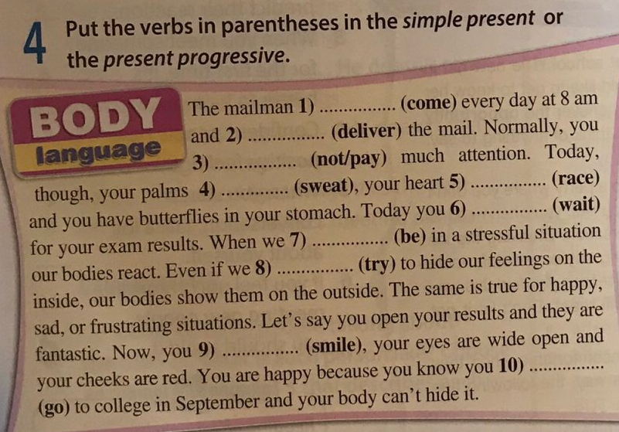
comes
delivers
don’t pay
is racing
are sweating
are waiting
are
try
are smiling
are going

Slide 8
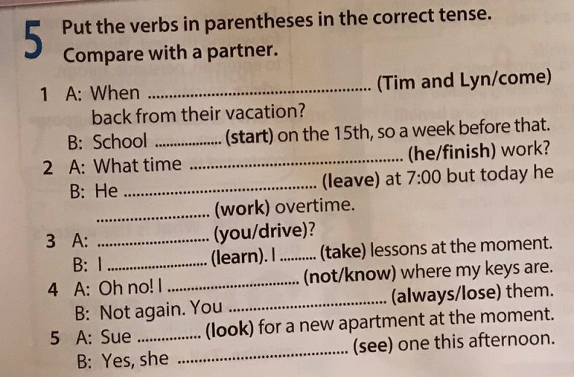
are Tim and Lyn coming
starts
does he finish
leaves
is working
Do you drive
am learning
am taking
don’t know
are always losing
is looking
is seeing

Slide 9
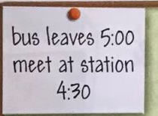
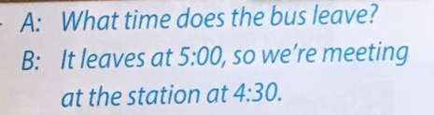
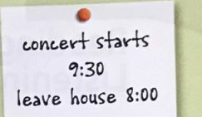
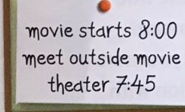
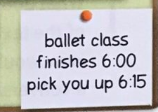
Use the notes to act out short dialogues

Slide 10
Work in pairs. Tell your partner one thing:
that is happening now
that you usually do
that you are doing tomorrow
that annoys you

Slide 11
Complete the sentences about people you know. Choose the correct preposition.
____________ is very popular to/ with his/ her ___________
____________ is jealous of/ with other people’s __________
____________ is very fond at/ of _____________
____________ is good for/ at ___________
____________ is patient of/ with _____________

Slide 12
Homework

Slide 13
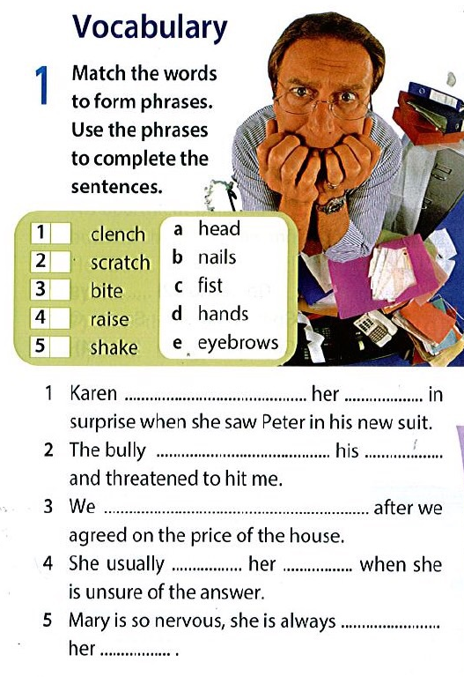
c
a
b
e
d
raised
eyebrows
clenched
fist
shook hands
scratches
head
biting
nails

Slide 14
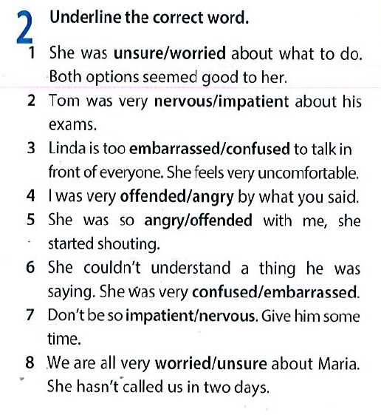

Slide 15
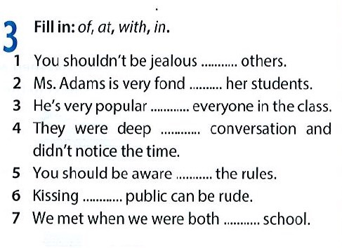
of
of
with
in
of
in
at

Slide 16
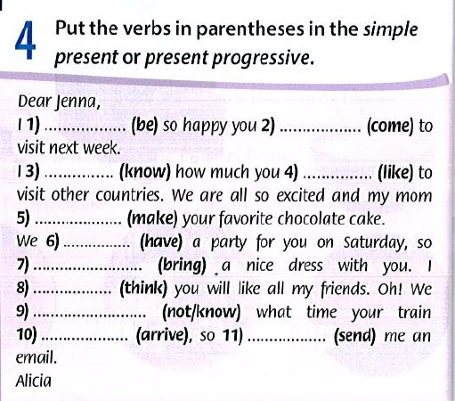
am
are coming
know
like
is making
are having
bring
think
don’t know
arrives/
is arriving
send

Slide 17
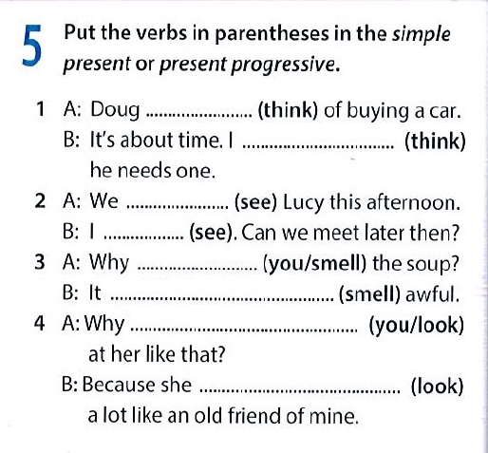
is thinking
think
are seeing
see
are you smelling
smells
are you looking
looks

