Slide 1

GETTING TO KNOW YOU

Slide 2

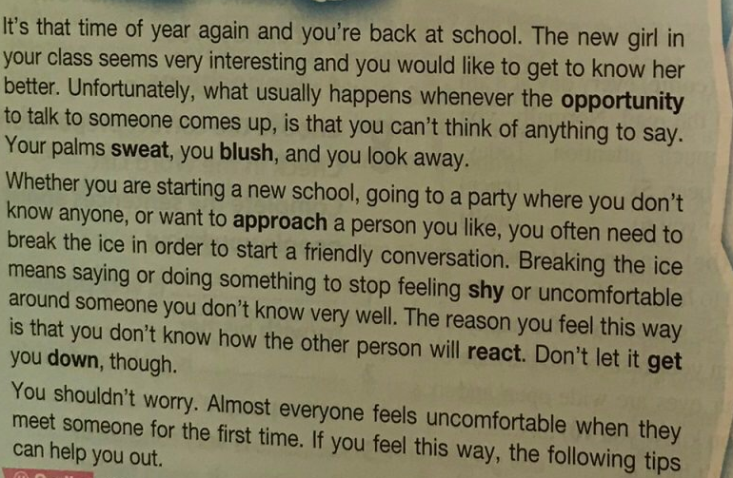
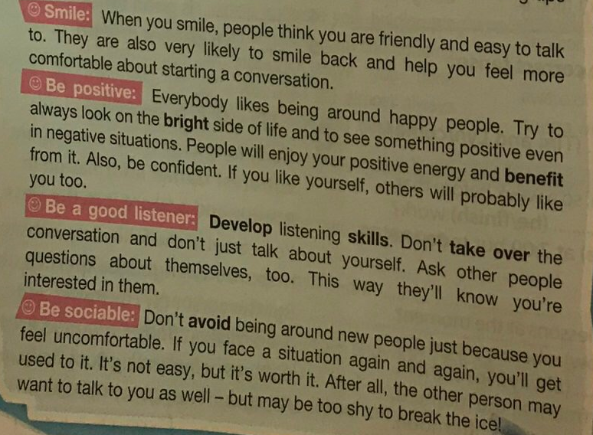
What does the title of the text mean? How would you start a conversation with someone you don’t know? Read and check
I would smile, be positive and be sociable to start a conversation with someone new.
To say or do something to learn about someone new.

Slide 3
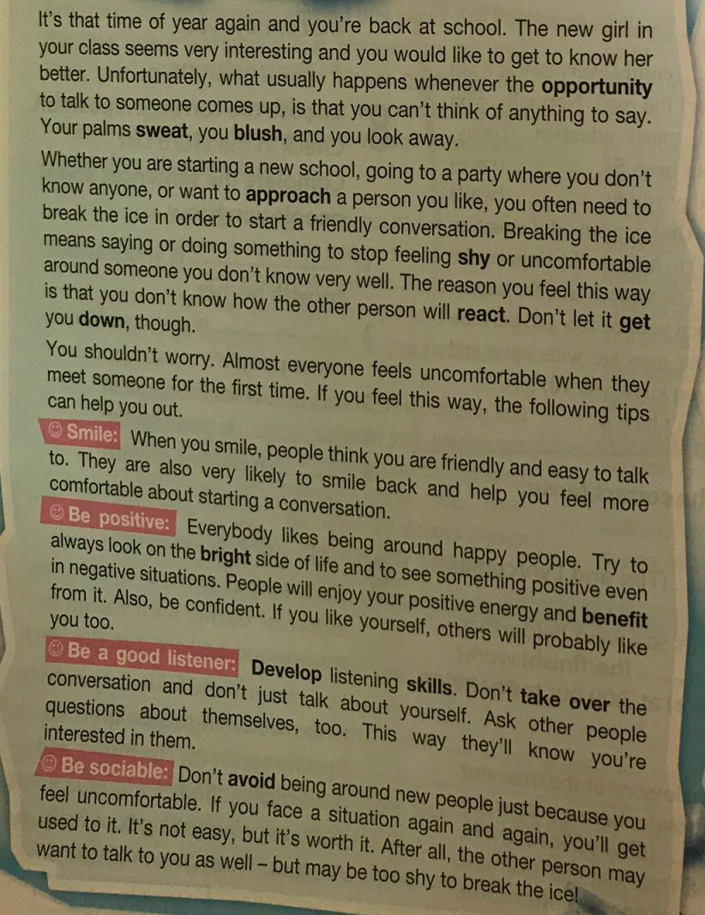

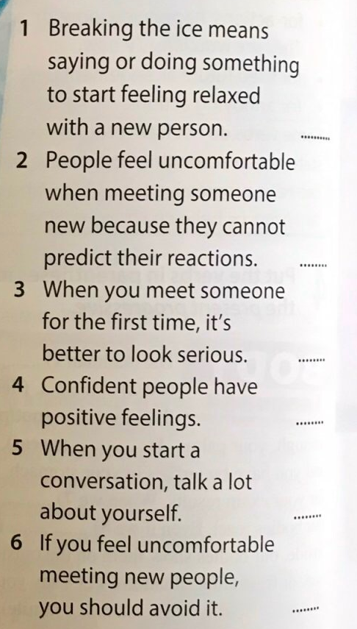
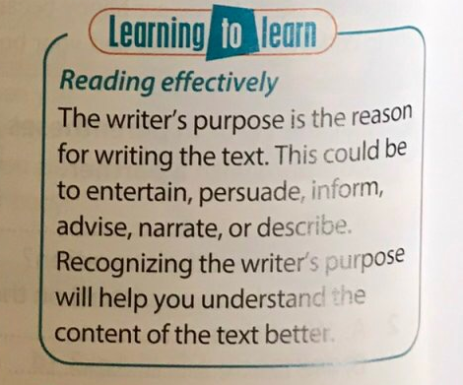


Listen and read the text and mark sentences 1-> 6, True or False
True
False
To inform the readers and give them advice about how to successfully break the ice with new people.
False

Slide 4
chance
become wet
go red in the face
come closer to
respond in a certain way
timid, quiet
make someone unhappy
optimistic, positive
gain something from something
improve
dominate
stay away from

Slide 5
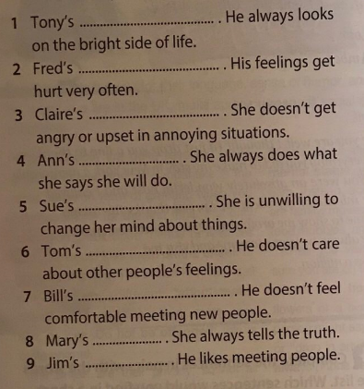
Fill in the blanks
sociable
selfish
shy
sensitive
stubborn
honest
optimistic
reliable
patient

Slide 6


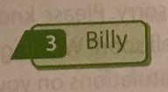
Listen to three people talking about themselves. What is each person like? Choose an adjective that describes each person.
sociable
selfish
shy
sensitive
stubborn
honest
optimistic
reliable
patient

Slide 7
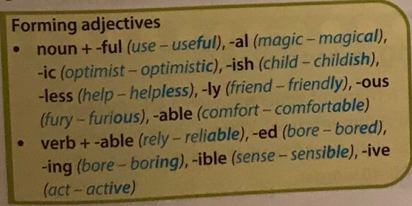
Read the table. Find examples in exercise 5.
sociable
selfish
shy
sensitive
stubborn
honest
optimistic
reliable
patient

Slide 8
Write down adjectives of these words and use them in sentences.
imagine
→ imaginative
My sister is imaginative. She can always tell a good story.
talent
→ talented
cheer
→ cheerful
responsibility
→ responsible
friend
→ friendly
courage
→ courageous
interest
→ interesting
ambition
→ ambitious
mystery
→ mysterious

Slide 9
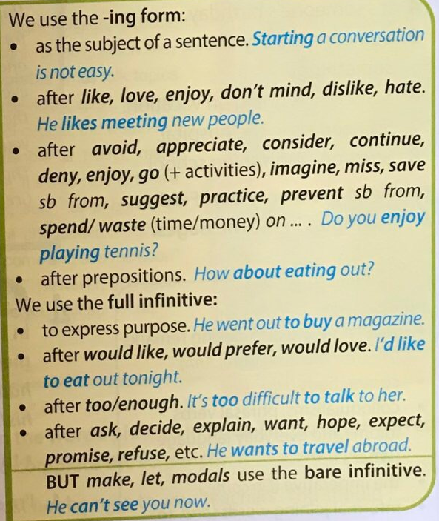
V-ing or To V_
Read the rules and the examples. Find examples in the text.

Slide 10
V-ing or To V_
Read the rules and the examples. Find examples in the text.

Slide 11
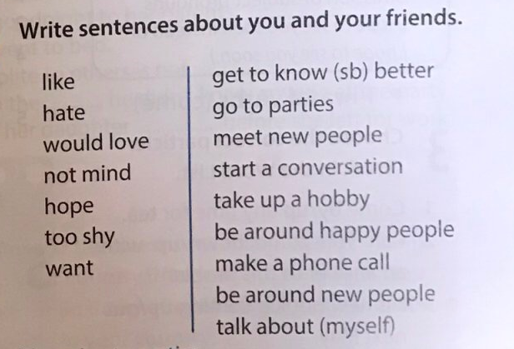
I like going to parties.

