Slide 1
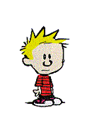

Shark attack
F
O
L
K
T
A
L
E
YOU WIN
a
b
c
d
e
f
YOU LOSE
g
h
i
j
k
l
1
m
n
o
p
q
r
2
s
t
v
w
x
y
3
4
5
6
7
8
0

Slide 2
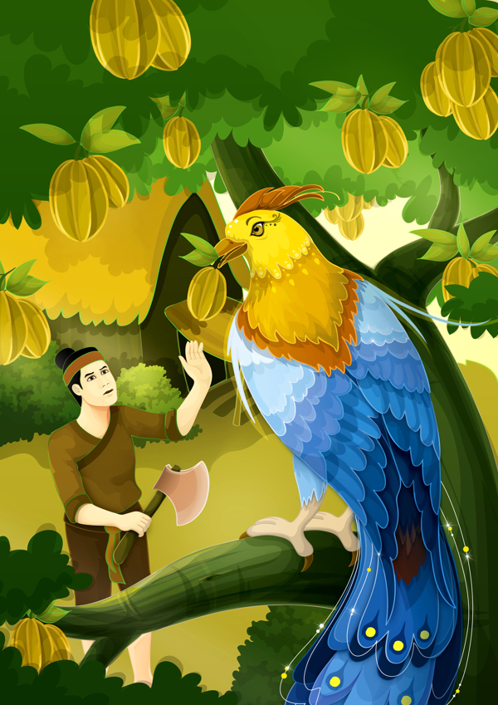
A. The golden star fruit tree
B. Here’s my wisdom

Slide 3
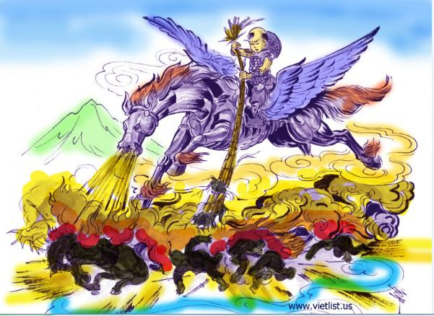
A. The legend of watermelons
B. The legend of Saint Giong

Slide 4
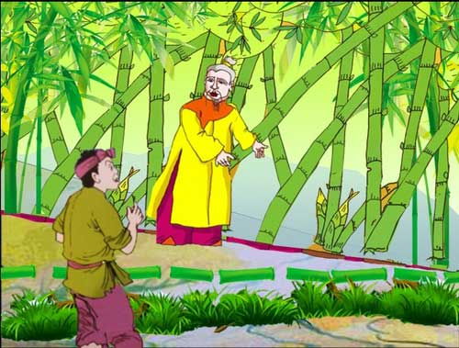
A. The hundred-knot bamboo
B. Thach Sanh’s story

Slide 5
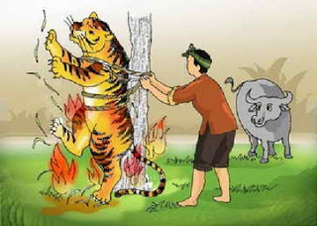
A. Here’s my wisdom
B. The moon boy

Slide 6
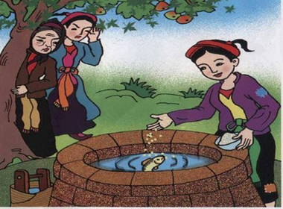
A. The story of rice cake
B. The story of Tam and Cam

Slide 7
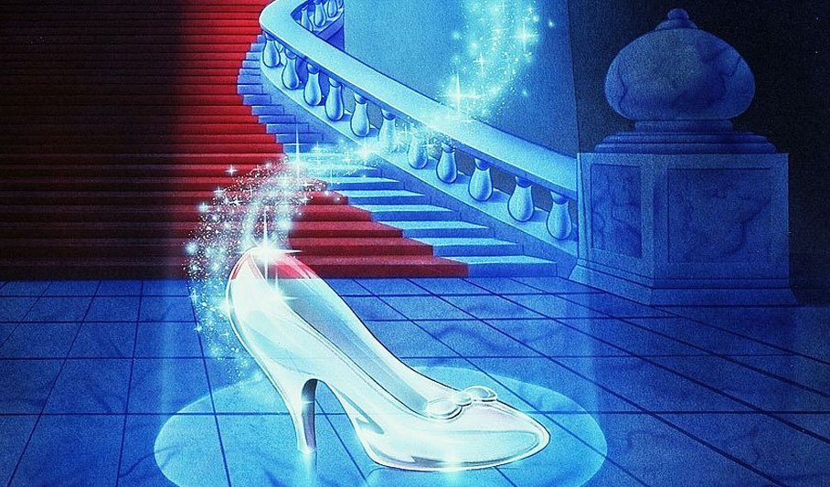

Unit 4:
OUR PAST
<READ>
THE LOST SHOE

Slide 8
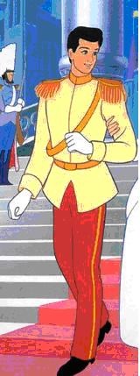
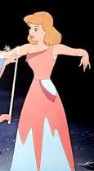
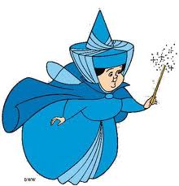
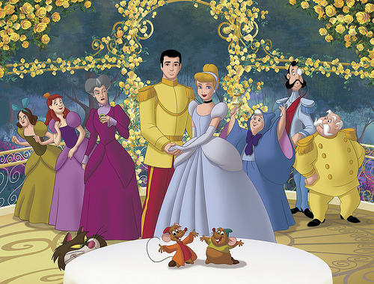
I/ New words:
- (to) marry ['mæri] (v)
Kết hôn
- cruel ['kru:əl] (adj):
Độc ác
- a prince [prins] (n):
Hoàng tử
- a fairy ['feəri] (n):
Bà tiên
- rags [rægs] (n):
Quần, áo rách
- (to) appear [ə’pir] (v)
Xuất hiện

Slide 9

MATCHING
1/ (to) marry
2/ cruel (a)
3/ a prince
4/ a fairy
5/ rags (n)
6/ (to) appear
a/ xuất hiện
b/ tiên, nàng tiên
c/ hoàng tử
d/ kết hôn
e/ độc ác
f/ quần áo rách, vải vụn

Slide 10


Unit 4: OUR PAST
READ page 41
The lost shoe
“Once a poor farmer had a daughter named Little Pea. After his wife died, the farmer married again. His new wife had a daughter, Stout Nut. Unfortunately, the new wife was very cruel to Little Pea. Little Pea had to do chores all day. This made Little Pea’s father very upset. He soon died of a broken heart.
Summer came and went. In the fall, the village held its harvest festival. That year, everyone was excited as the prince wanted to choose his wife from the village. Stout Nut’s mother made new clothes for her, but poor Little Pea had none.
However, before the festival started, a fairy appeared and magically changed Little Pea’s rags into beautiful clothes.
As Little Pea ran to the festival, she dropped one of her shoes and lost it. When the prince found the shoe, he decided to marry the girl who owned it. Of course the shoe fitted Little Pea, and the prince immediately fell in love with her.”

Slide 11

MATCHING
upset (a)
broken heart
festival (n)
magically (adv)
(to) drop
(to) fall in love with sb
phải lòng ai
lễ hội
buồn phiền
đánh rơi
bệnh đau tim
kì diệu

Slide 12

Unit 4: OUR PAST
READ page 41
TRUE/ FALSE?
T
___1. Little Pea was a poor farmer’s daughter.
___2. Her father got married again.
___3. The second mother was very nice.
___4. Her second mother didn’t make her do chores all day.
___5. A fairy changed Little Pea’s rags into beautiful clothes to take part in the festival.
___6. The prince decided to marry the girl who was the most beautiful.
T
F
cruel
F
made
T
F
owned the shoe

Slide 13
Unit 4: OUR PAST
READ page 41
II/ Practice/ 42:
1/ Complete the sentences with words from the story:
farmer
a/ Little Pea’s father was a _________ .
b/ Little Pea’s mother _______ when she was young.
c/ Little Pea _______ to do the housework all day after her father got married __________ .
d/ The prince wanted to _____________ a girl from Little Pea’s village.
e/ Stout Nut’s mother did not make ______ __________ for Little Pea.
f/ The prince found Little Pea’s ________ shoe.
died
had
again
choose/ marry
new
clothes
lost

Slide 14
Unit 4: OUR PAST
READ page 41
2/ ANSWER THE QUESTIONS:
a/ Who was Little Pea?
b/ What did Stout Nut’s mother make Little Pea do all day?
c/ How did Little Pea get her new clothes?
d/ Who did the prince decide to marry?
e/ Is this a true story? How do you know?
f/ What is the moral lesson from the story?

Slide 15
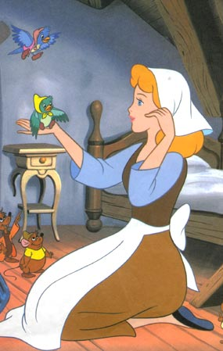
a/ Who was Little Pea?
She was a poor
farmer’s daughter.

Slide 16
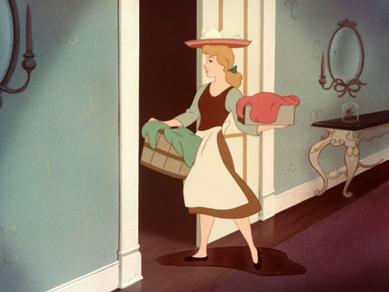
b/ What did
Stout Nut’s mother make Little Pea do all day?
→She made Little Pea do chores all day.

Slide 17
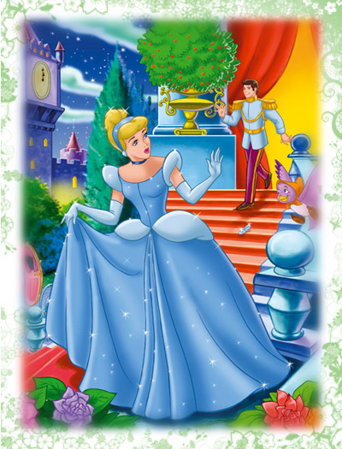
e/ Is this a true story?
How do you know?
→No, It isn’t.
It’s a folktale.

Slide 18
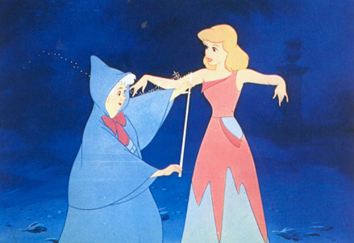
c/ How did Little Pea get her new clothes?
→ A fairy magically changed Little Pea’s rags into beautiful clothes.

Slide 19
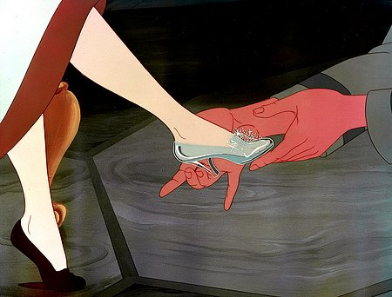
d/ Who did the prince decide to marry?
→He decided to marry the girl who owned the shoe.

Slide 20
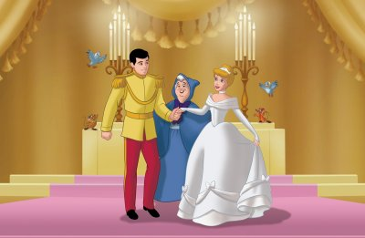
f/ What is the moral lesson from the story?
“ONE GOOD TURN DESERVES ANOTHER”
ở hiền gặp lành

Slide 21
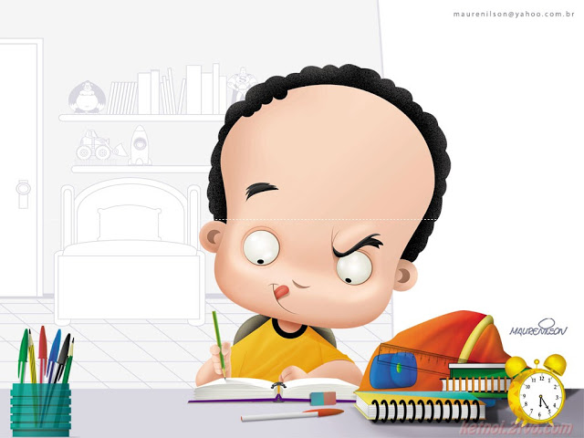
HOMEWORK
- Learn this lesson at home.
Do exercise in your exercise book.
Prepare WRITE.

Slide 22

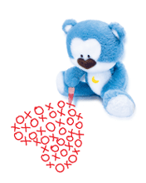

THANKS FOR YOUR ATTENTION
SEE YOU LATER

