Slide 1
Unit 3 AT HOME
lESSON 1: GETTING STARTED - LISTEN AND READ

Slide 2
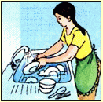
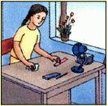
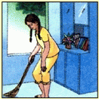
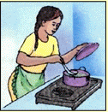
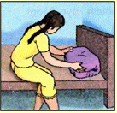
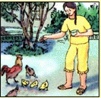
Unit:3. At home
Lesson:1. Getting started-Listen and read
I. Getting started
What do you often
do to help your Mom
at home?
Washing the dishes
tidying up
sweeping the floor
cooking
making the bed
feeding the chickens

Slide 3
Unit:3. At home
Lesson:1. Getting started-Listen and read
II. Listen and read
* True/fasle statements prediction
1.Mrs.Vui has to go and visit her friends after work.
2.Mrs.Vui will be home before dinner.
3.Nam will have to cook dinner himself.
4.Mrs.Chi will go to the market and buy some fish and vegetables for Nam.

Slide 4

Unit:3. At home
Lesson:1. Getting started-Listen and read
II. Listen and read
Nam: Hello.
Mrs.Vui: Nam, it’s Mom.
Nam: Hi, Mom.
Mrs.Vui: I’m going to be home late tonight. I have to go and visit grandma after work.
Nam: What time will you be home?
Mrs.vui: I’ll be home after dinner. I’m sorry, but you’ll have to cook dinner yourself.
Nam: all right.
Mrs.Vui: There’s rice in the cupboard, but you ought to go to the market yourself and buy some fish and vegetables. The steamer is under the sink, between the saucepan and the frying pan. The rice cooker is beside the stove.
Nam: OK. Give my love to Grandma.
Mrs.Vui: I will. Oh, I almost forget. Can you call Aunt Chi, please? Ask her to meet me at Grandma’s house.
Nam: No problem. Bye, Mom.
Mrs.Vui: Bye.

Slide 5
Unit:3. At home
Lesson:1. Getting started-Listen and read
II. Listen and read
* True/fasle statements prediction
1.Mrs.Vui has to go and visit her friends after work.
F
grandma
2.Mrs.Vui will be home before dinner.
F
after
3.Nam will have to cook dinner himself.
T
4.Mrs.Chi will go to the market and buy some fish and vegetables for Nam.
F
Nam ought to go to the market himself and buy some fish and vegetables.

Slide 6
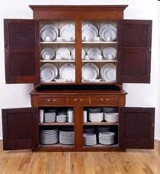
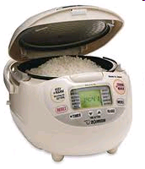
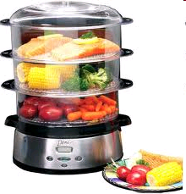
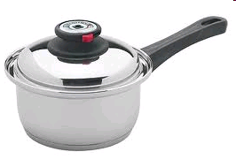
Unit:3. At home
Lesson:1. Getting started-Listen and read
II. Listen and read
1. Vocabulary:
chore(s) (c.n)
= housework (unc.n)
cupboard(n)
Tủ ly, chén
rice cooker (n)
Nồi nấu cơm
steamer(n)
Nồi hấp
saucepan(n)
Cái chảo lồng sâu, xoong

Slide 7
Unit:3. At home
Lesson:1. Getting started-Listen and read
II, Listen and read
1. Vocabulary:
chore
công việc nhà
cupboard
tủ chén, ly tách
rice cooker
nồi nấu cơm
steamer
nồi hấp
saucepan
cái chảo sâu, xoong

Slide 8
Ex: You have to cook dinner yourself.
Ex: You ought to go to the market yourself.
=> Ought to/have to + inf.
=> Reflexive pronouns
Pronoun | Reflexive pronoun
I You She He It They We | myself yourself/ yourselves herself himself itself themselves ourselves

Slide 9

Reflexive pronouns
Pronoun | Reflexive pronoun
I You She He it They We | myself yourself /yourselves herself himself itself themselves ourselves
-Dùng khi chủ từ và túc từ của động từ là cùng 1 người.
Ex: He cut himself while he was cooking.
-Chỉ chủ ngữ tự làm việc gì đó mà không có sự trợ giúp với từ ‘ by’ =>(without help)
Ex: We painted the walls by ourselves.

Slide 10
practice dialogue in pairs

Slide 11
Unit:3. At home
Lesson:1. Getting started-Listen and read
Getting started
Listen and read
1. Vocabulary
2. Complete the list of the things Nam has to do
Cook dinner.
Go to the market himself and buy some fish and vegetables.
Call Aunt Chi and ask her to meet his mother at Grandma’s house.

Slide 12
* Choose the best answer by circling A, B, C or D.
1. Nam ………..go to the market to buy food himself.
A. have to B. has to C. have D. has
2. Ha ought to ……… homework herself.
A. doing B. does C. do D. did
3. Can you do it by……
himself B. herself
C. themselves D. yourself

Slide 13

Homework - Practice dialogue at home, learn new word
by heart. - Prepare new lesson speak-listen - Do ex 1/20 complete the sentences

