Slide 1

GAME:CROSSWORD
K
S
A
T
U
R
D
A
Y
1
T
S
E
P
T
E
M
B
E
R
2
E
W
E
L
L
3
L
Y
E
A
R
4
E
P
H
Y
S
I
C
S
5
P
K
I
T
C
H
E
N
6
H
L
O
N
G
7
O
N
O
S
E
8
N
9
A
D
D
R
E
E
S
S
B
O
O
K
The adverb form of the word “ Good “
The book you write addresses and phone numbers in
A part of body helps you smell
The subject in which you do experiments
The name of the month has nine letters
The place where we usually cook meals
It is opposite to “ Short “
The day between Friday and Sunday
It has twelve months

Slide 2
Answer questions
Who invented the telephone?
* Alexander Graham Bell
2.When was he born?
* He was born on march 3,1847
3.Where was he born?
* He was born in Scotland
4.When did he invent the first telephone?
* In 1876

Slide 3
Unit 2. Making arrangements
Lessson 4. Write

Slide 4
(?) Have you ever taken a telephone message?
(?) What do we write in the message?
Date:
Time:
For:
Message:
Taken by:

Slide 5
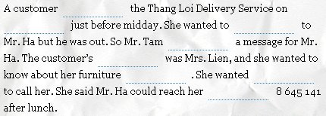
Thang Loi Delivery Service
Date:
May 12
Time:
11:50 am
For :
Mr. Ha
Message: Mrs Lien called
about her furniture delivery.
She wants you
to call her after lunch. Her telephone number is 8 645 141
Taken by :
Tam
(1)
(2)
(3)
(4)
(5)
(6)
(7)
(8)

Slide 6
NEWWORD
customer (n)
delivery (n)
service (n)
message (n)
khách hàng
phân phối , phát
sự phục vụ, dịch vụ
lời nhắn, tin nhắn
furniture (n)
đồ đạc trang trí nội thất
reach (v)
liên lạc qua điện thoại
taken by (v)
stationery (n)
được nhận bởi
văn phòng phẩm

Slide 7

Jumbled words:
1. cumestor
3. messgea
2.funirretu
4.raehc
5. seircve
6. ledivyre
→ customer
→ message
→ furniture
→ reach
→ service
→ delivery

Slide 8
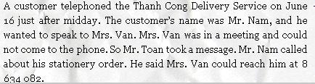

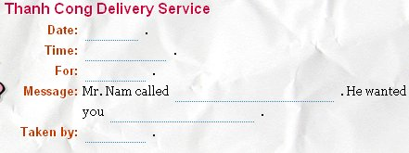
June 16
After midday
Mrs. Van
about his stationary order
to call him after lunch. His telephone number is 8 634 082
Mr. Toan

Slide 9
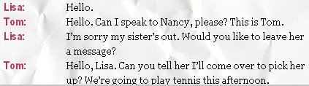

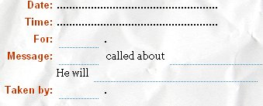
September 15th
10.am
Nancy
Nancy
Tom
playing tennis this afternoon.
come over to pick you up at 1.30.
Lisa
Lisa

Slide 10
Remember to write a message
Date:
Time:
For:
Message:
Taken by:

Slide 11


Homework
Write a message.
- Prepare Unit 2: Language focus

