Slide 1

Week 7
WELCOME
TO
ACCESS
GRADE 8
Student’s Book

Slide 2
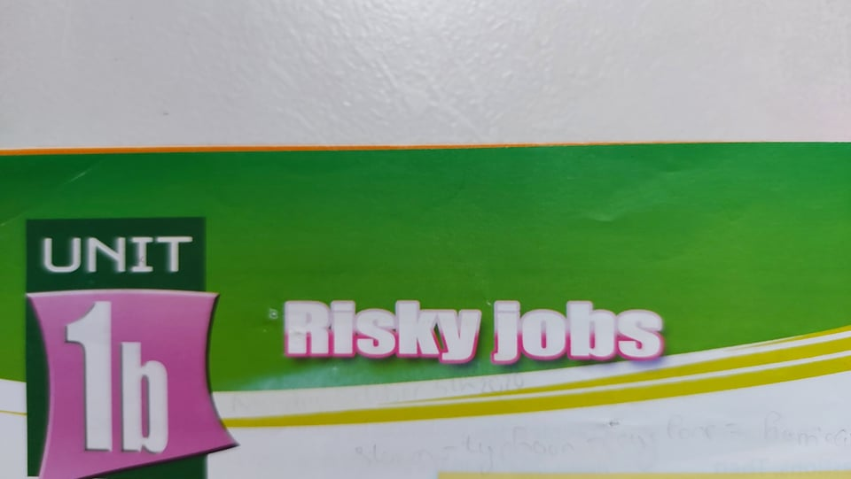
Week 7
(Những công việc nhiều rủi ro, nguy hiểm.)

Slide 3
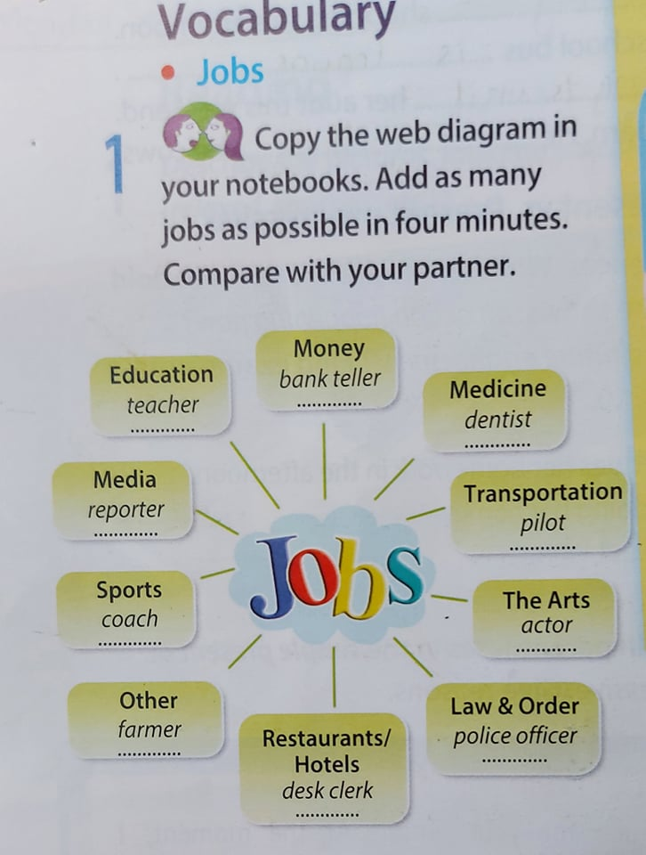
10
1
cashier
student
2
doctor
9
Journalist
3
driver
8
4
Football player
actress
7
firefighter
6
5
lawyer
waiter

Slide 4
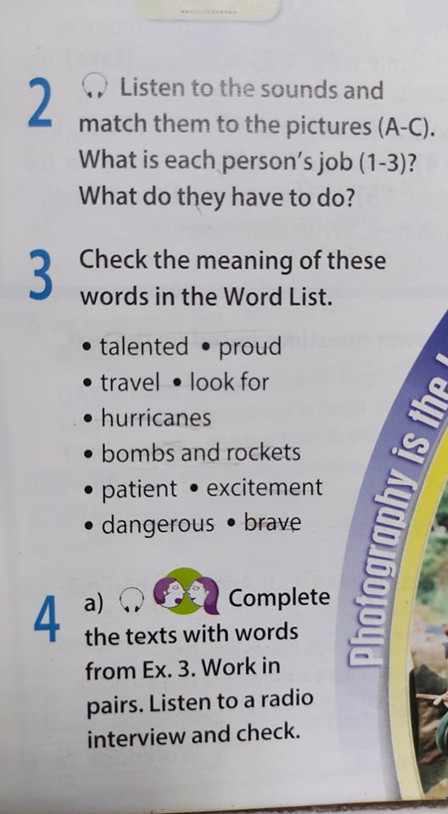
New words:
*bomb (n): weapon that explodes and damages a large area.
*hurricane (n): very strong wind, storm with rain, thunder, and lightning.
*proud (of) (adj) : feeling pleased about sth good you have done.
*rocket (n): weapon that explodes.
*brave (adj): showing no fear.
*talented (adj): very good at do sth.
*travel (v): to go from one place to another.
*Look for (v): to search, try to find.
*patient (adj): calm and not getting annoyed.
*excitement (n): happiness.
*dangerous (adj): risky, unsafe

Slide 5
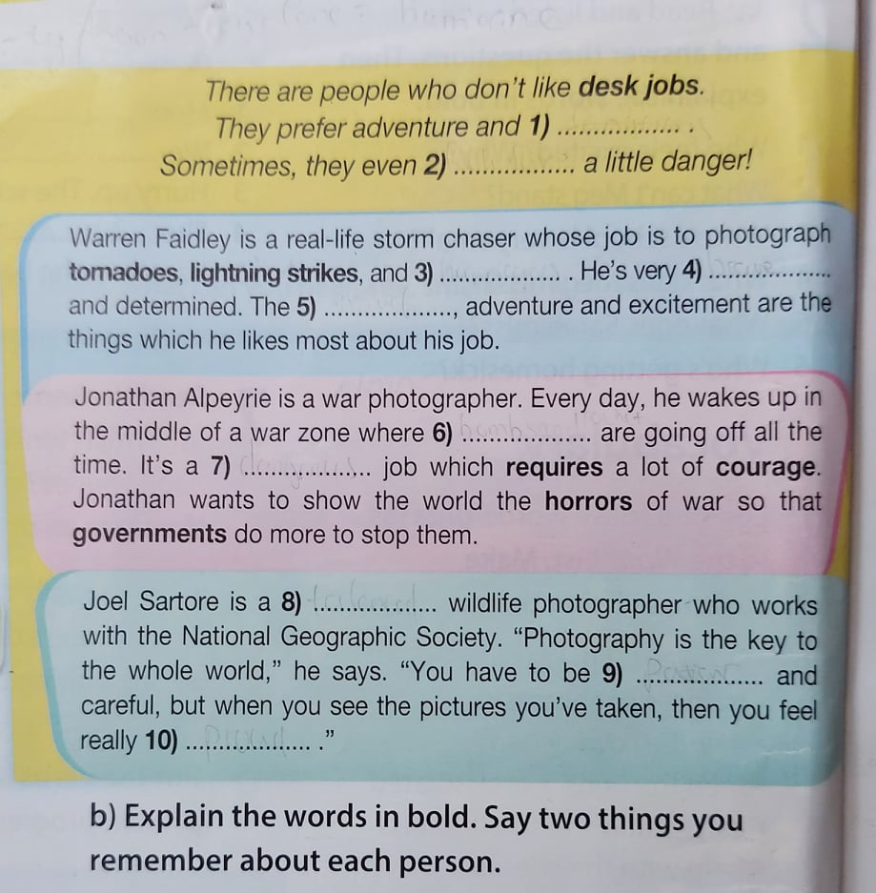
excitement
look for
hurricanes
brave
travel
bombs and rockets
dangerous
talented
patient
proud

Slide 6
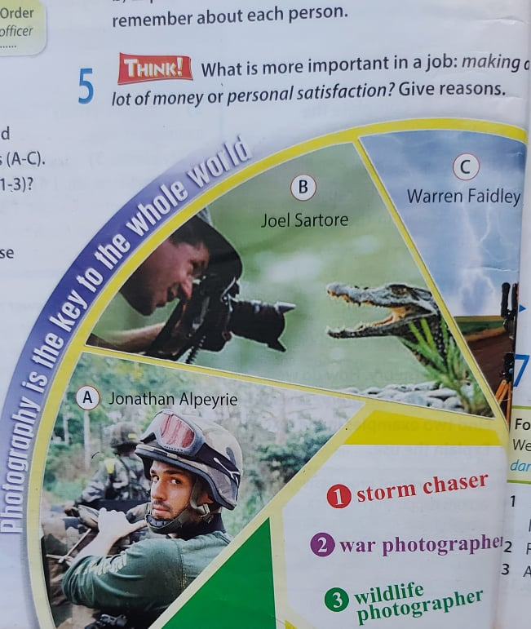
Notes:
**Jonathan Alpeyrie
War photographer = sb who takes photos of a war zone. (Nhiếp ảnh gia chuyên chụp hình ở các vùng có chiến tranh/ phóng viên chiến trường.)
**Joel Sartore →Wildlife photographer = sb who takes photos of animals and plants in the wild. (Nhiếp ảnh gia chuyên chụp hình về động vật và cây cối hoang dã)
**Warren Faidley → Storm chaser = sb who follows storms in order to photograph them. (Người săn bão/ chuyên chụp hình những cơn bão)

Slide 7

Answer:
1/ What does Jonathan Alpeyrie/ Joel Sartore/ Warren Faidley do?
2/ Tell some things they do.

