Slide 1


Slide 2
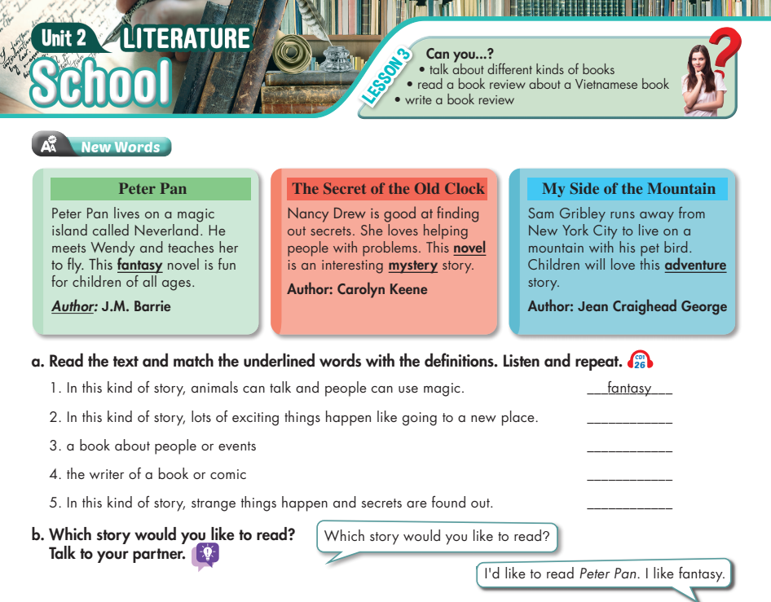

Lesson 3
adventure
novel
author
mystery

Slide 3
UNIT 2: SHOOL – Lesson 1 (period 1)
New words
No | Words |  | Meaning
1 | fantasy | (n) | Chuyện tưởng tượng
2 | adventure | (n) | cuộc phiêu lưu
3 | novel | (n) | tiểu thuyết
4 | author | (n) | tác giả
5 | mystery | (n) | sự huyền bí
6 | would like to V_ | (v) | Muốn
7 | secret | (n) | điều bí mật
8 | event | (n) | sự kiện

Slide 4
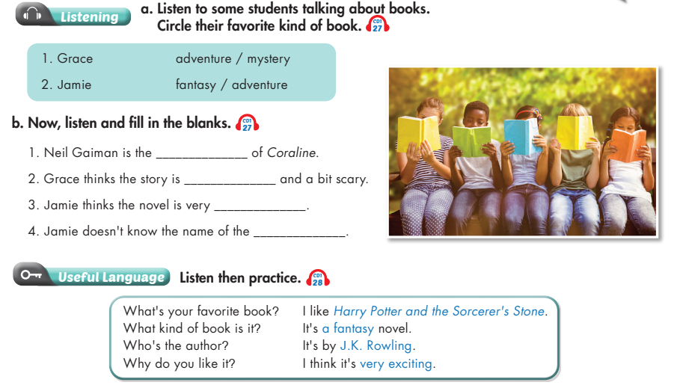
Lesson 3
author
interesting
exciting
author

Slide 5
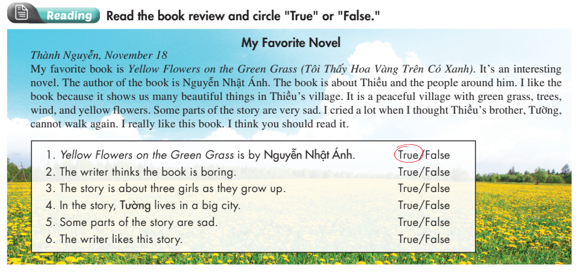
Lesson 3

Slide 6
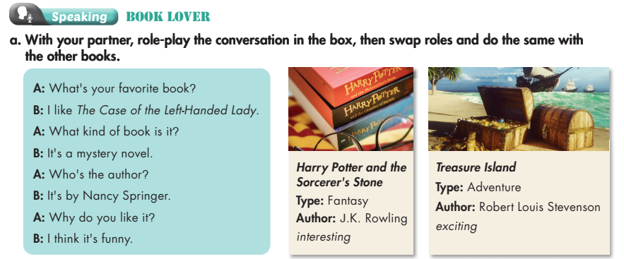
Lesson 3

Slide 7
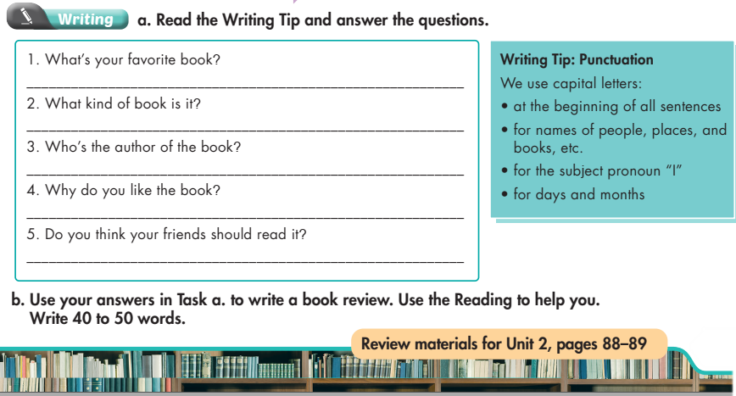
Lesson 3

Slide 8


Review

Slide 9
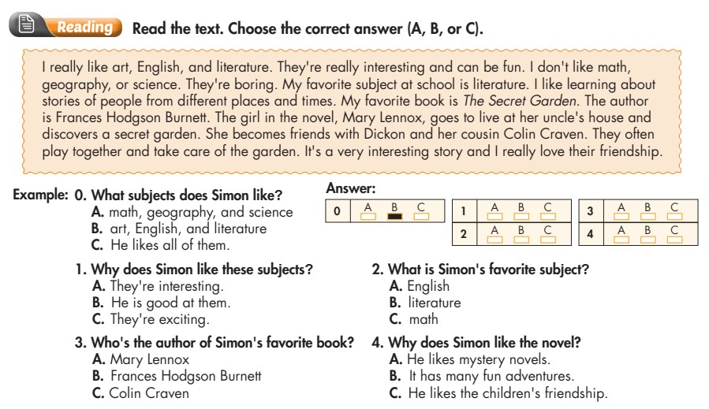
Review

Slide 10
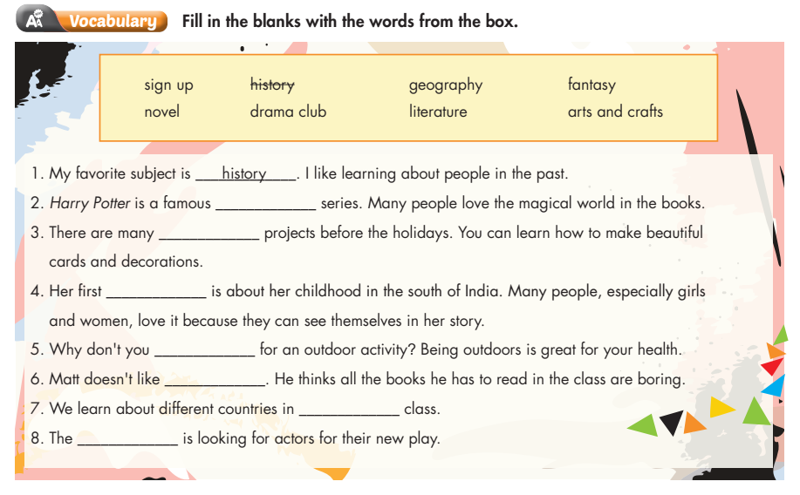
Review
fantasy
arts and crafts
novel
sign up
literature
geography
drama club

Slide 11
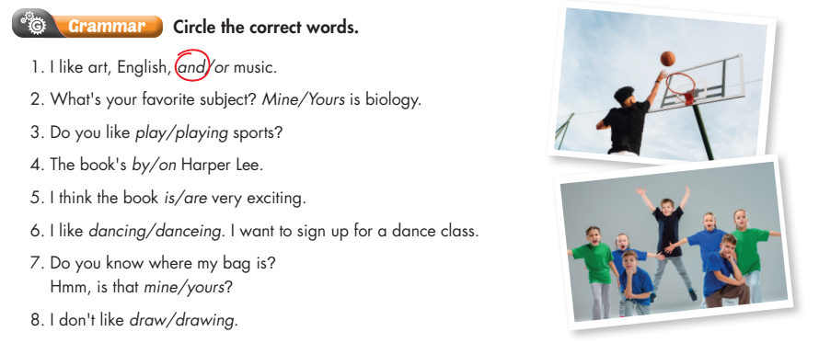
Review

Slide 12
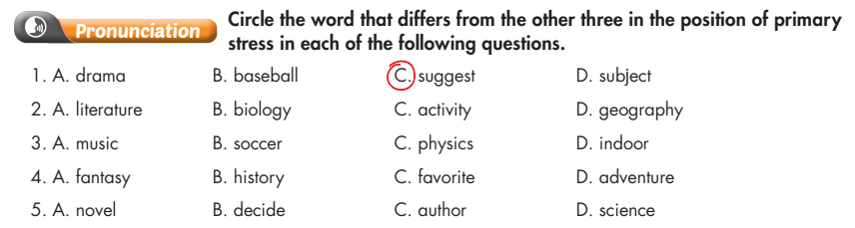
Review

