Slide 1

Week 7 - Period 19
Unit Four : AT SCHOOL
KHỐI 7
2021 - 2022

Slide 2
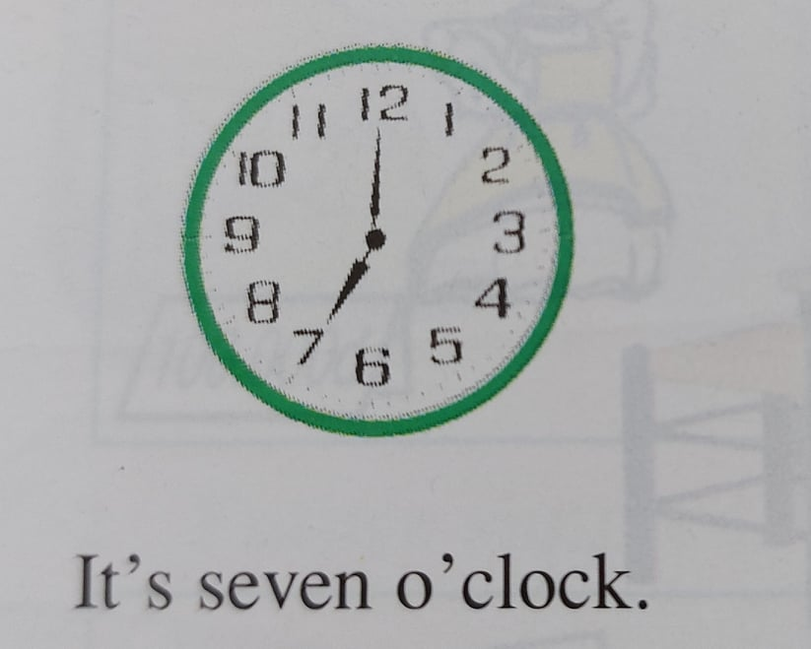
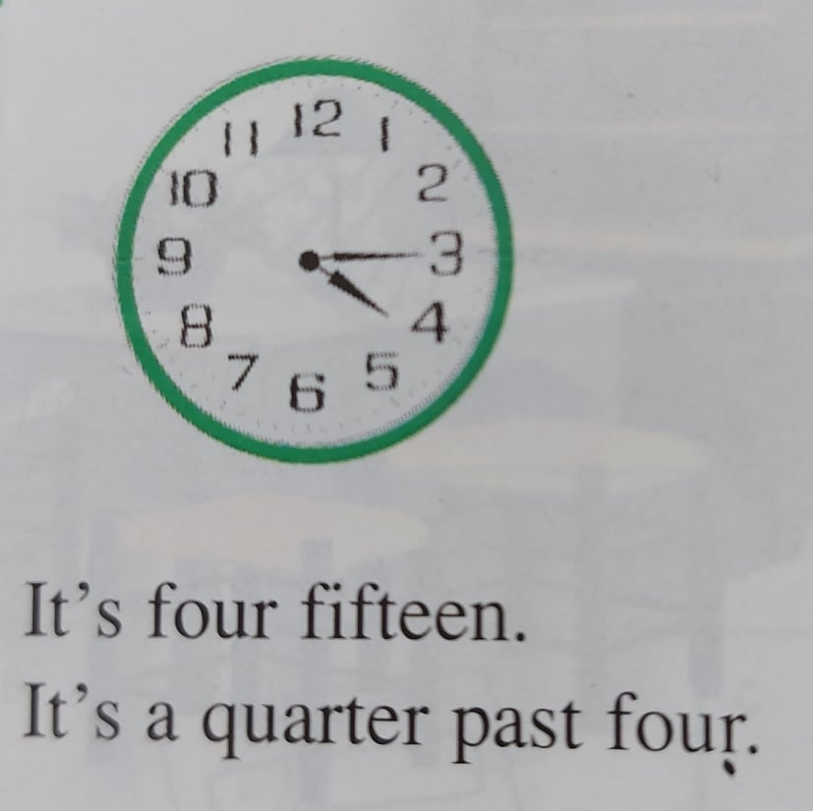
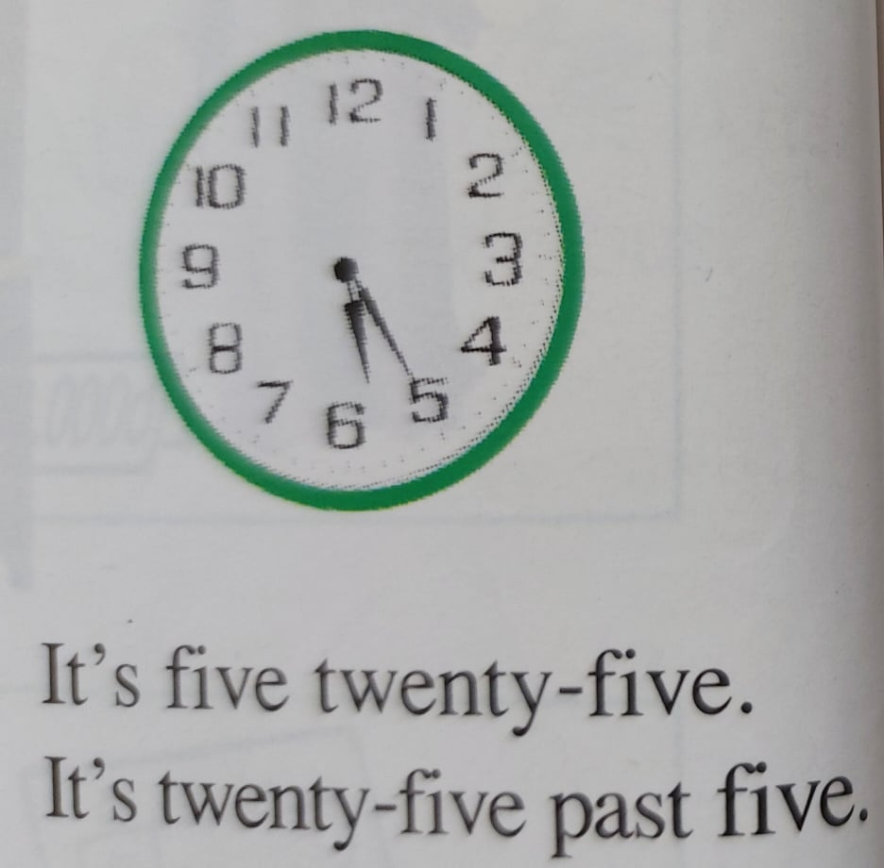
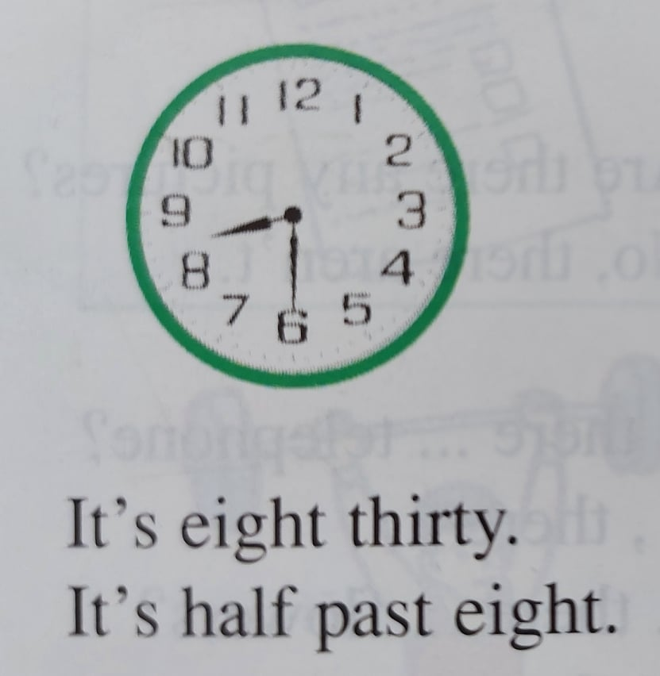
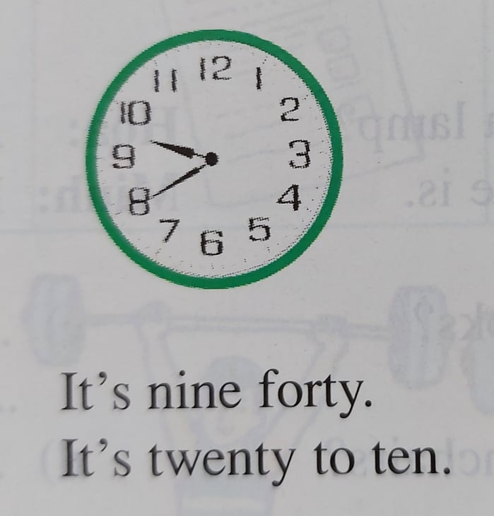
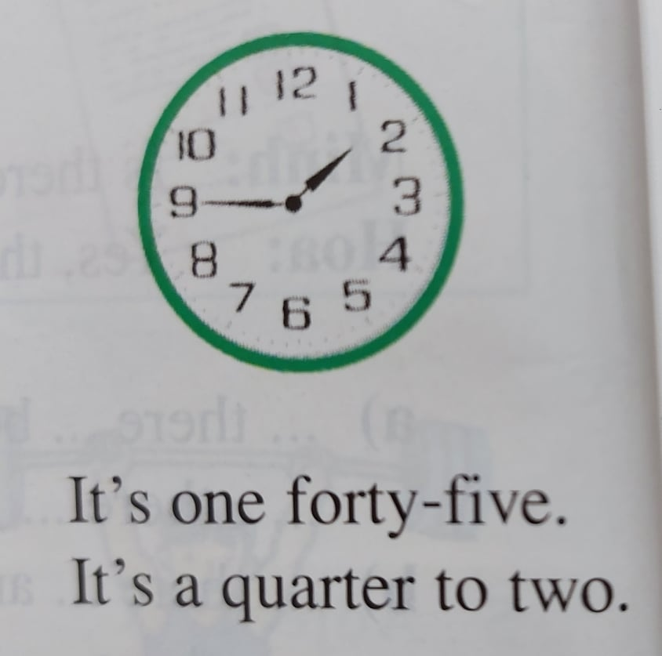
Week 7 – Period 19
Unit 4: AT SCHOOL
A/ Schedules: (Thời khóa biểu) = Time table)
What time is it? → It’s seven o’clock.

Slide 3

What time is it? = What’s the time?: (Mấy giờ rồi?)
**Giờ chẵn: →
It’s + số giờ + o’clock.
Ex: 7:00 It’s seven o’clock.
2:00 It’s two o’clock.
** Giờ lẻ: →
It’s + số giờ + số phút
It’s + số phút + PAST + số giờ
Ex : 4:10 It’s four ten. / It’s ten past four.
** Giờ kém: →
It’s + số giờ + số phút
It’s + số phút + TO + số giờ
Ex: 5:45 It’s five forty-five. / It’s a quarter to six.
*15’ = fifteen = a quarter → It’s a quarter past ten. (10.15)
*30’ = thirty = half → It’s half past ten. (10.30)

Slide 4
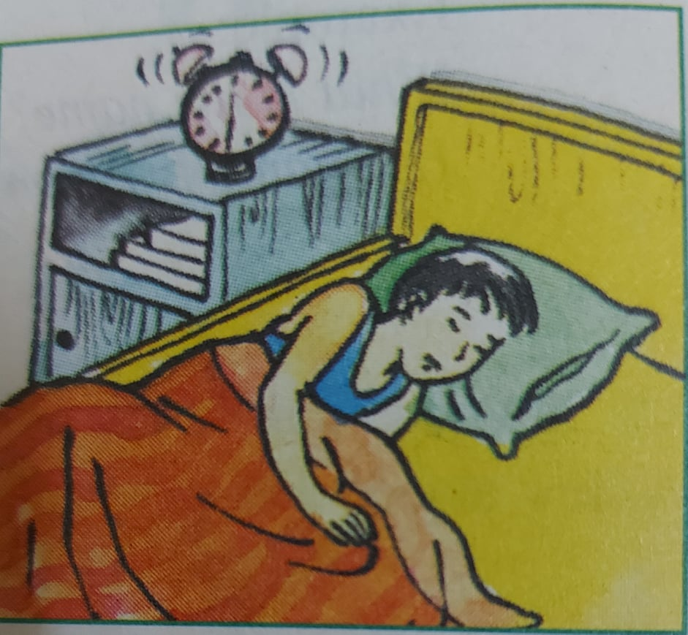
A2/ Answer about you.
a/ What time do you get up? → I get up at 6 o’clock.
b/ What time do classes start? → They start at 7 o’clock.
c/ What time do they finish? → They finish at ten forty-five
(a quarter to eleven)
d/ What time do you have lunch? → I have lunch at eleven
o’clock.
e/ What time do you go to bed? → I go to bed at half past ten.

Slide 5

HOMEWORK :
*Learn how to talk about the time.
*Do exercises.

Slide 6

Week 7 – Period 20
Unit Four: AT SCHOOL (Cont)
KHỐI 7

Slide 7
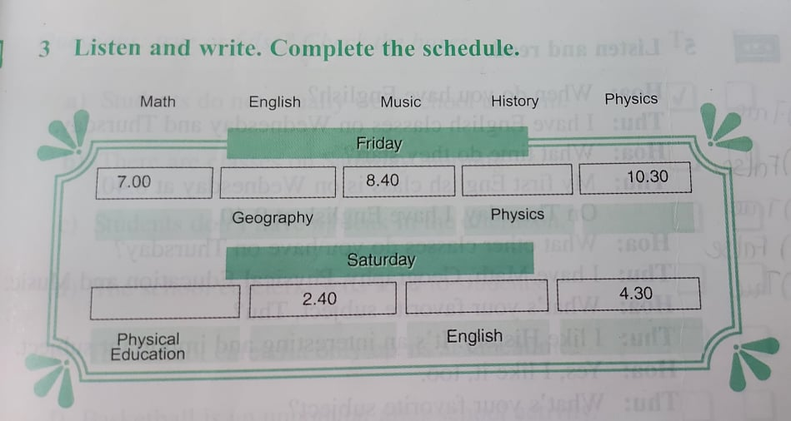
Week 7 – Period 20
Unit Four: AT SCHOOL (Cont)
Good morning everybody. There are some small changes to your schedule this Friday and Saturday. Please write the correct subject and time in your book.
One Saturday, English is at 7 am usual. Then Geography is at 7.50. The next class is Music at 8.40. We start again at 0.40. Physics and our last lesson of the day is History.
On Saturday afternoon, the first class is Physical Education at one o’clock and the second class is Math. We have another period of English at 3.40 and Physics is at 4.30. Any question? No ? Good. Let’s continue with today in class.
ENGLISH
7.50
9.40
MUSIC
HISTORY
1.00
3.40
MATH
Physics

Slide 8
Grammar: 1/The Present Progressive Tense.
(Thì Hiện Tại Tiếp Diễn)
*Diễn tả 1 hành động, 1 sự việc đang diễn ra trong hiện tại.
→Dấu hiệu nhận biết: Now, At present, At the moment, Listen!, Look!..
FORM: (+) S + Be (am/ is/ are) + V-ing
(-) S + am/ is/ are + not + V-ing
(?) Am/ Is/ Are + S + V-ing ?
Ex: a/ I am reading./ She is writing./ They are playing soccer now.
b/ He isn’t doing exercises at present.
c/ Look ! They are dancing.
d/ Are you reading book? – Yes, I am./ No, I am not.
2/ Câu hỏi với WHAT ở thì HTTD ta dùng:
What + am/ is/ are + S + V-ing?
Ex: What are you doing? → I am listening to music.
What’s Minh studying ? → He’s studying English.

Slide 9
Subject(s) môn học
*Literature (n): môn Văn
*History (n): môn Sử
*English (n): môn Tiếng Anh
*Civic Education (n): môn GDCD (CE)
*Math (n): môn Toán
*Physics (n): môn Lý
*Chemistry (n): môn Hóa
*Geography (n): môn Địa
*Biology (n): môn Sinh Học
*Technology (n): môn Công Nghệ
*Physical Education (n): môn Thể Dục (PE)
*Music (n): môn Âm Nhạc
*Fine Arts (n): môn Mỹ Thuật

Slide 10
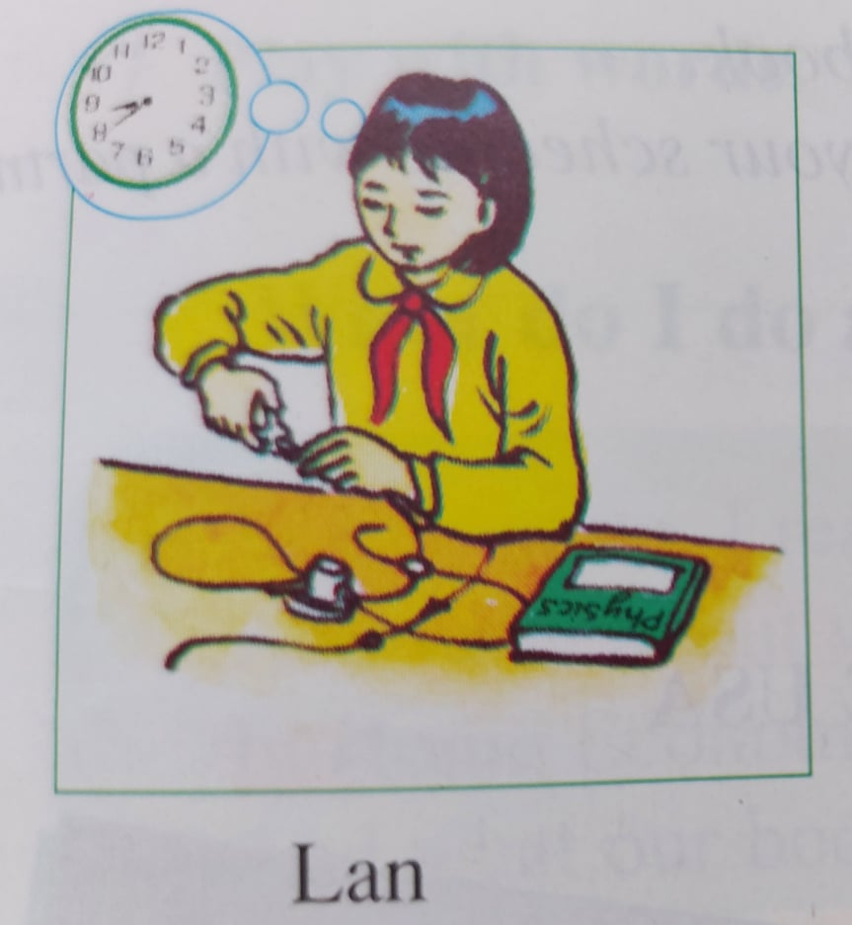
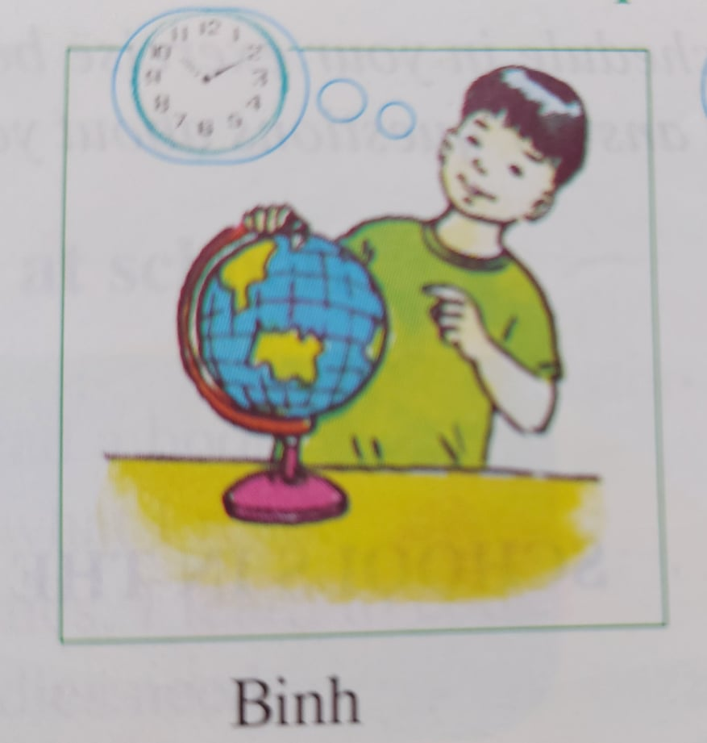
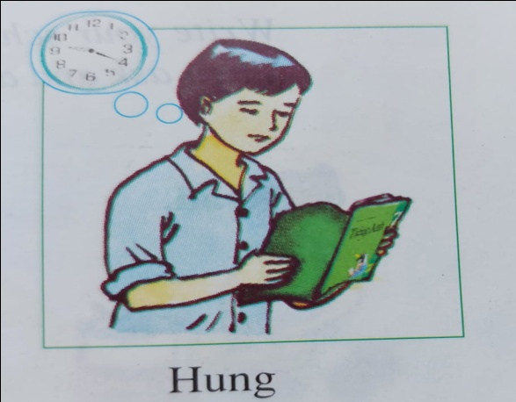
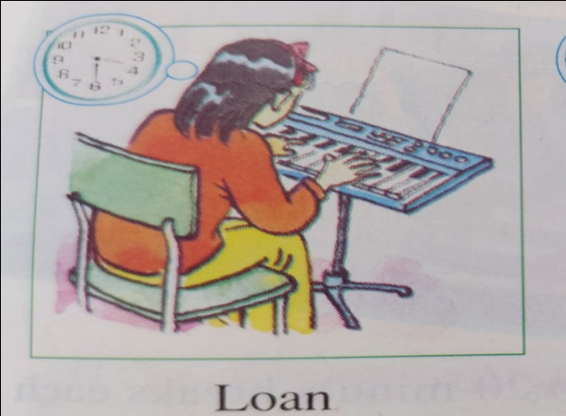
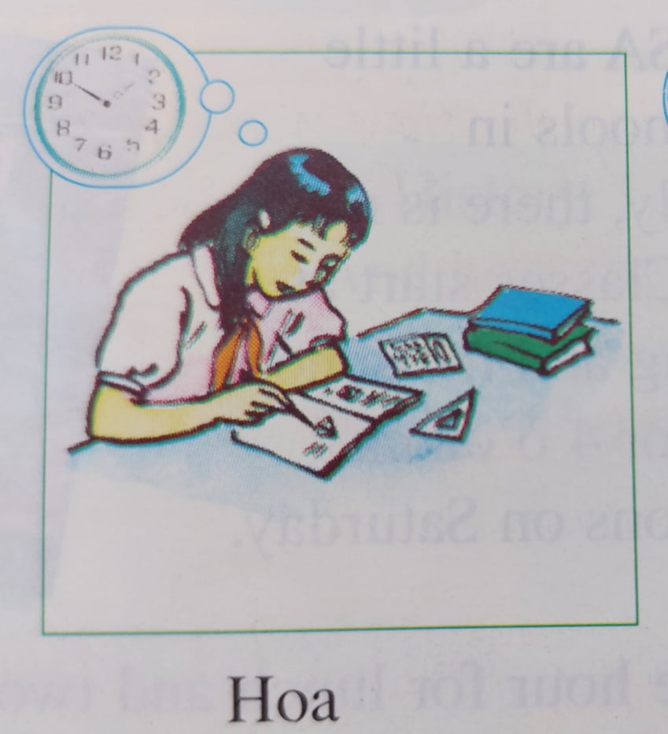
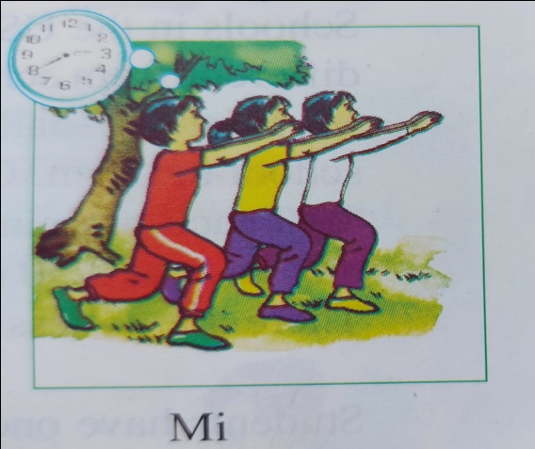
A4/ Look at the pictures. Ask and answer questions.
*What is Lan studying? → Lan is studying Physics.
*What time deos Lan have her Physics class?
→ She has her Physics class at 8.40.

Slide 11
*What is Binh studying ? → Binh is studying Geography.
What time does Binh have his Geography class?
→ He has his Geography class at 10.10.
*What is Hung studying? → Hung is studying English.
What time does Hung have his English class?
→ He has his English class at 9.20.
*What is Loan studying ? → Loan is studying Music.
What time does Loan have her Music class?
→ She has her Music class at 3.30.
*What is Hoa studying? → Hoa is studying Math.
What time does Hoa have her Math class?
→ She has her Math class at 2.50.
*What is Mi studying? → Mi is studying Physical Education (PE)
What time does Mi have her P.E class?
→ She has her P.E class at 2.40.

Slide 12
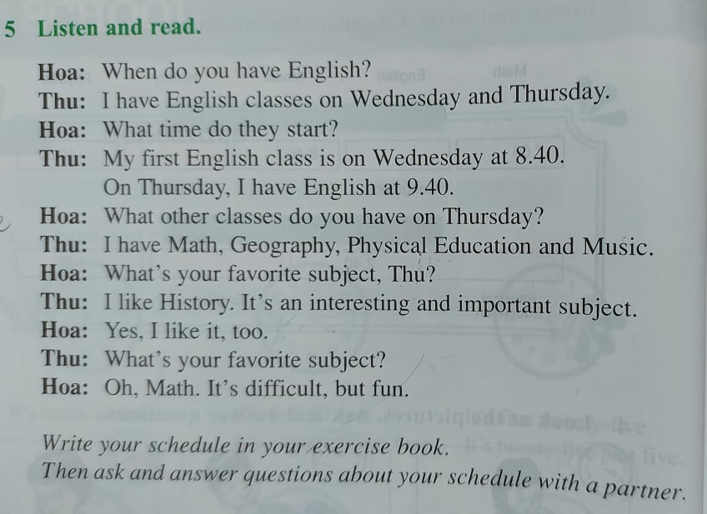

Slide 13

HOMEWORK:
*Learn new words and grammar by heart.
*Do exercises.
*Write your schedule in your exercise book.
*Prepare next lesson.

