Slide 1

Tuần: 5 & 6 – Tiết 13 → 18
KHỐI 7
UNIT THREE: AT HOME

Slide 2

Review: Answer the questions.
1/ What’s your full name?
2/ What’s your family name?
3/ What’s your telephone number?
4/ Where do you live?
5/ How far is it from your house to school?
6/ How do you go to school?
7/ How may people are there in your family?
8/ Who is the tallest student in your class?
9/ How old will you be on your next birthday?
10/ What’s your address?

Slide 3
Week 5 - Period 13
UNIT THREE: AT HOME
A1/ What a lovely home! (page 29,30)
New words:
1/ awful (adj) : tồi tệ, tệ hại
2/ Have a seat: mời ngồi
3/ comfortable (adj): thoải mái, dễ chịu
4/ favorite (adj): yêu thích, ưa thích
5/ The rest of….: phần còn lại của…
6/ sink (n): bồn rửa mặt, rửa tay
7/ tub (n): bồn tắm
8/ shower (n): vòi sen
9/ amazing (adj): bất ngờ, kinh ngạc
10/ washing machine (n): máy giặt
11/ dryer (n): máy sấy
12/ refrigerator (n): tủ lạnh
13/ dishwasher (n): máy rửa chén, dĩa
14/ electric stove (n): bếp điện
15/ convenient (adj): tiện nghi, tiện lợi

Slide 4
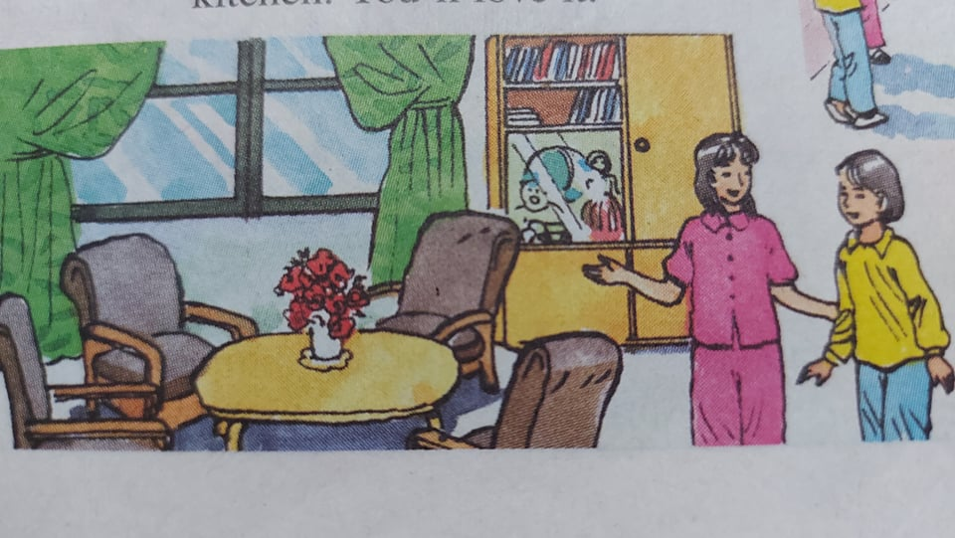
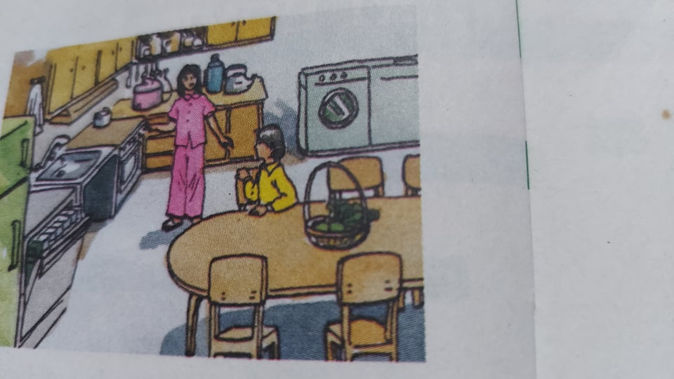
DIALOGUE:
Hoa: What an awful day! You must be cold, Lan.
Come in and have a seat. That armchair is comfortable.
Lan: Thanks. What a lovely living room!
Where are your uncle and aunt?
Hoa: My uncle is at work and my aunt is shopping.
Would you like some tea?
Lan: No, thanks. I’m fine.
Hoa: Ok. Come and see my room.
Lan: What a bright room!
And what nice colors! Pink and white.
Pink is my favorite color.
Can I see the rest of the house?
Hoa: Of course.
Hoa: This is the bathroom.
Lan: What a beautiful bathroom!
It has a sink, a tub and a shower.
Hoa: Yes, it’s very modern.
Now come and look at the kitchen. You’ll love it.
Lan: Wow! What an amazing kitchen! It has everything:
washing machine, dryer, refrigerator, dishwasher, electric stove…
Hoa: Yes, it’s very convenient. How about a drink, Lan?
Would you like some orange juice?
Lan: What a great idea! I’d love some.

Slide 5

Now answer:
a/ Which rooms do Hoa and Lan talk about?
→ They talk about living room, bed room, bath room and kitchen.
b/ Why does Lan like Hoa’s room?
→ Because her room is bright and nice.
c/ What is the bath room?
→ It is beautiful. It has a sink, a tub and a shower.
d/ What is the kitchen?
→ It is convenient. It has everything: washing machine, dryer, refrigerator…..
About you:
e/ How many rooms are there in your house/ apartment?
f/ What things are there in your room/ kitchen/ bathroom?

Slide 6
A2/ (page 30, 31)
Exclamations (Câu cảm thán)
Diễn tả cảm xúc trước một sự vật hay sự việc xảy ra, ta dùng cách nói với:
WHAT + (a / an) +Adjective + Noun !
a/ Complaints: (Than phiền, phàn nàn)
Ex: What an expensive dress! (Một chiếc áo đầm đắt quá!)
What an awful restaurant!
What a lazy boy!
b/ Compliments: (Khen ngợi)
Ex: What a great party!
What a pretty girl!
What intelligent boys!
PRACTICE: Write exclamations.
a/ Complaints:
1/ boring party → What a boring party!
2/ wet day → ________________!
3/ bad movie → __________________!
b/ Compliments:
4/ interesting movie → _____________!
5/ delicious dinner → _____________!
6/ bright room → _____________!
7/ lovely house → _____________!
8/ beautiful day → _______________!

Slide 7

HOMEWORK:
*Learn new words, grammar by heart.
*Read dialogue many times.
*Repare : B/ Hoa’s family B1

Slide 8

Week 5 - Period 14
Unit Three: AT HOME (Cont)
B/ Hoa’s family.
B1/ (page33)
New words:
*What does your father/ your mother do?: Bố/ Mẹ bạn làm nghề gì?
*Farm (n): nông trại, trang trại
*Farmer (n): nông dân.
*work on the farm: làm việc ở nông trại
*work in the field: làm việc trên cánh đồng
*countryside (n): miền quê, thôn quê
*grow (v): trồng trọt
*raise (v): nuôi
*cattle (n): gia súc
*work hard: làm việc vất vã, cực nhọc
*from morning till night: từ sáng tới tối
*housework (n): công việc nhà
*job (n): công việc
*LOVE + V-ing: yêu thích làm gì
→ love working on the farm: thích làm việc ở nông trại
*photo (n): tấm hình, tấm ảnh

Slide 9
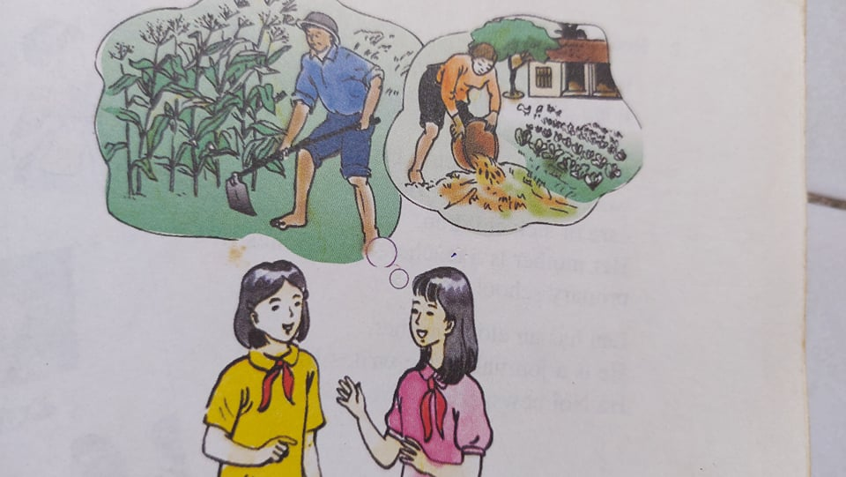
LDIAOGUE:
Lan: Tell me about your family, Hoa.
What does your father do?
Hoa: He’s a farmer. He works on our farm in the countryside.
He grows vegetables and raises cattle.
Lan: What about your mom? What does she do?
Hoa: She’s always busy. She works hard from morning till night.
She does the housework, and she helps on the farm.
Lan: Do they like their jobs?
Hoa: Yes, they love working on their farm.
Lan: Do you have any brothers or sisters?
Hoa: Yes. I have a younger sister. She’s only 8. Here is a photo of her.

Slide 10
Now answer: (page 33, 34)
a/ What does Hoa’s father do? → He’s a farmer.
b/ Where does he work? → He works on the farm.
c/ What is her mother’s job? → She is a farmer, too.
d/ What does she do every day? → She does housework and
helps on the farm.
e/ Are they happy? → Yes, they are.
f/ How old is Hoa’s sister? → She is only 8 years old.

Slide 11

HOMEWORK:
*Learn new words by heart
*Read dialogue many times.
*Phần A3, A4 → HS tự học. (Tiết 15)

Slide 12
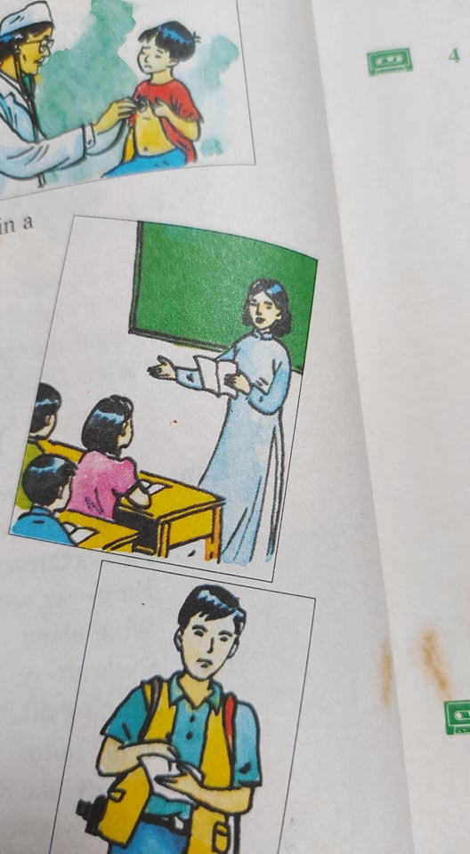
Week 6 Period 16
Unit Three: AT HOME (Cont)
B2/ Read (page 34)
What’s about Lan’s family?
What do her parents do?
Her father is a doctor. He works in a hospital. He takes care of sick children.
Her mother is a teacher. She teaches in a primary school.
Lan has a elder brother. He is a journalist. He writes for a Ha Noi newspaper.
New words:
*hospital (n): bệnh viện
*take care of: chăm sóc
*sick childrent: bệnh nhi
*primary school (n): trường tiểu học (cấp 1)
*elder brother: anh lớn
*journalist (n): phóng viên, nhà báo
*newspaper (n): tờ báo
*write for a Ha Noi newspaper: viết cho tòa soạn báo Ha Noi.

Slide 13
Now practice with a partner.
a/ Talk about La’s family.
What does her father/ mother/ brother/ do?
Where does he/ she work?
About you.
b/ Talk about your family.
Where does your father/ mother/ brother/ sister work?
What does she/ he do?
B3 (page 35)
Match these half-sentences.
A farmer writes for a newspaper.
A doctor works on a farm.
A journalist teaches in a school.
A teacher takes care of sick people.

Slide 14
B4/ Listen. Complete these forms for three people on the tape. (page 35)
Name: _Tom___
Age: __26_____
Job: __Teacher____
Place of work: _ High School.
Name: __Susan__
Age: _19____
Job: __Journalist_____
Place of work: _Newspaper
Name: ___Bill____
Age: __20____
Job: ___Nurse_____
Place of work: _Hospital_
Remember: (page 37)
What does he/ she do? → He/ She is a doctor.
Where does he/ she work? → He/ She works in a hospital.
Does he/ she work in a factory? → Yes, he/ she does. / No, he/ she doesn’t.
Adjective | Comparative | Superlative
Good | Better | The best
Cheap | Cheaper | The cheapest
Expensive | More expensive | The most expensive

Slide 15

WeeK 6 – Tiết 17
REVIEW: (Unit 1,2,3)
A/Grammar: a/ Simple Present Tense.
b/ Present Continuous Tense.
c/ Simple Future Tense.
d/ Ordinal numbers.
e/ Prepositions.
f/ Comparative and Superlative.
g/ Occupations.
h/ Question words
B/Vocabulary.

Slide 16
EXERCISES:
A/ Choose the best word:
1/ He takes care of sick children in the hospital. He is a ____. (Journalist/ teacher/ artist/ doctor)
2/ Would you like ______ dinner with me? (having/ have/ has/ to have)
3/ Hoa doesn’t have ______ friends in Ha Noi. (many/ lots/ a lots of/ much)
4/ How far ______ from your house to the cinema? (it is/ is it/ does it/ it does)
5/ ______ nice weather! (What a/ What/ Which/ How)
6/ Nam studies _____ other students in his class. (hard/ hardest/ harder than/ harder)
7/ Children enjoy ________ cartoons. (watch/ to watch/ watches/ watching)
8/ It is good for you _______ morning exercise. (do/ does/ doing/ to do)
9/ Her mother is a _____. She works in the factory. (doctor/ worker/ nurse/ teacher)
10/ Which city is ______? – London or Tokyo ? ( the biggest/ bigger/ the big/ big)
B/ Supply the correct form of the word:
11/ Be careful ! The teacher (look) ________ at you.
12/ What an __________ kitchen. (amaze)
13/ The armchair is ________. (comfort)
14/ My parents _________ a new house next month. (buy)
15/ Mai sometimes ________ to music in her free time. (listen)
16/ Linh often ________in hue for a week. (stay)
17/ John Robinson is an English _________ from USA. (teach)
18/ Pink is my _________ color. (favor)
19/ How old _____ she _____ on her next birthday? (be)
20/ She hopes she ________ many new friends soon. (have)

Slide 17
C/ Rewrite the second sentence so that it has a similar meaning to the first sentence:
21/ The student is intelligent. → What ____________________________________!
22/ The movie is awful. → What _________________________________________!
23/ What is your date of birth? → When ___________________________________?
24/ It is difficult to listen to English. → It is not ______________________________?
25/ Where do you live? → What _________________________________________?
26/ He looks after the sick people. → He takes ______________________________.
27/ What’s his father’s job? → What ______________________________________?
28/ My class has fifty students. → There are ________________________________.
29/ I walk to school every day. → I go _____________________________________.
30/ Your book is newer than my book. → My book ___________________________.
D/ Make questions for the underlined words:
31/ The students go to school by bus. → ___________________________________?
32/ Nam will be 14 on his next birthday. → __________________________________?
33/ Mai worried because she doesn’t have any friends.
→ ________________________________________?
34/ The film starts at 8 p.m. → ______________________________?
35/ I live at 357 Le Van Si Street. → ___________________________?
36/ Her telephone number is 0908734246. → ________________________________?
37/ My family name is Nguyên. → _________________________________________?
38/ It is about 500 meters from my house to the bus stop.
→ ________________________________________?

Slide 18

HOMEWORK:
Learn new words, structures and grammar carefully.
*Phần B5, B6 trang 35/36 HS tự học. (Tiết 18)
*Prepare Unit 4.

