Slide 1


WELCOME TO ENGLISH 7
UNIT TWO: PERSONAL INFORMATION
Tuần : 3 & 4
Tiết: 7 → 12

Slide 2
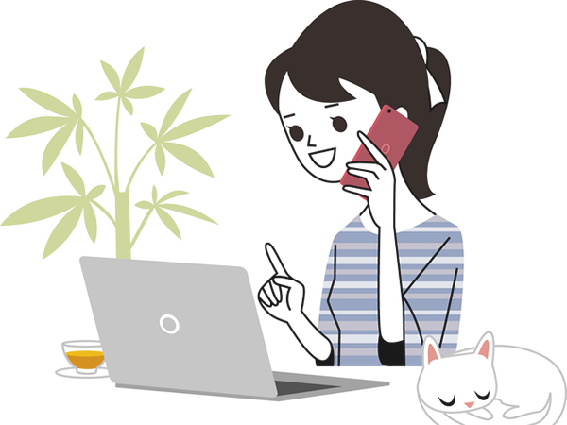
TUÂN 3: Tiết 7
UNIT TWO : PERSONAL INFORMATION (Thông tin cá nhân)
A/ Telephone numbers. (Số điện thoại)
A 1/ TELEPHONE DIRECTORY: (Danh bạ điện thoại) (page 19)
Practice with a partner. Say the telephone number for these people.
EX: a/ Dao Van An : C8 Giải Phóng 7 345 610
b/ Pham Viet Anh : 21 Lương Ngọc Quyến 8 269 561
c/ Pham Thanh Ba : 131 Hàng Bạc 5 267 117
A 2/ Listen and write the telephone numbers.
a/ 8 251 654 b/ 8 250 514 c/ 8 521 936 d/ 8 351 793 e/ 8 237 041 f/ 8 821 652

Slide 3
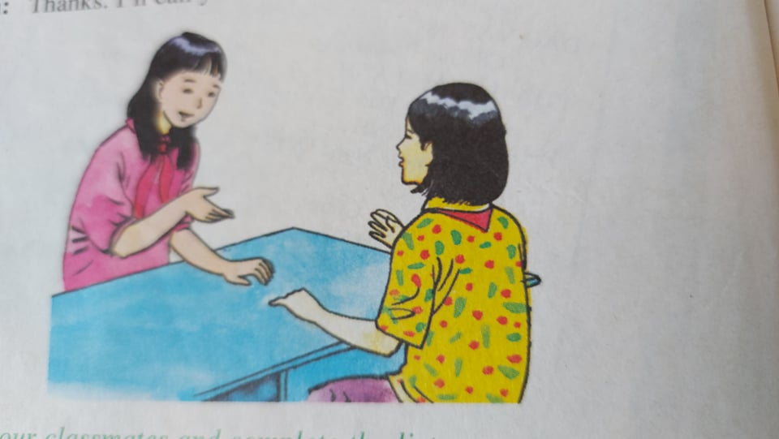
Tiết 8
UNIT TWO: (Cont)
A 3/ LISTEN: (page 20)
Lan: Excuse me, Hoa.
Hoa: Yes, Lan?
Lan: What’s your telephone number?
Hoa: 8 262 019
Lan: Thanks. I’ll call you soon.
Notes:
*Excuse me : xin lỗi (để hỏi thăm một điều gì đó)
*What’s your telephone number?: Số điện thoại của bạn là số mấy?
→My telephone number is 0908 922 907.
*I’ll call you soon: Tôi sẽ gọi lại sau.
Now ask your classmates and complete the list.
NAME | ADDRESS | TELEPHONE NUMBER
TRAN VAN MINH | 12 Tran Hung Dao Street | 8 524 576
NGUYEN MINH ANH | 245 Le Van Si Street | 8 123 789

Slide 4
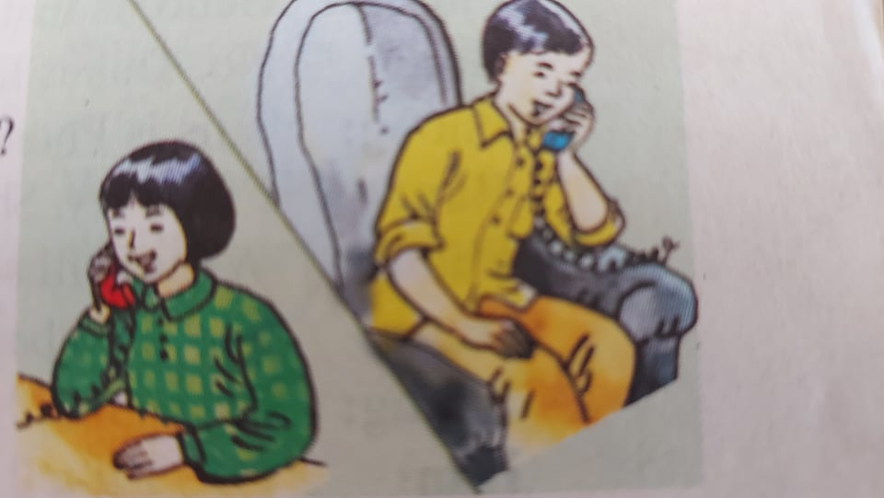
A 4/ Listen and Read. Then answer the questions.
Phong: Hello. This is 8 537 471.
Tam: Hello. Is this Phong?
Phong: Yes. Who’s this?
Tam: It’s me, Tam. Will you be free tomorrow evening?
Phong: Yes, I will.
Tam: Would you like to see a movie?
Phong: Sure. What time will it start?
Tam: It’ll start at seven o’clock.
Let’s meet at 6.45.
Phong: Where will we meet?
Tam: We’ll meet in front of the movie theater.
Phong: Great. I’ll see you tomorrow. Don’t be late!

Slide 5
Notes:
*Free (adj): rảnh rỗi =/= busy (adj): bận rộn
*Would you like + to-V……? Bạn có muốn/ thích ….? (Lời mời lịch sự)
*to see a movie : xem phim
*start (v): bắt đầu =/= finish (v): kết thúc.
*Let’s + V…. Chúng ta hãy
*in front of (adv) phía trước=/= behind (adv): phía sau
*Don’t be late! : đừng đến trễ nhé!
Questions:
a/ Who will meet tomorrow? →Phong and Tam will meet tomorrow.
b/ What will we do? →They will see a movie.
c/ What time will they meet? → They will meet at 6.45.
d/ Where will they meet? → They will meet in front of the movie theater.

Slide 6
Tiết 9:
A 5/ Listen. Then write the answers.
a/ Telephone number: ....8 545 545.............
b/ They will see: …………a movie…………………
c/ They will meet at: ……Lan’s house…………
d/ They will go by: …………bus……………………….
GRAMMAR:
THE SIMPLE FUTURE TENSE: (Thì Tương Lai Đơn)
Diễn tả hành động xảy ra trong tương lai, thường đi với các trạng từ chỉ thời gian như: tomorrow, tonight, next week/ month/ year, soon…
(+) S + will + V
* I / We → Will = I’ll / We’ll
*He / She / It / You / They → Will = He’ll / She’ll / It’ll / You’ll / They’ll
EX: We will go to the meeting tomorrow.
She’ll be back home at 6 o’clock.
(-) S + Will + not + V… → Will + not = Won’t : sẽ không
EX: I won’t have a test tomorrow.
He won’t come here next week.
(?) Will + S + V …?
EX: Will you study English tomorrow ? Yes, I will. / No, I won’t.

Slide 7
TUÂN 4 :
TiẾT 10:
B/ MY BIRTHDAY
B 1/ Listen and repeat.
ORDINAL NUMBERS: (Số thứ tự)
First (1st ) – Second(2nd ) – Third(3rd ) – Fourth(4th ) – Fifth (5th ) – Sixth(6th ) – Seventh(7th ) – Eighth (8th ) – Ninth (9th ) – Tenth (10th )
Eleventh (th ) - Twelfth (12th ) – Thirteenth (13th ) – Fourteenth (14th )
– Fifteenth (15th ) – Sixteenth (16th ) – Seventeenth (17th ) – Eighteenth (18TH ) – Nineteenth(19th ) – Twentieth (20th )
Twenty-first (21st )/ Twenty-second (22nd )/ Twenty-third (23rd ) / Twenty-fourth (24th ) / Twenty-fifth(25th ) / Twenty-sixth (26th ) /
Twenty- seventh (27th ) / Twenty- eighth(28th ) / Twenty-ninth (29th ) / Thirtieth (30th )– Thirty-first (31st )……

Slide 8
B 2/ Listen and write the dates.
JULY
*The first of July.
*The sixth of July.
*The fourteenth of July.
*The seventeenth of July.
*The nineteenth of July.
*The thirty-first of July.
B 3/ Write the months in order from first to twelfth.
January – February – March – April – May – June – July – August – September – October – November – December

Slide 9
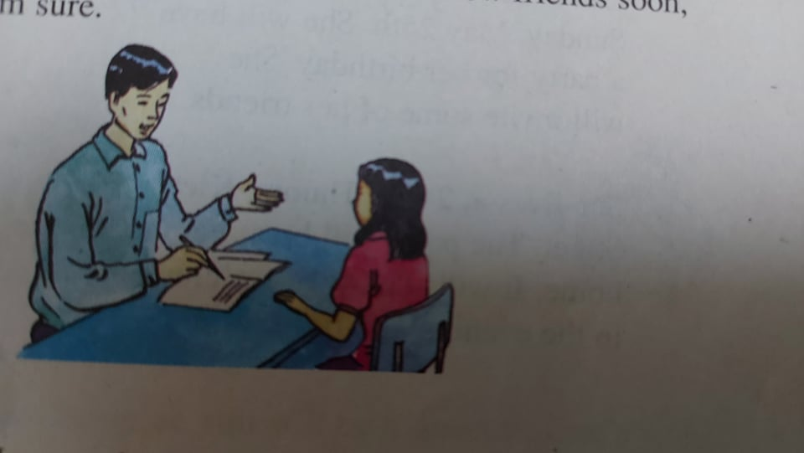
TiẾT 11:
B 4/ Listen. Then practice with a partner. (page25)
Mr. Tan: Next, please.
Hoa: Good morning.
Mr. Tan: Good morning. What’s your name?
Hoa: Pham Thi Hoa.
Mr.Tan: What’s your date of birth?
Hoa: June eighth. I’ll be 14 on my next birthday.
Mr. Tan: What’s your address?
Hoa: 12 Tran Hung Dao Street. I live with my uncle and aunt.
Mr. Tan: What’s your telephone number?
Hoa: 8 262 019.
Mr. Tan: Thank you, Hoa. Do you like our school?
Hoa: Yes. It’s very nice. But I’m very nervous.
I don’t have any friends. I won’t be happy.
Mr.Tan: Don’t worry. You’ll have lots of new friends soon, I’m sure.

Slide 10
NOTES:
*What’s your date of birth? Ngày tháng năm sanh của bạn là gì?
*When’s your birthday? Khi nào đến sinh nhật của bạn?
*What’s your telephone number? Số điện thoại của bạn là gì?
My telephone number is ……….
*nervous (adj): lo lắng = worried
*Don’t worry: đừng lo lắng.
*soon: chẳng bao lâu, chẳng mấy chốc.
Now answer:
a/ How old is Hoa now? → She is 13 years old now.
b/ How old will she be on her next birthday? →She will be 14 on her next birthday.
c/ When is her birthday? → Her birthday is on June eighth (8th June).
d/ Who does Hoa live with? → She lives with her uncle and aunt.
e/ Why is Hoa worried? → Because she doesn’t have any friends.
About you.
f/ How old will you be on your next birthday? → I will be 14 on my next birthday.
g/ Who do you live with? → I live with my mother, father and brother.
h/ What’s your address? → My address is at 12 THD Street.

Slide 11
TiẾT 12:
B 5/ Read the dialogue again. The complete this form.
Student Registration Form
Name: Pham Thi Hoa
Date of birth: June eight
Address: 12 THD Street
Telephone number: 8 262 919
Complete this invitation card to Lan’s party.
Dear Minh
I am having a birthday party on Sunday, May 25th . The party will be at my house at 24 LTK Street from 55:00 to 9:00 pm
I hope you will come and join the fun.
Love,
Lan
Tel: 8 674 758
B 6/ Read. Then complete the card
Lan is 12. She will be 13 on Sunday,
May 25th . She will have a party for her birthday.
She will invite some of her friends.
She lives at 24 Ly Thuong Kiet Street.
The party will be at her home. It will start at five o’clock.
In the evening and finish at nine.
Invite (v): mời
*invitation card: thiệp mời

