Slide 1
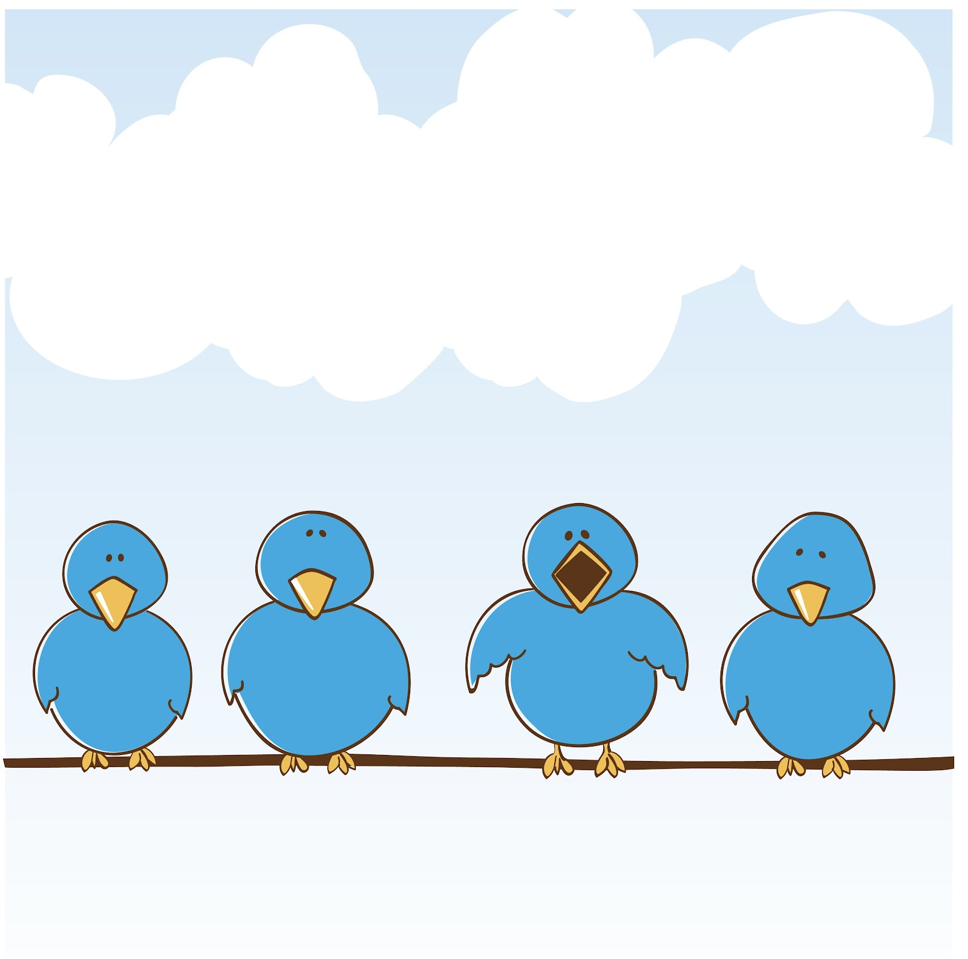
REVIEW UNIT 1-2-3

Slide 2
The Present
Simple
Tense

Slide 3
Positive and Negative
I We You They | like cheese. don’t like cheese.
He She It | likes cheese. doesn’t like cheese.

Slide 4
Questions and Short Answers
I you we they he she it | like cheese?
Do
Does
Yes, I/we/they/you/do
Yes, he/she/it does
No, I/we/you/they don’t
No he/she/it doesn’t.

Slide 5
I. Underline the correct answers
1. We sometimes (read/ reads) books.
2. Emily (go/ goes) to the art club.
3. It often (rain/rains) on Sundays.
4. Pete and his sister (wash/washes) the family car.
5. I always (hurry/ hurries) to the bus stop.
6. She (speak/ speaks) four languages.
7. Jane is a teacher. She (teach/ teaches) French.
8. Those shoes (cost/ costs) too much.
9. My sister (go/ goes) to the library once a week.
10. We both (listen/ listens) to the radio in the morning.

Slide 6
II. Put “do/ don’t/ does/ doesn’t” in each blank to complete the sentences.
1. My mother likes chocolate, but she__________ like biscuits.
2. _________ the children wear their uniform at your school?
3. Lynn’s father watches badminton on TV, but he _________ watch judo.
4. Where _________ the Masons buy their fruit?
5. _________ the cat like to sleep on the sofa?
6. Dogs love bones, but they _________ love cheese.
7. Where _________ Sam and Ben hide their pocket money?
8. We eat pizza, but we _________ eat hamburgers.
9. _________ Miss Jenny read magazines?
10. _________ the boys play cricket outside?

Slide 7
III. Underline the correct word for each sentence.
1. Is this cup _______________ (your / yours)?
2. The coffee is _______________(my/mine).
3. That coat is _______________ (my/mine).
4. He lives in _______________ (her/hers) house.
5. You might want _______________ (your/yours) phone.
6. The new car is _______________ (their/theirs).
7. She cooked _______________ (our/ours) food.
8. Don't stand on _______________(my/mine) foot!
9. She gave him _______________ (her/hers) suitcase.
10. I met _______________ (their/theirs) mother.

Slide 8
Read the text. Choose the correct answer (A, B, or C).
I really like art, English, and literature. They're really interesting and can be fun. I don't like math, geography, or science. They're boring. My favorite subject at school is literature. I like learning about stories of people from different places and times. My favorite book is The Secret Garden. The author is Frances Hodgson Burnett. The girl in the novel, Mary Lennox, goes to live at her uncle's house and discovers a secret garden. She becomes friends with Dickon and her cousin Colin Craven. They often play together and take care of the garden. It's a very interesting story and I really love their friendship.
friendship.

Slide 9
1. What subjects does Simon like? A. math, geography, and science B. art, English, and literature C. He likes all of them. 2. Why does Simon like these subjects? A. They're interesting. B. He is good at them. C. They're exciting. 3. What is Simon's favorite subject? A. English. B. literature. C. math. | 4. Who's the author of Simon's favorite book? A. Mary Lennox B. Frances Hodgson Burnett C. Colin Craven 5. Why does Simon like the novel? A. He likes mystery novels. B. It has many fun adventures. C. He likes the children's

Slide 10
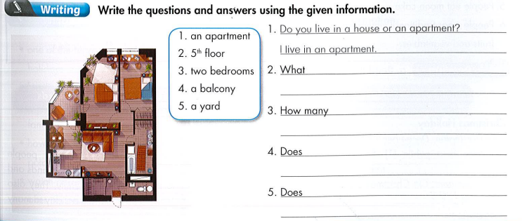

Slide 11
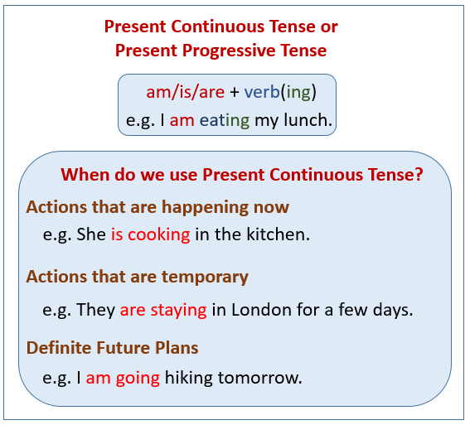

Slide 12
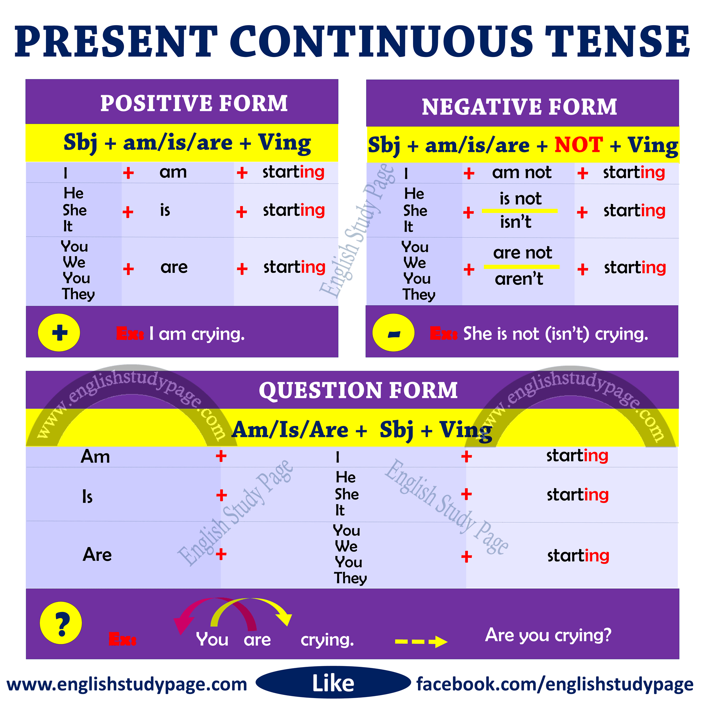

Slide 13
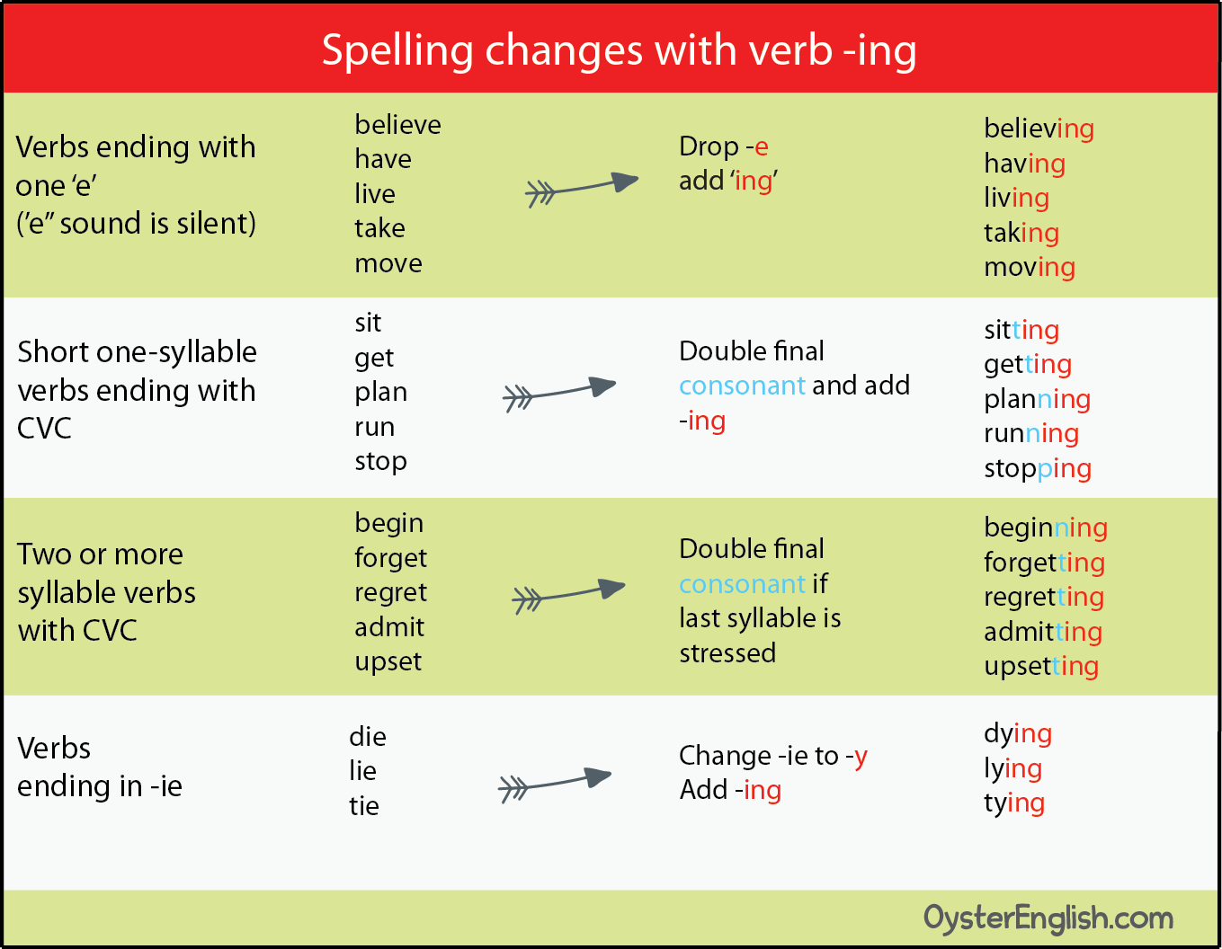

Slide 14
III. Fill in the blanks using the Present Continuous.
1. My brother (go)__________ shopping on Friday.
2. What __________ you (do)__________ tomorrow?
3. I (make)__________ a pizza tomorrow.
4. __________they (have)__________ a picnic in the park this weekend?
5. She (go)__________ to the mall with Mark on Saturday.
6. We (play)__________ basketball this evening.
7. __________he (watch)__________ a movie at home tonight?

