Slide 1
Week 9
EXERCISES

Slide 2
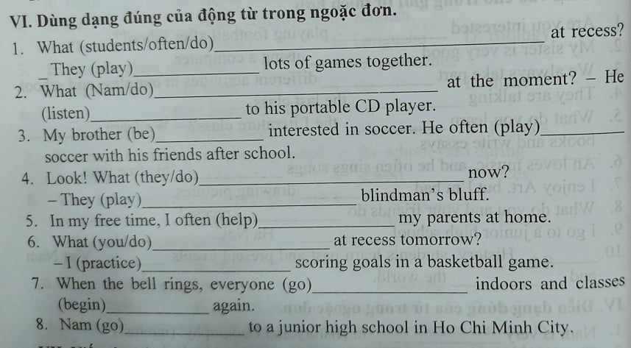

Slide 3
