Slide 1

Week: 9 - Period: 25
Unit Five: WORK AND PLAY
KHỐI 7
2021 - 2022

Slide 2
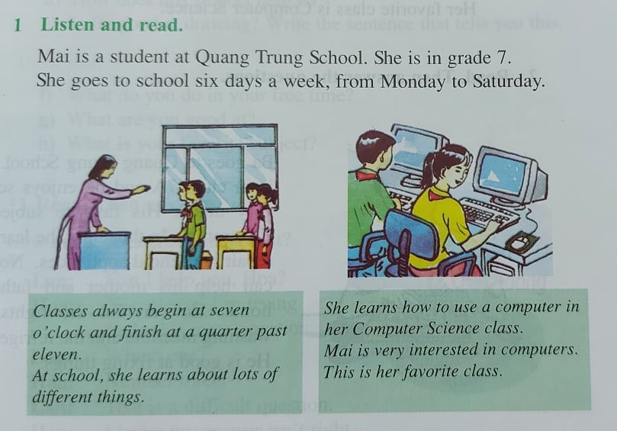
Week 9 – Period 25
Unit Five : WORK AND PLAY
A/ IN CLASS:
A1/ Listen and Read: (page 51, 52)
New words:
*learn how to use a computer: học cách sử dụng máy tính.
*Computer Science class: tiết tin học
*be interested in + Noun/ V-ing: yêu thích cái gì/ việc gì
____________________________
_____________________
__
____________

Slide 3
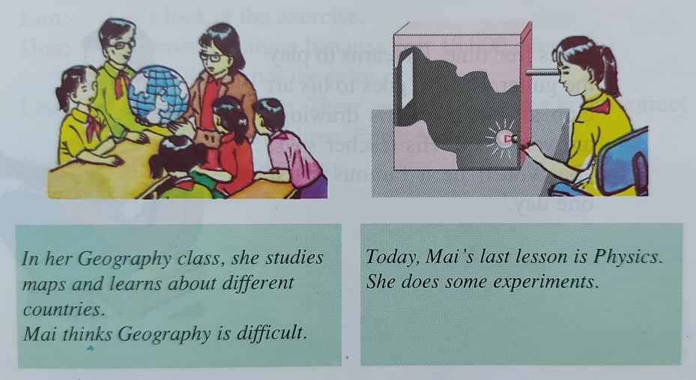
*map (n) : bản đồ
*country (countries) (n): đất nước
*experiment (n): cuộc thí nghiệm
* do some experiments: làm một vài thí nghiệm
____
______________________
________

Slide 4
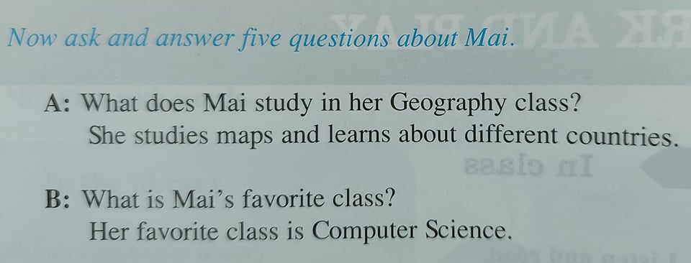
A: What does Mai study in her Computer Science class?
She learns how to use computer.
B: What does Mai do in Physics class?
She does some experiments.

Slide 5
REMEMBER:
I/ Strutures:
* What do you/ we/ they study in + Subject + class?
→ I/ We/ They study….
Ex: What do you study in History?
→ I study past and present events in Viet Nam and around the word.
*What does he/ she/ Peter learn in + subject + class?
→ He/ She/ Peter learns about …..
Ex: What does she learn in Physics class?
→ She learns about how things work.
II/ To Be good at + Noun / V-ng ( giỏi về việc gì đó)
Ex: She/ He/ Tom/ Minh is good at English.
They/ You/ We are good at fixing things.
III/ Adverbs of Frequency: (Trạng từ chỉ sự thường xuyên)
Always, Usually, Often, Sometimes, never.
*Đứng sau To Be.
*Đứng trước động từ chính.
Ex: They usually play baseball at recess.
We are always busy on weekdays.

Slide 6
HOMEWORK:
-Learn new words/ grammar by heart.
-Do exercises.
-Prepare next lessons.

Slide 7

Week 9 – Period 26
Unit Five: WORK AND PLAY (cont)
KHỐI 7
2021 - 2022

Slide 8
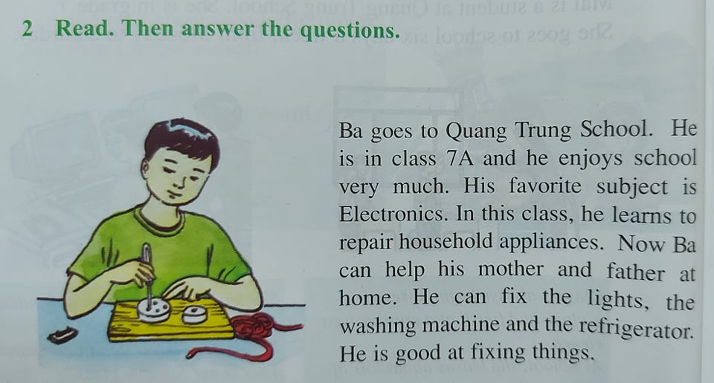
Week 9 – Period 26
Unit Five: WORK AND PLAY (cont) – (page 52)
New Words:
*enjoy + V-ing / Noun: yêu thích gì
*electronics (n): môn điện
*household appliances: thiết bị gia đình
*learn how to repair: học cách sửa chữa
*fix (v): sửa chữa
*be good at + V-ing / Noun: giỏi về việc gì
__________
________
_____
____________________
___
_______________

Slide 9
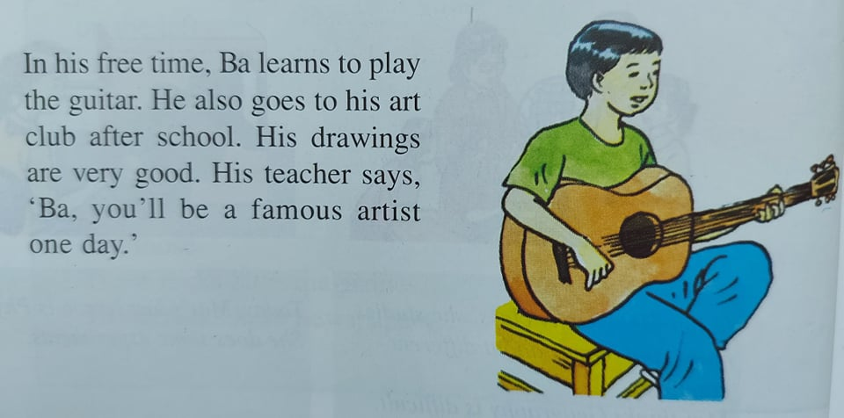
*learn to play the guitar: học chơi đàn ghi-ta
*Art Club: Câu lạc bộ Mỹ Thuật.
*Artist (n): họa sĩ * drawing (n): bức họa
*famous (adj): nổi tiếng
_______________
___________
____
____
_________
_________

Slide 10
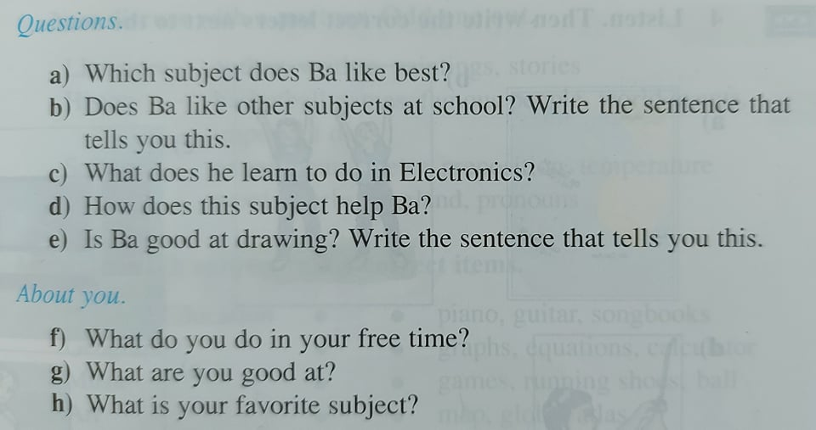

Slide 11
ANSWER:
a/ Ba likes Electronics best. (His favorite subject is Electronisc.)
b/ Yes, he also likes other subjects. “ He enjoys school very much.”
c/ He learns to repair household appliances in Electronics.
d/ He can fix the lights, the washing machine and the refrigerator.
e/ Yes, he is. “ His drawings are very good.”
About you:
f/ In my free time, I go to English club or learn to use computer.
g/ I’m good at English.
h/ My favorite subject is English.

Slide 12
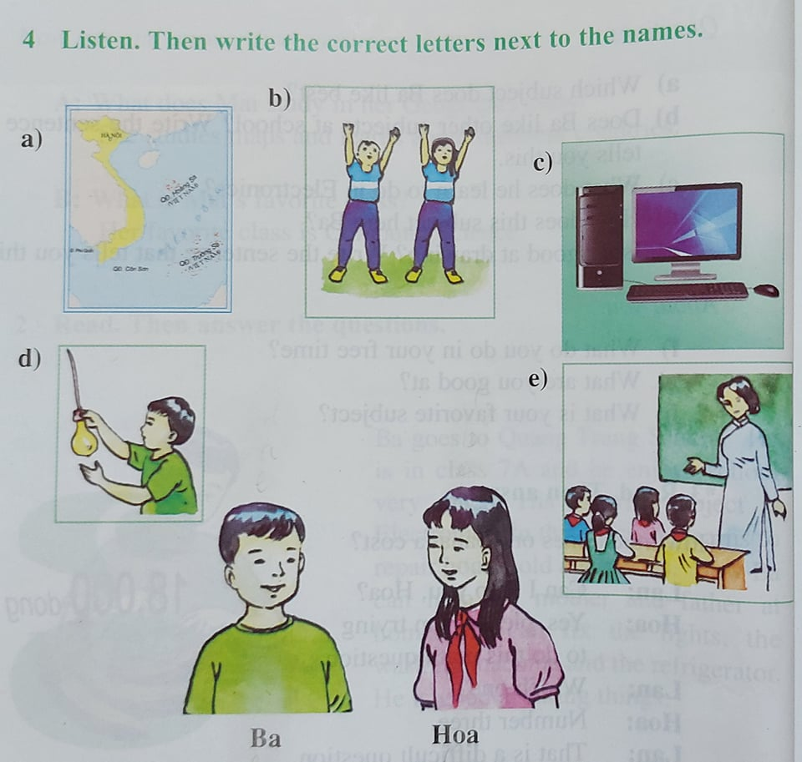
One Saturday morning, Ba and Hoa go to school. Some of the subjects they do on Saturday are the same, but some of them are different. At 7o’clock , Ba has Technology and Hoa has Computer Science. These classes last for two periods. At 8.40, Ba has Geography class. Hoa does not have Geography on Saturday. She has Physical Education instead. In the last period, they have the same class. Hoa and Ba both have class activity then.
d-a-e
b-c-e

Slide 13
HOMEWORK:
*Learn new words by heart.
*Do exercises.
* Prepare next lessons.

