Slide 1
Unit 1:
A VISIT FROM A PENPAL
Week: 2
Period: 4

Slide 2
Warm up:
Look at the pictures with the flags. How many countries are there in the ASEAN?
There are ten countries in the ASEAN:
Viet Nam, Malaysia, Singapore, Indonesia, the Philippines, Laos, Cambodia, Myanmar, Thailand, Brunei.

Slide 3

Formal name: Brunei Darussalam
Capital (city): Bandar Seri Begawan
Language: Malay, English
Currency: kip

Slide 4
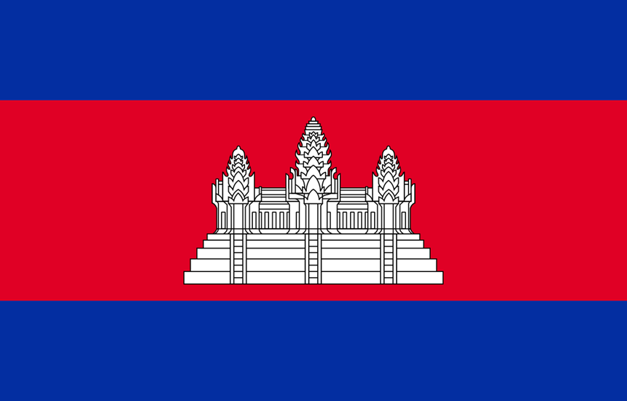
Formal name: Kingdom of Cambodia
Capital (city): Phnom Penh
Language: Khmer
Currency: riel

Slide 5
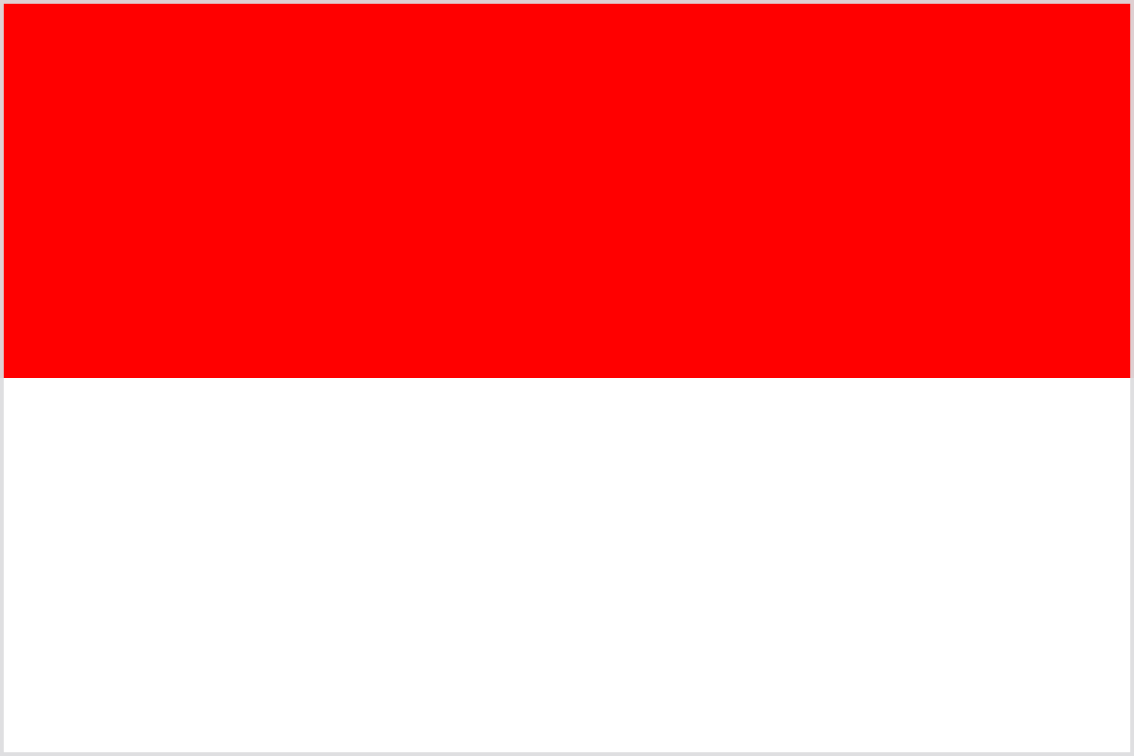
Formal name: Republic of Indonesia
Capital (city): Jakarta
Language: Bahasa Indonesia
Currency: rupiah

Slide 6
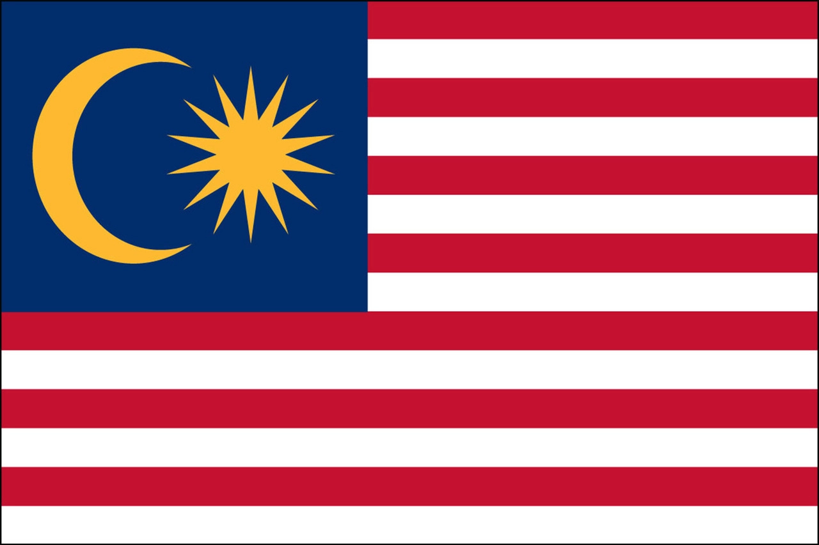
Formal name: Federation of Malaysia
Capital (city): Kuala Lumpur
Language: Bahasa Malay
Currency: ringgit

Slide 7
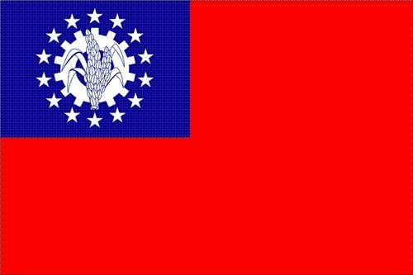
Formal name: Union of Myanmar
Capital (city): Rangoon
Language: Burmese
Currency: kyat

Slide 8
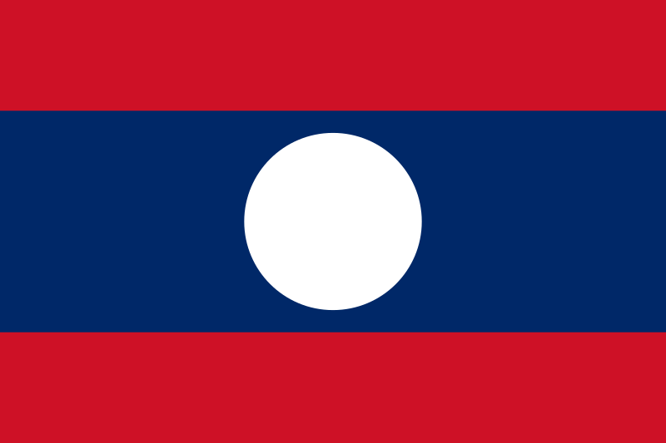
Formal name: Lao People’s Democratic Republic
Capital (city): Vientiane
Language: Lao
Currency: kip

Slide 9
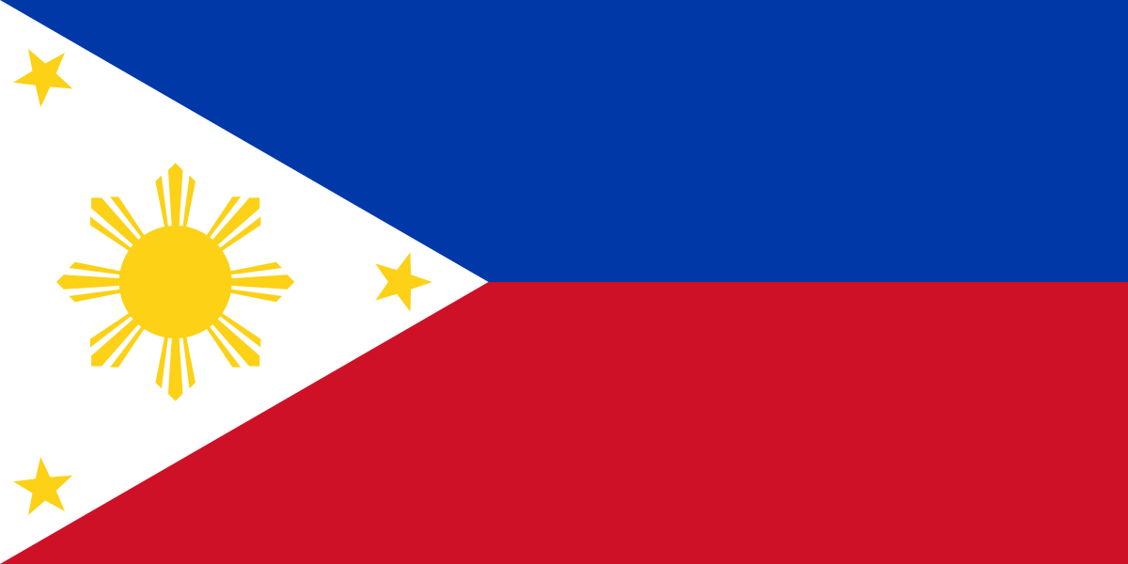
Formal name: Republic of the Philippines
Capital (city): Manila
Language: Filipino
Currency: peso

Slide 10
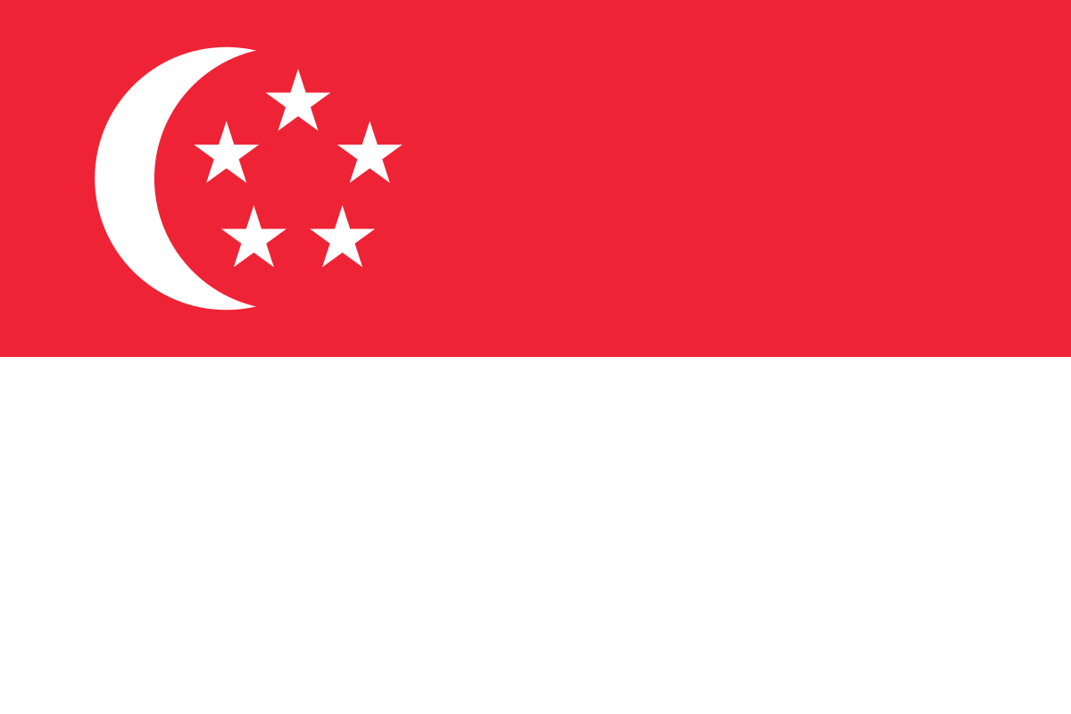
Formal name: Republic of Singapore
Capital (city): Singapore
Language: Chinese, Malay, Tamil, English
Currency: dollar

Slide 11
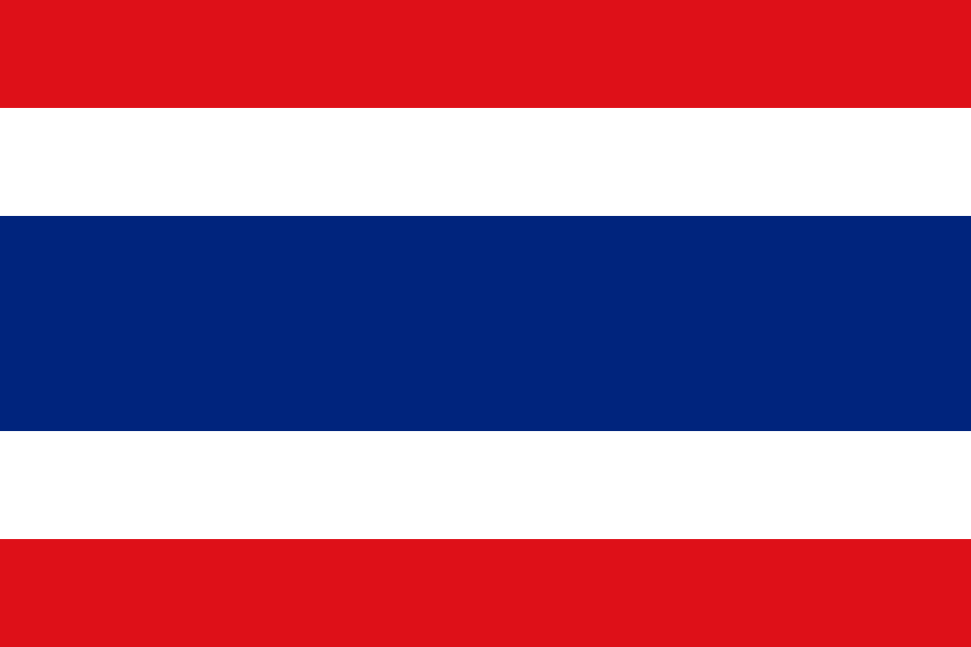
Formal name: Kingdom of Thailand
Capital (city): Bangkok
Language: Thai
Currency: bath

Slide 12

Formal name: Socialist Republic of Viet Nam
Capital (city): Ha Noi
Language: Vietnamese
Currency: dong

Slide 13
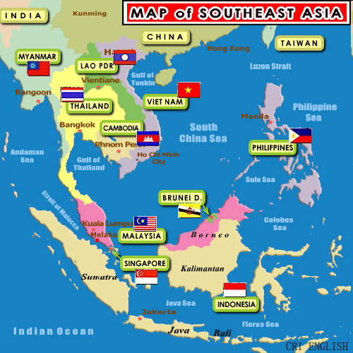

Slide 14
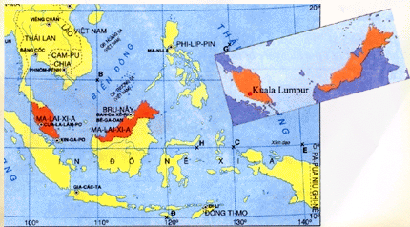

Slide 15
What do you know about Malaysia?
Where is it on the global map?
b) What is the capital of Malaysia?
c) What is its population?
d) How big is Malaysia?
e) What is the national language in this country?
It is in the Southeast Asia.
Kuala Lumpur.
Over 22 million.
329,758 sq km.
Bahasa Malaysia – Malay.

Slide 16
Vocabulary:
ASEAN: The association of Southeast Asian Nations
(hiệp hội các quốc gia Đông Nam Á)
comprise (v)
Bao gồm
unit of currency (n)
Đơn vị tiền tệ
tropical climate (n)
Khí hậu nhiệt đới
primary language
Ngôn ngữ chính
divide into (v)
Chia, chia ra
compulsory (a)
Bắt buộc

Slide 17
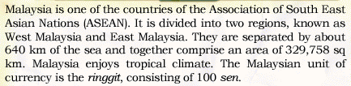
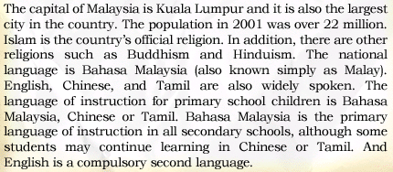


Slide 18
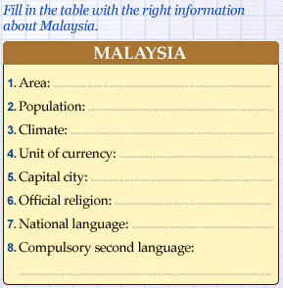
329,758 sq km
over 22 million (2001)
tropical climate
ringgit (consist of 100 sen)
Kuala Lumpur
Islam
Bahasa Malaysia
English

Slide 19
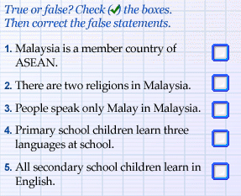
T
F
F
F
F
2-F: There are more than two religions.
3-F: English, Chinese, and Tamil are also widely spoken.
4-F: One of the three: Malay, Chinese, Tamil.
5-F: English is a compulsory second language, not primary language
of instruction. Bahasa Malaysia is a primary language of instruction
in all secondary school.

Slide 21
Ask and answer questions about Malaysia:
a) In what region is Malaysia?
It is in the ASEAN.
b) How many regions are there in Malaysia?
There are more than two regions in Malaysia.
c) What is its total area?
It is 329,758 sq km.
d) What is the population of Malaysia?
It is over 22 million in 2001.

Slide 22
HOMEWORK:
Learn by heart new words.
Read the text and talk about Malaysia.

