Slide 1


WELCOME
TO
ENGLISH 8

Slide 2
TUÂN1: Tiết 1
ÔN TẬP ĐẦU NĂM:
ADVERBS: (Trạng Từ)
1/Hầu hết các trạng từ được thành lập bằng cách thêm “LY” vào sau tính từ.
Slow (adj) → slowly (adv)/ clever (adj) → cleverly (adv)/ annual (adj) → annually
2/Ngoại lệ: Tính từ tận cùng bằng BLE, thì bỏ E trước khi thêm LY.
Enjoyable (adj) → enjoyably/ Sensible → sensibly/ Suitable → suitably/ True → truly
3/Một ngoại lệ khác: một tính từ tận cùng bằng E vẫn giữ nguyên rồi thêm LY.
Extreme (adj) → extremely (adv)/ approximate (adj) → approximately (adv)/ free (adj) → freely (adv)
4/Tính từ tận cùng bằng “Y” ta đổi y → i , trước khi thêm LY
Happy (adj) → happily (adv)/ greedy (adj) → greedily (adv)
5/ Ngoại lệ: Tính từ tận cùng bằng “Y”, giữ nguyên Y rồi thêm LY.
Dry (adj) → dryly (adv) : khô khan/ sly (adj) → slyly (adv): ranh mãnh
6/ Một số tính từ và trạng từ không thay đổi:
Early (adj) → early (adv)/ late (adj) → late (adv)/ hard (adj) → hard (adv)/ fast (adj) → fast (adv)/ high (adj) → high (adv)/ low (adj) → low (adv)/ long (adj) → long (adv)

Slide 3
ADJECTIVES: (Tính Từ)
1/ Tính Từ được thành lập bằng những cách thêm: Y/ AL/ IAL/ LY/ ISH/ IC/ OUS/ FUL vào sau danh từ.
Luck (n) → lucky/ hair (n) → hairy/ storm (n) → stormy/ wind (n) → windy
Accident (n) → accidental (adj)/ nature (n) → natural (adj)/
Commerce(n) → commercial(adj)
*man (n) → manly/ human (n) → humanly (adj)/ friend (n) → friendly (adj)
*Girl (n) → girlish (adj)/ child (n) → childish (adj)/ book (n) → bookish (adj)
*Tragedy (n) → tragic/ Artist (n) → artistic (adj)
Mystery (n) → mysterious (adj)/ fame (n) → famous (adj)
*Beauty (n) → beautiful (adj)/ care (n) → careful (adj)
2/ Một số tính từ được thành lập từ động từ.
*read (v) → readable (adj)/ enjoy (v) → enjoyable (adj)
*continue (v) → continuous (adj)/
*hate (v) → hateful (adj)/ help (v) → helpful (adj)
*tire (v) → tireless (adj)
*create (v) → creative (adj)

Slide 5

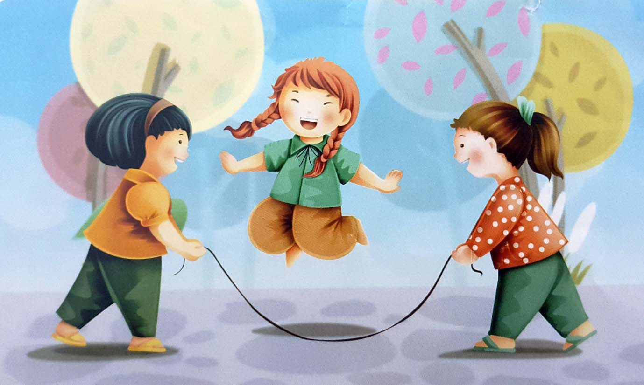
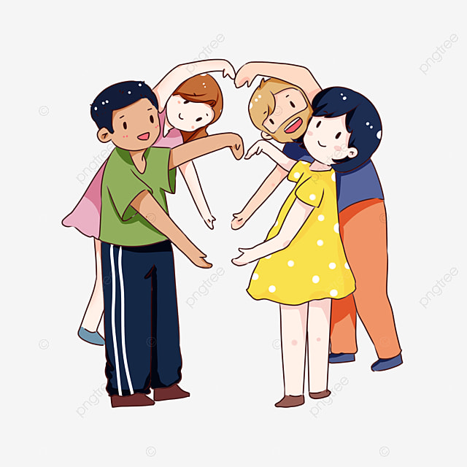
TiẾT 2
UNIT ONE:
MY FRIENDS

Slide 6
I/ GETTING STARTED: (page 10)
Describe these groups of friends and their favorite activities.
a/ They are playing football.
b/ The girls are reading books.
c/ They are playing chess.
d/ They are playing volleyball.
II/ LISTEN AND READ:
NEW WORDS:
Seem (v) + Adj: có vẻ như, dường như
receive … from(v): nhận, tiếp nhận…từ
next-door: cạnh nhà, kế bên nhà
neighbor(n) hàng xóm
neighborhood (n): khu phố, khu vực
What does she/he look like? Chị/ Anh ấy trông như thế nào?
photograph (n): tấm hình, tấm ảnh
photographer (n): thợ chụp hình/ ảnh
What a lovely smile? (What + (a/an) + adj + Noun !) nụ cười đáng yêu làm sao!
classmate (n): bạn cùng lớp
enough: đủ
Would you like + to V….? Bạn có muốn/ thích…?
I’d love to: tôi thích/ muốn.
ANSWER:
a/ She lives in Hue.
b/ No, she doesn’t.
c/ “She wasn’t old enough to be in my class.”
d/ She is going to visit Hoa at Christmas.

Slide 7
TiẾT 3
III/ SPEAK: (page11, 12)
1/ Read the dialogue.
Hoa: This person is short and thin. She has
long blond hair.
Lan: Is this Mary.
Hoa: Yes.
New words:
Build (n); dáng vóc
tall (adj): cao =/= short (adj): lùn, thấp
slim (adj): mảnh mai
thin (adj): gầy
Hair (n): tóc
long (adj): dài =/= short (adj): ngắn
straight (adj): thẳng
curly (adj): quăn, xoăn
brown (adj): nâu
black/ dark (adj): đen
blond/ fair (adj): vàng hoe/ vàng nhạt
bald (adj): hói
fat (adj): mập
2/ Now take turns to make similar dialogue. Use the adjectives in the table.
EX: A: This person is tall and thin.
He has short black hair.
B: Is this Văn ?
A: Yes.

Slide 8
IV/ LISTEN: (page 12, 13)
Listen and complete the conversations.
How do you do?: hân hạnh được biết bạn.
Nice to meet you./ It’s pleasure to meet you: rất vui được gặp bạn.
I’d like you to meet: tôi muốn bạn gặp…
pleasure (n): niềm vui, điều thú vị.
principal (n): hiệu trưởng
Answer:
I’d like you to meet
Nice to meet you
I’d like you to meet
It’s a pleasure to meet you
Come and meet
How do you do?

Slide 9
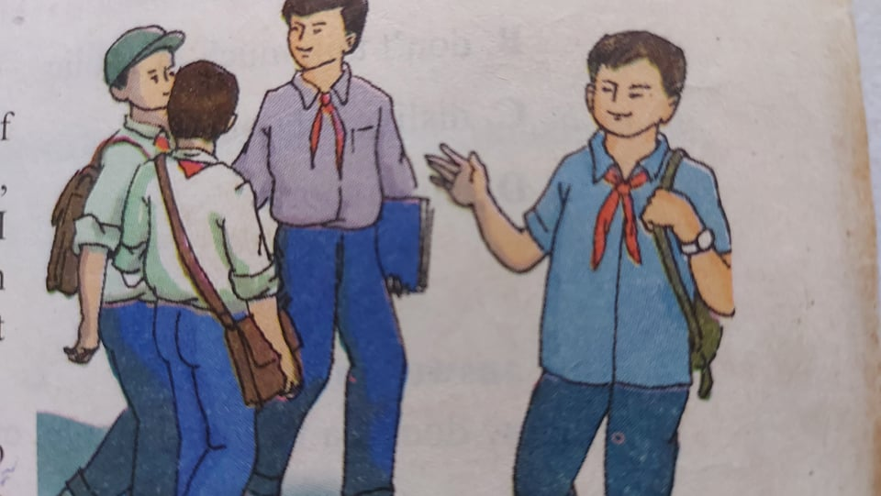
TiẾT 4:
READ: (page 13, 14)
Ba is talking about his friends.
I am lucky enough to have a lot of friends. Of all my friends, Bao, Khai, and Song are the ones I spend most of my time with. Each of us, however, has a different character.
Bao is the most sociable. He is also extremely kind and generous. He spends his free time doing volunteer work at a local orphanage, and he is a hard-working student who always gets good grades.
Unlike bao, Khai and Song are quite reserved in public. Both boys enjoy school, but they prefer to be outside the classroom. Song is our school’s star soccer player, and Khai likes the peace and quiet of the local library.
I am not as outgoing as Bao, but I enjoy telling jokes. My friends usually enjoy my sense of humor. However, sometimes my jokes annoy them.
Although we have quite different characters, the four of us are very close friends.
New words:
*lucky(adj): may mắn
*character(n): tính cách
*sociable(adj): hòa đồng
*extremely(adv): rất, cực kỳ
*generous(adj): rộng lượng
*do volunteer work: làm việc tình nguyện
*local orphanage: trại mồ côi địa phương
*hard-working: chăm chỉ
*unlike(adv): không giống, không như
*reserved(adj): kín đáo, rụt rè
*peace(n): hòa bình, thanh bình
*quiet(n): sự yên tĩnh
*outgoing(adj): cởi mở, vui vẻ
*joke(n): chuyện đùa
*sense of humor: óc hài hước
*annoy(v): làm phiền

Slide 10
1/ Choose the best answer and write:
a/ Ba talks about three of his friends.
b/ Bao’s volunteer work does not affect his school work.
c/ Khai and Song don’t talk much in public.
d/ Ba’s friends sometimes get tired of his jokes.
2/ Answer the questions:
a/ Ba feels lucky having a lot of friends.
b/ Bao is the most sociable.
c/ Khai likes reading.
d/ Ba’s jokes annoy his friends.
e/ Bao spends his free time doing volunteer.
f/ Yes, we do. We have the same characters.
11/ difficulty(n)/ difficult(adj)difficultly(adv): khó khăn
12/ happiness(n)/ happy(adj)/ happily(adv): hạnh phúc
WORD FORMS:
1/ annoy(v)/ annoyance(n)/ annoyed(adj): làm phiền
2/ generosity(n)/ generous(adj)/ generously(adv):rộng lượng
3/ humor(n)/ humorous(adj)/ humorously(adv): hài hước
4/ orphan(n): trẻ mồ côi/ orphanage(n): trại mồ côi
5/ peace(n)/ peaceful(adj)/ peacefully(adv): hòa bình
6/ sociable(adj)/ social(adj)/ sociably(adv): hòa đồng, thích xã giao
7/ differ(v)/ difference(n)/ different(from) (adj)/ differently(adv): khác biệt
8/ volunteer(n)/ voluntary(adj)/ voluntarily(adv): tình nguyện
9/ reservation(n)/ reserved(adj): bảo thủ, rụt rè
10/ care(n)/ careful(adj)/ carefully(adv): cẩ thận

Slide 11
TiẾT 5:
WRITE: (page 15)
1/ Read the information about Tam.
His name’s le Van tam and he’s fourteen years old. He lives at 26 Tran Phu Street in Ha noi with his mother, father and his elder brother, Hung. He’s tall and thin and has short black hair. He is sociable, humorous and heilful. His best friends are Ba and Bao.
2/ Fill in a similar form for your partner. Use the following questions as prompts.
EX: Name: Le Minh Anh Age: 14
Appearance (ngoại hình): tall, fat, long back hair
Characters (tính cách): generous, kind, helpful
Address: 15 Hai Ba Trung Street, HCM City
Family: mother, father elder sister, Hoa
Friends: Lan, Long
3/ Now write a paragraph about your partner.
___________________________________
___________________________________
___________________________________

Slide 12
TiẾT 6
LANGUAGE FOCUS:
A/ Present simlpe tense:
(+) S + V / V (s/es) (-) S + do / does + not + V (?) Do / Does + S + V…..?
Thì hiện tại đơn được dùng để diễn đạt:
Chân lý, sự thật hiển nhiên.
EX: The earth moves around the sun.
Water freezes zero degree Celsius.
*Thói quen hay sự việc xảy ra thường xuyên ở hiện tại.
EX: She goes to school five times a week.
We don’t often go out for a meal.
Sự việc xảy ra theo thời gian biểu.
EX: The new school year starts on September 6th .
B/ Quy tắc về thứ tự Tính Từ:
Khi có quá nhiều tính từ miêu tả đứng trước danh từ thì thứ tự được xếp như sau:
Size(kích thước), Age(tuổi tác), Shape(hình dáng), Color(màu sắc), Origin(nguồn gốc), Material(chất liệu) từ) + Noun (danh từ).
(Trong một câu không quá 3 tính từ)
EX: I have long straight black hair. (Tôi có mái tóc đen, thẳng, dài.)
She carried a small brown plastic bag. (Cô ấy mang 1 túi xách bằng nhựa màu nâu nhỏ.
There was a large round wooden table in the room. (Có 1 cái bằng gỗ tròn nhỏ.)

Slide 13
C/ Phrases of Result: (Cụm từ chỉ kết quả)
a/ Enough …to: (đủ….để có thể) được dùng để chỉ nguyên nhân dẫn đến một kết quả khẳng định. Enough thường theo sau tính từ (adjective) và trạng từ (adverb).
adjective / adverb + ENOUGH (for somebody) +to-V
EX: He is strong enough to lift the box.
Nam didn’t run fast enough to win the race.
She is old enough to drive a car.
The weather is fine enough for Mary and her brother to go camping.
ENOUGH + NOUN + to-V / For somebody
Ex: I don’t have enough money to buy a car.
There aren’t enough chairs for everyone.
b/ TOO…to: (quá…không thể) để chỉ nguyên nhân dẫn đến một kết quả phủ định. Too thường đứng trước tính từ và trạng từ.
S + V + TOO + adj/ adv + (for somebody) + to-V
Ex: He is too weak to run.
The coffee was too hot for me to drink.
These boxes are too heavy to carry.
He spoke too quickly for me to understand.

Slide 14
EXERCISES:
A/ Use “Adjective + ENOUGH + To-V”
EX: My brother is old. He can ride a motorbike.
My brother is old enough to ride a motorbike.
1/ They are tall. They can play volleyball.
2/ He is rich. He can buy that expensive house.
3/ She is good. She can pass the exam..
B/ Use “ ENOUGH + NOUN + To-V”
4/ We have money. We can buy that car.
5/ I don’t have money. I can’t go on holiday
6/ She has a lot of free time. She can go to the movie with you.
C/ Use “ Adjective + ENOUGH + For somebody + To-V”
7/ That book is interesting. You should read it.
8/ This song is simple. Everyone can sing it.
9/ Those apple aren’t ripe. We can’t eat them.
D/ Use “TOO….To-V”
10/ He is very young. He can’t go swimming alone.
11/ This book is very difficult. I can’t read it.
12/ Mary was tired. She didn’t go to work.

