Slide 1
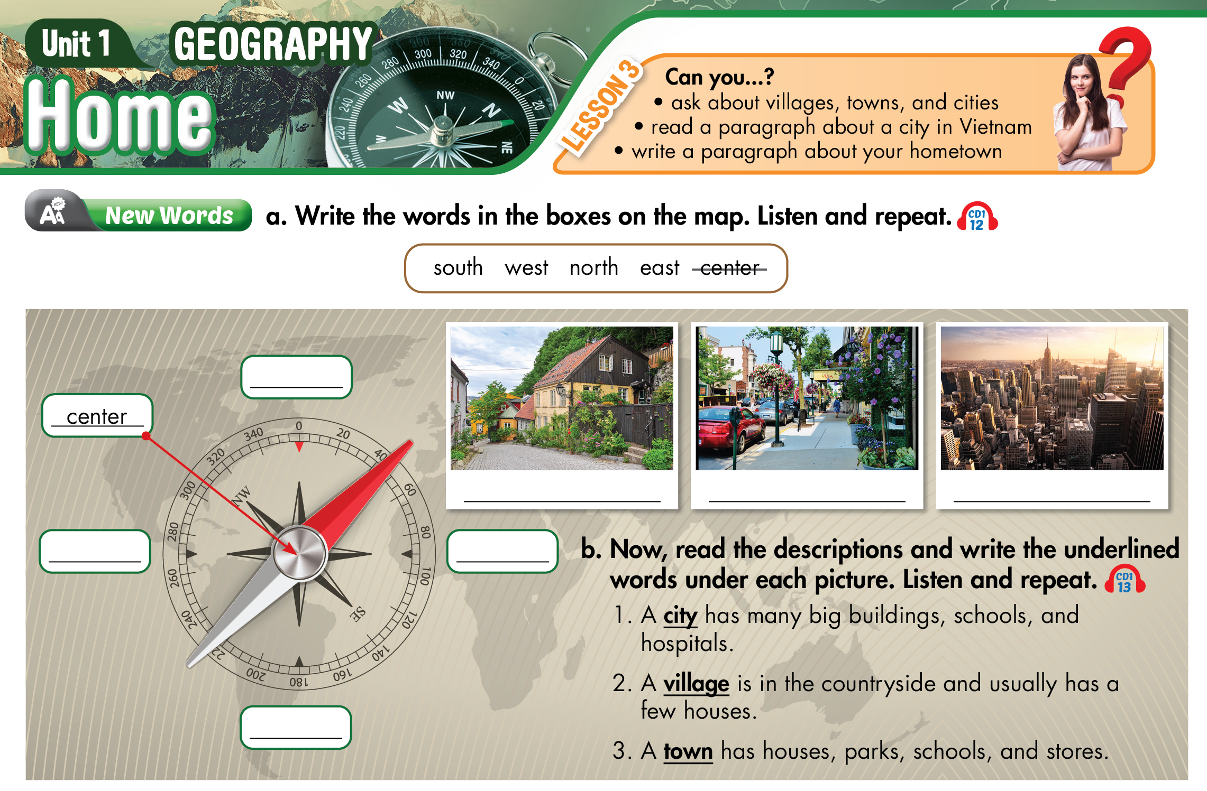

Lesson 3
north
village
town
city
west
east
south

Slide 2
UNIT 1: HOME – Lesson 2 (period 1)
New words
No | Words |  | Transcription | Meaning
1 | east | (n) | /iːst/ | hướng Đông
2 | west | (n) | /west/ | hướng Tây
3 | south | (n) | /saʊθ/ | hướng Nam
4 | north | (n) | /nɔːrθ/ | hướng Bắc
5 | village | (n) | /ˈvɪl.ɪdʒ/ | làng
6 | town | (n) | /taʊn/ | thị trấn
7 | city | (n) | /ˈsɪt̬.i/ | thành phố

Slide 3
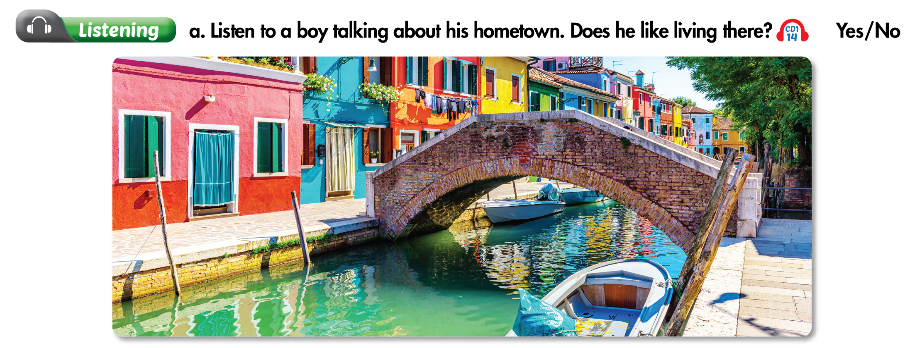
Lesson 3

Slide 4
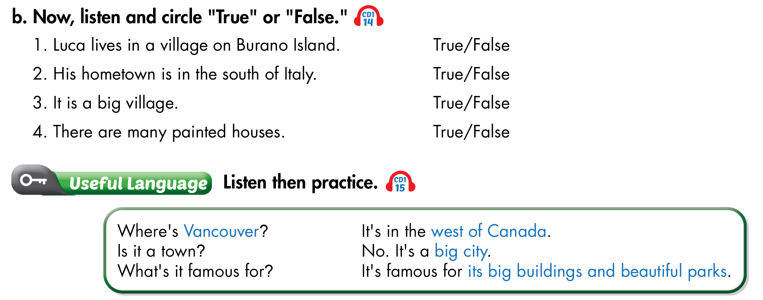
Lesson 3

Slide 5
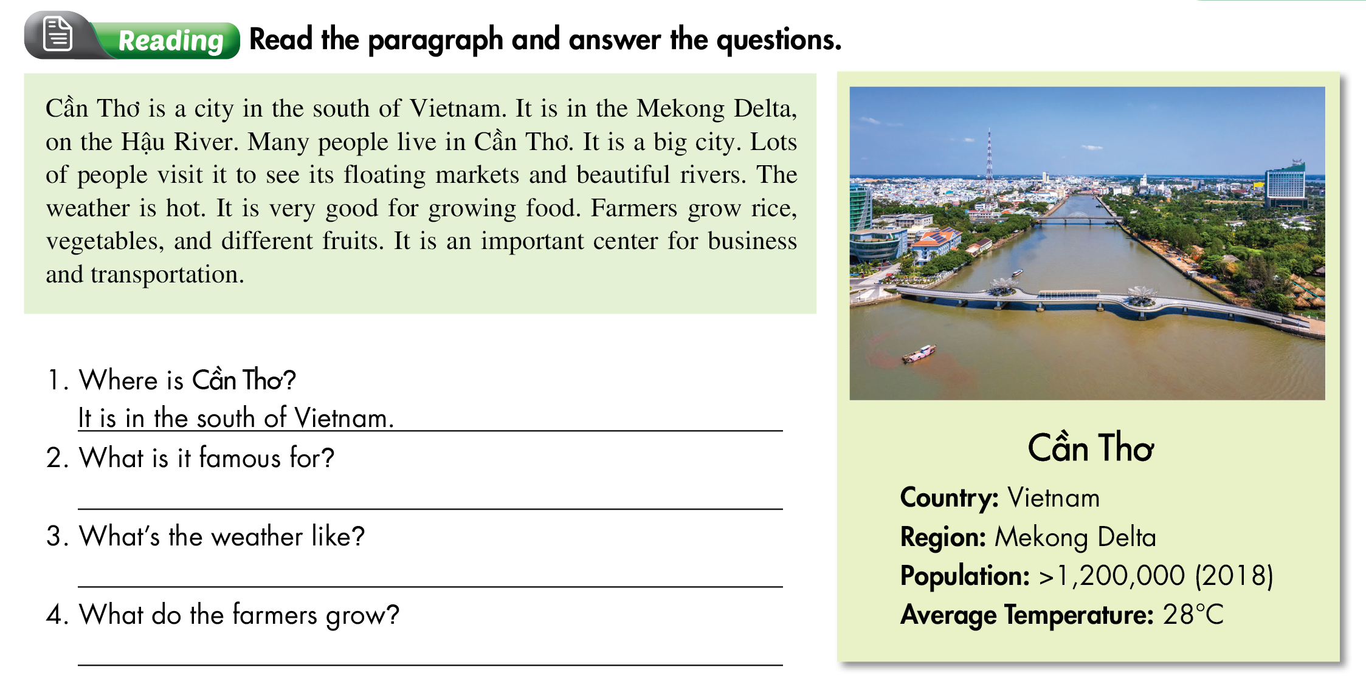
Lesson 3
It is famous for floating markets and beautiful rivers.
It’s hot.
They grow rice.

Slide 6
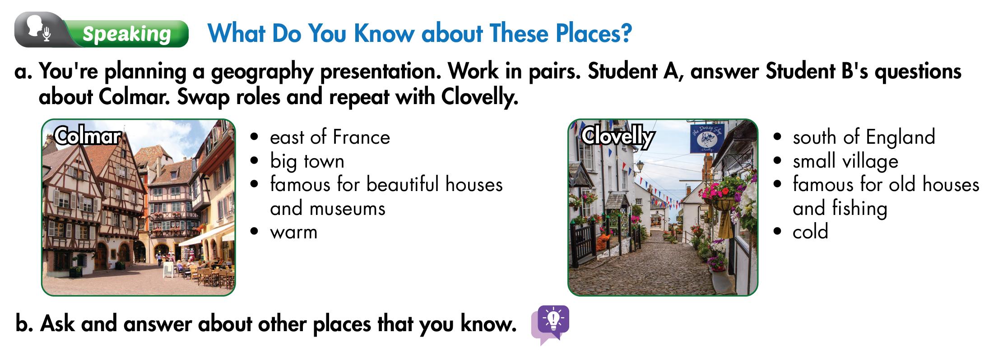
Lesson 3

Slide 7
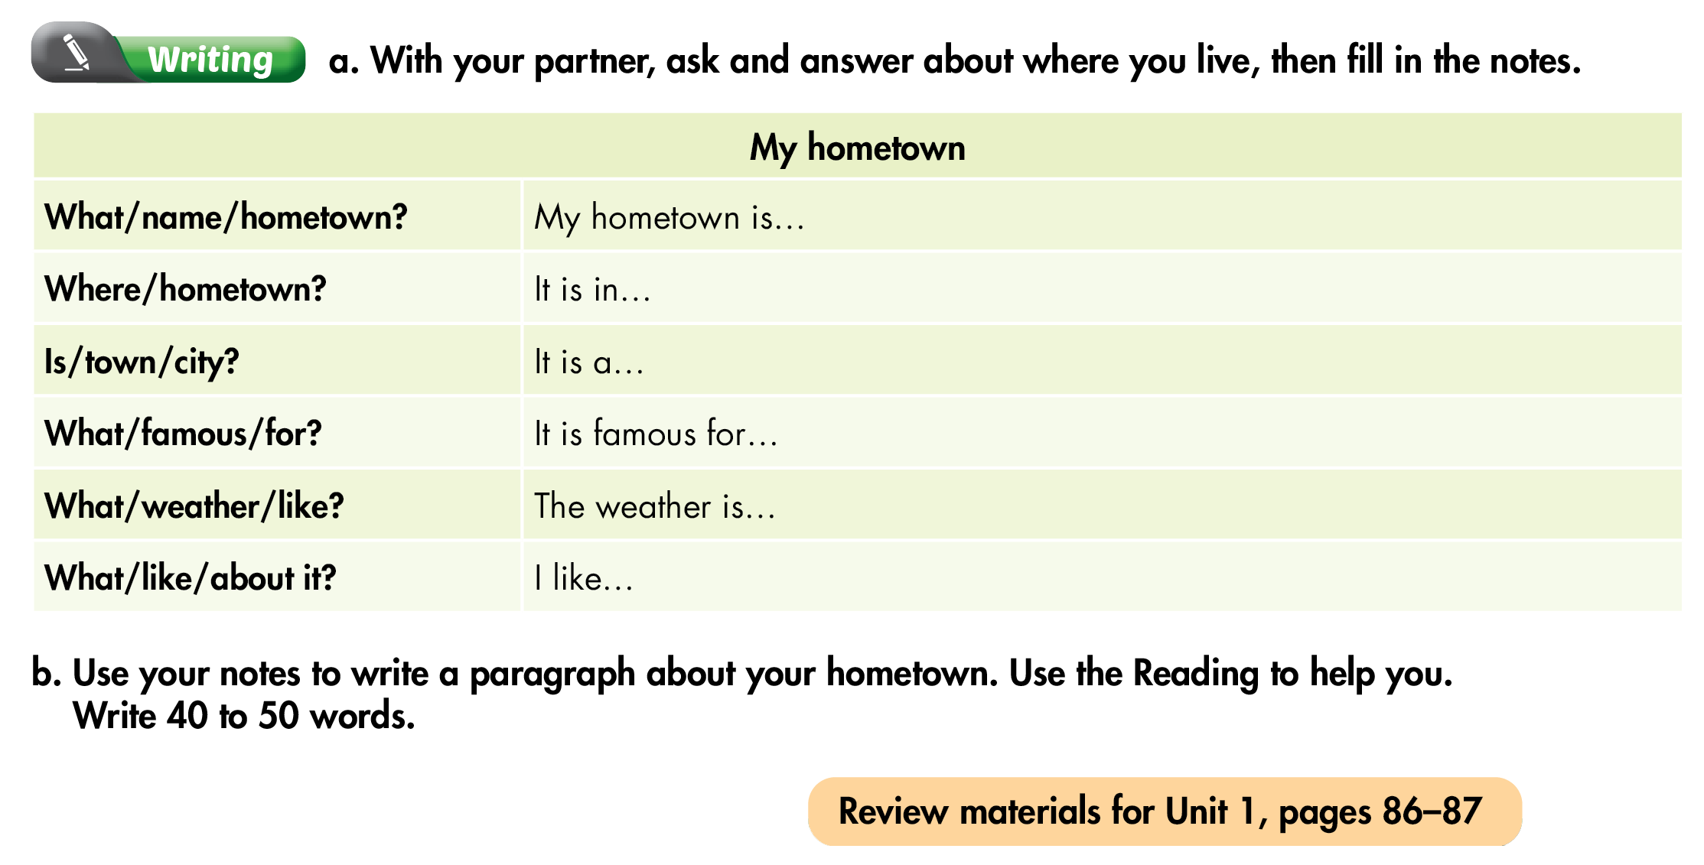
Lesson 3

Slide 8

Homework
HOMEWORK:
- Learn by heart and Write down 2 lines/ each word &
3 times/ grammar.
- Write five sentences about your city/ hometown.

Slide 9
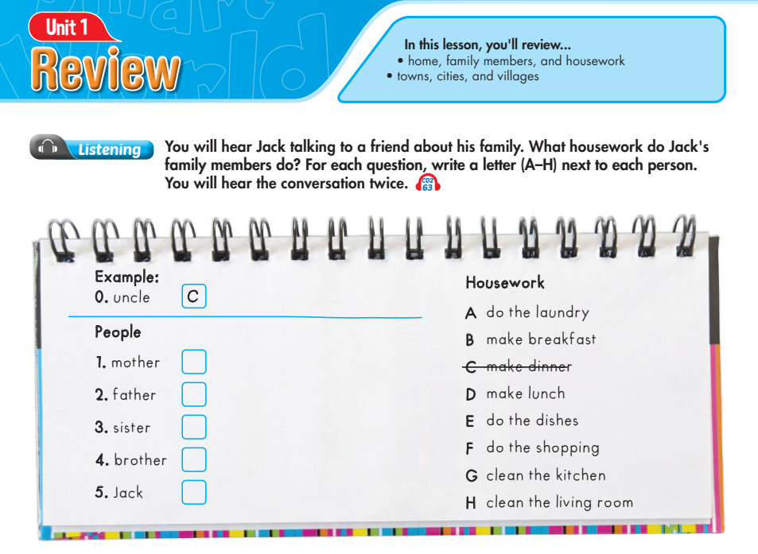
Lesson 1
A
F
G
E
B

Slide 10
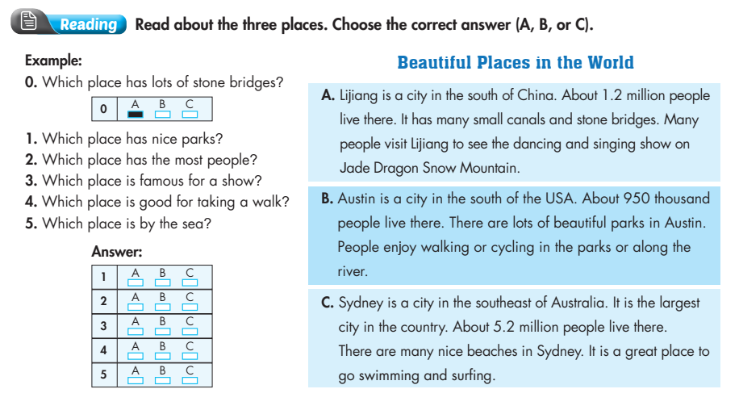
Review

Slide 11
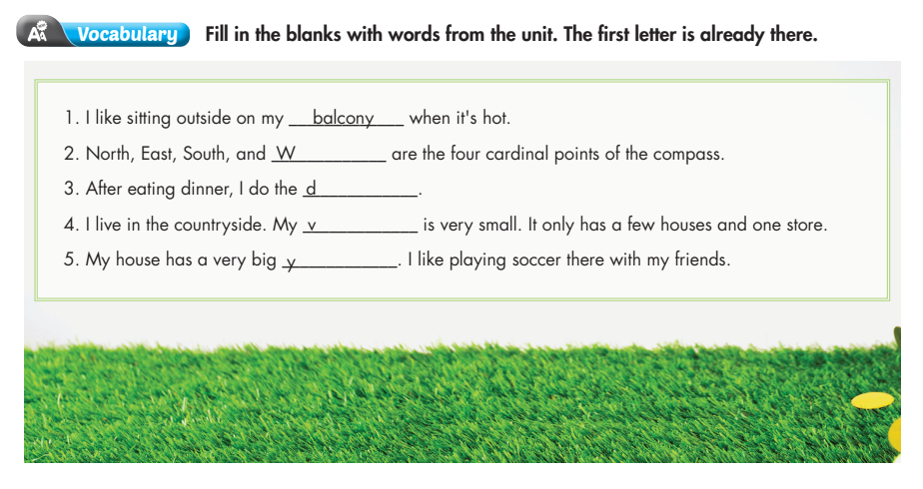
Review
est
ishes
illage
ard

Slide 12
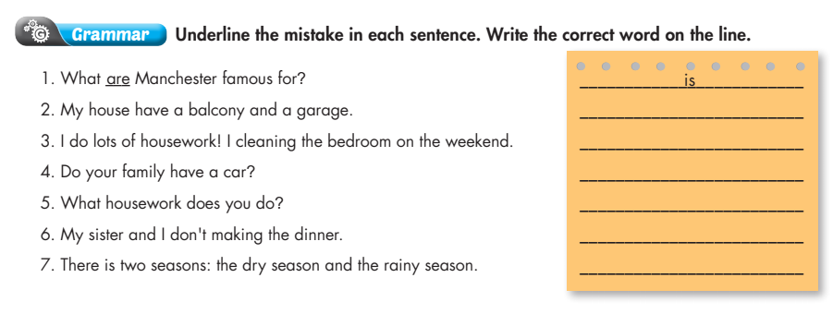
Review
has
clean
Does
do
make
are

Slide 13
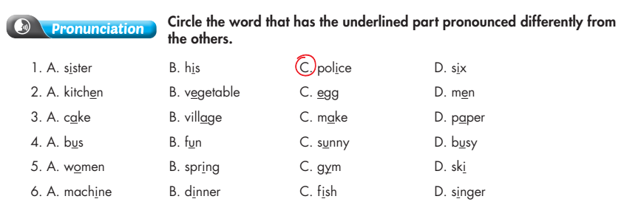
Review

