Slide 1

ENGLISH 8
BINH KHANH SECONDARY SCHOOL

Slide 2

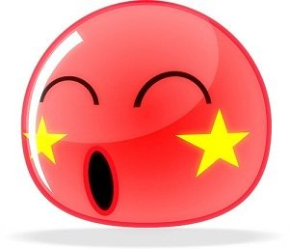
Welcome to our class!!!

Slide 3
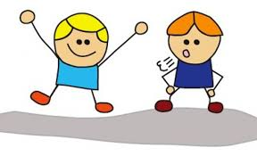


Slide 4


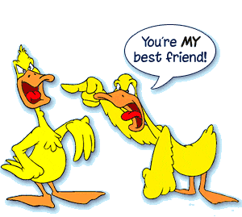
Unit 1:
My friends
PART: WRITE

Slide 5


1. VOCABULARY:
generous
thin
helpful
slim
kind
tall
black hair
fat
sociable
humorous
black hair
kind
humorous
tall
Characters.
Appearance.
thin
helpful
sociable
fat
generous
slim

Slide 6


PART: WRITE

Slide 7

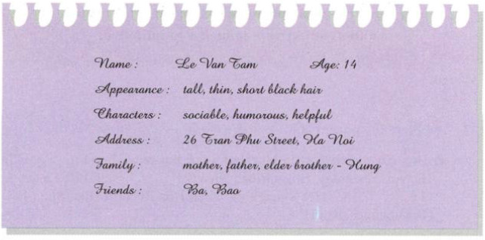
Read the information about Tam then answer the questions
Unit: 1 My friends
Lesson:5. Write

Slide 8
Read the information about Tam then answer the questions
Unit: 1 My friends
Lesson:5. Write
His name’s Le Van Tam and he’s fourteen years old. He lives at 26 Tran Phu Street in Ha Noi with his mother, father and his elder brother, Hung. He’s tall and thin and has short black hair. He is sociable, humorous and helpful. His best friends are Ba and Bao.

Slide 9
Read the information about Tam then answer the questions.
Unit: 1 My friends
Lesson 5: Write
(?) What’s his name?
His name’s Tam.
(?) How old is he?
He is 14 years old.
(?) What does he look like?
He is tall and thin. He has short black hair.
(?) What is he like?
He’s sociable, humorous and helpful.
(?) Where does he live?
At 26 Tran Phu street, Ha Noi.
(?) Who does he live with?
He lives with his mother, father and an elder brother.
(?) Who are his close friends?
They are Ba and Bao.

Slide 10
Make a similar form for your partner (one of your classmates)
Unit: 1 My friends
Lesson 5. Write
Name:………………. Age:……………..
Appearance:………………………………
Characters:……………………………….
Address:…………………………………….
Family:……………………………………….
Friends:…………………………………….

Slide 11
Write a paragraph about your friend
Now write a paragraph about your classmate using the information in your form.
*Useful:
This is my friend. His / Her name is ............... . He / She is ............... years old . He / She lives in ............... with ............... He / She is ............... and ............... He / She has ............... hair. He / She is ............... His / Her best friends are ...............

Slide 12
Now write a paragraph about your classmate using the information in your form.
Lesson 5: Write
(suggestion)
This is my friend. His name is Nam. He is 14 years old. He lives in Binh Khanh with his parents and his sister, Huong. He is tall and fat and he has short curly black hair. He is sociable, generous and helpful. His best friends are Phu and Quoc.

Slide 13
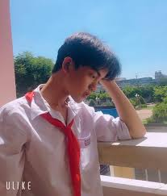
Unit: 1 My friends
Lesson 5. Write
Write a paragraph using given information.
Name: Tuan
Age: 15
Appearance: tall, fat, short black hair
Character: sociable, generous, helpful
Address: 21 Rung Sac
Street, Can Gio
Family: father, mother
and younger sister, Hanh
Friends: Thanh, Khoa

Slide 14
Unit1: My friends
Lesson5: Write
His name is Tuan. He is 15 years old. He lives at 21 Rung Sac Street, Can Gio with his father, mother and younger sister, Hanh. He is tall, fat and he has short black hair. He is sociable, generous, helpful. His best friends are Thanh, Khoa.

Slide 15




Homework
Write a paragraph about one of your family member.
Prepare for next lesson.

Slide 16






Thanks for your attention

