Slide 1

ENGLISH 8
BINH KHANH SECONDARY SCHOOL

Slide 2
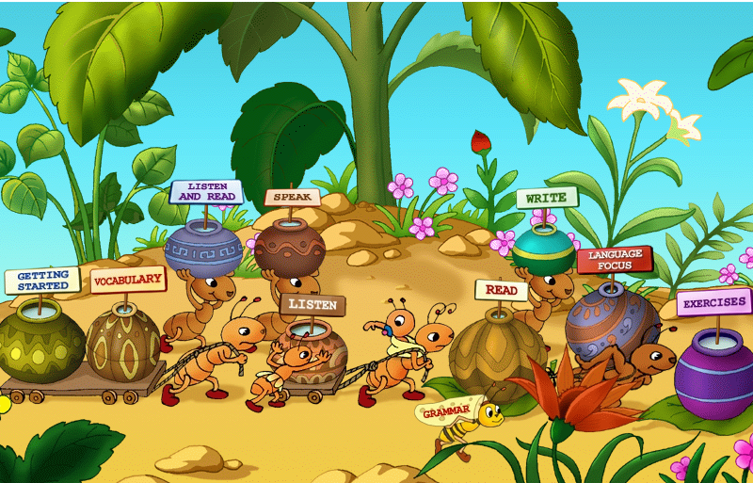

Good morning!

Slide 3
* Supply the simple past form of the verbs.
Infinitive/ Base form | Simple past
1. live
2. be
3. send
4. come
5. introduce
6. show
lived
was/ were
sent
came
introduced
showed

Slide 4
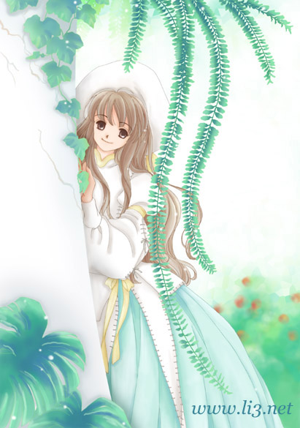
UNIT 1: MY FRIENDS
LESSON 5: LANGUAGE FOCUS

Slide 5


Language focus.
* Vocabulary:
- earth (n)
: tr¸i ®Êt
- Mercury (n)
: sao thuû
- Mars (n)
: sao ho¶
- rise(v)
: mäc
- set(v)
: lÆn

Slide 6
Practice:
* Complete the paragraph using correct form of the verbs in brackets.
lived
Hoa (0) ………(live) in Hue last year, but she now(1) ................. (live) in Ha Noi. Yesterday, Hoa’s friend, Nien (2) .................(send) Hoa a letter. Nien (3) .................(be) Hoa’s neighbor when Hoa lived in Hue. She (4) ................. (be) younger than Hoa.
Lan (0) …….(be) Hoa’s best friend. The two girls (1) .................(be) in the same class at Quang Trung school. Last year, Hoa (2) ................. (come) to the school for the first time. Lan (3) ................. (show) her around and (4) .......................... (introduce) her to many friends.
lives
sent
was
is
is
are
came
showed
introduced

Slide 7
* Complete the dialogue.
be move set rise go
Ba: What do you know about the sun, Tuan?
Tuan: The sun (0) ……….in the east and (2)
................. in the west.
Ba: Can you tell me anything about another
planet?
Tuan: I know something about the earth. It
................. around the sun.
Ba: Yes, and the moon (3) ................. around
the Earth.
Tuan: Where is Mars Ba?
Ba: It (4) ................. near the sun.
Tuan: No, It’s silly! That (5) .................
Mercury. Mars (6) ................. near the Earth
rises
sets
moves
moves
is
is
is

Slide 8
* Grammar note:
- She wasn’t old enough to be in my class
+be (not)
Form:
S
+adj
+ enough
+to
-infinitive (V)
Mean:
(không) đủ ……. để làm gì….

Slide 9
* Complete the dialogue.
a. Hoa:Can you put the groceries in your bag?
Lan: No, it is ……….…………to carry everthing (big)
b. Hoa: Is Ba going to drive his father’s car?
Lan: Don’t be silly! Ba is ....................................to drive a car (old)
c. Hoa: Do you need any help?
Lan: No, thanks. I’m ................................. to lift this box. (strong)
d. Hoa: Why don’t you join our Englishspeaking club?
Lan: I don’t think my English is ...............................to be a member. (good)
not big enough
not old enough
strong enough
good enough

Slide 10

HOMEWORK:
- Learn vocab and make sentences
Write 5 sentences about themselves using the
structure: “ be (not) adj enough + to V

Slide 11

GOODBYE !
SEE YOU AGAIN !

