Slide 1
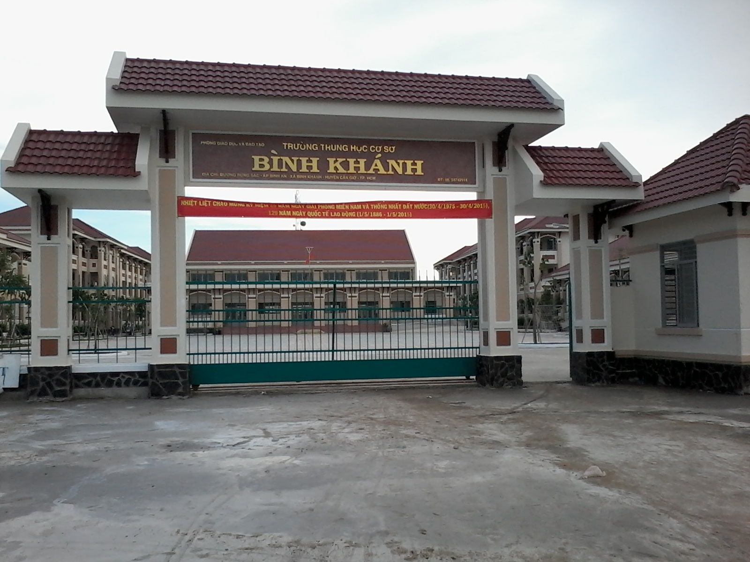



BINH KHANH SECONDARY SCHOOL
FRIENDS PLUS 6

Slide 2

UNIT 5: PUZZLES AND GAMES

Slide 3


Slide 4
H
B
R
E
C
O
D
A
R
Y
S
A
T
_ _ _ _ _ _ _ _ _ _ _ _ _
CARBOHYDRATES

Slide 5
N
I
M
I
A
S
V
T
_ _ _ _ _ _ _ _
VITAMINS

Slide 6
E
S
E
I
A
S
D
S
_ _ _ _ _ _ _ _
DISEASES

Slide 7
P
O
E
T
N
R
I
_ _ _ _ _ _ _
PROTEIN

Slide 8
L
M
N
I
R
E
S
A
_ _ _ _ _ _ _ _
MINERALS

Slide 9
W
R
E
A
T
_ _ _ _ _
WATER

Slide 10
A
F
T
_ _ _
FAT

Slide 11

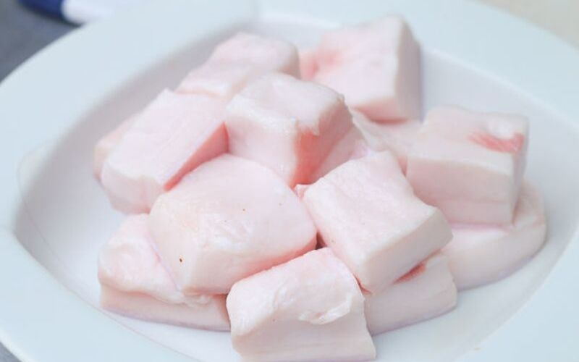

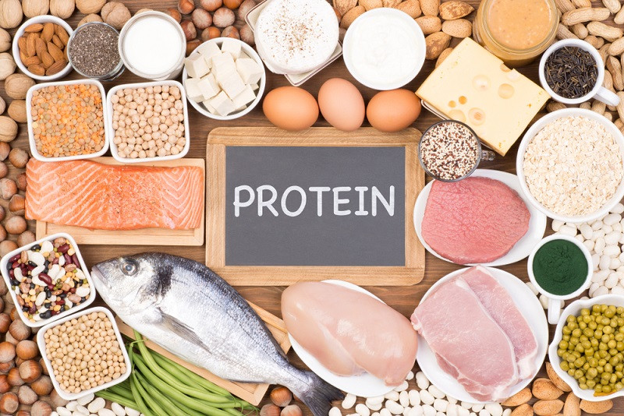

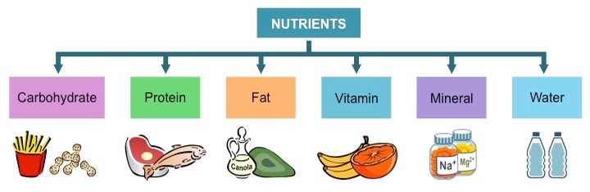

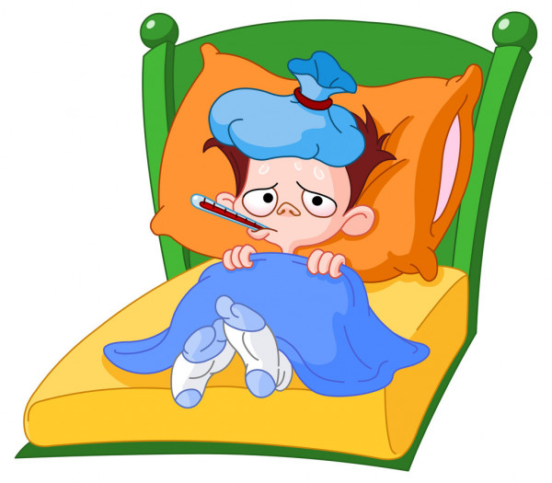
minerals (n)
fat (n)
carbohydrates (n)
protein (n)
vitamins (n)
water (n)
nutrients (n)
diseases (n)

Slide 12

1/ GUESS THE FOOD. Work in pairs. Look at the words in the box. One student chooses a word and makes a sentence about it. The other students listen and guesses the food.
burger, pasta, raisins, meat, juice,
sweets, rice, vegetables, nuts, crisps,
cheese, pear, olives, tuna
It’s got bread and meat. It’s unhealthy.
Burger?

Slide 13

2/ MEMORY GAME. Play in groups. Make sentences with a, an, a lot of, some and many. Follow the instructions.
In my kitchen, there’s
a lot of pasta and an apple.
In my kitchen, there’s
a lot of pasta.
In my kitchen, there’s
a lot of pasta, and apple, and some orange juice.
In my kitchen, there’s
a lot of pasta, and apple, some orange juice and ....
The first
student
The second
student
The third
student
The last
student

Slide 14
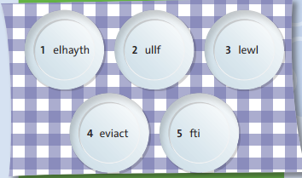
3/ Find five adjectives about health on the plates. Write the words.
healthy
full
well
active
fit

Slide 15

4/ Complete the crossword with the opposites of the adjectives from exercise 3.
L
A
I
Z
U
N
H
E
A
L
T
H
Y
N
U
L
F
N
I
G
T
R
Y

Slide 16
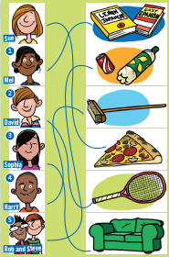
5/ Follow the lines and complete the sentences with the verb+-ing:
For example: Sue likes eating pizza.
1/ Mel enjoys _________________
learning languages.
playing tennis.
2/ David doesn’t like ____________
3/ Sophia really likes _______________
sitting on the sofa.
4/ Harry doesn’t mind _______________
doing housework.
5/ Rob and Steve love __________________
drinking fizzy drinks.

Slide 17
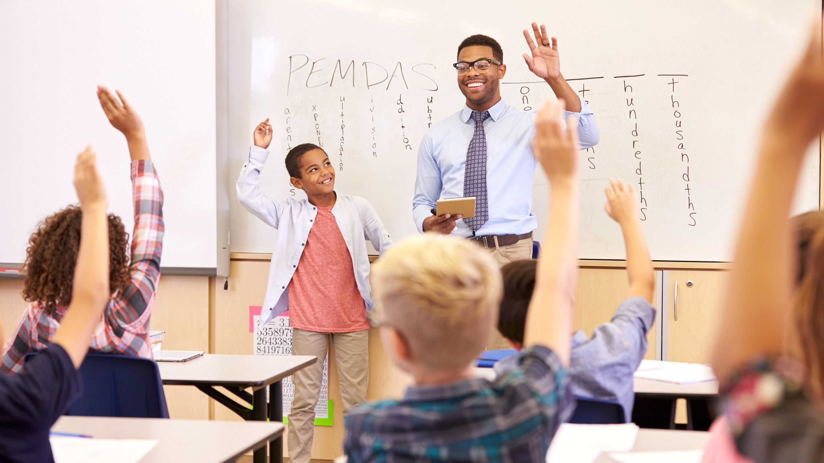
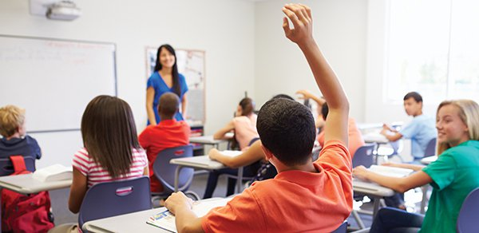
6/ The “Please” Game. Work in groups. Follow the instructions:
Raise your hand, please.
Raise your hand.
✓
✗

Slide 18

DISCUSSION TIME!
=>What have we learnt in Unit 5?

Slide 19

* Homework: - Review the grammar structures and new words of unit 5. - Prepare for the next lesson “Unit 6: SPORTS - VOCABULARY”.

