Slide 1
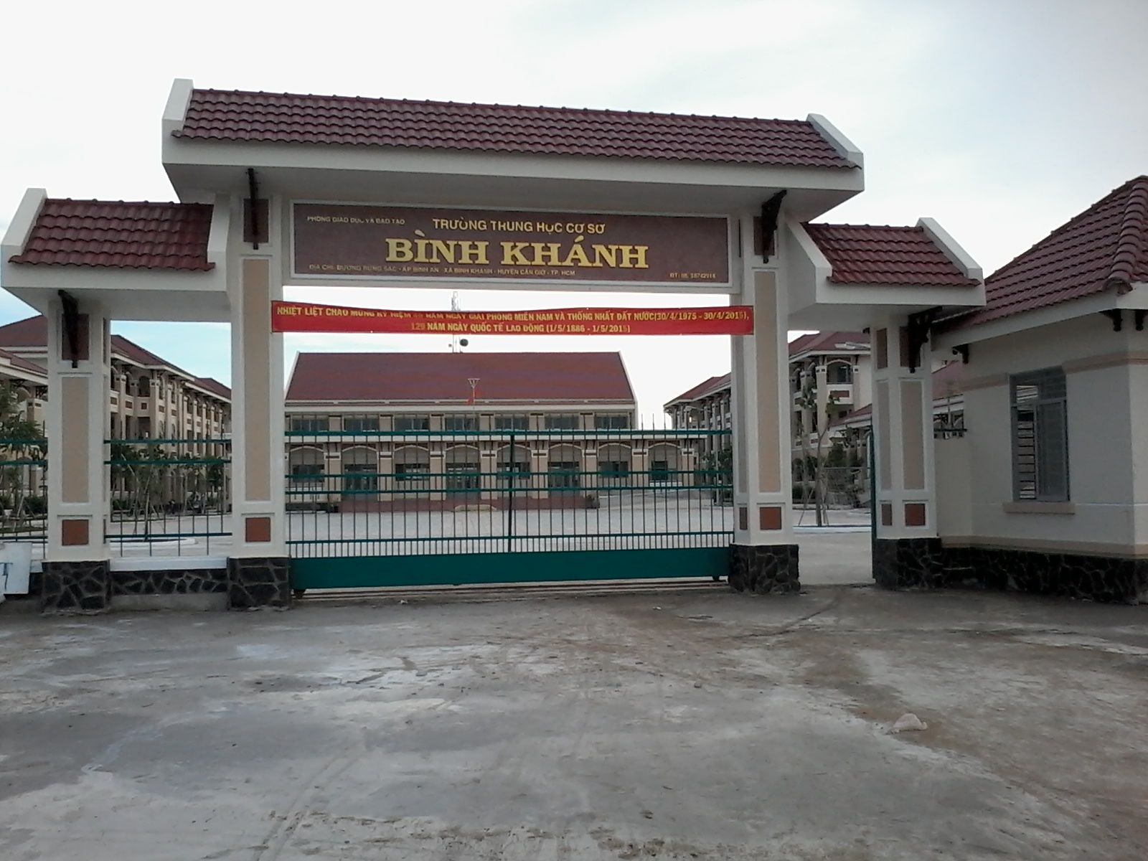



BINH KHANH SECONDARY SCHOOL
FRIENDS PLUS 6

Slide 2
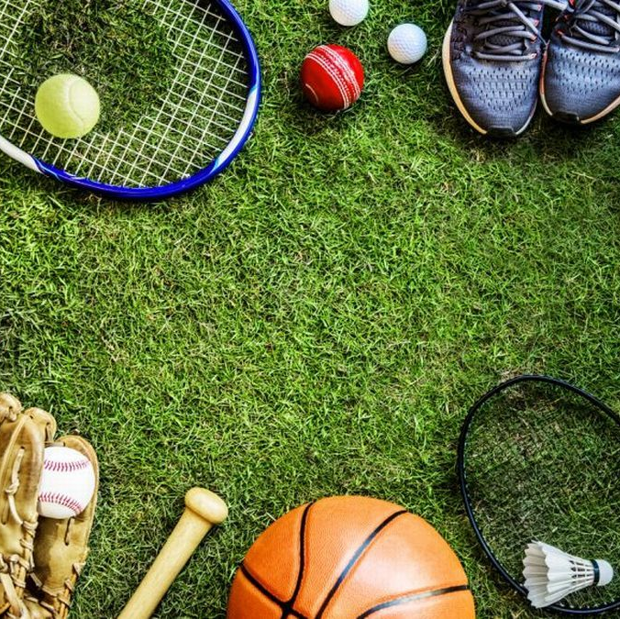
INITIALS

Slide 3
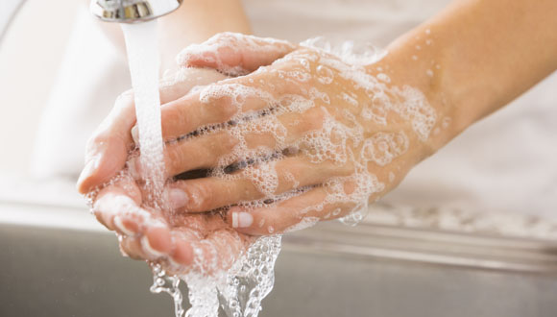
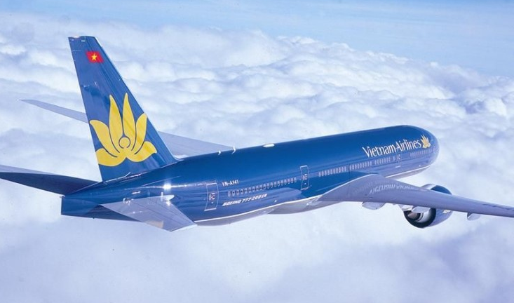
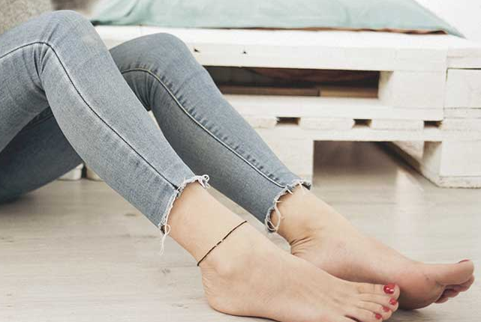
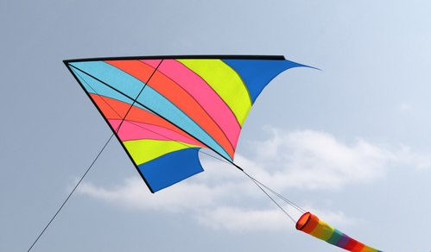
RULE
Take the first letters from each picture and form the mystery word!
WASH
AIRPLANE
LEG
KITE
W A L K

Slide 4
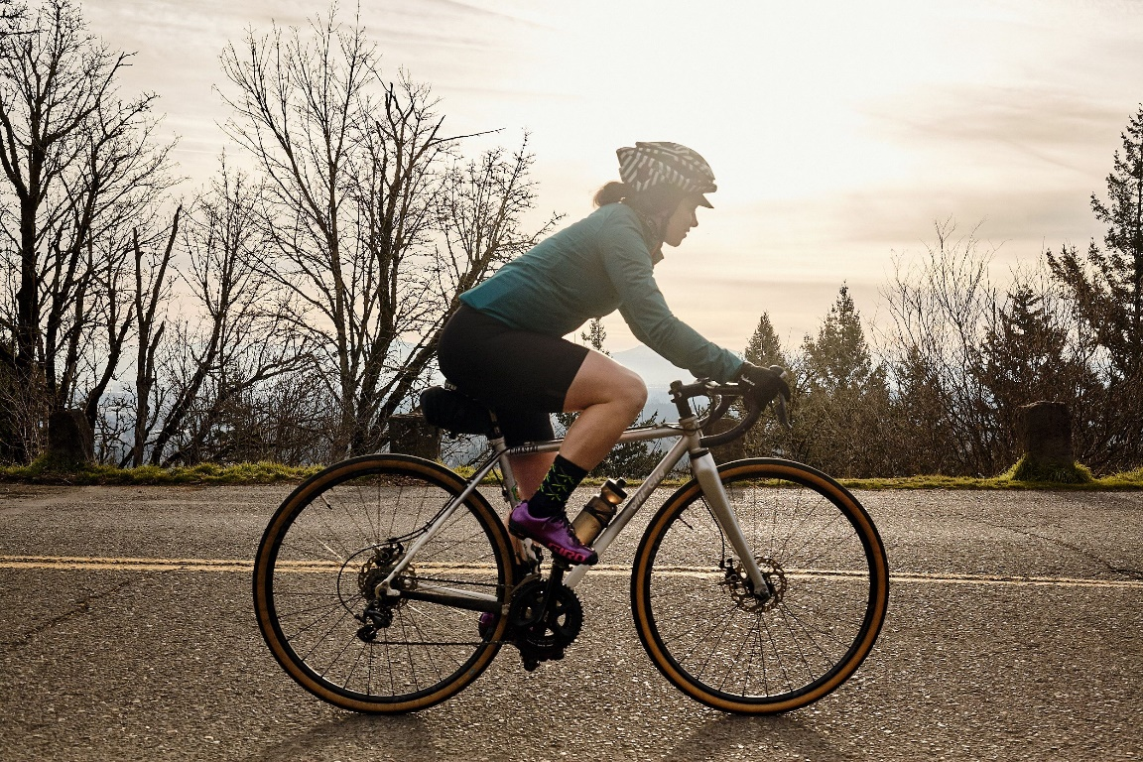
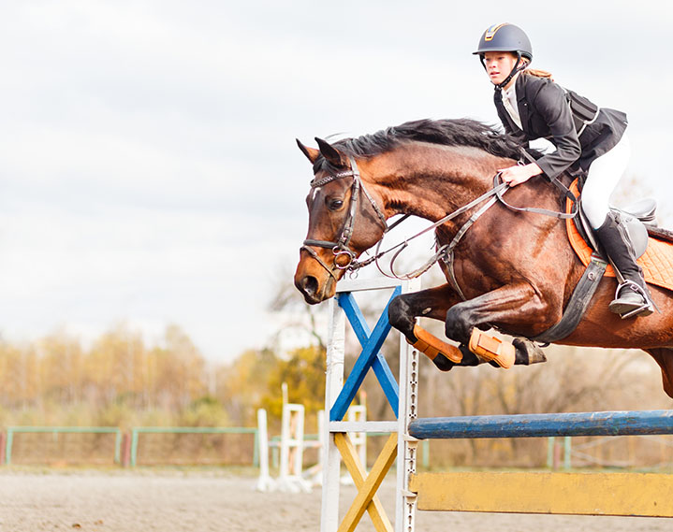
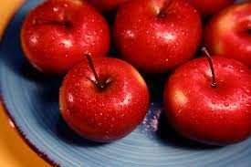
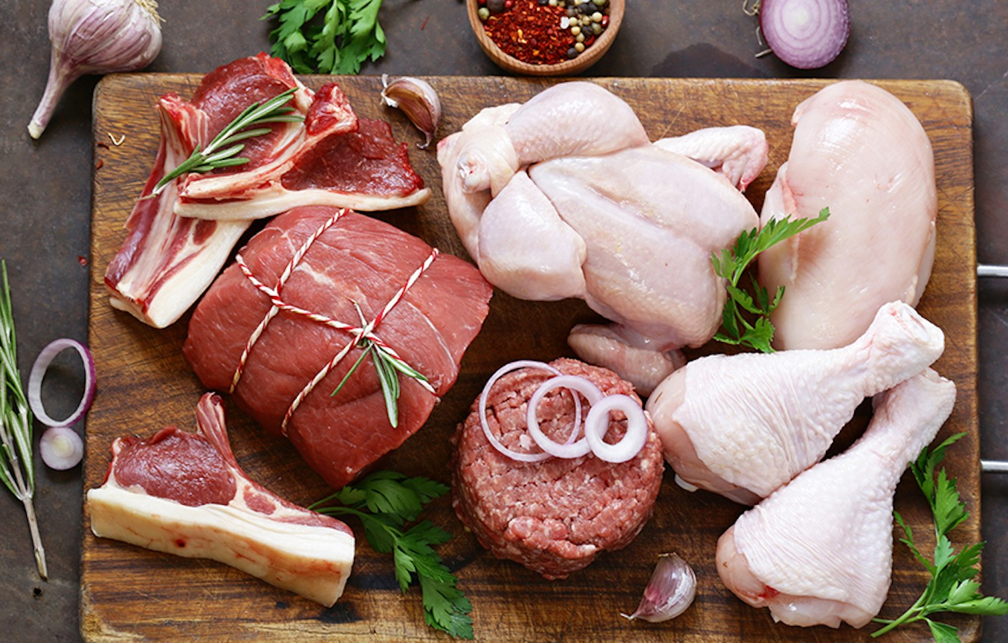
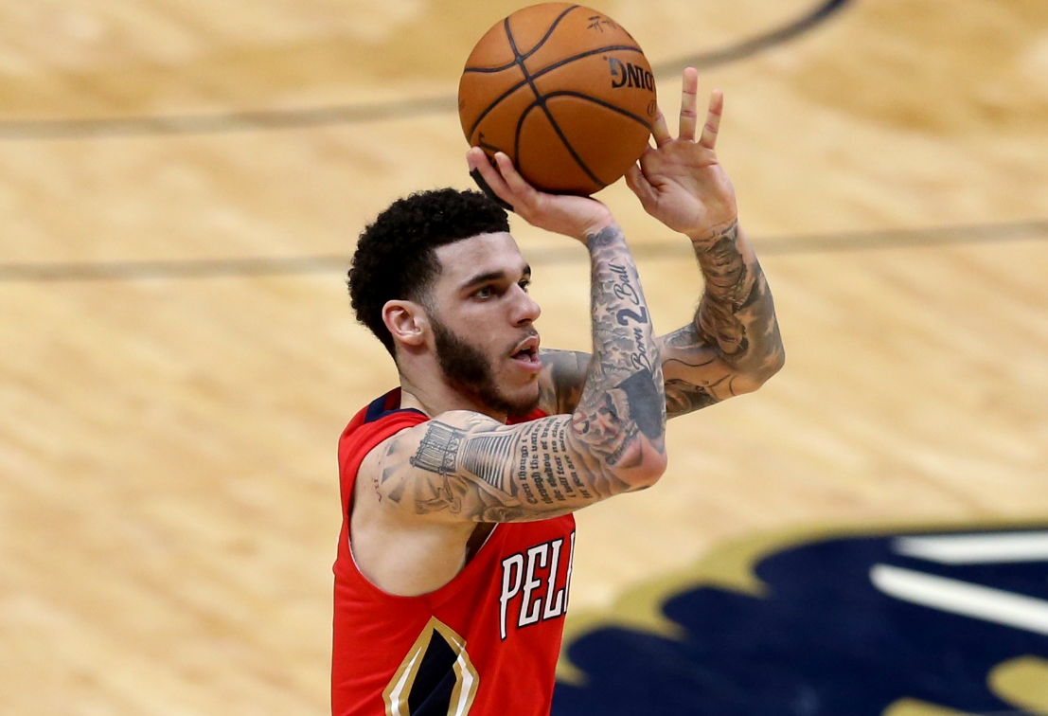

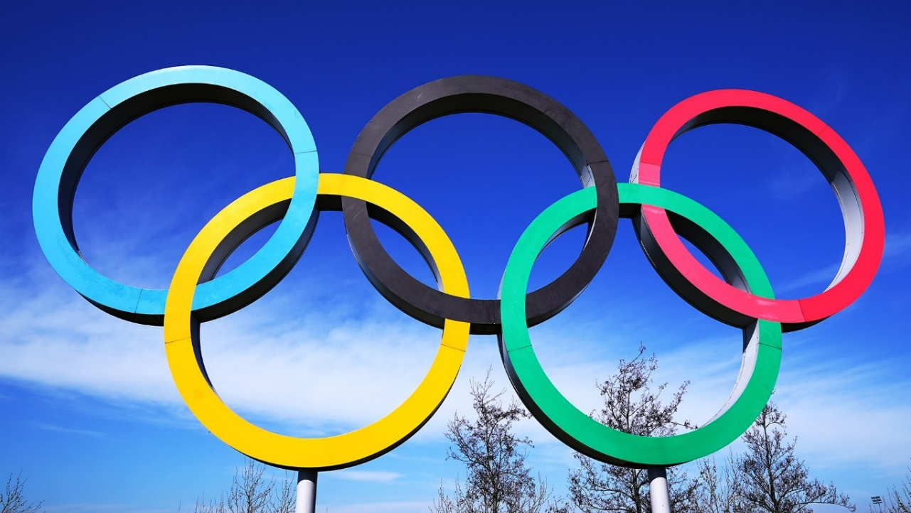
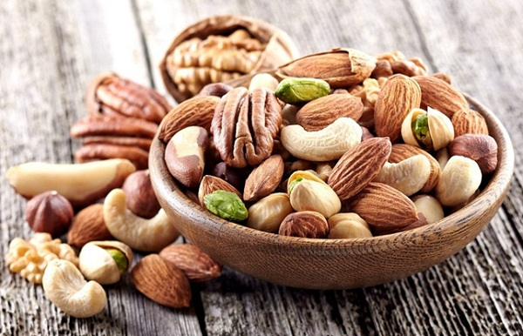
CYCLING
HORSE-RIDING
APPLE
MEAT
PLAYER
IN
OLYMPIC
NUTS

Slide 5
C H A M P I O N

Slide 6
UNIT 6: SPORTS
Lesson 2
READING

Slide 7
1. When and where are the next Olympic Games?
2. Which sport in the box is NOT in the Olympics?

Slide 8
Activity 1:
swimming, marathon / running, golf, rugby

Slide 9
Activity 2:
1. False
(There were only silver and bronze medals.)
2. True
(She was from Denmark.)
3. False
4. True
(They were Olympic sports for the first time in 2016.)
5. False

Slide 10

Activity 3:
1. winner (n)
/ˈwɪn.ɚ/

Slide 11
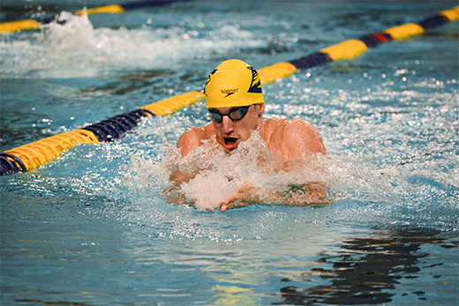
2. swimmer (n)
/ˈswɪm·ər/

Slide 12
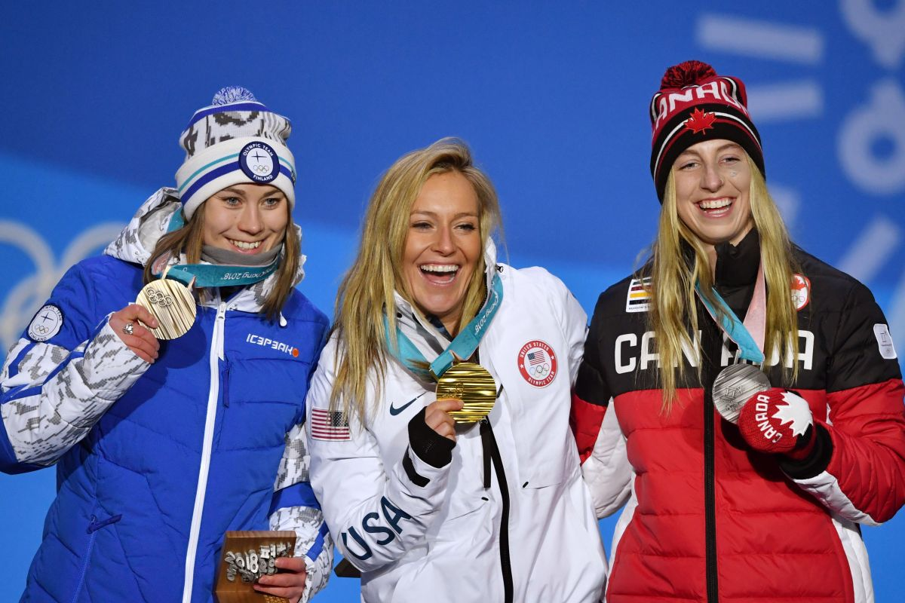
3. medallist (n)
/ˈmed.əl.ɪst/

Slide 13
Activity 3 - Words in blue:
1. winner (n) /ˈwɪn.ɚ/
2. swimmer (n) /ˈswɪm·ər/
3. medallist (n) /ˈmed.əl.ɪst/

Slide 14
Complete the sentences with the blue words
from the text.
1. A ______________ wins a competition.
2. A ______________wins a medal.
3. A ______________swims.
winner
medallist
swimmer

Slide 15


Slide 16

Activity 4:
Speaking

Slide 17
Which piece of information in the text do you think is the most interesting?
What sports do you like watching in the Olympics?

Slide 18
HOMEWORK
Learn by heart all the new words.
Workbook: page 46.
Prepare Lesson 3 – LANGUAGE FOCUS.

