Slide 1




BINH KHANH SECONDARY SCHOOL
FRIENDS PLUS 6

Slide 2
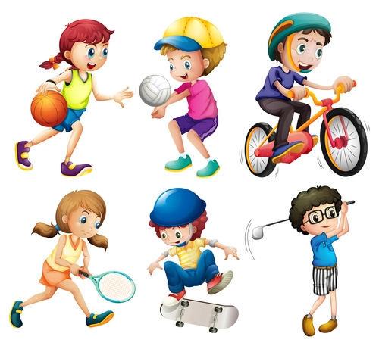
UNIT 6: SPORTS
LESSON 4: VOCABULARY AND LISTENING

Slide 3
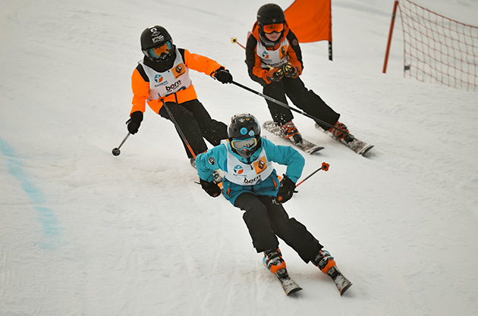
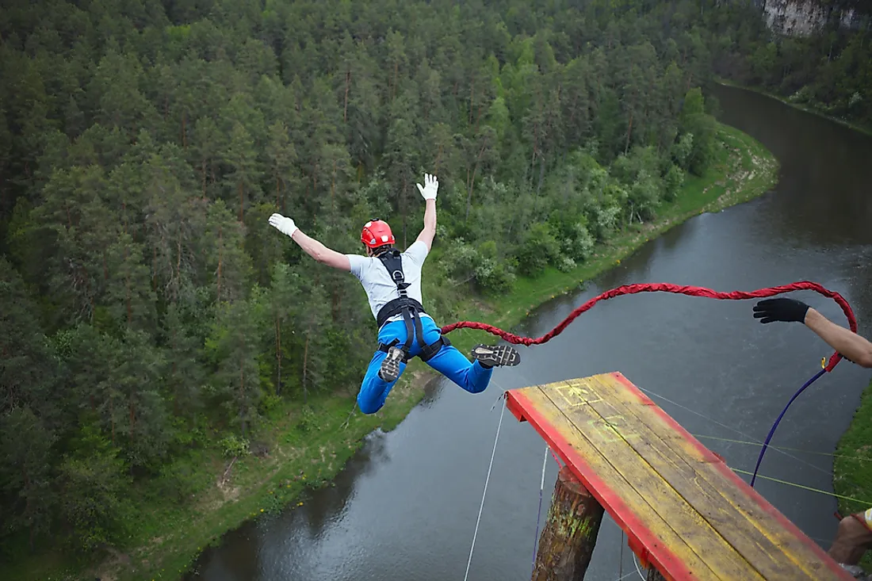
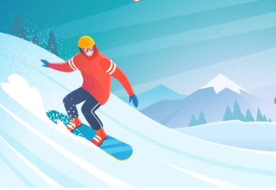
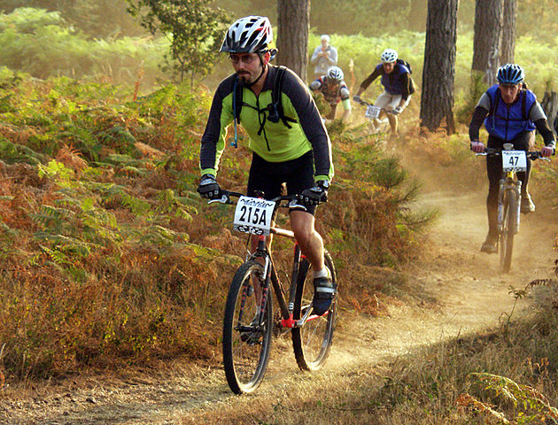
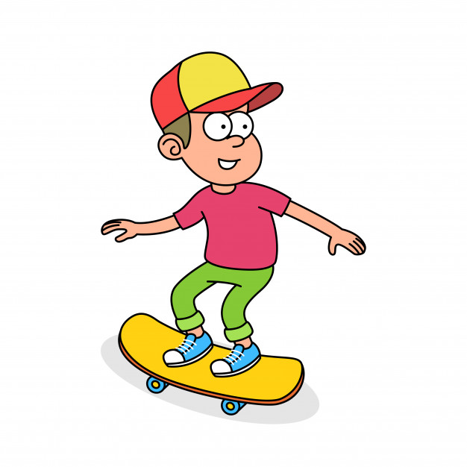

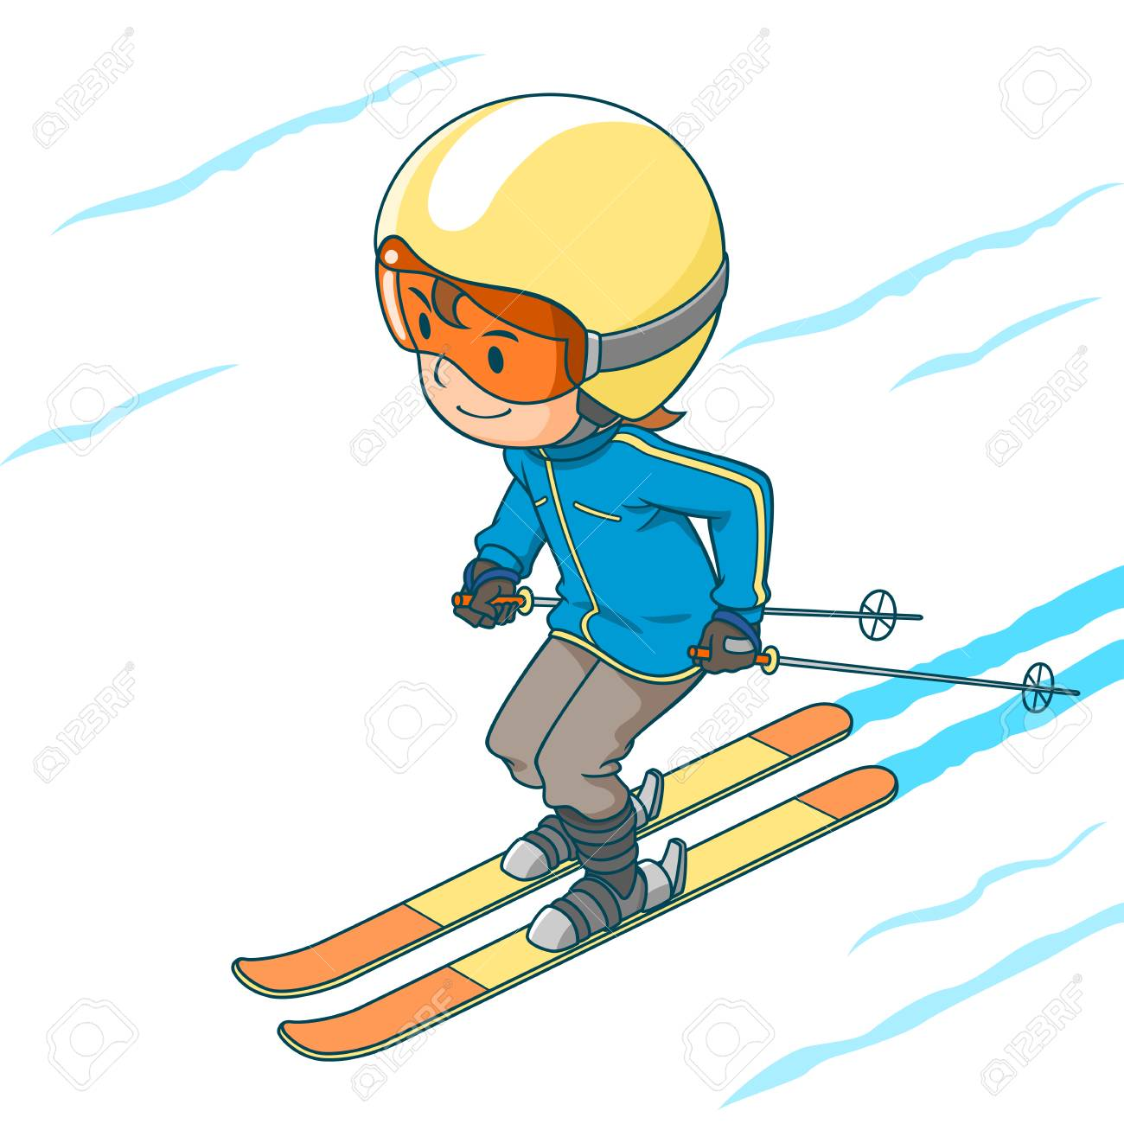
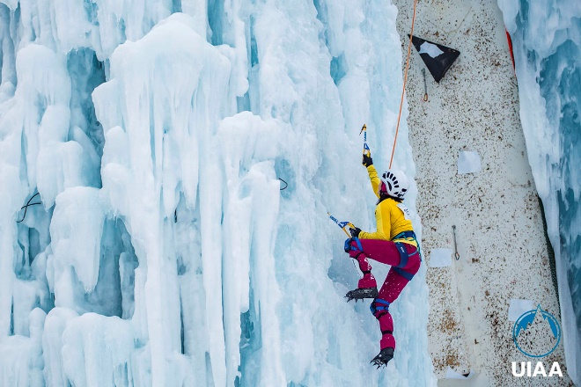
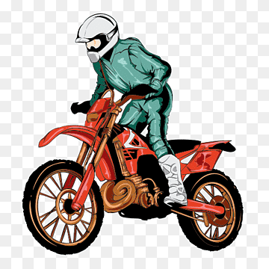
a.
MATCHING
i.
1. BMX
2. Skiing
6. Snowboard
3. Skateboard
7. Mountain bike racing
b.
8. Ice climbing
h.
4. Ski cross
5. Motor cross
9. Bungee jumping
1-e; 2-f; 3-d; 4-a; 5-g; 6-b; 7-h; 8-c; 9-i
d.
e.
f.
c.
g.

Slide 4

Why is this sport dangerous?
Would you like to try this sport?

Slide 5
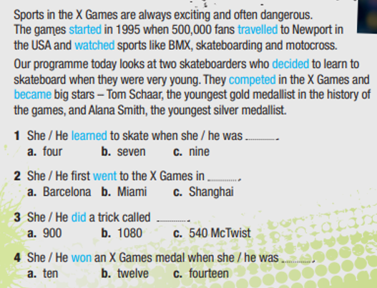
EXERCISE 1: Check the meaning of the verbs 1-10. Then read the text and sentences 1 - 4. Match verbs 1 - 10 with the past simple forms in blue. Listen and check
learn
start
go
win
travel
become
watch
do
compete
decide
→ learned
→ started
→ went
→ won
→ travelled
→ became
→ watched
→ did
→ competed
→ decided

Slide 6
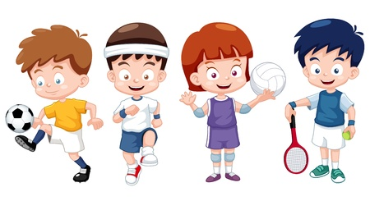
Complete the collocations with verbs from exercise 1.
1. to ___________a competition / a medal
2. to ___________TV / a film / a football match
3. to ____________ a language / to ski
4. to ____________in a race / in a competition
win
watch
learn
compete

Slide 7
EXERCISE 2: Listen to information about Alana Smith and Tom Schaar. From column A, choose who is talking. From column B, choose where they are.
A | B
1. parents talking 2. sports fans talking 3. Alana and Tom talking | 4. at school 5. at the X Games Asia 6. on a TV programme
Who is talking?
Where they are?

Slide 8
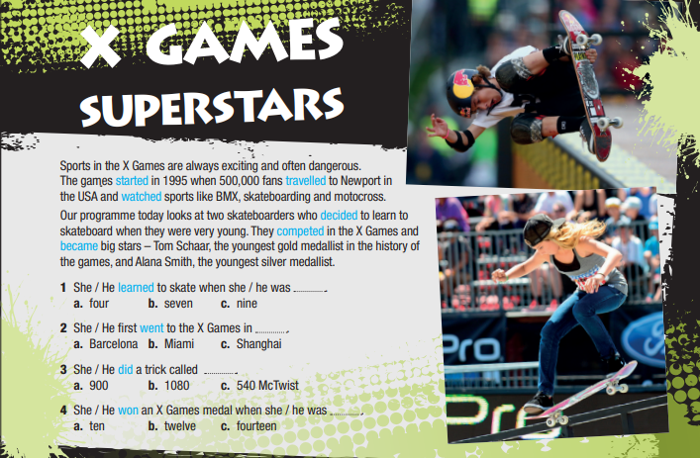
EXERCISE 3: Listen again and look at sentences 1 - 4 in the text. Choose the correct answer for Alana and then for Tom.
+ Alana:
1 b 2 a 3 c 4 b
+ Tom:
1 a 2 c 3 b 4 b

Slide 9
EXERCISE 4: Listen again and correct the sentences. Check answers with the class.
1. Alana watched the X Games when she was five.
2. She won a gold medal when she was twelve.
3. Tom Schaar was on this programme one year ago.
4. A 1080 is an easy trick.
→ Alana watched the X Games when she was six.
→ She won a silver medal when she was twelve.
→ Tom Schaar was on this programme two years ago.
→ A 1080 is a very difficult trick.

Slide 10
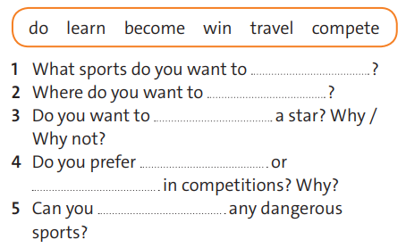
EXERCISE 5: Work in pairs. Complete the questions with the correct form of the verbs in the box.
learn
travel
become
winning
competing
do

Slide 11
DRAW A MINDMAP
What sports are difficult, dangerous and popular?
DANGEROUS
SPORTS
DIFFICULT
POPULAR

Slide 12



- Learn by heart all vocabulary
- Workbook: Exercises page 44.

