Slide 1
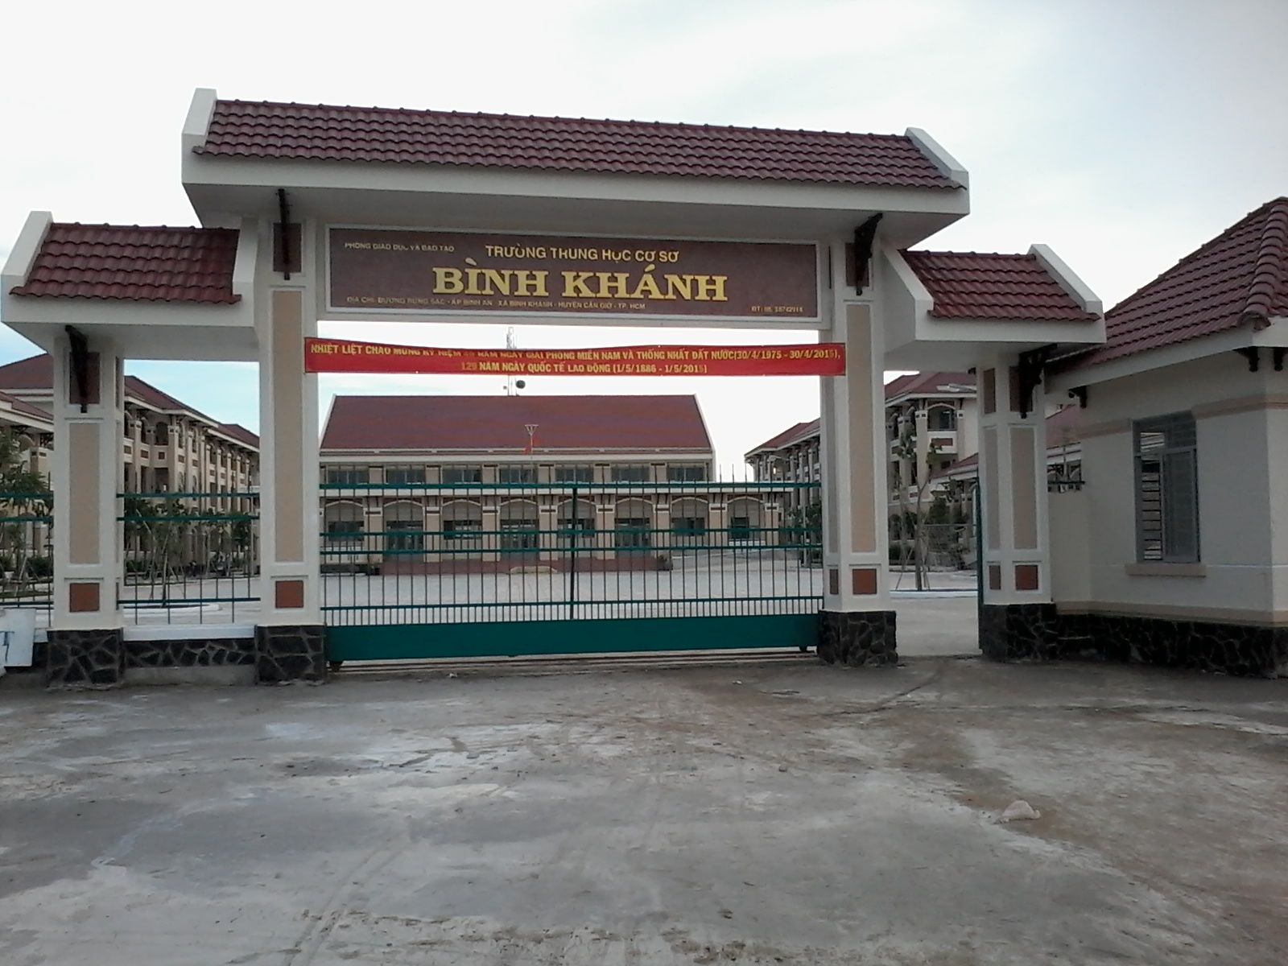



BINH KHANH SECONDARY SCHOOL
FRIENDS PLUS 6

Slide 2

UNIT 6: PUZZLES AND GAMES

Slide 3

LET TELL YOUR CLASSMATES ABOUT YOUR SPROTS CLUB.

Slide 4
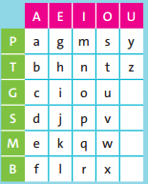
1/ Use the grid to find the first and last letters of sports 1-8. Then write the sports.
EX:
PE BA
gf = golf
1/ BA BE
2/ PA PO
3/ TE PU
4/ BI PU
5/ PE PO
6/ SO BE
7/ SE GI
8/ TO PO

Slide 5
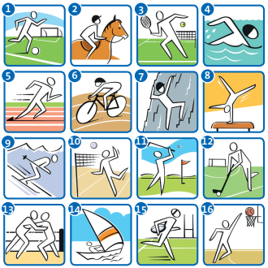
1/ Use the grid to find the first and last letters of sports 1-8. Then write the sports.
1/ BA BE
f l = football

Slide 6
1/ Use the grid to find the first and last letters of sports 1-8. Then write the sports.
2/ PA PO
a s = athletics

Slide 7
1/ Use the grid to find the first and last letters of sports 1-8. Then write the sports.
3/ TE PU
h y = hockey

Slide 8
1/ Use the grid to find the first and last letters of sports 1-8. Then write the sports.
4/ BI PU
r y = rugby

Slide 9
1/ Use the grid to find the first and last letters of sports 1-8. Then write the sports.
5/ PE PO
g s = gymnastics

Slide 10
1/ Use the grid to find the first and last letters of sports 1-8. Then write the sports.
6/ SO BE
v l = volleyball

Slide 11
1/ Use the grid to find the first and last letters of sports 1-8. Then write the sports.
7/ SE GI
j o = judo

Slide 12
1/ Use the grid to find the first and last letters of sports 1-8. Then write the sports.
8/ TO PO
t s = tennis

Slide 13

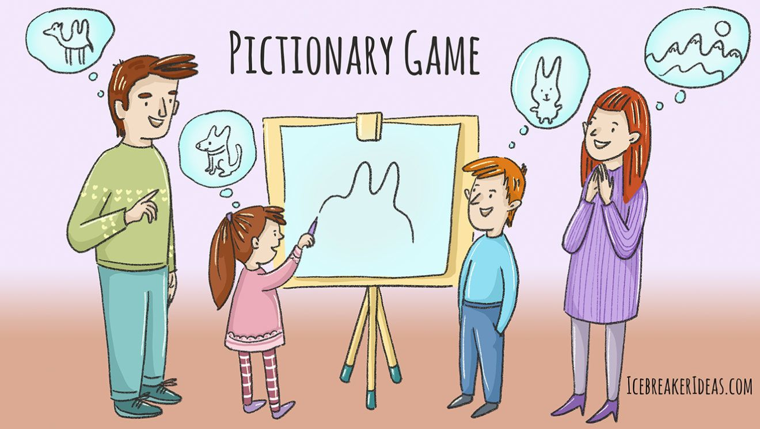
2/ SPORT ART. Work in groups.
* Instructions:
Write the names of the sports on page 72 on pieces of paper.
One student takes a piece of paper and draws the sport.
The others guess.
The winner is the group guessing the most sports.

Slide 14
3/ MEMORY GAME. Work in pairs. Follow the instructions:
* Instructions:
Put four to eight objects on your desk.
Look at the objects for ten seconds and remember them.
One student closes his / her eyes.
The other student takes the objects from the desk and hides them.
The student opens his / her eyes and says what object(s) was / were on the desk using there was / there were.
The student gets a point for every correct sentence.
Repeat the game with different objects.
Who can get the most points?
*For example:
There was a pen. There was a ruler. There were three books. There was an apple.

Slide 15
4/ Join the letters to find regular and irregular past simple forms:
STA | NT
1/ WE | ETED
2/ W | RTED
3/ TRAV | ID
4/ BEC | RNED
5/ LEA | IDED
6/ WAT | ON
7/ D | AME
8/ COMP | CHED
9/ DEC | ELLED
STARTED
WENT
WON
TRAVELLED
BECAME
LEARNED
WATCHED
DID
COMPETED
DECIDED

Slide 16
Could you make some sentences with these verbs?
STARTED
WENT
WON
TRAVELLED
*For example:
BECAME
LEARNED
- I started learning English 3 years ago.
WATCHED
DID
COMPETED
DECIDED

Slide 17
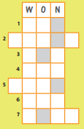
5/ Complete the sentences. Then write the past simple form of the missing verbs in the puzzle. Then use the letters in the grey boxes to make a mystery word:
France won the football World Cup in 2018.
was
1/ Phan Thị Hà Thanh _______ born in Việt Nam.
W
A
S
broke
2/ Usain Bolt ____________ the world record in Beijing.
B
R
O
K
E
ran
R
A
N
3/ Pheidippides _________ from Marathon to Athens.
W
O
N
won
4/ Nguyễn Thị Ánh Viên _________ 3 gold medals at the SEA Games 27.
W
E
N
T
went
5/ My dad ________ to the match on Saturday.

Slide 18
5/ Complete the sentences. Then write the past simple form of the missing verbs in the puzzle. Then use the letters in the grey boxes to make a mystery word:
did
6/ I _______ all my homework last night
W
A
S
B
R
O
K
E
were
R
A
N
7/ The 2016 Olympics ________ in Rio
W
O
N
W
E
N
T
Mystery word: skate
D
I
D
W
E
R
E

Slide 19

DISCUSSION TIME!
=>What have we learnt in Unit 6?

Slide 20

* Homework: - Learn by heart all structures and vocabulary.. - Complete the “PROGRESS REVIEW 3”.

