Slide 1
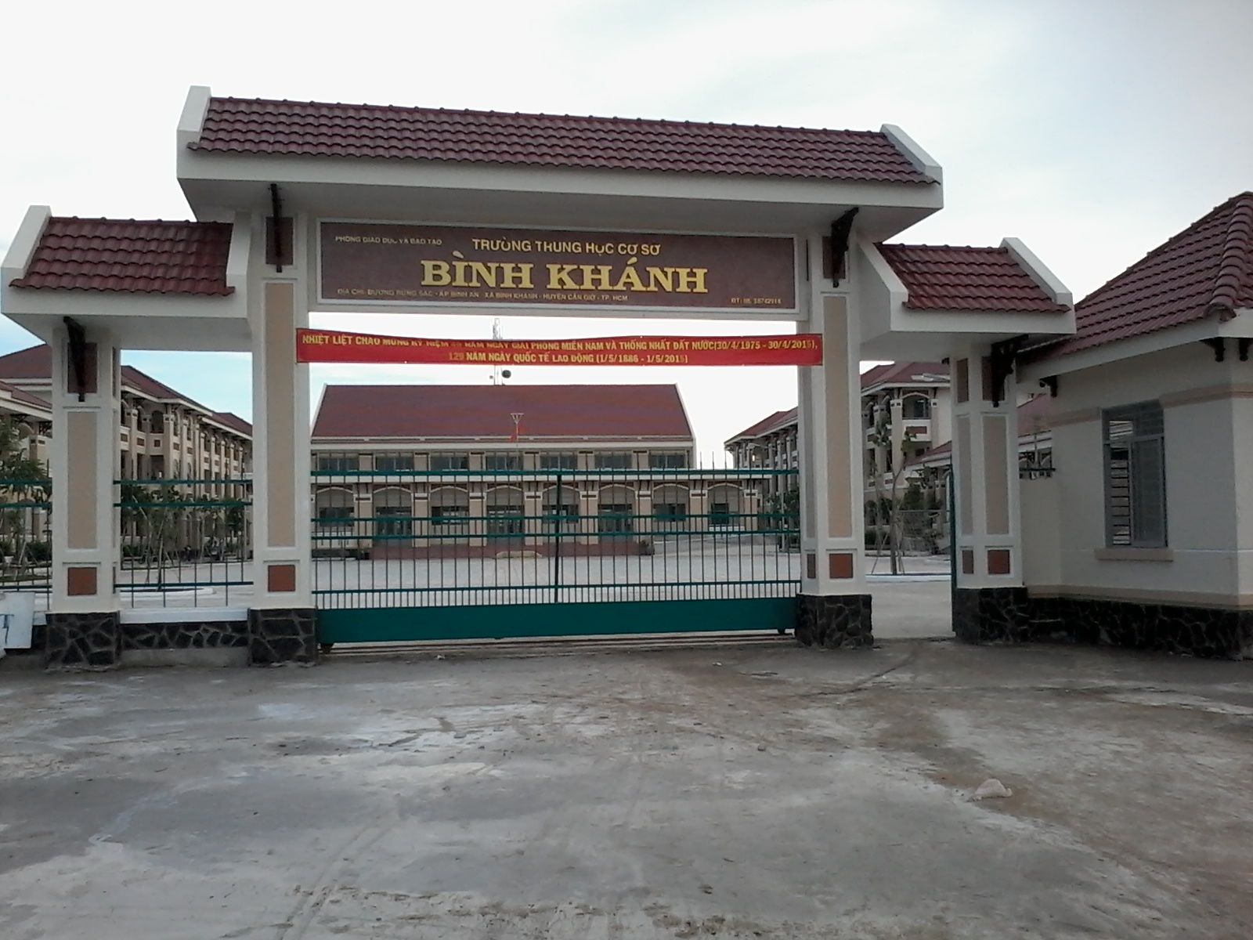



BINH KHANH SECONDARY SCHOOL
FRIENDS PLUS 6

Slide 2
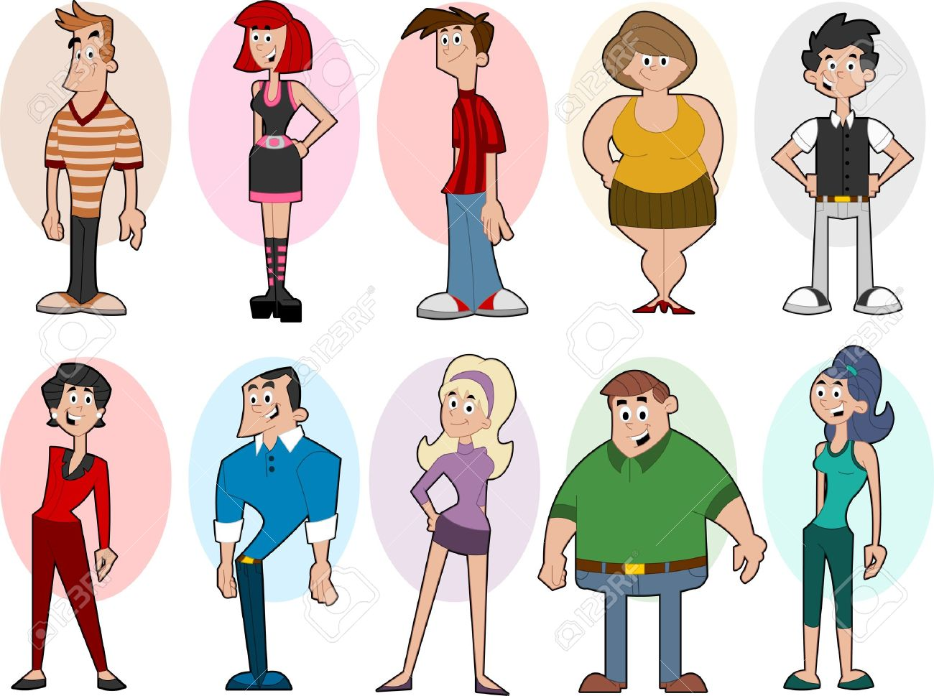
UNIT 7: GROWING UP
LESSON 1: VOCABULARY
Describing people

Slide 3


Slide 4


Answer the questions:
" Who are they?
What do they look like?"

Slide 5
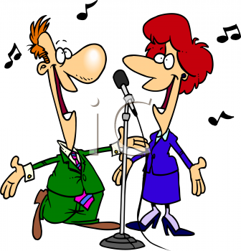
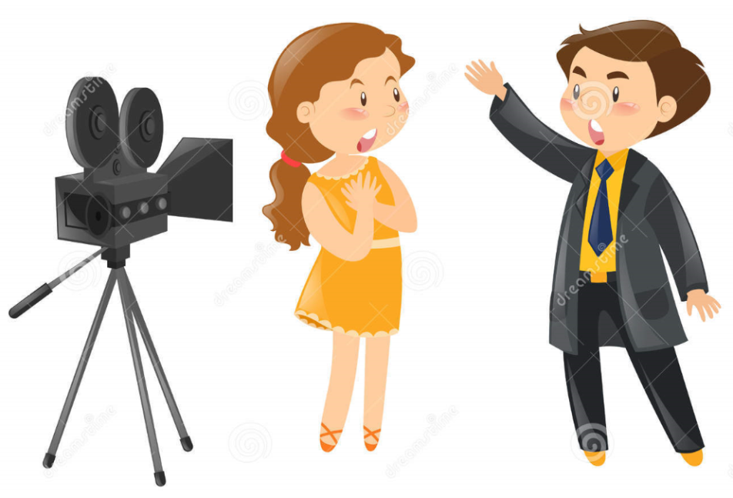

PRESENTATION
Who are your favourite singers?
Who are your favourite actors?
Which famous person would you most like to meet? Why?

Slide 6
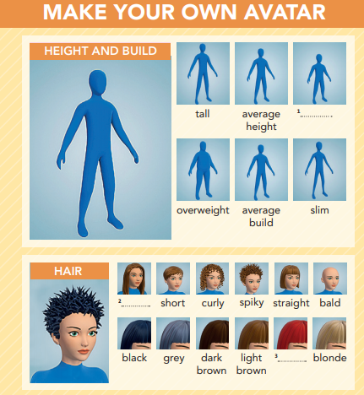
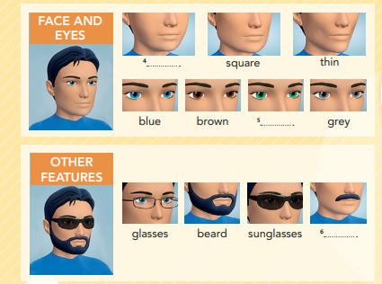
EXERCISE 1: Complete 1–6 with the words in the box.
moustache
round
red
long
green
short

Slide 7


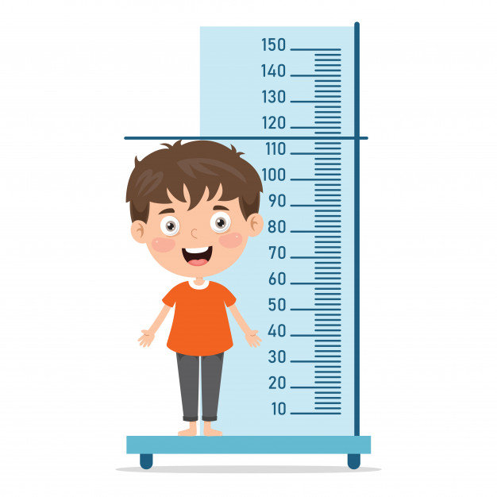
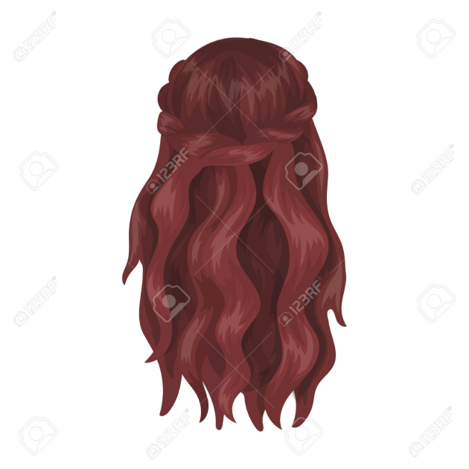
NEW WORDS:
build (n) /bɪld/
moustache (n)
/məˈstɑːʃ/
height (n) /haɪt/
hair (n) /heər/

Slide 8
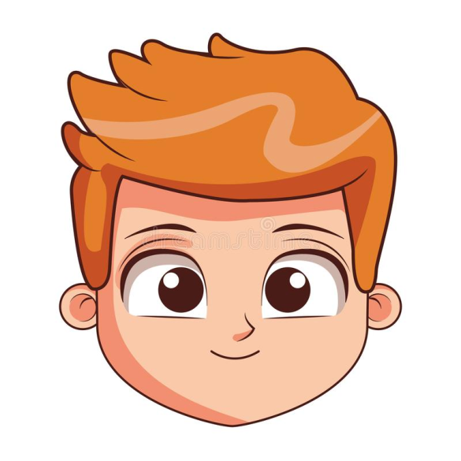
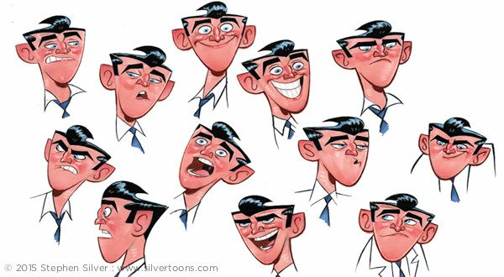

NEW WORDS:
feature (n) /ˈfiː.tʃər/
face (n) /feɪs/
eye (n) /aɪ/

Slide 9
NEW WORDS:
moustache (n) /məˈstɑːʃ/
height (n) /haɪt/
build (n) /bɪld
hair (n) /heər/
face (n) /feɪs/
eye (n) /aɪ/
feature (n) /ˈfiː.tʃər/

Slide 10
EXERCISE 2: Listen and repeat the words in EX 1. Which words describe you?
Which words describe you?
moustache (n) /məˈstɑːʃ/
height (n) /haɪt/
build (n) /bɪld/
hair (n) /heər/
face (n) /feɪs/
eye (n) /aɪ/
feature (n) /ˈfiː.tʃər/
Eg:
I am short and slim.
My hair is long and brown.

Slide 11
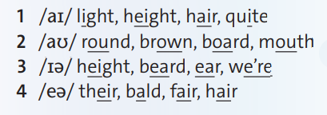
EXERCISE 3: Pronunciation - Diphthongs. Which words is the odd one out?
Which words is the odd one out?

Slide 12
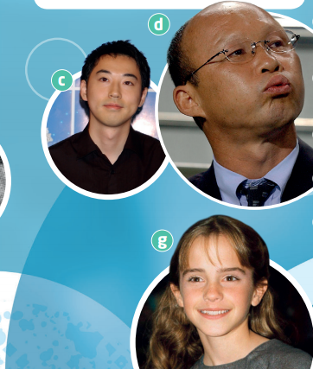
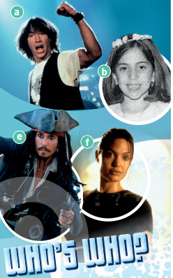
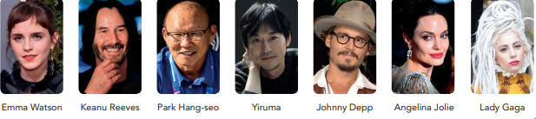
EXERCISE 4: Work in pairs. Watch or listen. Look at photos a-g. Which photos are the people talking about?
1. photo - a
2. photo - g
3. photo - b

Slide 13
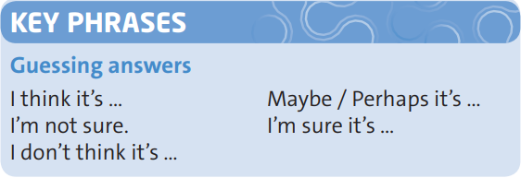
EXERCISE 5: Watch or listen again. Which key phrases does Lewis use?
Which key phrases does Lewis use?
→ I'm not sure. I think it's ...

Slide 14
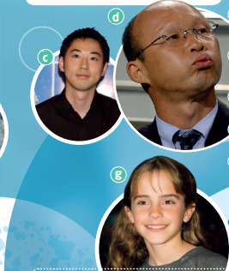
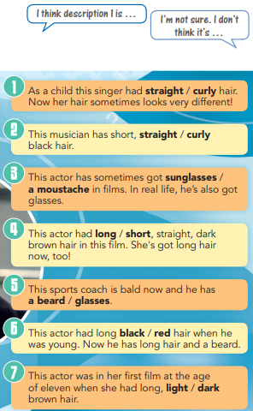
EXERCISE 6: Choose the correct words in descriptions 1-7. Then match the descriptions to photos a-g and name the famous people. Compare with a partner using the Key Phrases.
1 - b (Lady Gaga)
2 - c (Yiruma)
3 - e (Johnny Depp)
4 - f (Angelina Jolie)
5 - d (Park Hang-seo)
6 - a (Keanu Reeves)
7 - g (Emma Watson)

Slide 15
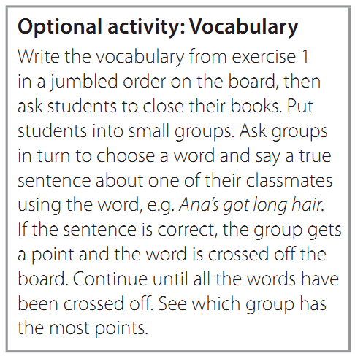
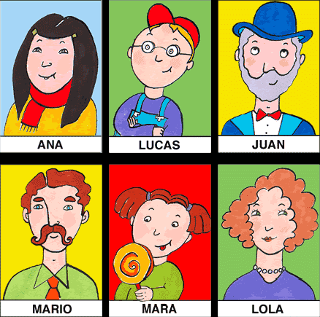
Discussion

Slide 16



- Learn by heart all the new words.
- Workbook: Exercises page 48
- Prepare Lesson 2 – Reading.

