Slide 1
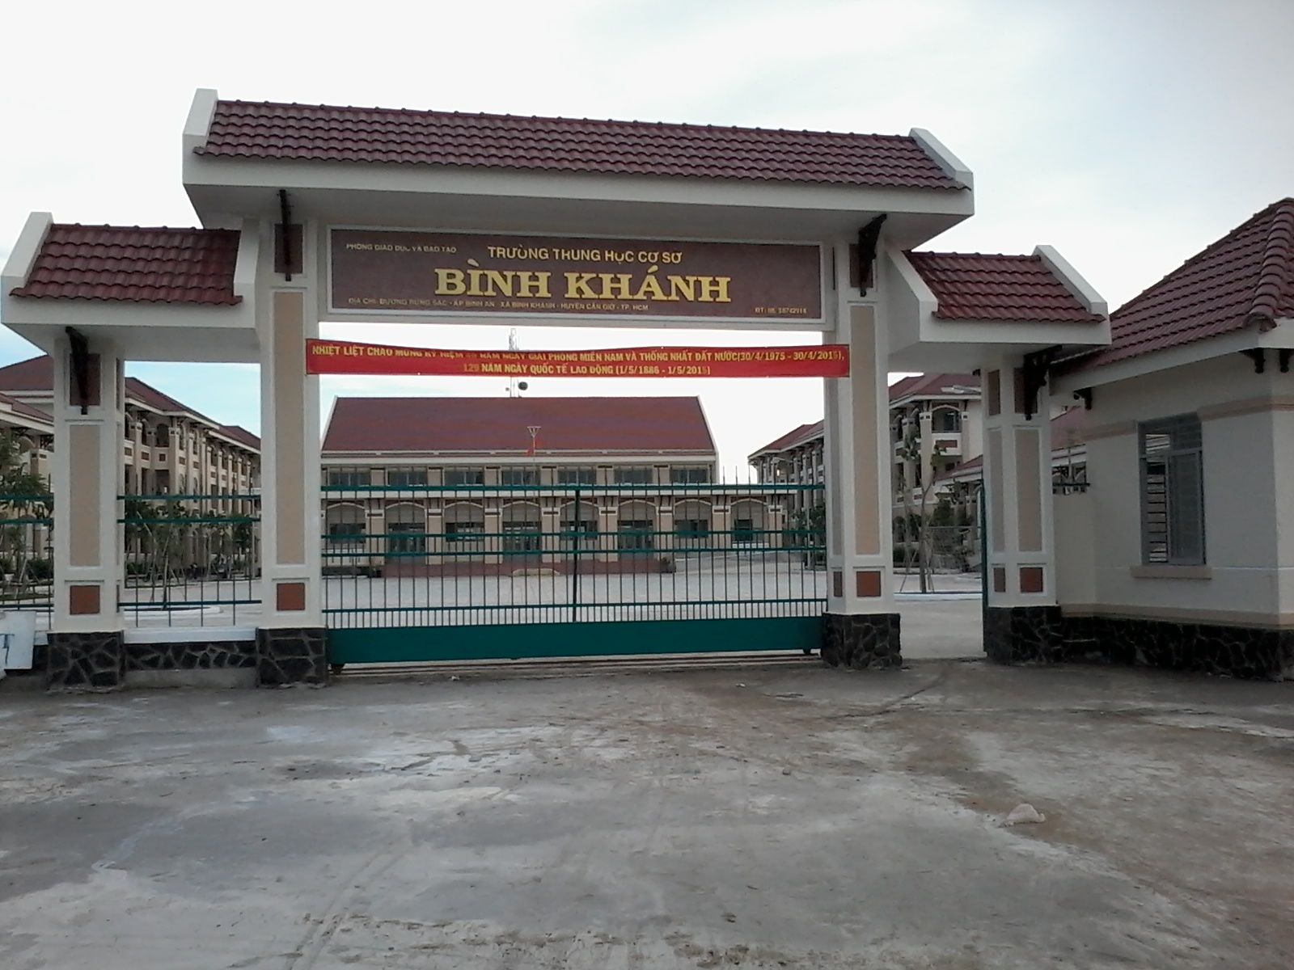



BINH KHANH SECONDARY SCHOOL
FRIENDS PLUS 6

Slide 2

THE MEMORY CIRCLE

Slide 3
Example:
Teacher: I played soccer last night.
Student 1: I played soccer last night and I studied yesterday.
Student 2: I played soccer last night and I studied yesterday, then I talked to my parents…..

Slide 4
Munish took a photo of his daughter.
Sometimes Suman was tired or sad.
She wasn’t happy.
What are the infinitive forms of “took, was and wasn’t” ?

Slide 5
do
drive
What are the simple past forms of these verbs?
cut
make
have

Slide 6

UNIT 7
GROWING UP
Lesson 3: LANGUAGE FOCUS

Slide 7
Study the examples. Find other examples of the negative form in the text. How do we form the past simple negative? Read the Rule to check
She had glasses. She didn’t have glasses

Slide 8
SIMPLE PAST TENSE – AFFIRMATIVE AND NEGATIVE FORM
FORM:
(+):
S + V_{2/ED} + O
Ex: I read a book last night.
(-):
S + DIDN’T + V_{bare}+ O
Ex: I didn’t read a book last night.

Slide 9

SIMPLE PAST TENSE – AFFIRMATIVE AND NEGATIVE FORM
Examples in the text:
didn’t want, didn’t change

Slide 10
Write the opposite forms of the sentences
1) I read a book last night.
I didn’t read a book last night.
2) My brother didn't start a new school last year.
My brother started a new school last year.
3) We played basketball yesterday.
We didn’t play basketball yesterday.
4) My cousin gave me a present for my birthday.
My cousin didn’t give me a present for my birthday.
5) I didn't like playing football when I was young.
I liked playing football when I was young.
6) My best friend didn't go on holiday last year
My best friend went on holiday last year.

Slide 11
A life in film
Complete the text with the affirmative or negative form of the verbs.

Slide 12

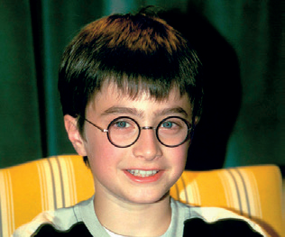

A life in film
Between the ages of ten and twenty, Daniel Radcliffe (1) (act) ________ in eight Harry Potter films. In that time he (2) (not make) _______________ other films and he (3) (not go) ______________ to school. A tutor (4) (give) ________ special classes to all of the actors.
Sometimes very young actors have problems because their lives aren’t normal, but Daniel (5) (not have) _____________ a bad time. He (6) (love) ________ the job and (7) (have) ___________a lot of friends and fun.
acted
didn’t make
didn’t go
gave
didn’t have
loved
had

Slide 13
Write about your experiences. Use the affirmative or negative form of the verbs.

Slide 14
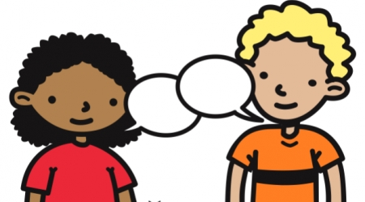
Pair-work

Slide 15
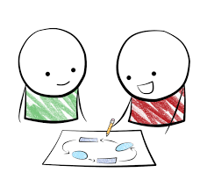
Compare your sentences in exercise 5

Slide 16
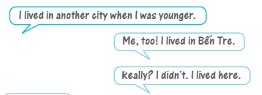
Example:

Slide 17
homework
Learn by heart all structures.
Write a short paragraph about what you did last weekend.
Prepare the next lesson: SPEAKING

