Slide 1
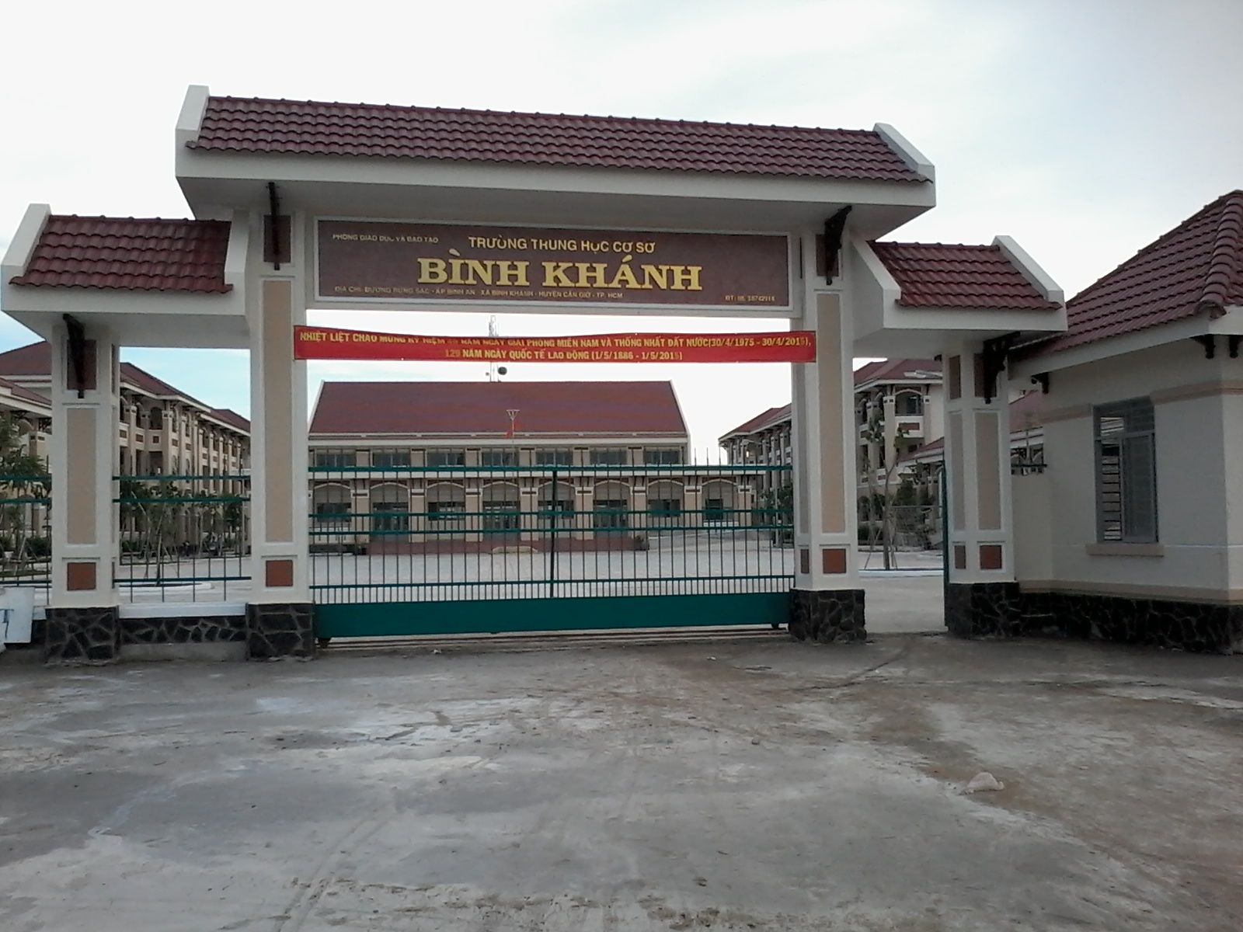



BINH KHANH SECONDARY SCHOOL
ENGLISH 9

Slide 2
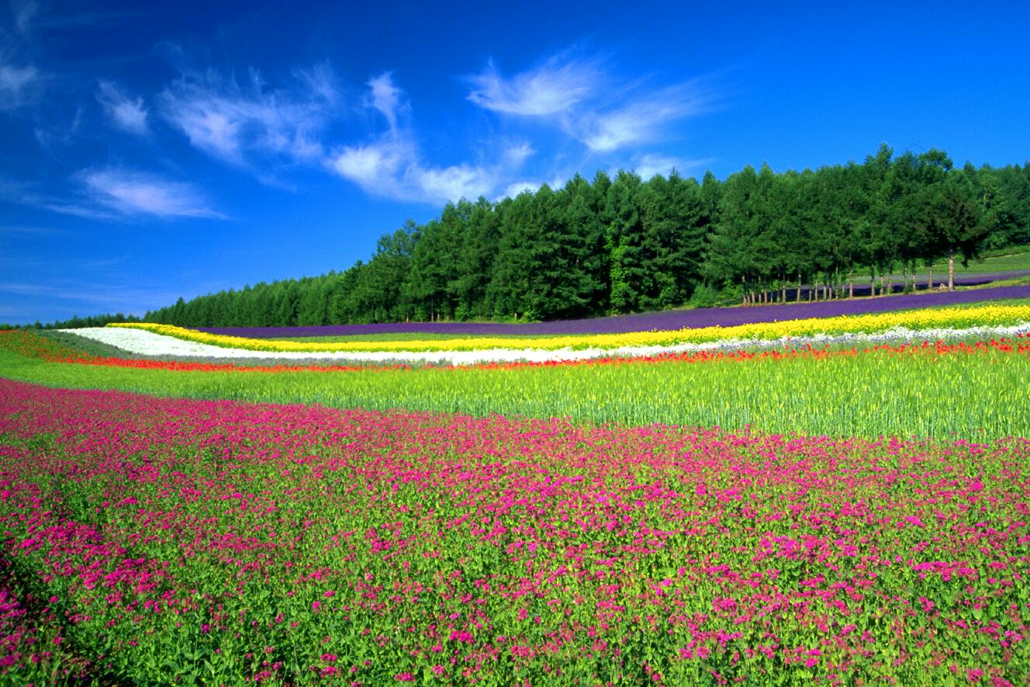
Unit 8: Celebrations
Read

Slide 3


Exercise:
Give the names of the celebrations in English according to the dates shown on the screen
20/11 | 8/3
25/12 | 3rd Sunday in June
The Teacher's Day
The Women's Day
Christmas Day

Slide 4

Daddy, I am writing this to tell you how...

Slide 5
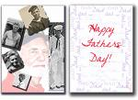



Daddy, I am writing to tell you how much you are missed and loved. I will always remember that day – my wedding day You were standing there with tears in your eyes while
I was walking towards my groom.
You gave me a hug, and the feeling that you never wanted to let me go.
But at last I had to leave you and start my new life a moment in time that lasted forever.
I now have children , Dad but I will always be your little girl! Happy Father’s Day
Rita (Australia)
Jane (USA)
To the one who teaches me how to love, cry and love.
To the one who say never lose heart and always finish what you start.
To the one whose feelings for me are so strong that the word love can’t describe them.
Can you guess who it is?
It’s not too hard to tell……
Father's Day
Bob (Australia)
Father's Day
Daddy, I am writing to tell you how
much you are missed and loved. I will
always remember that day – my
wedding day You were standing
there with tears in your eyes while
I was walking towards my groom.
You gave me a hug, and the
feeling that you never wanted to let me go.
But at last I had to leave you and start my
new life a moment in time that lasted forever.
I now have children , Dad but I will always
be your little girl! Happy Father’s Day

Slide 6

Rita (Australia)
To the one who teaches me how to love,
cry and laugh.
To the one who says never lose heart and always
finish what you start.
To the one whose feelings for me are so strong that
the word love can’t describe them.
Can you guess who it is?
It’s not too hard to tell……
lose heart (v):
feelings
* Read and decide “True” or “False”
1. Rita sends this card to her uncle._____
2. Rita’s father teaches Rita how to love, cry and laugh.____
3. Rita’s father loves her so much that no word can describe._____
F
T
T

Slide 7
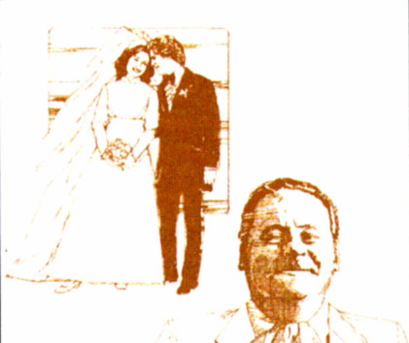
Jane (USA)
Daddy, I am writing to tell you how
much you are missed and loved. I will
always remember that day – my wedding
day you were standing there with tears in
your eyes while I was walking towards my
groom. You gave me a hug, and the feeling
that you never wanted to let me go. But at
last I had to leave you and start my new
life…. a moment in time that lasted
forever. I now have children, Dad but I will
always be your little girl! Happy Father’s Day
* Read and decide “True” or “False”
Jane doesn’t love her father.______
Father cried when Jane was walking towards her groom._______
3. Father gave her a hug , and the feeling that father never wanted to let her
go._______
F
T
T

Slide 8
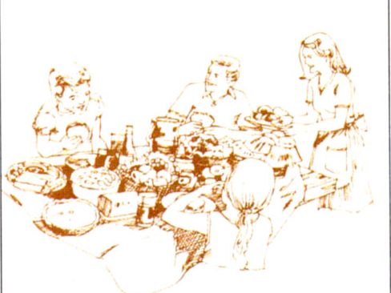
Bob ( Australia)
You ask me what I think about my
dad. Great! Great! I must tell you
my dad is the best person in the
world. Do you know what I mean?
He is a considerate and generous
man who is loved not only by his
family but also by all his friends.
His priority is always his family.
His sense of humor distinguishes
his from others. In a word, my
dad’s terrific! I’m so proud of him
and love him so much.
Happy Father’s Day, Daddy!
* Read and decide “True” or “False”
1. His father is considerate and generous._______
2. he is hated by his family and all his friends.______
3. His sense of humor makes him different from others._____
4. Bob isn’t proud of his father and doesn’t love him._____
T
F
T
F

Slide 9
What about you?
* Can you tell me about your father?
How old is he?
What does he do?
What does he look like?
What are your opinions and feelings about him ?
Which memories have you had about your father that you remember until now?

Slide 10
Fill in the blank with a suitable word.
hug/ feelings/ heart/ considerate
hug
feelings
heart
considerate
1. There are many occasions for you to express your _______ to others.
2. My father is the one who says never lose _____ and always finish what I start.
3. My father gave me a ______ and the feeling that he never wanted to let me go.
4. He is a _____________ and generous man.

Slide 12
Further information
What Makes A Dad
God took the strength of a mountain, The majesty of a tree,
The warmth of a summer sun, The calm of a quiet sea,
The generous soul of nature, The comforting arm of night,
The wisdom of the ages, The power of the eagle's flight,
The joy of a morning in spring, The faith of a mustard seed,
The patience of eternity, The depth of a family need,
Then God combined these qualities, When there was nothing more to add,
He knew His masterpiece was complete,
And so, He called it ... Dad

Slide 13
Father's Day is a special day for everyone! We use this day to honor our fathers all over the world! We celebrate this holiday on the third Sunday in June. A woman named Sonora Smart Dodd from Spokane, Washington, thought of the idea for Father's Day while listening to a Mother's Day sermon in 1909. Her father, Henry Jackson Smart, had raised Sonora after her mother died and she wanted him to know how special he was to her. Her father was born in June, so she chose that month to celebrate the new holiday!
Father's Day!

