Slide 1

ENGLISH 8
BINH KHANH SECONDARY SCHOOL

Slide 2
Guessing game
A
What ‘s this?
It has 8 letters
it may happen everyday if you are not careful
Everybody is afraid of this event
The first letter of this word is A
c
c
i
d
e
n
t

Slide 3
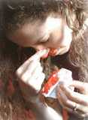
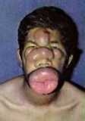
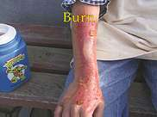
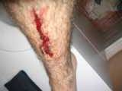
Unit 9: A first – aid course Lesson 1: Getting started & Listen and read
I/ Getting started
a girl has a nose bleed
boy has a bee sting
a boy has a bad cut on his leg
a girl has a
burn on her arm

Slide 4
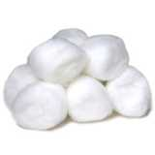
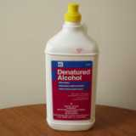
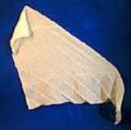
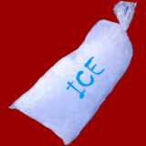
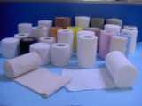
Unit 9: A first- aid course Lesson 1: Getting Started & Listen and read I/ Getting started
A girl has a burn on her arm
A girl has a nose bleed
A boy has a bee sting
A boy has a bad cut on his leg
bandage
cotton
handkerchief
ice bag
alcohol

Slide 5
Unit 9: A first- aid course Lesson 1: Getting Started & Listen and read I/ Getting started
* Things may be necessary for first aid
handkerchief -cotton balls
bandage -alcohol
ice bag -tiger balm
Discuss: Ask your partners
What happened?
What would you do and what do you need for the first aid?

Slide 6
Unit 9: A- first aid course Lesson 1: Getting Started & Listen and read
I/ Getting started
II/ Listen and read
1, Vocabulary:
- Ambulance:
-unconscious:
-Conscious:
-(to) bleed:
-(to) hold it tight:
-Emergency:
xe cÊp cøu
bÊt tØnh
tinh t¸o
ch¶y m¸u
cÇm m¸u
t×nh tr¹ng cÊp cøu, khÈn cÊp

Slide 7

Unit 9: A- first aid course Lesson 1: Getting Started & Listen and read I/ Getting started II/ Listen and read
Predict the topics covered in the dialogue | Yes | No | correction
a, Describing the condition of injured person b, Asking for the address c, Asking about the condition of injured person d, Asking for advice e, Giving first aid instructions f, Arranging for an ambulance g, Saying the injured person’s name

Slide 8
Unit 9: A- first aid course Lesson 1: Getting Started & Listen and read I/ Getting started II/ Listen and read
Selected topics covered in the dialogue | Topics
a, Describing the condition of injured person b, Asking for the address c, Asking about the condition of injured person e, Giving first aid instructions f, Arranging for an ambulance
- she has a bad cut on her head, it’s bleeding badly
-What is the address of the school
- Is she conscious?
-Stop the bleeding, use a handkerchief to cover the wound
-The ambulance will be there in 10 minutes

Slide 9
Unit 9: A- first aid course Lesson 1: Getting started & listen and read I/ Getting started II/ Listen and read
Model sentence1
a,Make request:
Lan: Will you hurry ,please?
Nurse: yes, of course
Will....inf, please?

Slide 10
Unit 9: A- first aid course Lesson 1: Getting started & listen and read I/ Getting started II/ Listen and read
Model sentence2
b, Give a promise :
Lan: I promise I’ll keep her awake
I promise I’ll........

Slide 11
Unit 9 : A – first aid course Lesson 1: Getting started & Listen and read
Complete the dialogue
Nga: Please....... ..............................(1)...to NCT street
My brother.......................................(2)
Nurse: Calm down,
Nurse: Is he ..............................(3)..?
Nga: Yes but it’s..............................(4)....badly
Nurse: Try to stop the bleeding with a towel to cover...... ...(5)
hold it tight
Nga: will...............................(6)........, please?
Nurse: of course, what........................................(7)....?
Nga: No. 25 NCT street
Nurse: Keep him.. .......... (8) the ambulance will be there in
15 minutes
Nga: I..... ....................(9)
send an ambulance
had a bad cut on his hand
conscious
bleeding
the wound
you hurry
is your address
awake
promise, I will

