Slide 1

ENGLISH 8
BINH KHANH SECONDARY SCHOOL

Slide 2
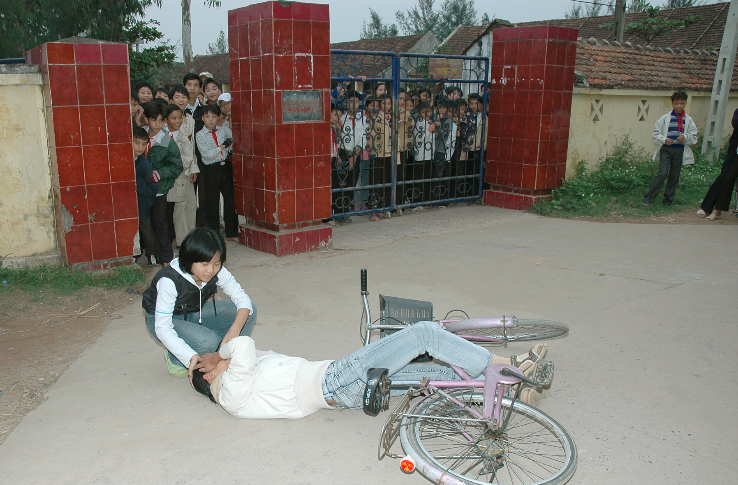
=> Look at this picture and describe.
Lan
Ba
1. What happened to Ba?
Ba fell off his bike and had a bad cut on his head.
2. What could Lan do to help him?
Lan could use a cotton ball or a handkerchief to stop the bleeding.
3. How could Ba say if he wanted Lan to take him to the hospital?
“ Will you please take me to the hospital?”

Slide 3
Unit 9. A first - aid course
Period 56
Lesson 2. Speak + Listen.

Slide 4
Unit 9. A first- aid course
1. Speak.
*Look at the picture and answer.
To make requests
Can you please.….?
Could
Will
Would
Lan
Responses
Ba
Sure/ Ok/ All right.
I’m sorry, I can’t.
I’m afraid not.
Ba: Will you please get me a bandage?
Lan: Sure.

Slide 5
Unit 9. A first- aid course
1. Speak.
*Look at the picture and answer.
To make offers
Would you like………?
What can I do for you?
Shall I………………...?
Will/ Won’t you have...?
Can I get you………..?
Lan
Responses
Ba
Yes, please.
That would be nice.
No, thank you.
Lan: Would you like a bandage?
Ba: Yes, please.

Slide 6
Unit 9. A first- aid course
1. Speak.
* Think of this situation:
To make promises
* You tell your mother that you’ll surely get up early.
- How can you say?
=>
You: I promise I will get up early.
Your mother: I hope so.
I will…………….I promise.
I promise I’ll……………….
I promise I won’t………….
I promise to……………….
Responses
I hope so/ Good.
I’m glad.
Don’t forget.

Slide 7
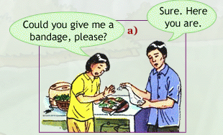
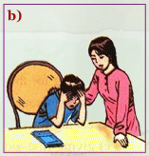
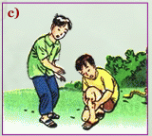
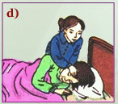
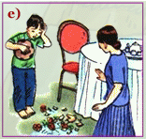
Unit 9. A first- aid course
1. Speak.
To make requests | To make offers | To make promises
Can you…………….? Could Will Would | Would you like………? What can I do for you? Shall I………………...? Will/ Won’t you have...? Can I get you………..? | I will…………….I promise. I promise I’ll………………. I promise I won’t…………. I promise to……………….
Responses | Responses | Responses
Sure/ Ok/ All right. I’m sorry, I can’t. I’m afraid not. | Yes, please. That would be nice. No, thank you. | I hope so/ Good. I’m glad. Don’t forget.
=> Identify the situations:
Request Offer
Promise
Request Offer
Promise
Request Offer
Promise
Request Offer
Promise
Request Offer
Promise

Slide 8
Unit 9. A first- aid course
1. Speak.
Work with a partner. Look at the phrases and the pictures. Take turns to make and respond to requests, offers and promises:
=> Request:
Girl: Could you please get me a bandage?
Boy: Sure. Here you are.
=> Offer:
Boy: Shall I get you a bandage?
Girl: Yes, please.
The girl has a burn on her hand.
Request: (some medicine/ water)
Offer: (some medicine/ water)
- Would / Can you get me some medicine?
+ Sure. Here you are.
- Can I get you some medicine/ water?
+ Yes, please/ That would be nice.
The boy has a headache.

Slide 9
Unit 9. A first- aid course
1. Speak.
To make requests | To make offers | To make promises
Can you…………….? Could Will Would | Would you like………? What can I do for you? Shall I………………...? Will/ Won’t you have...? Can I get you………..? | I will…………….I promise. I promise I’ll………………. I promise I won’t…………. I promise to……………….
Responses | Responses | Responses
Sure/ Ok/ All right. I’m sorry, I can’t. I’m afraid not. | Yes, please. That would be nice. No, thank you. | I hope so/ Good. I’m glad. Don’t forget.
=> Practice. Work with your partner:
Request Offer
Promise
Request Offer
Promise
Request Offer
Promise
Request Offer
Promise
Request Offer
Promise

Slide 10
Game!
“Who is the best actor or actress?”
Work in pairs
Play the real situations for yourselves!

Slide 11
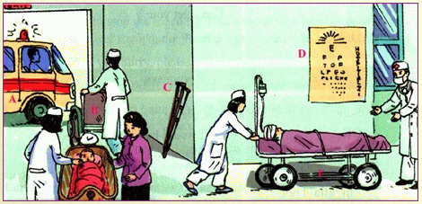
Unit 9. A first- aid course
2. Listen.
Match the letters A, B, C, D, E or F to the correct words in the box, then put them in the correct order as you hear:
Look at the picture:

Slide 12
2. Listen: Match the letters A, B, C, D, E or F to the correct words in the box, then put them in the correct order as you hear.
ambulance
crutches
scale
stretcher
wheelchair
eyechart
D
+ eyesight (n)
C
+ to wheel
A
B
+ to lean (against)…
+ paramedic (n)
F
E
a. Match the letter A, B, C, D, E or F to the correct words in the box:
 | Guess | Answer | Correct answer
A
B
C
D
E
F

Slide 13
2. Listen:
Unit 9. A first- aid course
b. Listen. Put the words in the correct order as you hear:
1
2
 | Answer | Correct order
A. ambulance
B. wheelchair
C. crutches
D. eyechart
E. scale
F. stretcher
5
6
4
3

Slide 14
Unit 9. A first- aid course
2. Listen.
=> Describe activities in the picture, using the information you heard:
Ex: This is the emergency room in a hospital…………………………..

Slide 15
Unit 9. A first- aid course
2. Listen.
Homework
1. Remember how to make and respond to the
requests, offers and promises.
2. Write a paragraph to describe the activities in
the picture “Listen- page 82” in your notebook

Slide 16

Thank you
for your attendance

