Slide 1

ENGLISH 8
BINH KHANH SECONDARY SCHOOL

Slide 2
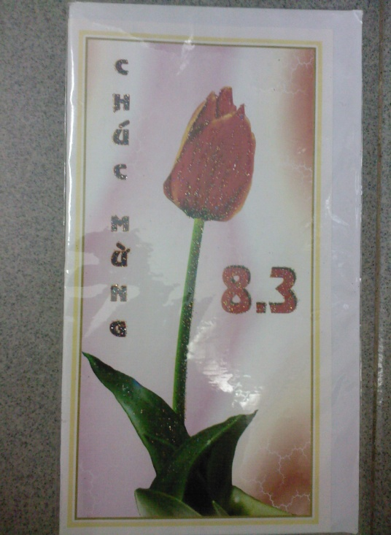

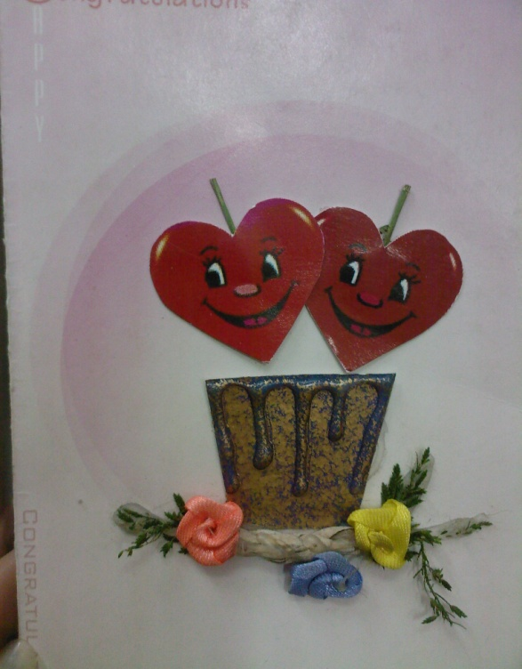
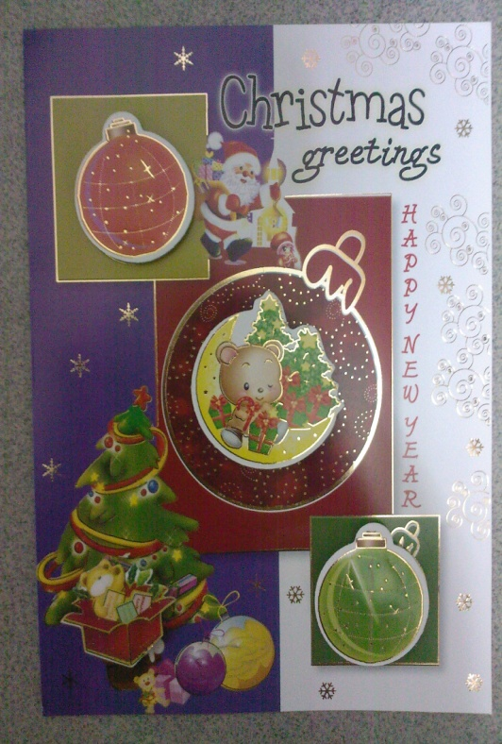
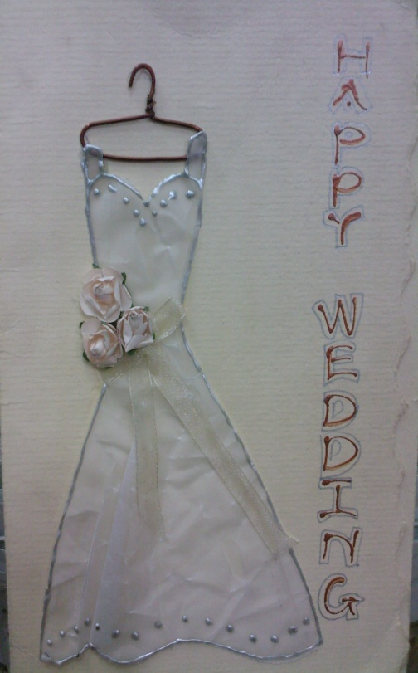
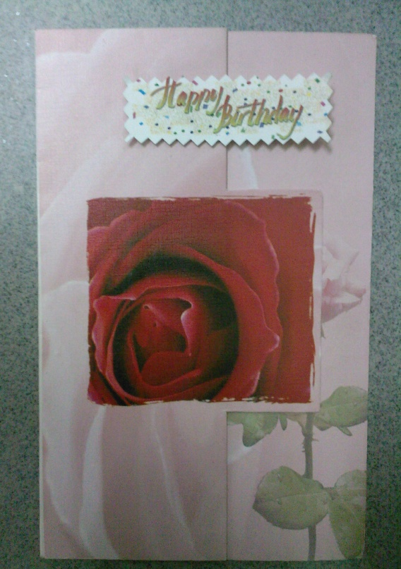
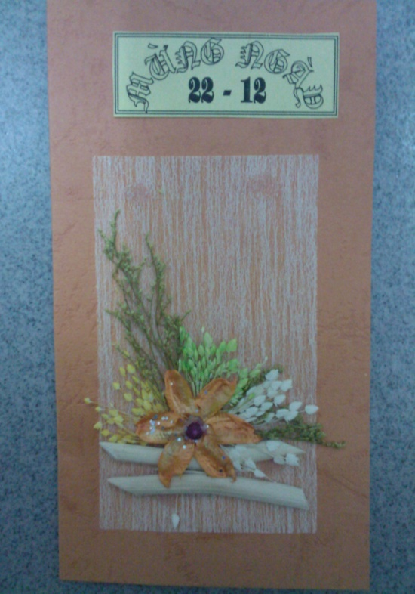

20-11
This is the way to say
Thank u so much

Slide 3

Monday, 12th January 2009
Period 58
Unit nine:
A first- aid course
Lesson 4:
Write

Slide 4

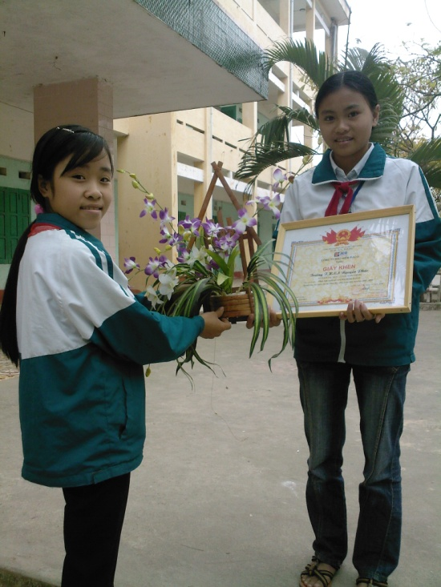
Unit 9: A first- aid course
Lesson 4: Write
I.Vocabulary:
Vocabulary:
(to) thank … for smt / doing smt
Cảm ơn ai về việc gì
(to) cheer … up = to make ... feel happy
Chúc mừng, khích lệ ai = Làm cho ai đó vui lên
(to) come over
Đến thăm
Eg: Yesterday Ha came over to my house
(to) look forward to...
Mong ®îi

Slide 5

Matching
Cheer... Up
Come over
Look forward to...
Thank...for
Mong ®îi
C¶m ¬n vÒ
Liªn l¹c
®Õn th¨m
Chóc mõng

Slide 6


Unit 9: A first- aid course
Lesson 4: Write

Slide 7

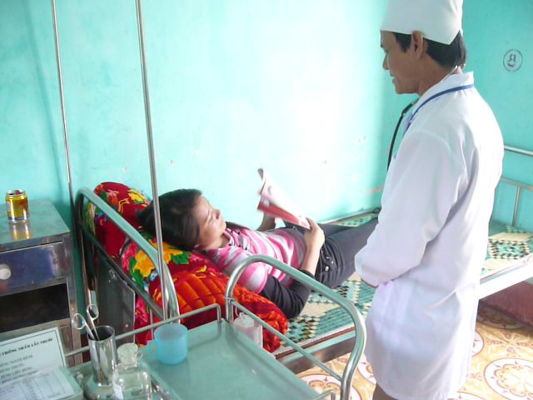
What was the matter with her?
Last week
Nga

Slide 8
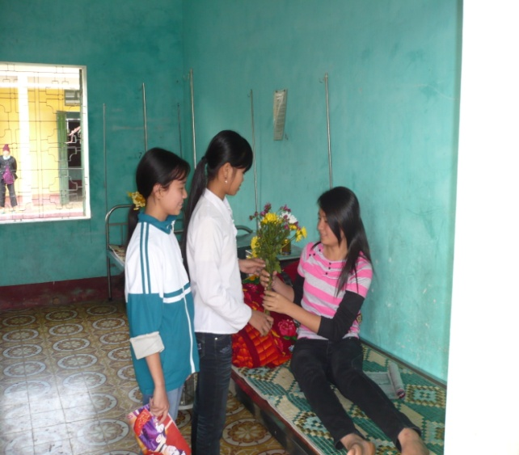
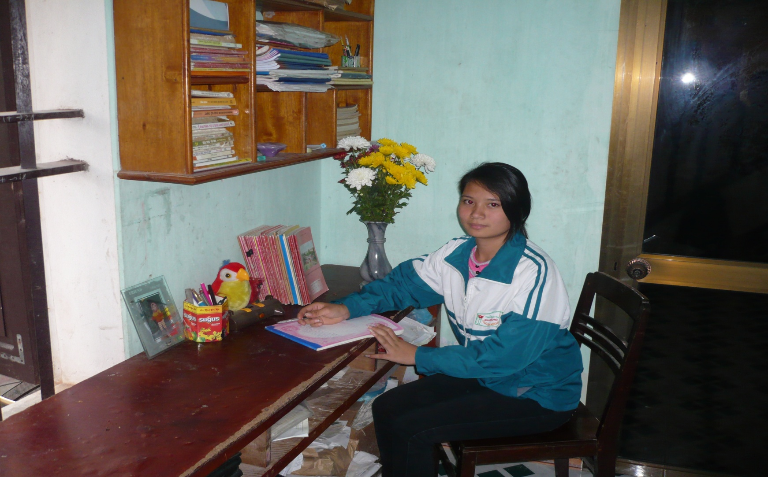
This week
Is she at home now?
How is she?

Slide 9



Unit 9: A first- aid course
Lesson 4: Write
I. Vocabulary
Complete the letter
* to thank … for smt/doing smt.
* to cheer … up
to come over
to look forward (to)
Dear Hoa,
Thank you very much for the flowers you sent me while I (1).........(be) in the hospital. They (2) ........ (be) beautiful and they really (3)............... (help) to cheer me up. I (4)..............( come) out of the hospital on Monday morning.
Now I (5)......... ( be) very bored. Will you come over to my place on the weekend? I’d love to see you.
I (6) ........................... ( phone) you on Friday afternoon.
Your friend.
Nga
was
were
helped
came
am
will phone

Slide 10

Dear Hoa,
Thank you very much for the flowers you sent me while I (1).........(be) in the hospital. They (2) ........ (be) beautiful and they really (3)............... (help) to cheer me up. I (4)..............( come) out of the hospital on Monday morning.
Now I (5)......... ( be) very bored. Will you come over to my place on the weekend? I’d love to see you.
I (6) ........................... ( phone) you on Friday afternoon.
Your friend.
Nga
Answer questions:
was
1. Did Hoa send Nga flowers while she was in the hospital ?
were
helped
2. Was Nga unhappy when she received the present?
came
am
3.How does Nga feel now?
4. Does she want to invite Hoa to come over to her house?
will phone

Slide 11
Unit 9: A first- aid course
Lesson 4: Write
Suggestions:
I. Vocabulary
* to thank smb for smt/doing smt.
* to cheer smb up
to come over
to look forward (to)
1. What did your friend give/ send you?
2. On what occasion?
3. What was it/ were they like?
4. How did you feel when you received
the present?
5. How do you feel now?
6. Do you want to invite your friend
somewhere?
7. If so, then when?
8. How will you contact your friend?
II.Complete the letter:
1.was 2. were 3. helped 4. came 5. am 6. will phone
III.Writing
Write a thank you note to a friend. Invite your friend to go on a picnic with you. Arrange to contact your friend. Use the following questions to guide your writing.

Slide 12

Possible answers
1. What did your friend give/ send you?
2. On what occasion?
3. What was/ were it / they like?
4. How did you feel when you received the present?
5. How do you feel now?
6. Do you want to invite your friend somewhere?
7. If so, then when?
8. How will you contact your friend?
1. an interesting book /a lovely doll / flowers/...
2. On birthday / at Christmas /on Women’s Day /…
3. It is / They are lovely / useful /beautiful /…
4. I felt very happy / Your present helped me relax a lot / cheered me up…
5. Now, I am free / sad / …
6. I want to go out to enjoy the fresh air. Will you go with me?...
7. See you this Sunday morning...
8. I will phone you tonight for details....

Slide 13

Unit 9: A first- aid course
Lesson 4: Write
I. Vocabulary
* to thank … for smt/doing smt.
* to cheer … up
to come over
to look forward (to)
II.Complete the letter
1.was 2. were 3. helped
4. came 5. am
6. will phone/ telephone
III.Writing
Write a thank you note to a friend. Invite your friend to go on a picnic with you. Arrange to contact your friend. Use the following questions to guide your writing.

Slide 14

Dear Hoa,
Thank you very much for the flowers you sent me while I was in the hospital. They were beautiful and they really helped to cheer me up. I came out of the hospital on Monday morning.
Now I am very bored. Will you come over to my place on the weekend? I’d love to see you.
I will phone you on Friday afternoon.
Your friend.
Nga
Opening
Body
Closing

Slide 15
Grammar
The simple past tense.
  S + was / were + …
  S + Ved / cột 2 + …
The simple present tense.
  S + is/ am / are + …
  S + V / s / es + …
The simple future tense.
  S + Will + V + …

Slide 16
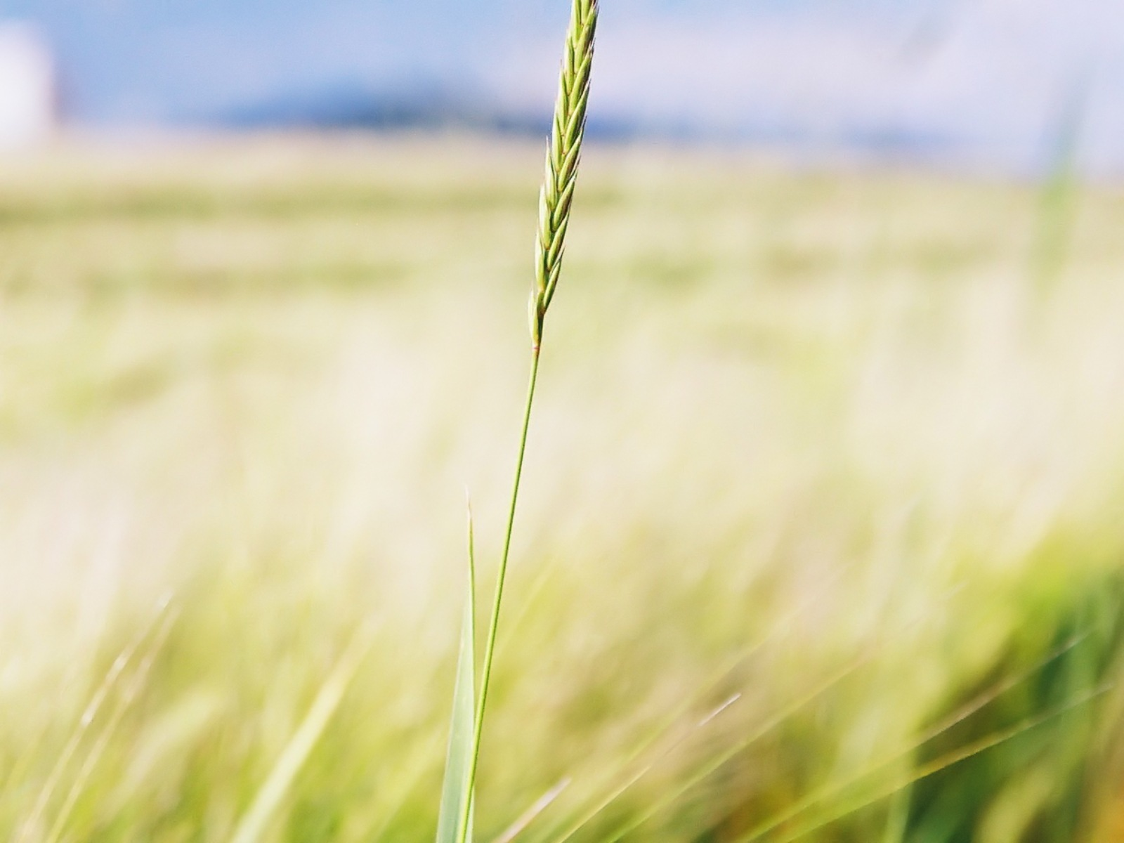
Outline
Dear…
Thank you for….
………………….
…………………
Your friend
……….
1. an interesting book /a lovely doll / flowers/...
2. On birthday / at Christmas /on Women’s Day /…
3. It is / They are lovely / useful /beautiful /…
4. I felt very happy / Your present helped me relax a lot / cheered me up…
5. Now, I am free / sad / …
6. I want to go out to enjoy the fresh air. Will you go with me?...
7. See you this Sunday morning.
8. I will phone you tonight for details.

Slide 17
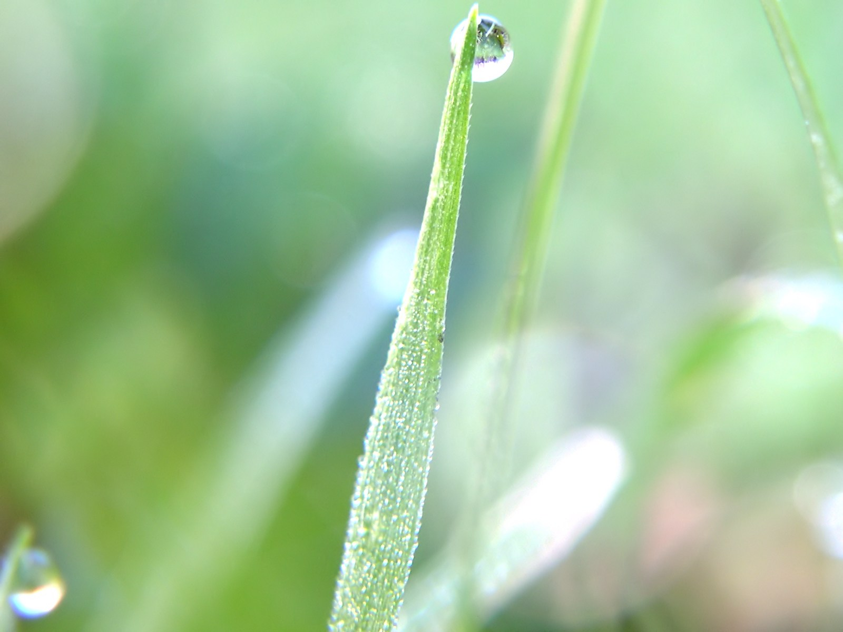
Suggested thank-you note
Dear Lan,
I’d like to say thank you for the interesting book you gave me on my birthday last month. It is a wonderful book about Vietnamese traditions. It helped to make my day much more meaningful.
This week I have more free time, and my family has decided to go on a picnic to my home village on Saturday. Why don’t you join us? We will be very happy to have you along.
I will telephone you tonight.
I love to see you then,
Your friend,
Mai

Slide 18
Unit 9: A first- aid course
Lesson 4: Write
I. Vocabulary
* to thank smb for smt/doing smt.
* to cheer smb up
* to come over
II.Complete the letter
1.was 2. were 3. helped 4. came 5. am 6. will phone/ telephone
III.Writing
1)Write a thank you note to a friend. Invite your friend to go on a picnic with you. Arrange to contact your friend. Use the following questions to guide your writing.
2)Use the same format to write another letter to another friend for other occasions.

Slide 19
Unit 9: A first- aid course
Lesson 4: Write
I. Vocabulary
1. What did your friend give/ send you?
2. On what occasion?
3. What was/ were it / they like?
4. How did you feel when you received the present?
5. How do you feel now?
6. Do you want to invite your friend somewhere?
7. If so, then when?
8. How will you contact your friend?
* to thank smb for smt/doing smt.
* to cheer smb up
* to come over
II.Complete the letter
1.was 2. were 3. helped 4. came 5. am 6. will phone/ telephone
III. While - writing
1)Write a thank you note to a friend. Invite your friend to go on a picnic with you. Arrange to contact your friend. Use the following questions to guide your writing.
2)Use the same format to write another letter to another friend for other occasions.

Slide 20
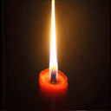
Homework
- Finish two letters at home
- Prepare Lesson 5:
Language focus.

