Slide 1

ENGLISH 8
BINH KHANH SECONDARY SCHOOL

Slide 2
A | M | B | U | L | A | N | C | E | A | B | C | D | E
F | G | U | H | I | G | K | K | M | N | L | O | P | Q
R | C | R | U | T | C | H | E | S | B | I | K | C | V
L | Y | N | T | W | V | M | Y | E | A | B | C | D | E
F | S | S | M | W | H | E | E | L | C | H | A | I | R
X | C | Z | J | K | L | V | C | E | Q | S | X | J | L
S | A | I | O | J | C | S | H | O | C | K | M | N | V
V | L | A | K | L | V | X | A | B | G | A | S | D | C
X | E | M | Y | S | Z | V | R | I | N | B | X | Z | O
I | L | N | F | A | I | N | T | I | N | G | W | J | P

Slide 3

5
10
15
20
25
30
35
40
45
50
55
60
65
70
75
80
85
90
95
100
105
110
115
120

Slide 4
A | M | B | U | L | A | N | C | E | A | B | C | D | E
F | G | U | H | I | G | K | K | M | N | L | O | P | Q
R | C | R | U | T | C | H | E | S | B | I | K | C | V
L | Y | N | T | W | V | M | Y | E | A | B | C | D | E
F | S | S | M | W | H | E | E | L | C | H | A | I | R
X | C | Z | J | K | L | V | C | E | Q | S | X | J | L
S | A | I | O | J | C | S | H | O | C | K | M | N | V
V | L | A | K | L | V | X | A | B | G | A | S | D | C
X | E | M | Y | S | Z | V | R | I | N | B | X | Z | O
I | L | N | F | A | I | N | T | I | N | G | W | J | P

Slide 5
UNIT 9: A FIRST-AID COURSE
Lesson 5: Language focus
*In order to; so as to
*Future simple
*Modal will to make requests, offers and promises

Slide 6
UNIT 9: A FIRST-AID COURSE
Lesson 5: Language focus
Phrase of purpose
so as to + infinitive
In order to + infinitive
Ex: I study English in order to / so as to communicate with foreigners

Slide 7
UNIT 9: A FIRST-AID COURSE
Lesson 5: Language focus
Phrase of purpose
so as to + infinitive
In order to + infinitive
So as not to + infinitive
In order not to + infinitive
Ex: He drives a car carefully in order not to / so as not to cause the accidents

Slide 8
Match one part of a sentence from column A with another part in column B. Then write a complete sentence by using in order to / so as to
A
B
1. I always keep the window open
a. Ease the victim’s pain and anxiety
2. Mary wrote a notice on the board
3. Mr. green got up early this morning
b. get to the meeting on time
c. inform her classmates about the change in schedule
4. My elder brother studies hard this year
d. minimize tissue damage
5. People use first-aid
e. pass the entrance exam to the university
6. You should cool the burns immediately
f. let fresh air in

Slide 9
A
B
1. I always keep the window open
a. Ease the victim’s pain and anxiety
2. Mary wrote a notice on the board
3. Mr. green got up early this morning
b. get to the meeting on time
c. inform her classmates about the change in schedule
4. My elder brother studies hard this year
d. minimize tissue damage
5. People use first-aid
e. pass the entrance exam to the university
6. You should cool the burns immediately
f. let fresh air in
1. I always keep the window open
I always keep the window open in other to / so as to let fresh air in
f. let fresh air in
4. My elder brother studies hard this year in other to/ so as to pass the entrance exam to the university.
2. Mary wrote a notice on the board in other to/ so as to inform her classmates about the change in schedule.
5. People use first-aid in other to/ so as to Ease the victim’s pain and anxiety.
3. Mr. green got up early this morning in other to/ so as to get to the meeting on time.
6. You should cool the burns immediately in other to/ so as to minimize tissue damage

Slide 10
UNIT 9: A FIRST-AID COURSE
Lesson 5: Language focus
Lesson 5: Language focus
The simple future tense
Shall / will + bare-infinitive
( ’ll )
Shall →
I, we
Will →
all of the nouns and pronouns

Slide 11
UNIT 9: A FIRST-AID COURSE
UNIT 9: A FIRST-AID COURSE
Lesson 5: Language focus
Lesson 5: Language focus
The simple future tense
Shall / will + bare-infinitive
Shall / will + bare-infinitive
( ’ll )
* Uses
- For a pure future action
- For a prediction…

Slide 12
UNIT 9: A FIRST-AID COURSE
UNIT 9: A FIRST-AID COURSE
UNIT 9: A FIRST-AID COURSE
UNIT 9: A FIRST-AID COURSE
UNIT 9: A FIRST-AID COURSE
UNIT 9: A FIRST-AID COURSE
UNIT 9: A FIRST-AID COURSE
UNIT 9: A FIRST-AID COURSE
Lesson 5: Language focus
Lesson 5: Language focus
Lesson 5: Language focus
Lesson 5: Language focus
Lesson 5: Language focus
Lesson 5: Language focus
The simple future tense
The simple future tense
The simple future tense
The simple future tense
The simple future tense
Shall / will + bare-infinitive
Shall / will + bare-infinitive
Shall / will + bare-infinitive
Shall / will + bare-infinitive
( ’ll )
* Note
Shall + not -> shan’t
Will + not -> won’t

Slide 13
UNIT 9: A FIRST-AID COURSE
Lesson 5: Language focus
The simple future tense
Ba is talking to his mother about his aunt Mai. Complete the dialogue. Use the correct word or short form
Ba: What time _______ Aunt Mai be here?
Mrs. Nga: She ________ be here in two hours
Ba: _______ Uncle Sau be with her?
Mrs. Nga: No, he ________. He has to stay in
Ho Chi Minh City.
Ba: _______ I come to the airport with you?
Mrs. Nga: OK. It ________ be a nice trip for us both.
Ba: Great, I ______ be ready in two minutes
Will
/shall
Will
/shall
Will
/’ll
Will /
won’t
Will /
shall
Will
/Won’t
Won’t /
’ll

Slide 14
UNIT 9: A FIRST-AID COURSE
UNIT 9: A FIRST-AID COURSE
UNIT 9: A FIRST-AID COURSE
Lesson 5: Language focus
Lesson 5: Language focus
Lesson 5: Language focus
Lesson 5: Language focus
Lesson 5: Language focus
Lesson 5: Language focus
Lesson 5: Language focus
The simple future tense
The simple future tense
The simple future tense
The simple future tense
The simple future tense
Shall / will + bare-infinitive
Shall / will + bare-infinitive
Shall / will + bare-infinitive
Shall / will + bare-infinitive
( ’ll )
* Uses
- Will can be used to give requests
Will you ……?
Will you ……?

Slide 15
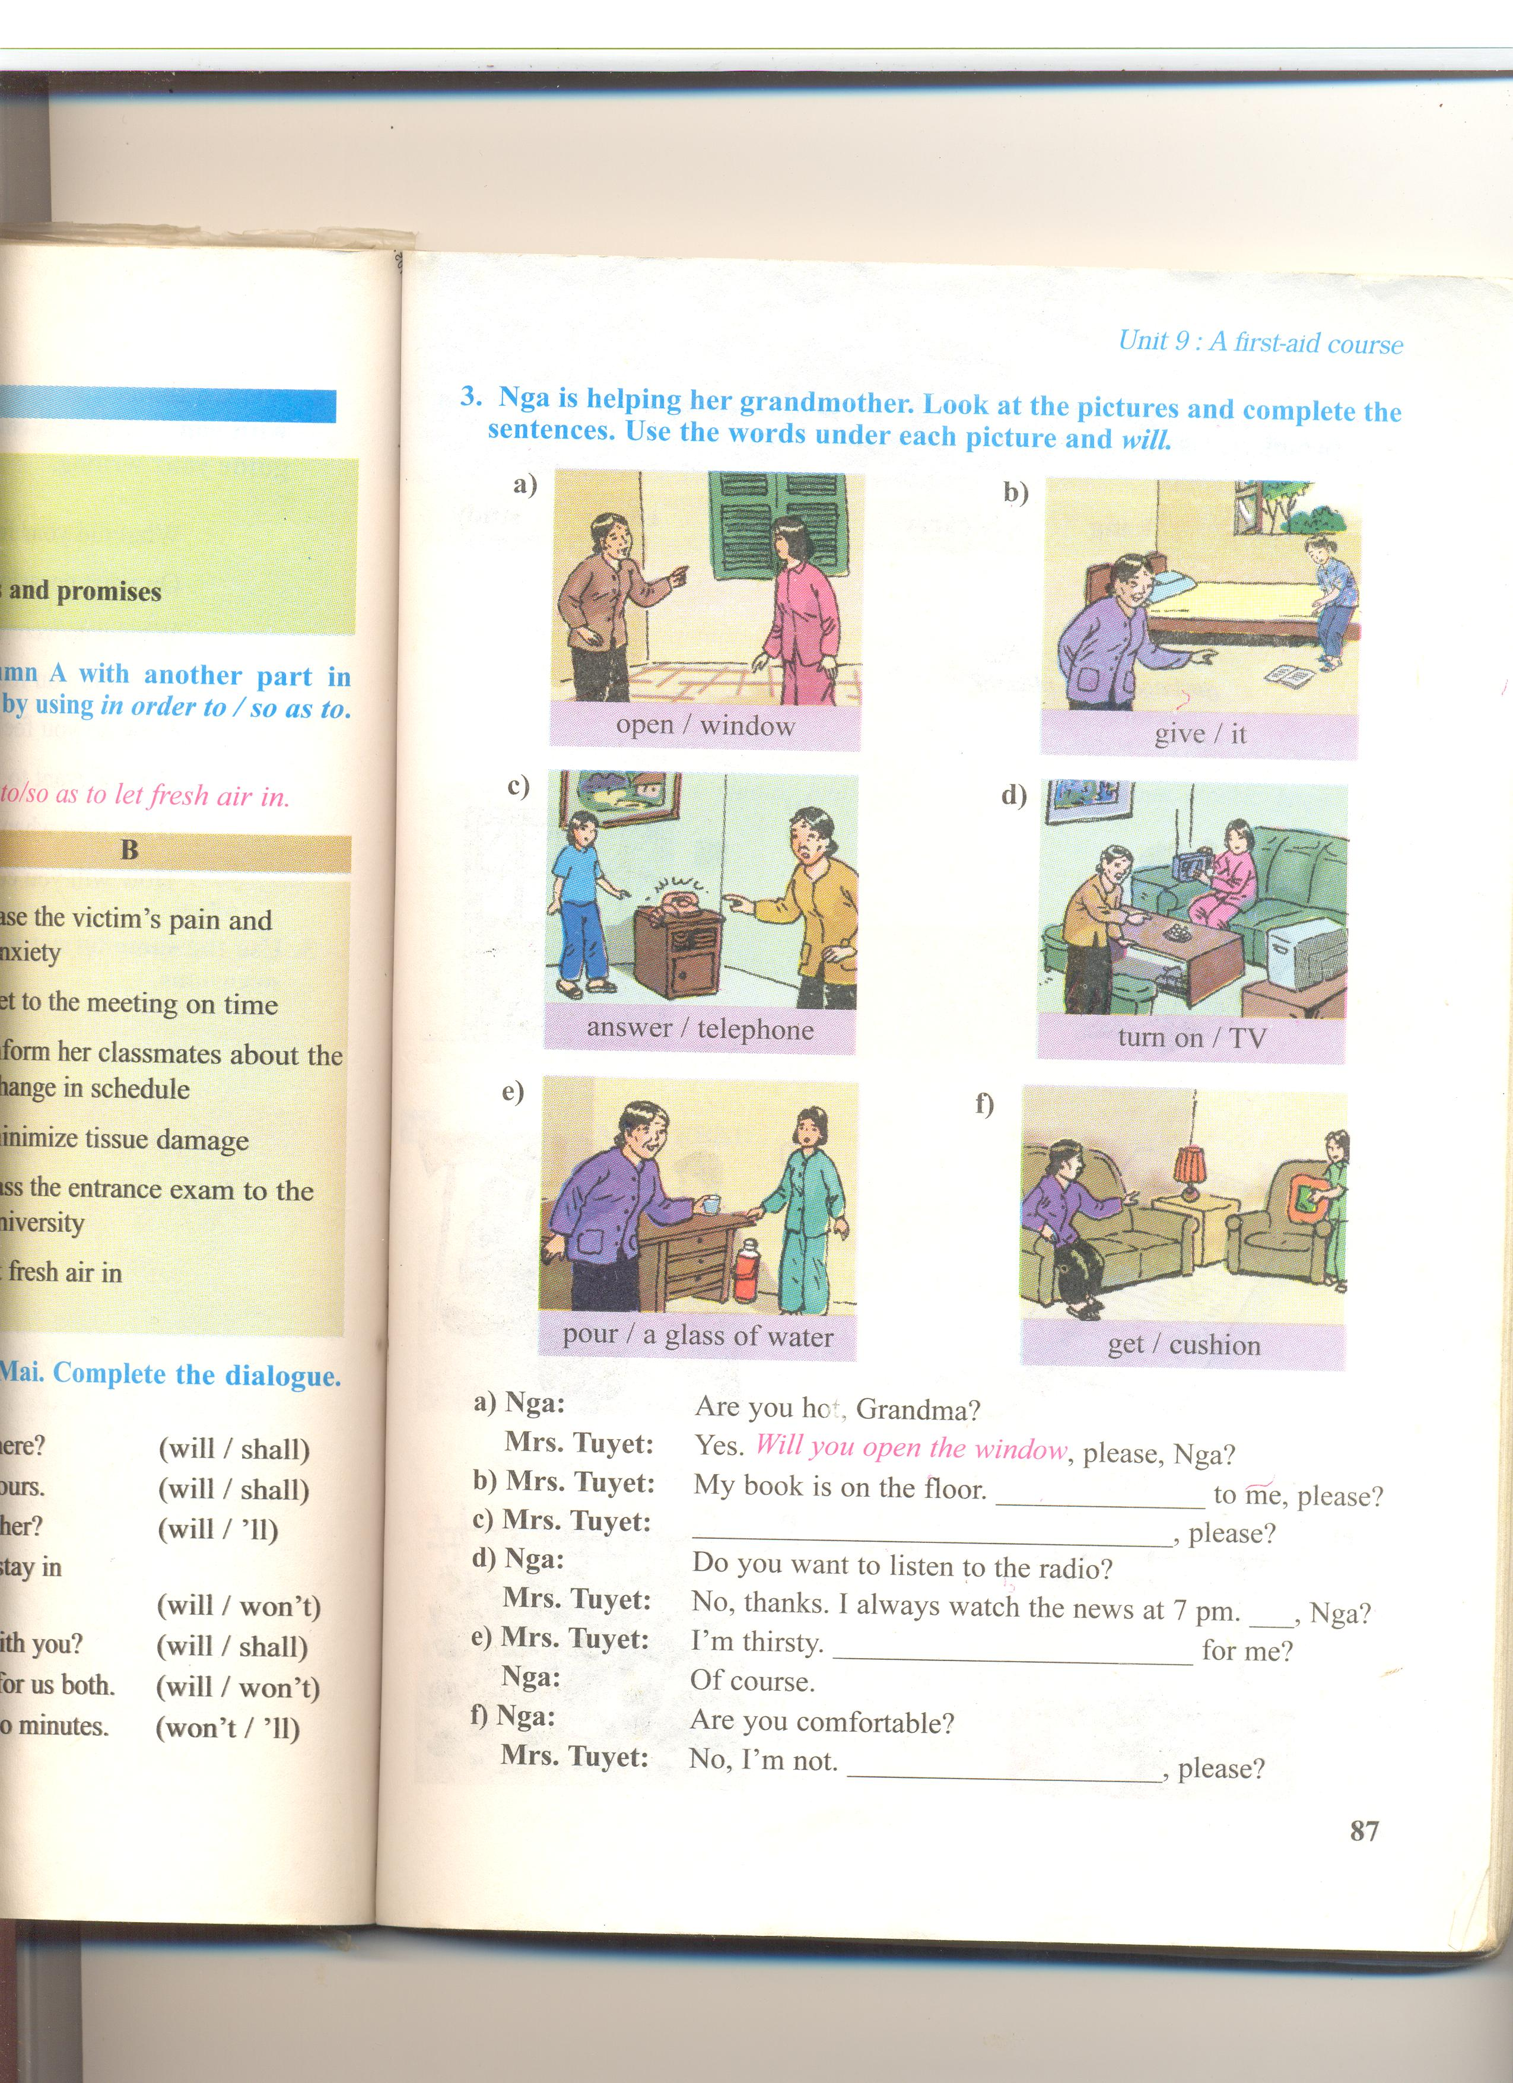
UNIT 9: A FIRST-AID COURSE
UNIT 9: A FIRST-AID COURSE
Lesson 5: Language focus
Nga is helping her grandmother. Look at the pictures and complete the sentences. Use the words under each picture and will
Nga: Are you hot, Grandma?
Mrs. Tuyet: Yes. , please, Nga?
Will you open the window

Slide 16
UNIT 9: A FIRST-AID COURSE
Lesson 5: Language focus
Nga is helping her grandmother. Look at the pictures and complete the sentences. Use the words under each picture and will
Will you give it
Mrs. Tuyet: My book is on the floor. to me, please

Slide 17
UNIT 9: A FIRST-AID COURSE
Lesson 5: Language focus
Nga is helping her grandmother. Look at the pictures and complete the sentences. Use the words under each picture and will
Will you answer the telephone
Mrs. Tuyet: , please?

Slide 18
UNIT 9: A FIRST-AID COURSE
Lesson 5: Language focus
Nga is helping her grandmother. Look at the pictures and complete the sentences. Use the words under each picture and will
Nga: Do you want to listen to the radio?
Mrs. Tuyet: No, thanks. I always watch the news at 7 pm.
, Nga?
Will you turn on the TV, please

Slide 19
UNIT 9: A FIRST-AID COURSE
Lesson 5: Language focus
Nga is helping her grandmother. Look at the pictures and complete the sentences. Use the words under each picture and will
Mrs. Tuyet: I’m thirsty. for me
Nga: Of course
Will you pour a glass of water

Slide 20
UNIT 9: A FIRST-AID COURSE
Lesson 5: Language focus
Nga is helping her grandmother. Look at the pictures and complete the sentences. Use the words under each picture and will
Nga: Are you comfortable?
Mrs. Tuyet: No, I’m not. , please
Will you get me the cushion

Slide 21
UNIT 9: A FIRST-AID COURSE
Lesson 5: Language focus
- Will can be used to give requests
Will you ……?
- Will can be used to give promises
(I promise) I will….
- Shall can be used to give offers
Shall I…..?

Slide 22
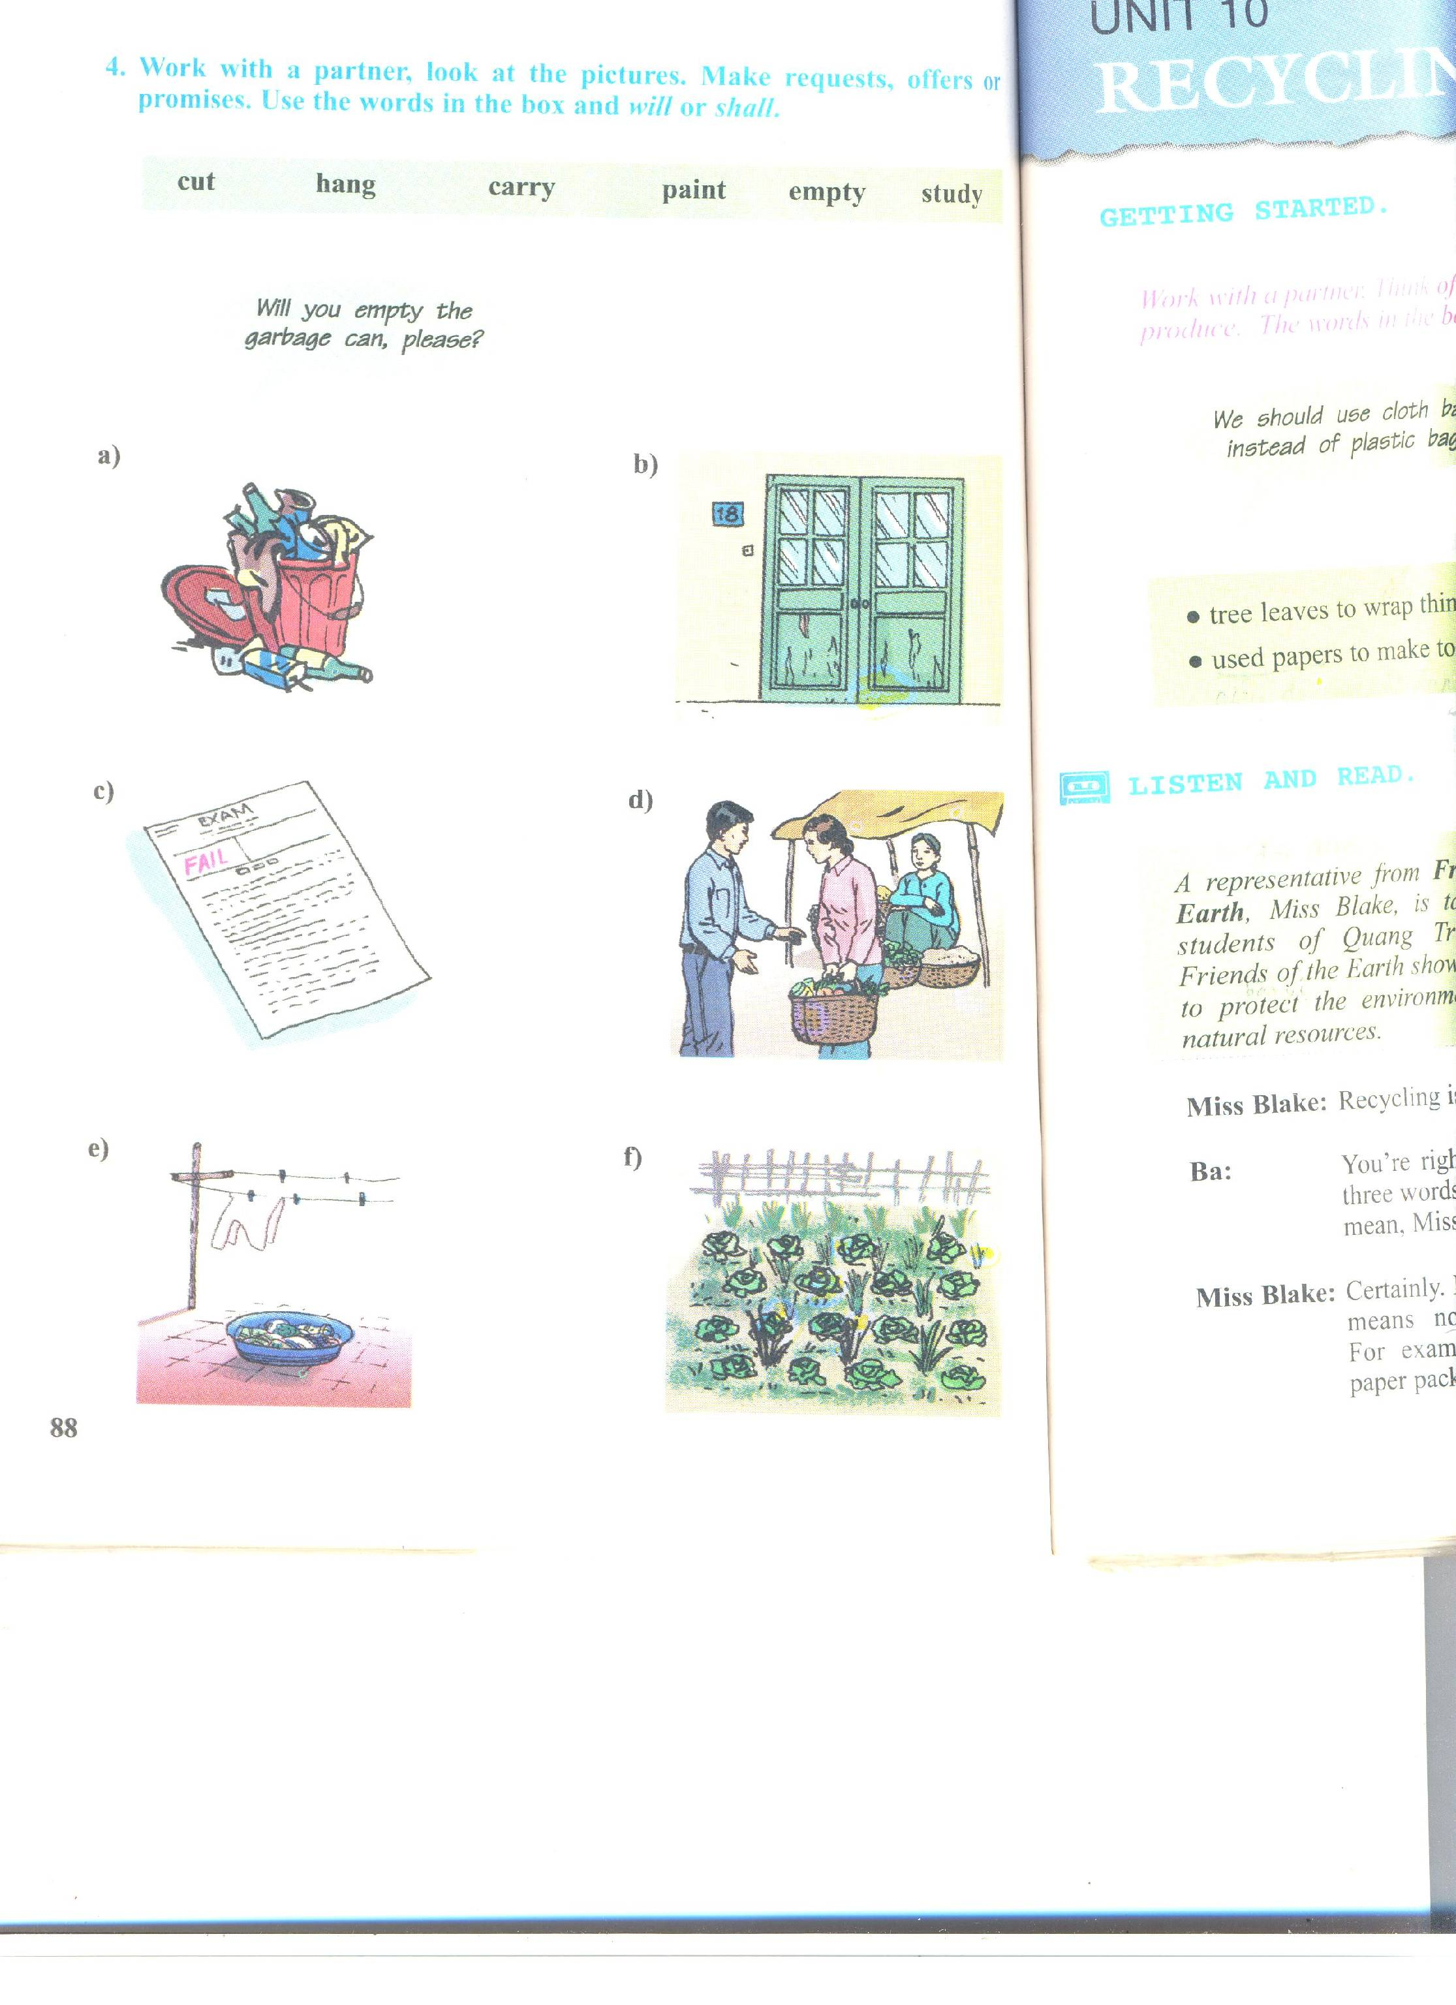
UNIT 9: A FIRST-AID COURSE
UNIT 9: A FIRST-AID COURSE
UNIT 9: A FIRST-AID COURSE
UNIT 9: A FIRST-AID COURSE
Lesson 5: Language focus
Lesson 5: Language focus
- Will / shall can be used to give requests, offers, promises
Will you ……?
Shall I…..?
(I promise) I will…
Will you empty the garbage can, please?
Shall I empty the garbage for you?
I will empty the garbage
empty

Slide 23
UNIT 9: A FIRST-AID COURSE
Lesson 5: Language focus
Work with a partner, look at the pictures. Make requests, offers or promises. Use the words in the box and will or shall
Will you paint the door, please?
Shall I paint the door ?
I promise I will paint the door
paint

Slide 24
UNIT 9: A FIRST-AID COURSE
UNIT 9: A FIRST-AID COURSE
Lesson 5: Language focus
Lesson 5: Language focus
Work with a partner, look at the pictures. Make requests, offers or promises. Use the words in the box and will or shall
Will you study harder, please?
I promise I will study harder
study

Slide 25
UNIT 9: A FIRST-AID COURSE
Lesson 5: Language focus
Work with a partner, look at the pictures. Make requests, offers or promises. Use the words in the box and will or shall
Will you carry the bag for me, please?
Shall I carry the bag for you?
carry

Slide 26
UNIT 9: A FIRST-AID COURSE
Lesson 5: Language focus
Work with a partner, look at the pictures. Make requests, offers or promises. Use the words in the box and will or shall
Will you hang the washing, please?
Shall I hang the washing for you?
I will hang the washing for you
hang

Slide 27
UNIT 9: A FIRST-AID COURSE
Lesson 5: Language focus
Work with a partner, look at the pictures. Make requests, offers or promises. Use the words in the box and will or shall
Will you cut the grass, please?
Shall I cut the grass for you?
I will cut the grass for you
cut

Slide 28
Homework
Learn the structures by heart
Do the exercises in your notebooks
Prepare unit 10:Getting started, listen and read

Slide 29

Thank you.
Goodbye!

