Slide 1
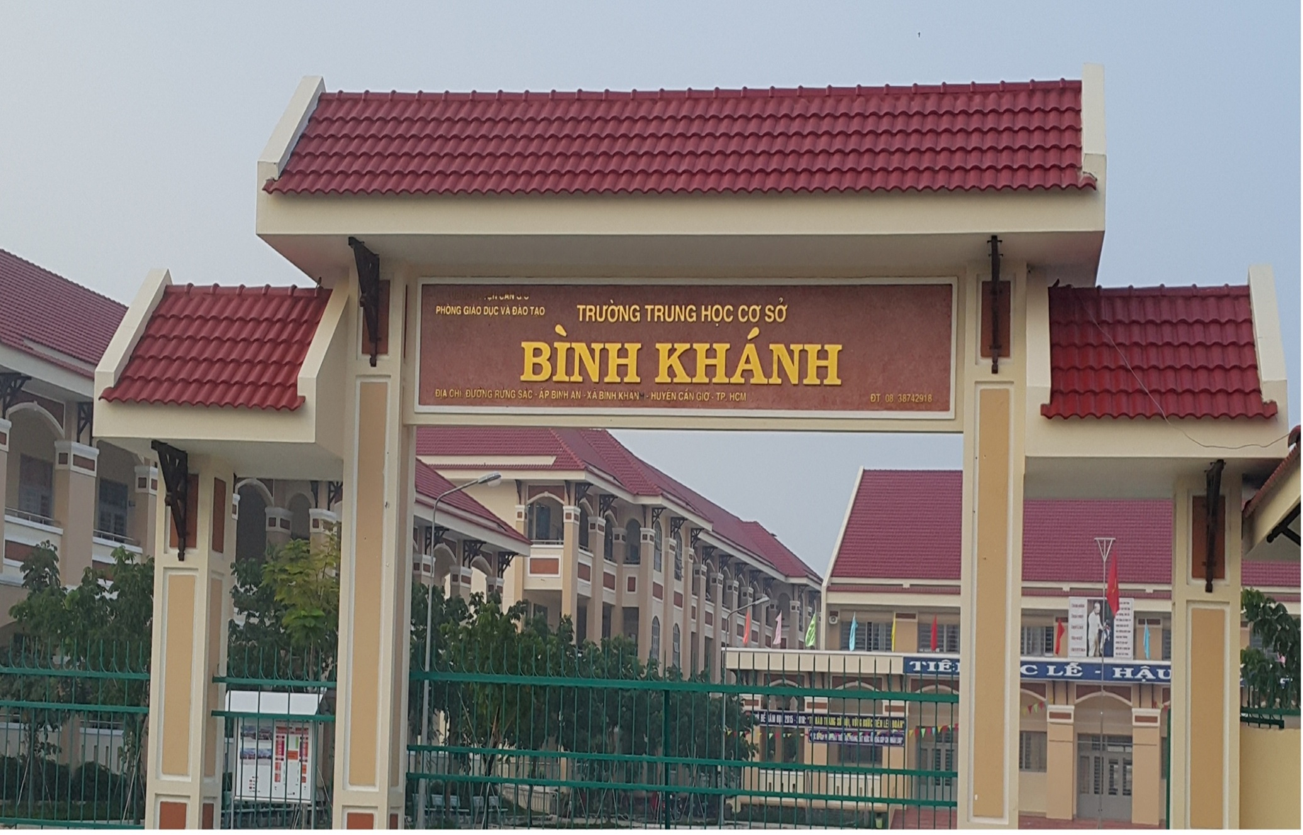
BINH KHANH SECONDARY SCHOOL
ENGLISH 9

Slide 2
Unit 10:
LIFE ON OTHER PLANETS
Lesson 4: WRITE

Slide 3

Reorder the passage and name each of the passage
1. If you follow these simple rules, not only will you save money , but also the environment will be cleaner.
3- Introduction
2. Most of us use too much gas .You can reduce this amount by :
2- Body
- Traveling by bicycle or public transport
- Having a mechanic check your motorcycle regularly
3. Good evening , ladies and gentlemen. I'm Professor Roberts and tonight I'm going to tell you how to save money.
1- conclusion

Slide 4
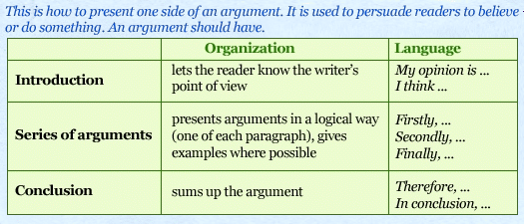
Discuss
a) How many parts does an argument have?
b) What does the writer do in each part
of an argument?

Slide 5

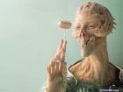


a) Vocabulary:
1.
flying saucer (n)
đĩa bay
imagine - imagination (v/n)
Tưởng tượng
2.
3.
trick (n)
Mẹo, thủ thuật
mysterious (a)
Bí hiểm
4.
man-like creature (n)
Sinh vật giống người
5.

Slide 6
Checking Vocabulary
What and Where

Slide 7
2.mysterious
1.imagination
3.exist
6.trick
4.man-like
creature
5.flying
saucer

Slide 8

UFO

Slide 9

Flying saucer

Slide 10
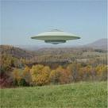
Flying saucer

Slide 11
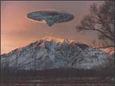
Flying saucer

Slide 12
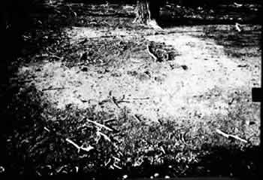
Trace of UFO’s landing

Slide 13
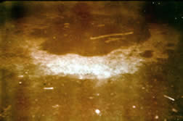
Trace of UFO’s landing

Slide 14
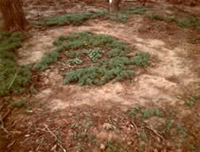
Trace of UFO’s landing

Slide 15
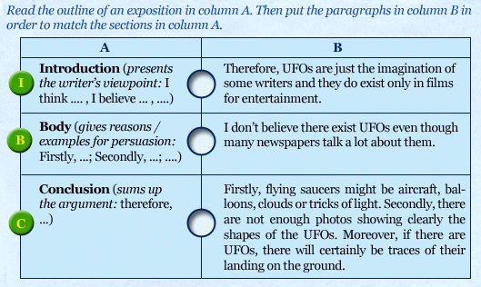
I
B
C

Slide 16
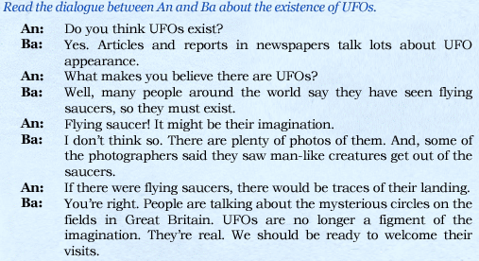

Slide 17
a) What does Ba think about the existence of UFO?
Ba thinks that UFOs exist.
b) Why does he think so?
Because articles and reports in newspaper talks a lot
about UFOs appearance. Many people around the
world say they have seen flying saucers. There are
plenty of photos of them. And some photographers
saw man-like creatures get out of the saucers. People
are talking about the mysterious circles on the fields
in Great Britain.
c) What does Ba think we should do?
UFOs are no longer human being’s imagination.
They are real. We should be ready to welcome
their visits.

Slide 18
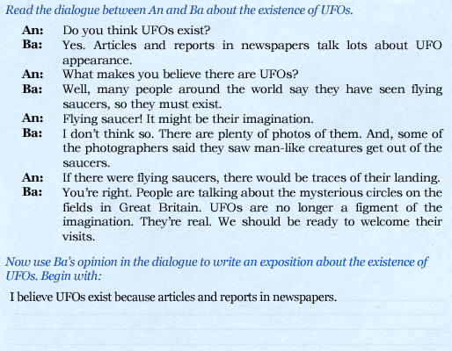

Slide 19
Suggested writing:
I believe UFOs exist because articles and reports
in newspapers talk a lots about its appearance.
Firstly, many people around the world say they have
seen flying saucers. Secondly, there are plenty of
photos of flying saucers and some photographers
said they saw man-like creatures get out of the
saucers. Moreover, people are talking about the
mysterious circles on the fields in Great Britain.
Therefore, UFOs are no longer human beings’
imagination. They are real. We should be ready
to welcome their visits.

Slide 20
HOMEWORK:
Rewrite an exposition, using An’s opinion.
Prepare Language focus

