Slide 1

ENGLISH 8
BINH KHANH SECONDARY SCHOOL

Slide 2
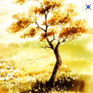

ENGLISH : 8
UNIT :10 - RECYCLING
PART: SPEAK

Slide 3
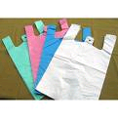


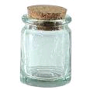

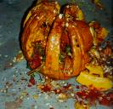
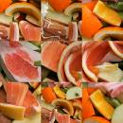
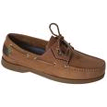
WARM-UP
Match the words from the box to the pictures.
shoes
jars
paper
Vegetable matter
glasses
Plastic bags
Fruit peels
cloth
1
2
3
4
5
6
7
8

Slide 4
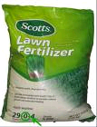



Unit : 10 SPEAK
NEW WORDS:
metal (n)
Gold , silver,iron… are metal.
fabric (n)
Clothes belong to fabric.
Shoes and sandals are made of leather.
leather (n)
compost (n)
fertilize(v)
compost
A farmer is fertilizing the rice-field.

Slide 5
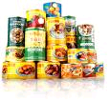
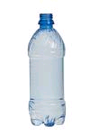
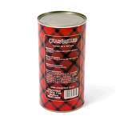
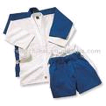
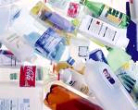
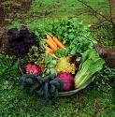
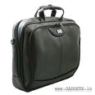
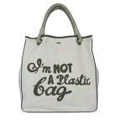

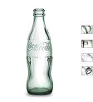

Unit : 10 SPEAK
Group or classify those things
1- leather
2- metal
3-paper
4- glass
5-plastic
6- vegetable matter
Plastic bags
bottles
Clothes
materials
Paper
Paper bags
wastepaper
Shoes
School bags
Food cans
tins
Fruit peels
vegetables
Glasses
bottles

Slide 6
Unit : 10 SPEAK
Practice with your friends, using the words
from the box.
clothes
fabric
recycle them and make them into paper or shopping bags
bottles
glass
clean them and refill them
A- which group do…………… belong to ?
B- Put them in “……………”.
A- What can we do with these ……….. ?
B-We can …………………………
………………………………………
…………………………..
clothes
fabric
clothes
recycle them and make them into
Paper or shopping bags

Slide 7
Unit : 10 SPEAK
Practice with your friends, using the words
from the box.
vegetables fruit-peels leaves
A- Is ………………… “ vegetable matter” ?
B- That’s right.
A- What will we do with it ?
B- We make it into compost and fertilize our field.
fruit

Slide 8
Unit : 10 SPEAK
Game : lucky munbers
1
2
3
4
5
6
7
8

Slide 9
Unit : 10 SPEAK
1- Which group do glasses belong to ?
A- fabric
C- paper
B- glass

Slide 10
Unit : 10 SPEAK
Do shoes belong to paper ?
A-Yes, that’s right.
B-No, they are in leather.

Slide 11

Unit : 10 SPEAK
Lucky number
Congratulation !

Slide 12
Unit : 10 SPEAK
Which is made into compost ?
A- leaves
B- fruit-peels
C- A and B

Slide 13
Unit : 10 SPEAK
Which thing does not belong to the group ?
1- paper 2-books 3- newspapers 4-cardboard boxes
5-school-bags

Slide 14
Unit : 10 SPEAK
Lucky number
Congratulation !

Slide 15
Unit : 10 SPEAK
Is food can “ metal” ?
A- That’s right.
B-No, It belongs to “ paper”.

Slide 16
Unit : 10 SPEAK
Plastic bottles belong to
…………………..
A- metal
B- glass
C- leather
D- plastic

Slide 17

Homework :
Learn new words by heart.
Write the dialogues into
your note books.
Prepare for the next time. (LISTEN)
THANKS FOR
YOUR ATTENTION
Good bye!

