Slide 1

ENGLISH 8
BINH KHANH SECONDARY SCHOOL

Slide 2
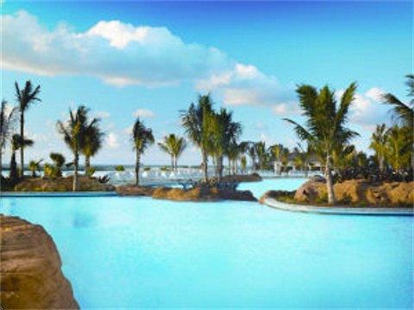
Unit10: RECYCLING
Lesson 3: Read

Slide 3

Warm-up

Slide 4
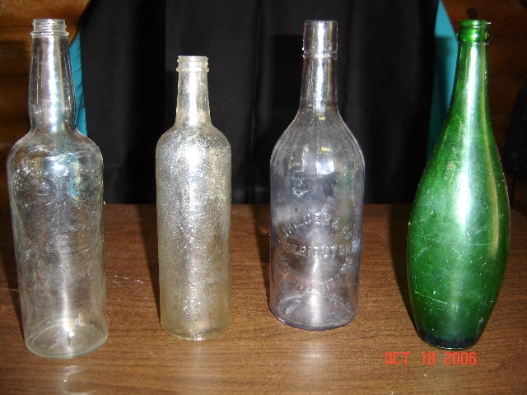
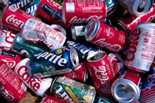
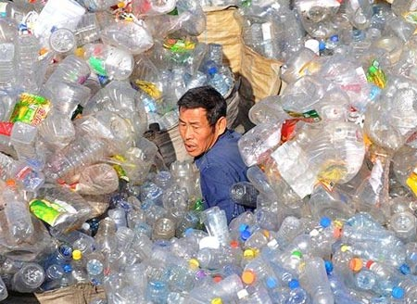
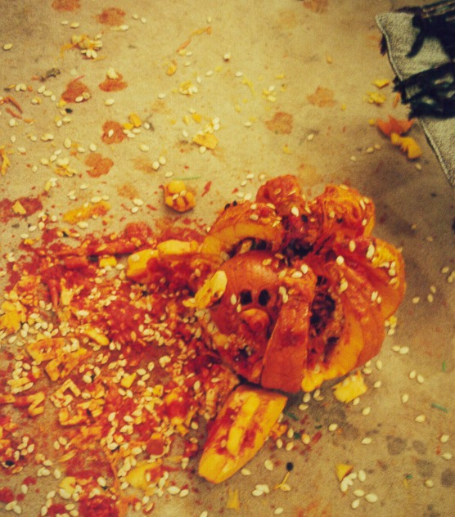
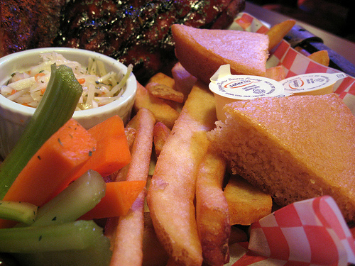
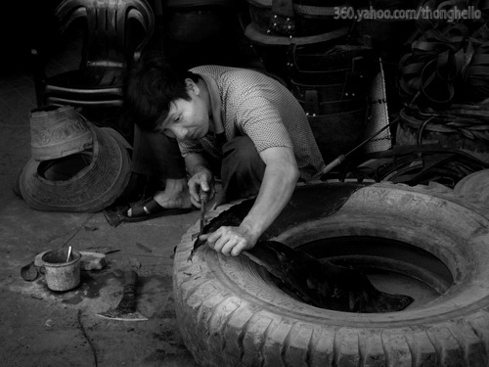
Match the words to the right pictures
1
2
3
glass
Drink cans
bottles
bottles glass drink cans car tires vegetable matter
4
5
6
Vegetable matter
Vegetable matter
Car tires

Slide 5

What do people do with empty glass?

Slide 6
What do people do with empty bottles?

Slide 7
What do people do with empty drink cans?

Slide 8
What do people do with vegetable matter?

Slide 9
What do people do with car tires?

Slide 10

Period 62
Unit10: RECYCLING
Lesson 3: Read

Slide 11
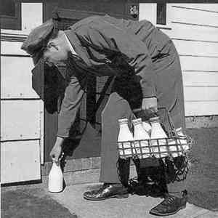
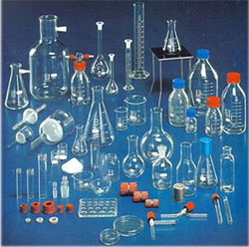
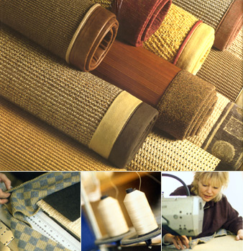
I. Vocabulary
Period 62: unit10 Lesson 3 read
Floor covering (n):
Milkman (n):
Refill (v):
Glassware (n):
Law (n):
Deposit (n):
Fertilizer (n):
Melt (v):
Tấm lót nền nhà
Người giao sữa
Làm đầy lại
Đồ dùng bằng thuỷ tinh
Luật pháp
Tiền đặt cọc
Phân bón
Làm nóng chảy ra

Slide 12

Period 62: unit10 Lesson 3 read
2.
T/F statements prediction
I guess
I read
1. Nowadays, many shoes and sandals are made from old car tires.
2. Every milk bottle can be reused thirty times.
3. New glassware can be made from old car tires.
4. In Oregon, billions of cans are thrown away every year.
5. Compost is a wonderful natural fertilizer.
T
F
T
T
F
T
T
F
F
glass
All over the world
T
F
F
T
F
T

Slide 13
3. Answer the questions
Period 62: unit10 Lesson 3 read
What do people do with empty bottles?
 People cleaned and refilled empty milk bottles.
b) What happens to the glass when it is sent to the factory?
 The glass is broken up, melted and made into new glassware.
c) What did the Oregon government do to prevent people from throwing drinks cans away?
 The Oregon government made a law that there must be a deposit on all drink cans.
d) What is compost made from?
 Compost is made from household and garden waste.
If you have a recycling story to share, how can you share it?
 If we have a recycling story to share, we can call or fax the magazine at 5 265 456.

Slide 14

4. Work with a partner. Complete …
Period 62: unit10 Lesson 3 read
Car tires __________________________________
Milk bottles _____________________
Glass ____________________________________
Drink cans _________________________
Household and garden waste __________________
are recycled to make pipes and floor coverings.
are cleaned and refilled.
is broken up, melted and made into new glassware.
are brought back for recycling.
is made into compost.

Slide 15
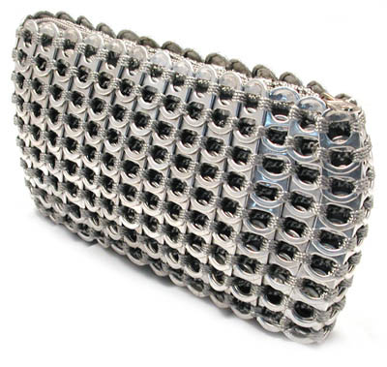
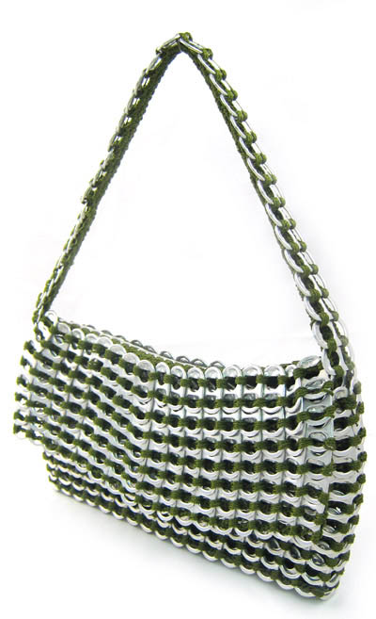
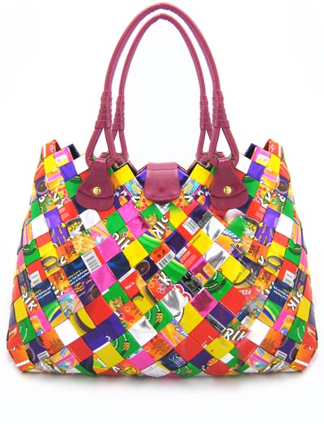
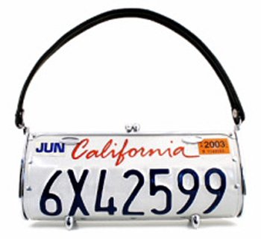
RECYCLING
Period 62: unit10 Lesson 3 read
Bags

Slide 16
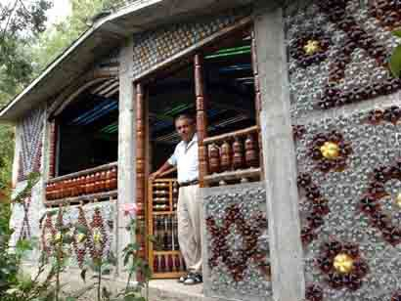
Period 62: unit10 Lesson 3 read
Ngôi nhà được trang trí bằng chai lọ

Slide 17
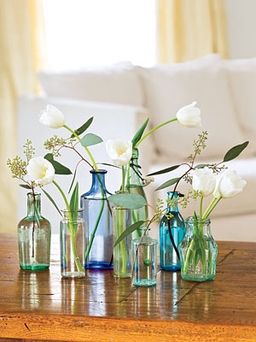
Period 62: unit10 Lesson 3 read
reuse
V­ên hoa ®Æc biÖt

Slide 18
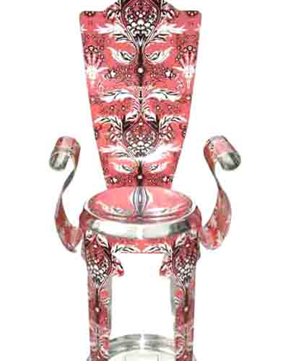
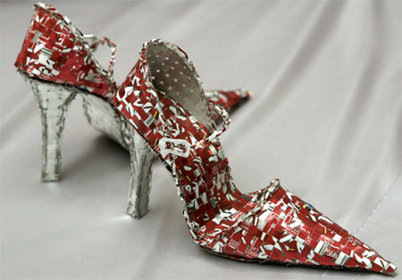
Period 62: unit10 Lesson 3 read
reuse

Slide 19
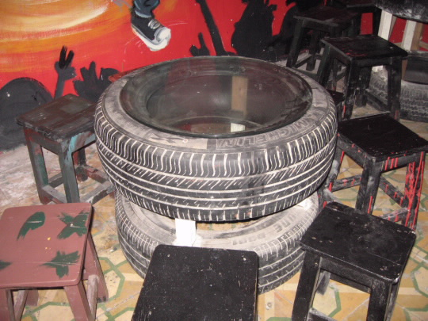
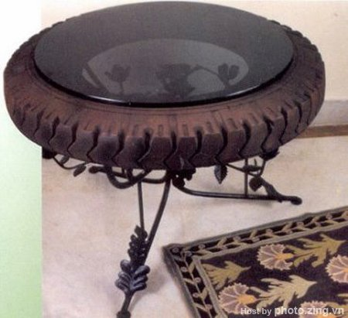

Period 62: unit10 Lesson 3 read
reuse

Slide 20
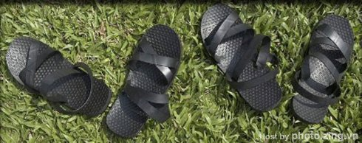
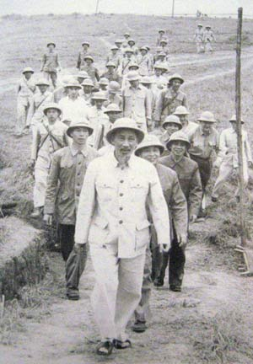
Đôi dép cao su – đôi dép Bác Hồ
Period 62: unit10 Lesson 3 read
reuse

Slide 21
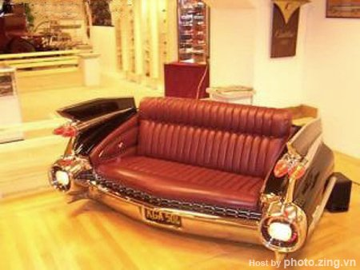
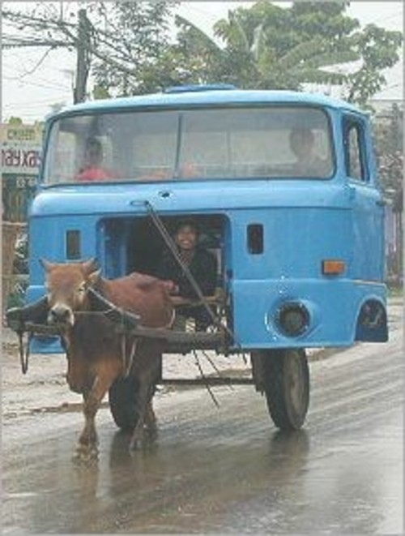
Có một không hai
Period 62: unit10 Lesson 3 read
reuse

Slide 22
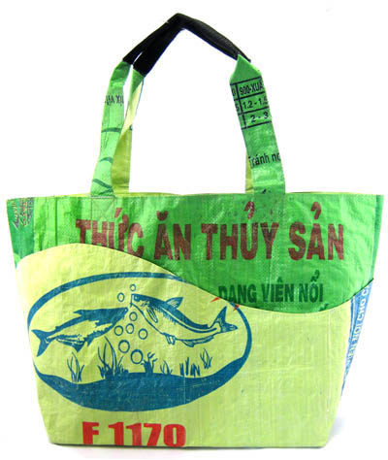
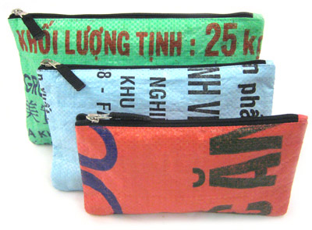
Tuyệt quá!
Period 62: unit10 Lesson 3 read
reuse

Slide 23


Period 62Unit 10 Lesson 3 read
5. Homework
- Read and translate the text.
Learn the new words.
Do exercise 1, 2 P. 93– textbook
Prepare WRITE

