Slide 1

ENGLISH 8
BINH KHANH SECONDARY SCHOOL

Slide 2
Matching
Used things
Recycling
1. glass
2. used paper
3.Vegetable matter
4. car tires
5. drink cans
a) is used to make toys
b) is made into compost
c) are brought back for recycling
d) is broken up, melted and made into new glassware
e) are recycled to make pipes and floor covering

Slide 3
Unit 10
RECYCLING
Period 64 - Lesson 5 : Write

Slide 4
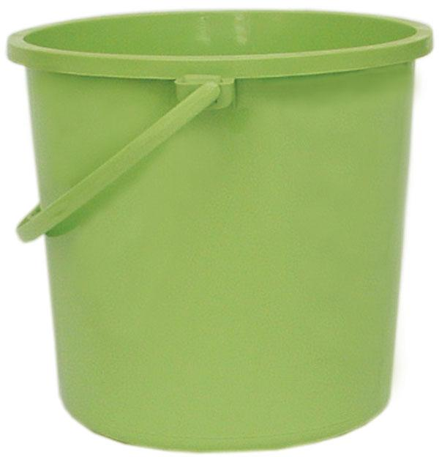
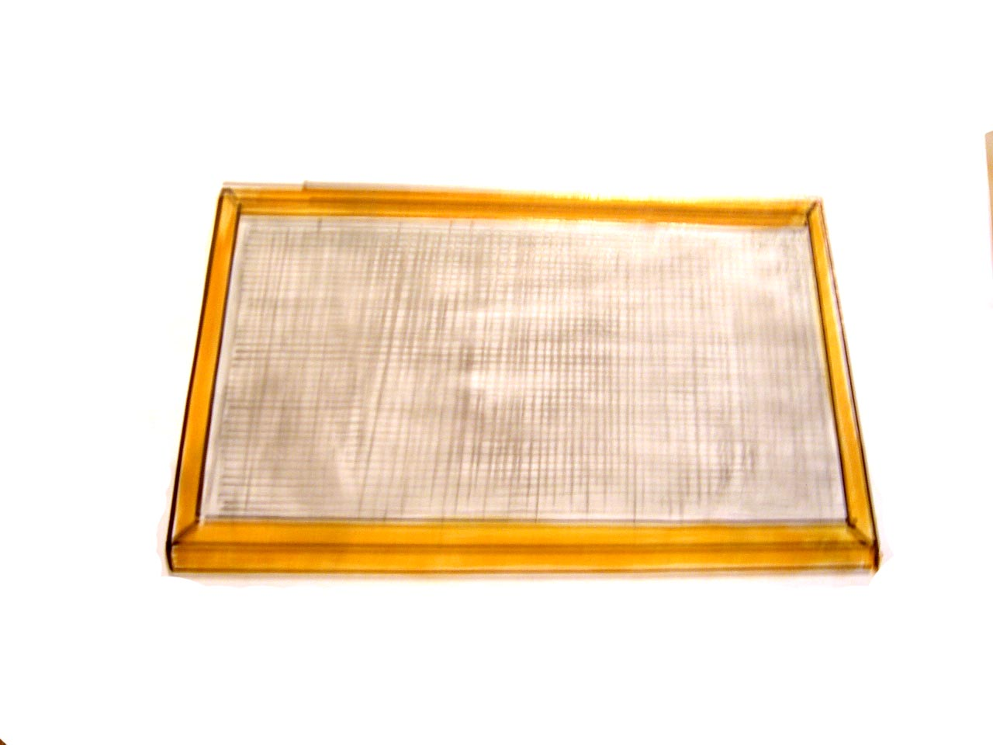

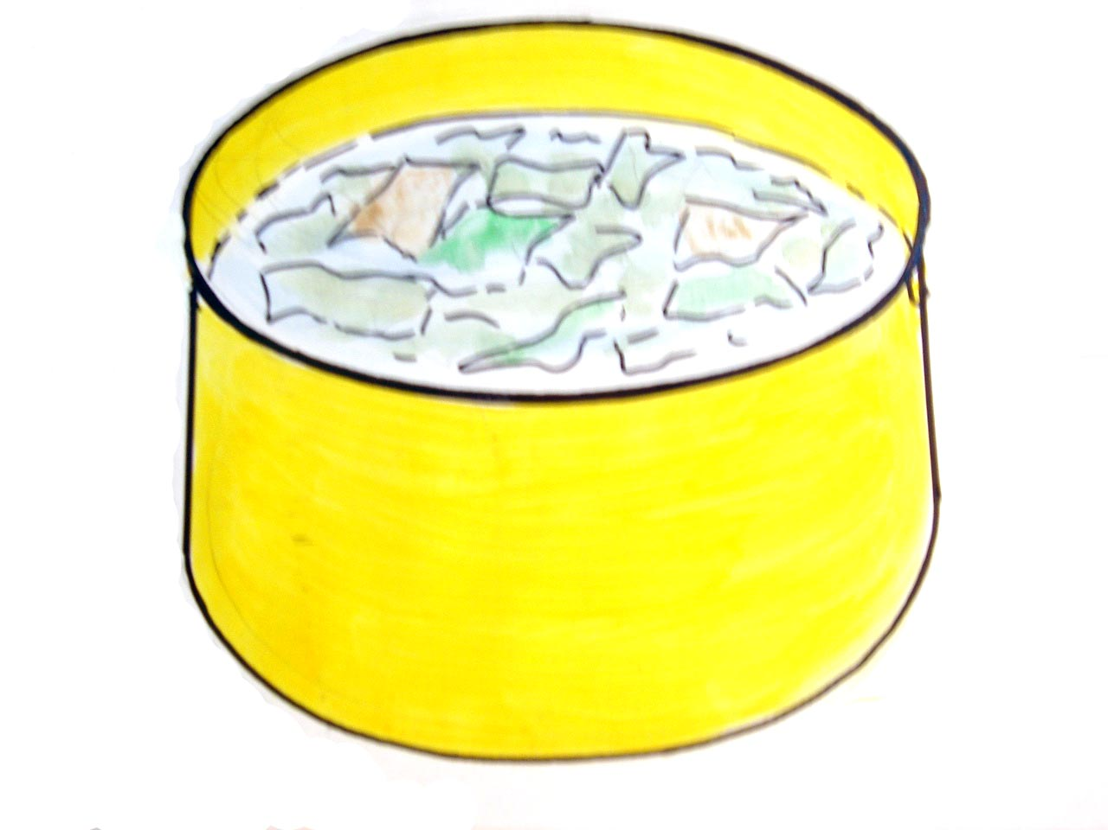
Unit 10. RECYCLING
Period 64 -Lesson 5: Write
I. Vocabulary:
1. (to) soak :
ngâm nước
làm nhuyễn, nghiền
2. (to) mash:
3.(to) scatter :
rải , rắc
4. wire mesh (n):
tấm lưới kim loại
5. bucket (n):
Thùng, Xô
6. tea pot (n) :
ấm trà

Slide 5
Unit 10. RECYCLING
Period 64 -Lesson 5: Write
I. Vocabulary
(to) soak:
thùng, xô
(to) mash:
r¶i, r¾c
wire mesh (n):
ấm trà
ngâm nước
bucket (n):
(to) scatter:
nghiền, làm nhuyễn
tea pot (n):
tấm lưới kim loại

Slide 6
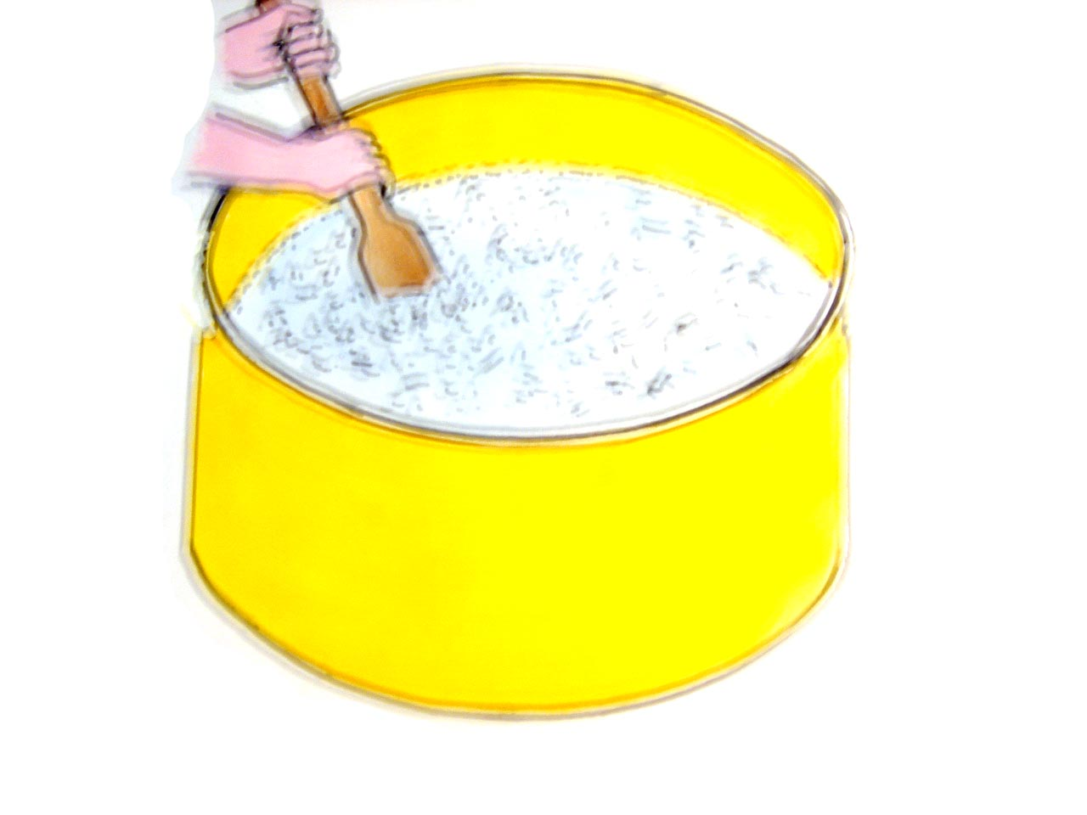
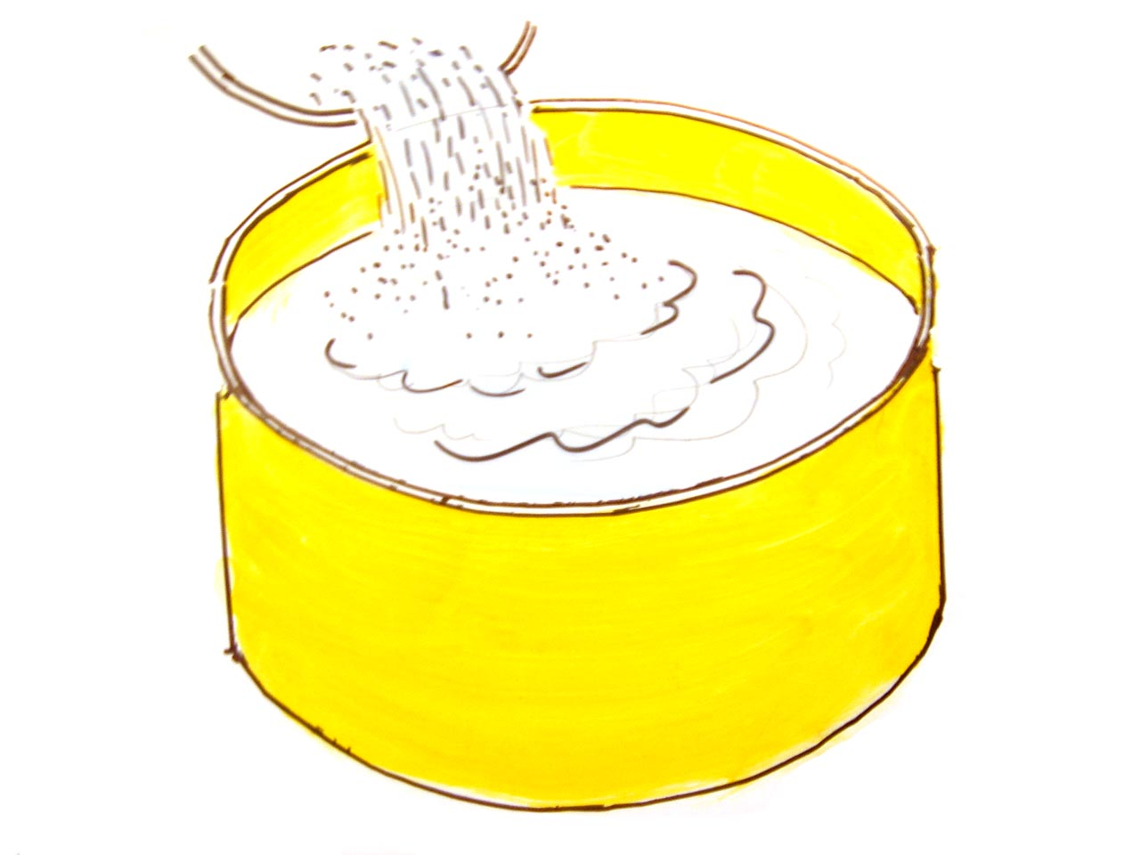
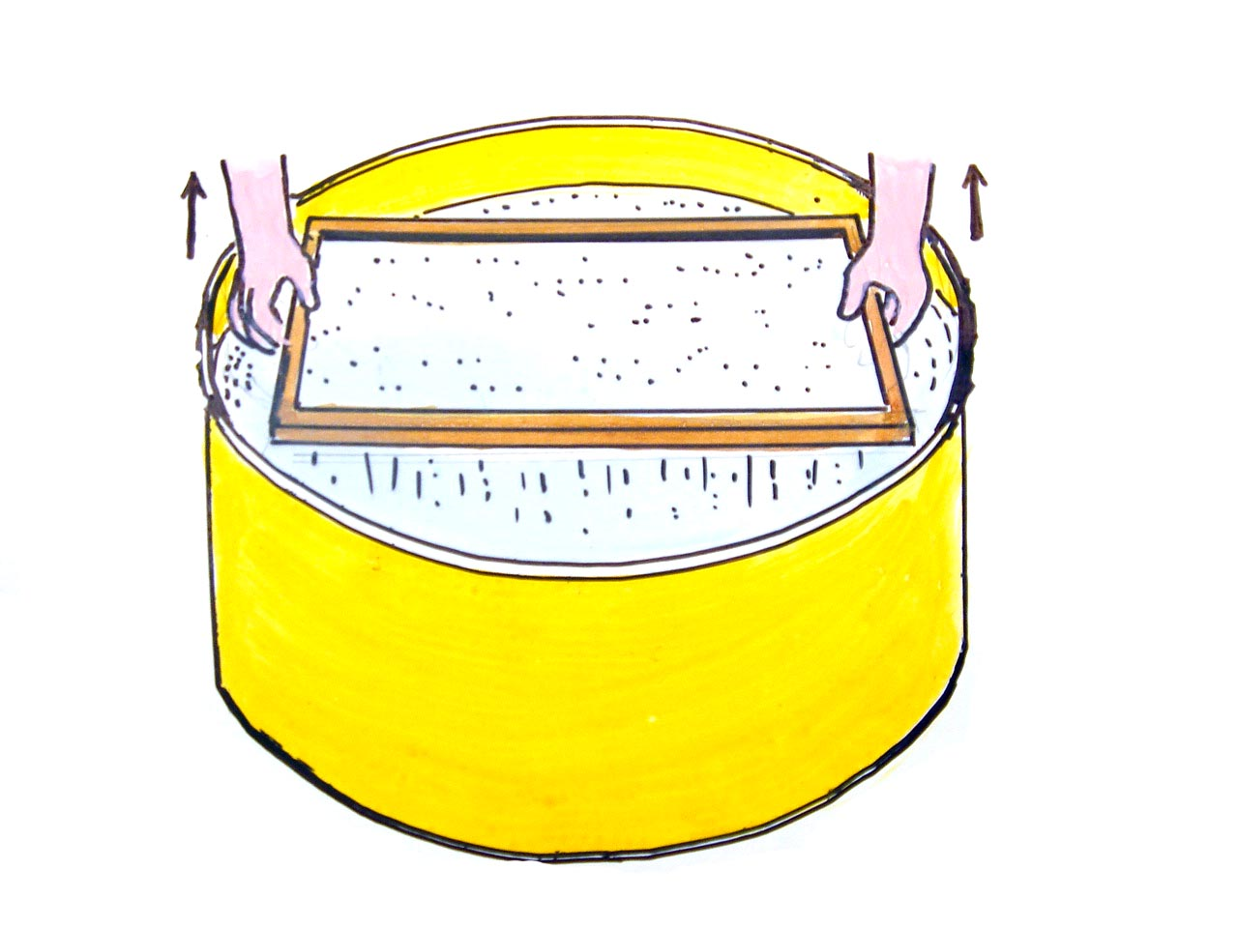
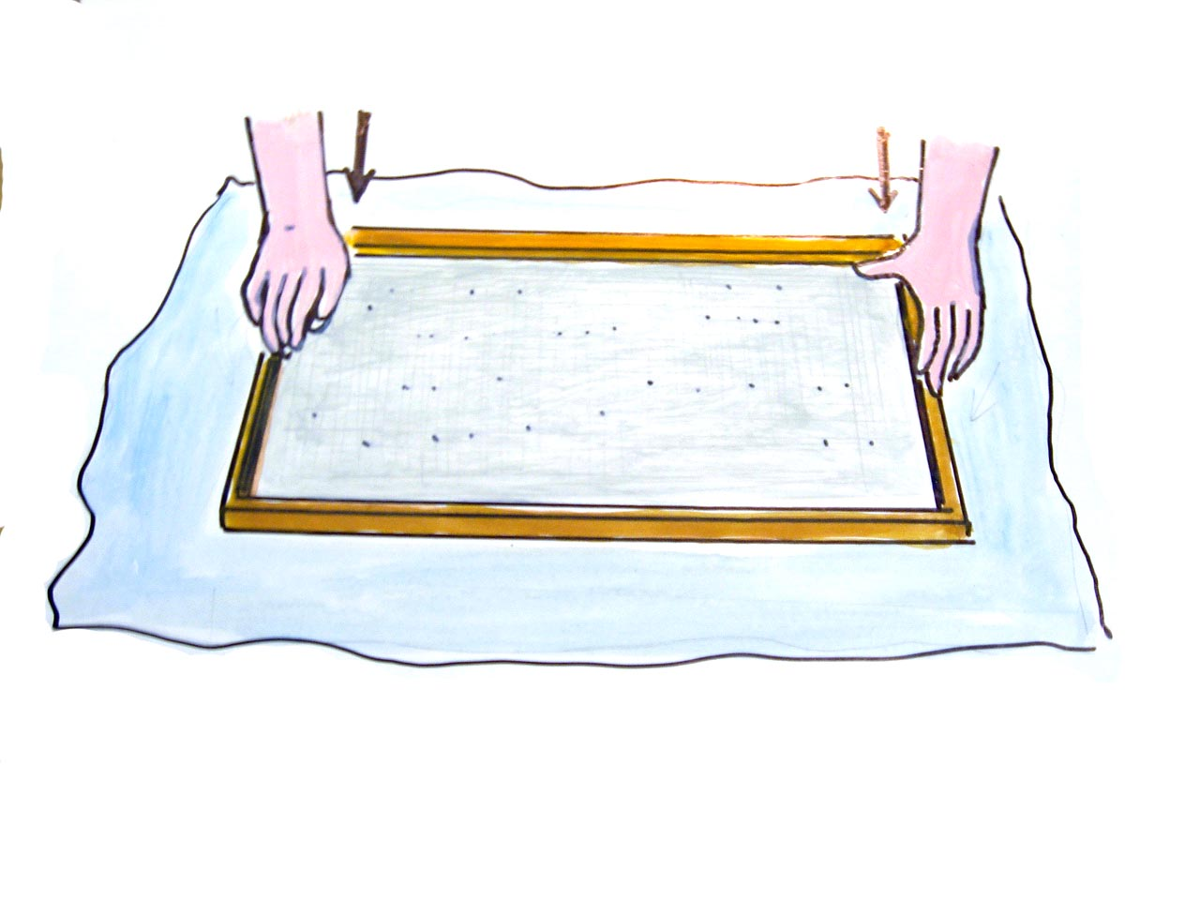
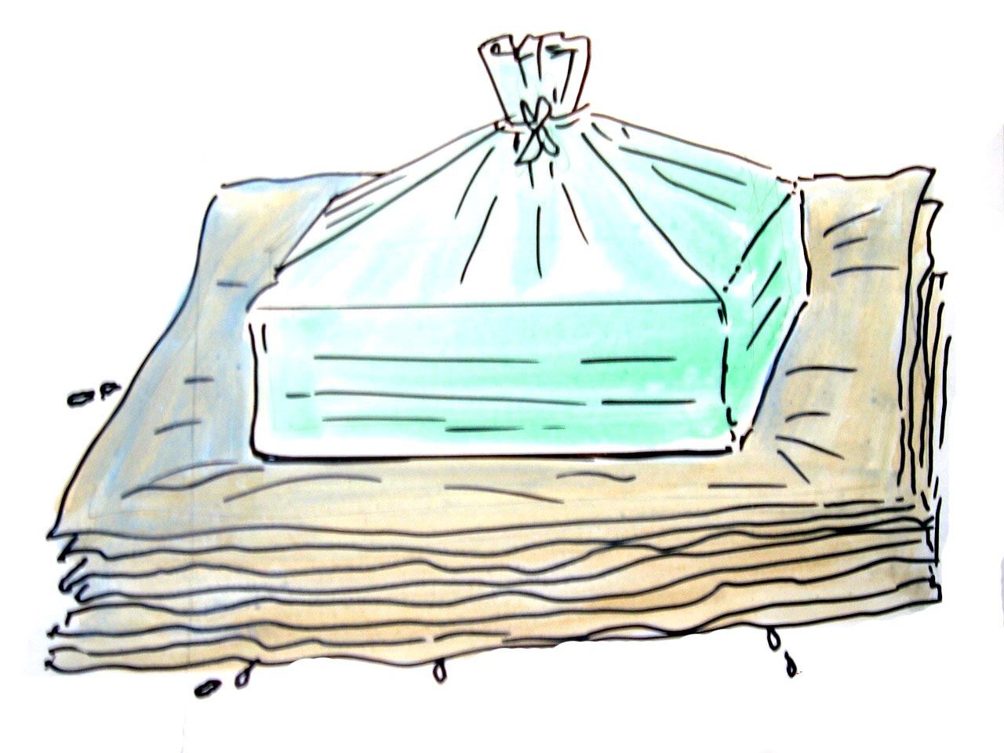
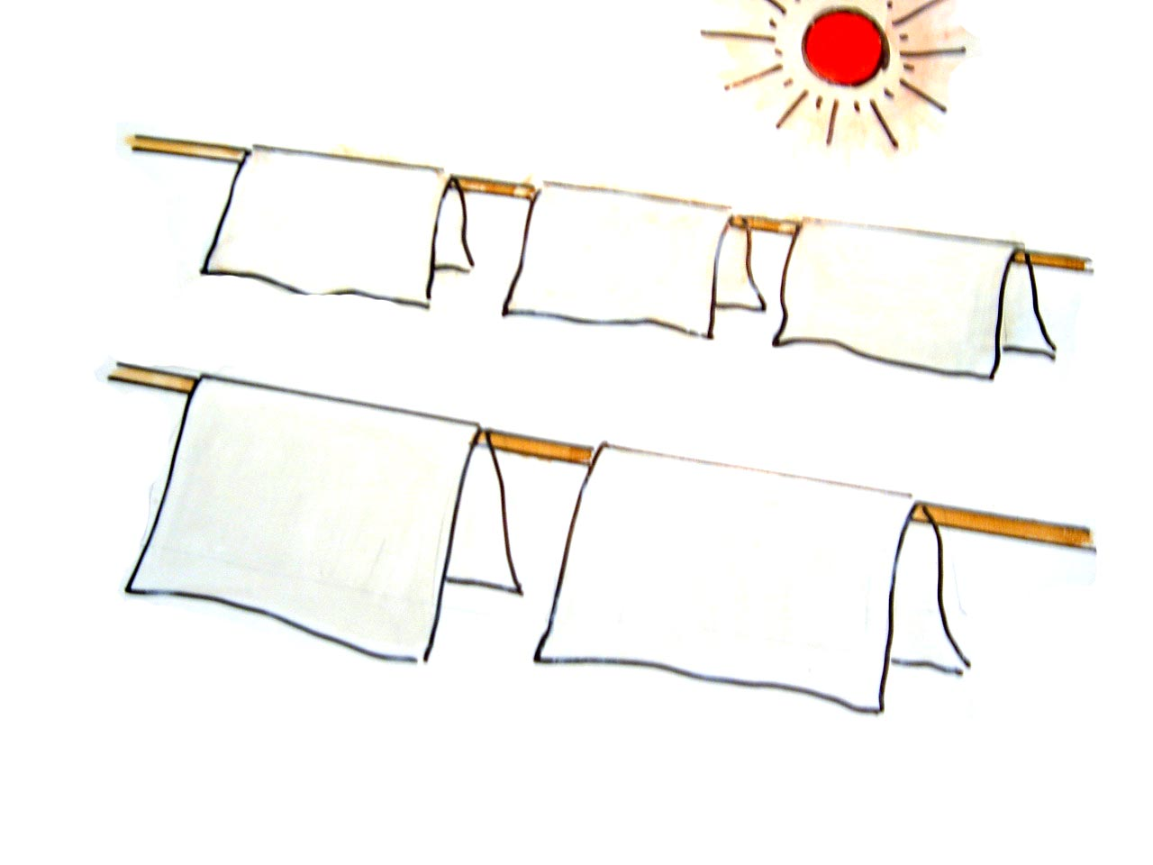
Unit 10. RECYCLING
Period 64 -Lesson 5: Write
I. Write:
* Note: Make the instructions
First, . . . . . . . . . . . . . . . . . . . . .
Then . . . . . . . . . . . . . . . . . … . .
Next, . . . . . . . . . . . . . . . . . .. . . .
After that, . . . . . . . . . . . . . . . . . .
Finally, . . . . . . . . . . . . . . . . . . . .

Slide 7
Unit 10. RECYCLING
Priod 64 -Lesson 5: Write
I. Write:
The recycling paper instructions
First, ……………………………………..

Slide 8
Unit 10. RECYCLING
Priod 64 -Lesson 5: Write + Language focus3,4
I. Write:
The recycling paper instructions
Then …………………………………………

Slide 9
Unit 10. RECYCLING
Priod 64 -Lesson 5: Write
I. Write:
The recycling paper instructions
Next, …………………………………..

Slide 10
Unit 10. RECYCLING
Priod 64 -Lesson 5: Write
I. Write:
The recycling paper instructions
After that, ………………………………..

Slide 11
Unit 10. RECYCLING
Priod 64 -Lesson 5: Write
I. Write:
The recycling paper instructions
Put the wire mesh ………………………..

Slide 12
Unit 10. RECYCLING
Period 64 -Lesson 5: Write
I. Write:
The recycling paper instructions
Put …………………………...

Slide 13
Unit 10. RECYCLING
Priod 64 -Lesson 5: Write
I. Write:
The recycling paper instructions
Finally, ……………………………..

Slide 14
Unit 10. RECYCLING
Period 64 -Lesson 5: Write
Complete the recycling instructions. Use the verbs in the boxes.
soak
place
wrap
dry
use
wait
mix
press
First, (0)………..…...some old newspapers in a bucket of water overnight.
Then (1)…………….a wooden spoon to mash the paper. Next, (2)………...……the mashed paper and the water together in another bucket.
(3)…….…..……….a wire mesh in the mixture then pull it out.
Then put the mesh with mixture on the cloth and (4)…………...…….it down firmly.
Take the mesh off the cloth (5)……….………..some heavy books in a plastic bag and put them on the cloth. (6)…..……..……about 5 munites.
Finally, put the books away and take the paper out of the cloth to (7)…………………in the sunlight.

Slide 15
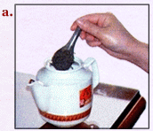
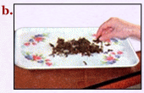
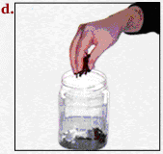
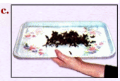
Unit 10. RECYCLING
Priod 64 -Lesson 5:
2. Write:
Make the instructions on how to reuse the dry tea leaves
take
put
dry
scatter
used/ tea leaves/ tea pot
tealeaves/ tray
dry/ leaves/ pot/ future use
leaves/sun

Slide 16
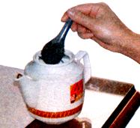
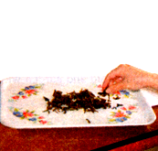
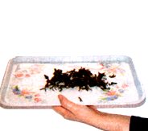
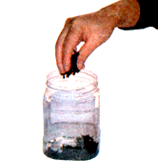
Unit 10. RECYCLING
Priod 64 -Lesson 5: Write
a, First , take the used tea leaves from
the tea pot .
b, Next , scatter the tea leaves on a tray .
c, Then , dry the tea leaves in the sun.
d, Finally , put the dry leaves in a pot for
future use .
a
b
c
d

Slide 17
Homework:
- Do exercise 7, 8, 9 (workbook)
- Rewrite the instructions on how to recycle old newspapers.

Slide 18


Thank you for your attention!
Have a good time!

